Slide 1
Devil physics The baddest class on campus IB Physics

Slide 2
Topic 9 Wave Phenomena
Tsokos lesson 9-1 simple harmonic motion

Slide 3
Essential Idea:
The solution of the harmonic oscillator can be framed around the variation of kinetic and potential energy in the system.

Slide 4
Nature Of Science:
Insights:
The equation for simple harmonic motion (SHM) can be solved analytically and numerically.
Physicists use such solutions to help them to visualize the behavior of the oscillator.
The use of the equations is very powerful as any oscillation can be described in terms of a combination of harmonic oscillators.
Numerical modeling of oscillators is important in the design of electrical circuits.

Slide 5
Understandings:
The defining equation of SHM
Energy changes

Slide 6
Applications And Skills:
Solving problems involving acceleration, velocity and displacement during simple harmonic motion, both graphically and algebraically
Describing the interchange of kinetic and potential energy during simple harmonic motion
Solving problems involving energy transfer during simple harmonic motion, both graphically and algebraically

Slide 7
Guidance:
Contexts for this sub-topic include the simple pendulum and a mass-spring system.

Slide 8
Data Booklet Reference:

Slide 9
Utilization:
Fourier analysis allows us to describe all periodic oscillations in terms of simple harmonic oscillators. The mathematics of simple harmonic motion is crucial to any areas of science and technology where oscillations occur
The interchange of energies in oscillation is important in electrical phenomena

Slide 10
Utilization:
Quadratic functions (see Mathematics HL sub-topic 2.6; Mathematics SL sub-topic 2.4; Mathematical studies SL sub-topic 6.3)
Trigonometric functions (see Mathematics SL sub-topic 3.4)

Slide 11
Aims:
Aim 4: students can use this topic to develop their ability to synthesize complex and diverse scientific information
Aim 7: the observation of simple harmonic motion and the variables affected can be easily followed in computer simulations

Slide 12
Aims:
Aim 6: experiments could include (but are not limited to): investigation of simple or torsional pendulums; measuring the vibrations of a tuning fork; further extensions of the experiments conducted in sub-topic 4.1. By using the force law, a student can, with iteration, determine the behaviour of an object under simple harmonic motion. The iterative approach (numerical solution), with given initial conditions, applies basic uniform acceleration equations in successive small time increments. At each increment, final values become the following initial conditions.

Slide 13
Oscillation vs. Simple Harmonic Motion
An oscillation is any motion in which the displacement of a particle from a fixed point keeps changing direction and there is a periodicity in the motion i.e. the motion repeats in some way.
In simple harmonic motion, the displacement from an equilibrium position and the force/acceleration are proportional and opposite to each other.

Slide 14
Relating SHM to Motion Around A Circle

Slide 15
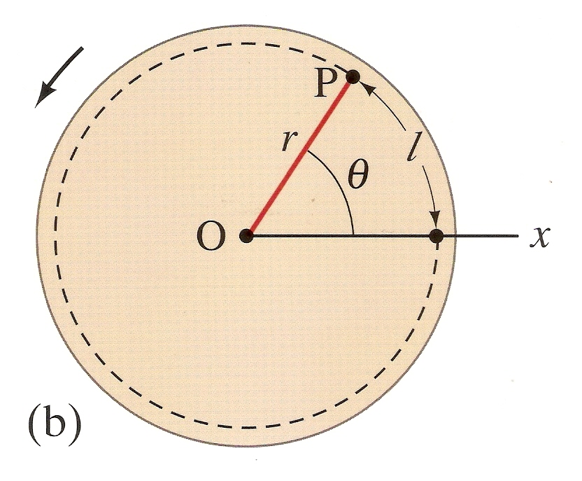
Radians
One radian is defined as the angle subtended by an arc whose length is equal to the radius

Slide 16
Radians

Slide 17
Angular Velocity

Slide 18
Angular Acceleration

Slide 19
Data Booklet Reference:

Slide 20
Period

Slide 21
Data Booklet Reference:

Slide 22
Frequency

Slide 23
Relating SHM to Motion Around A Circle
The period in one complete oscillation of simple harmonic motion can be likened to the period of one complete revolution of a circle.
angle swept
Time taken = ----------------------
angular speed (ω)

Slide 24
Mass-Spring System

Slide 25
Relating SHM to Motion Around A Circle, Mass-Spring

Slide 26
Relating SHM to Motion Around A Circle, Mass-Spring

Slide 27
Data Booklet Reference:

Slide 28
Relating SHM to Motion Around A Circle, Pendulum
θ
F_{T}
mg cosθ
mg sinθ
mg

Slide 29
Relating SHM to Motion Around A Circle, Pendulum
θ
F_{T}
mg cosθ
mg sinθ
mg

Slide 30
Relating SHM to Motion Around A Circle, Pendulum
θ
F_{T}
mg cosθ
mg sinθ
mg

Slide 31
Relating SHM to Motion Around A Circle, Pendulum
θ
F_{T}
mg cosθ
mg sinθ
mg

Slide 32
Data Booklet Reference:

Slide 33
Relating SHM to Motion Around A Circle, Pendulum
θ
F_{T}
mg cosθ
mg sinθ
mg

Slide 34
Relating SHM to Motion Around A Circle, Pendulum
θ
F_{T}
Differential Equation Machine
mg cosθ
mg sinθ
mg

Slide 35
Data Booklet Reference:

Slide 36
Relating SHM to Motion Around A Circle, Pendulum
θ
F_{T}
Max Displacement
mg cosθ
mg sinθ
mg
Zero Displacement

Slide 37
Relating SHM to Motion Around A Circle, Pendulum
θ
F_{T}
mg cosθ
mg sinθ
mg

Slide 38
Data Booklet Reference:

Slide 39
Relating SHM to Motion Around A Circle, Pendulum
θ
F_{T}
mg cosθ
mg sinθ
mg
So what is x₀?

Slide 40
Relating SHM to Motion Around A Circle, Pendulum
θ
F_{T}
mg cosθ
mg sinθ
mg
So what is x₀?
Amplitude

Slide 41
Equation Summary
Defining Equation:
Angular Frequency:
Period:

Slide 42
Equation Summary

Slide 43
Equation Summary
Maximum speed:
Maximum acceleration:

Slide 44
Data Booklet Reference:

Slide 45
Energy in SHM

Slide 46
Energy in SHM

Slide 47
Energy in SHM

Slide 48
Energy in SHM

Slide 49
Energy in SHM

Slide 50
Energy in SHM

Slide 51
Data Booklet Reference:

Slide 52
Energy in SHM

Slide 53
Data Booklet Reference:

Slide 54
End Result

Slide 55
Section Summary:

Slide 56
Essential Idea:
The solution of the harmonic oscillator can be framed around the variation of kinetic and potential energy in the system.

Slide 57
Understandings:
The defining equation of SHM
Energy changes

Slide 58
Applications And Skills:
Solving problems involving acceleration, velocity and displacement during simple harmonic motion, both graphically and algebraically
Describing the interchange of kinetic and potential energy during simple harmonic motion
Solving problems involving energy transfer during simple harmonic motion, both graphically and algebraically

Slide 59
Data Booklet Reference:

Slide 60
Aims:
Aim 4: students can use this topic to develop their ability to synthesize complex and diverse scientific information
Aim 7: the observation of simple harmonic motion and the variables affected can be easily followed in computer simulations

Slide 61
Aims:
Aim 6: experiments could include (but are not limited to): investigation of simple or torsional pendulums; measuring the vibrations of a tuning fork; further extensions of the experiments conducted in sub-topic 4.1. By using the force law, a student can, with iteration, determine the behaviour of an object under simple harmonic motion. The iterative approach (numerical solution), with given initial conditions, applies basic uniform acceleration equations in successive small time increments. At each increment, final values become the following initial conditions.

Slide 62
Homework
#1-13

