Slide 1
Devil physics The baddest class on campus IB Physics

Slide 2
Lsn 5-3: electric cells

Slide 3
Review Video: Electric Potential Voltage

Slide 4
In the last lesson we learned:
The definition of electric current,
The definition of electric resistance,
That metallic conductors at constant temperature satisfy Ohm’s Law,

Slide 5
In the last lesson we learned:
That the potential drops as one moves across a resistor in the direction of the current
That a resistor dissipates power,

Slide 6
Essential idea:
Electric cells allow us to store energy in a chemical form.

Slide 7
International-mindedness:
Battery storage is important to society for use in areas such as portable devices, transportation options and back-up power supplies for medical facilities

Slide 8
Theory of knowledge:
Battery storage is seen as useful to society despite the potential environmental issues surrounding their disposal.
Should scientists be held morally responsible for the long-term consequences of their inventions and discoveries?

Slide 9
Understandings:
Cells
Internal resistance
Secondary cells
Terminal potential difference
Electromotive force (emf)

Slide 10
Applications and skills:
Investigating practical electric cells (both primary and secondary)
Describing the discharge characteristic of a simple cell (variation of terminal potential difference with time)

Slide 11
Applications and skills:
Identifying the direction of current flow required to recharge a cell
Determining internal resistance experimentally
Solving problems involving emf, internal resistance and other electrical quantities

Slide 12
Guidance:
Students should recognize that the terminal potential difference of a typical practical electric cell loses its initial value quickly, has a stable and constant value for most of its lifetime, followed by a rapid decrease to zero as the cell discharges completely.

Slide 13
Data booklet reference:

Slide 14
Aims:
Aim 6: experiments could include (but are not limited to): investigation of simple electrolytic cells using various materials for the cathode, anode and electrolyte; software-based investigations of electrical cell design; comparison of the life expectancy of various batteries

Slide 15
Aims:
Aim 8: although cell technology can supply electricity without direct contribution from national grid systems (and the inherent carbon output issues), safe disposal of batteries and the chemicals they use can introduce land and water pollution problems

Slide 16
Aims:
Aim 10: improvements in cell technology has been through collaboration with chemists

Slide 17
Utilization:
The chemistry of electric cells (see Chemistry sub-topics 9.2 and C.6)

Slide 18
Introductory Video: Why Charges Move

Slide 19
Emf (ε)
Charges will not move in a conductor unless there exists an electric potential created by an electromotive force (emf) providing the energy
Resistance
Superconductors are an exception
Since the electrons must be ‘pushed’ from the positive terminal to the negative terminal, work must be done on the electrons

Slide 20
Emf (ε)
Emf sources
battery - converts stored chemical energy into electrical energy
generator – converts mechanical energy into electrical energy
thermocouple – converts thermal energy into electrical energy
photoelectric material – converts solar energy into electrical energy

Slide 21
Batteries: Practical Source of Electric Current

Slide 22
Emf (ε)
Electromotive force (emf, 𝛆) is equal to the total work done in moving a unit charge completely around a circuit
Unit for emf is the volt (V, J/C)

Slide 23
Emf (ε)
Emf can also be defined as the total power generated by the voltage source per unit current

Slide 24
Emf (ε)
Chemicals inside the battery create a small amount of resistance (r) which is the internal resistance of the battery
The total emf is reduced by the internal resistance of the battery, thus the potential of the battery is
Thus, the potential of a battery is always less than the emf of the battery

Slide 25
Secondary Cells

Slide 26
Secondary Cells
Primary cells are those that can only be used once
Secondary cells can be recharged
In circuit analysis, the potential of a recharging cell is subtracted from the emf

Slide 27
Secondary Cells
12.0 V
Is this circuit drawn correctly?
2.0 Ω
2.0 Ω
4.0 Ω
6.0 Ω
2.0 V

Slide 28
Secondary Cells
12.0 V
Is this circuit drawn correctly?
While it appears the currents from the two cells are flowing in opposite directions, the reality is that one cell is being used to recharge the other.
2.0 Ω
2.0 Ω
4.0 Ω
6.0 Ω
2.0 V

Slide 29
Secondary Cells
12.0 V
Which cell is being charged?
2.0 Ω
2.0 Ω
4.0 Ω
6.0 Ω
2.0 V

Slide 30
Secondary Cells
12.0 V
Which cell is being charged?
The 2-V cell
What will be the direction of the current?
2.0 Ω
2.0 Ω
4.0 Ω
6.0 Ω
2.0 V

Slide 31
Secondary Cells
12.0 V
Which cell is being charged?
The 2-V cell
What will be the direction of the current?
Counter-clockwise
What is the current in this circuit?
2.0 Ω
2.0 Ω
4.0 Ω
6.0 Ω
2.0 V

Slide 32
Secondary Cells
12.0 V
Which cell is being charged?
The 2-V cell
What will be the direction of the current?
Counter-clockwise
What is the current in this circuit?
2.0 Ω
2.0 Ω
4.0 Ω
6.0 Ω
2.0 V

Slide 33
Secondary Cells
12.0 V
How much power is being used to charge the 2.0 V cell?
2.0 Ω
2.0 Ω
4.0 Ω
6.0 Ω
2.0 V

Slide 34
Secondary Cells
12.0 V
How much power is being used to charge the 2.0 V cell?
2.0 Ω
2.0 Ω
4.0 Ω
6.0 Ω
2.0 V

Slide 35
Battery Discharge Rates
Highly dependent on amount of current
General trend in terminal voltage:
Initial drop
Generally constant
Quick drop-off

Slide 36
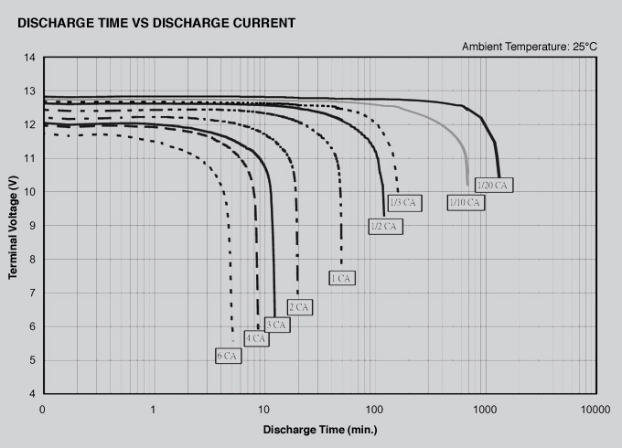
Discharge Rate – Car Battery

Slide 37
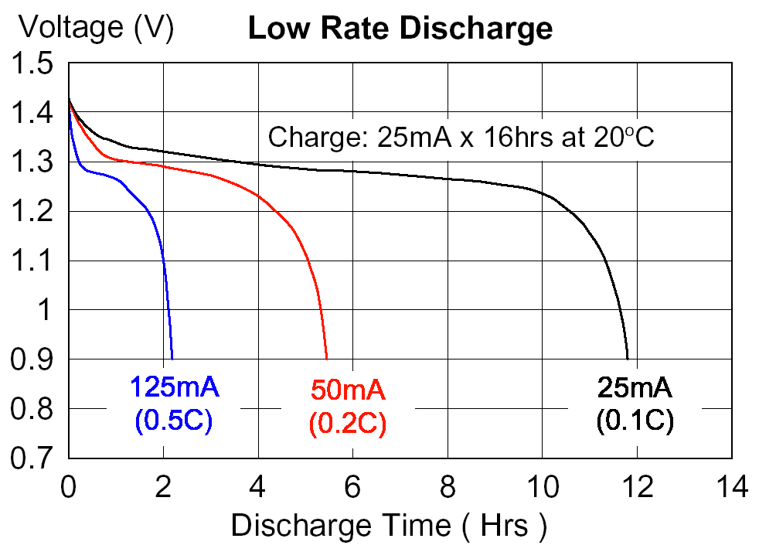
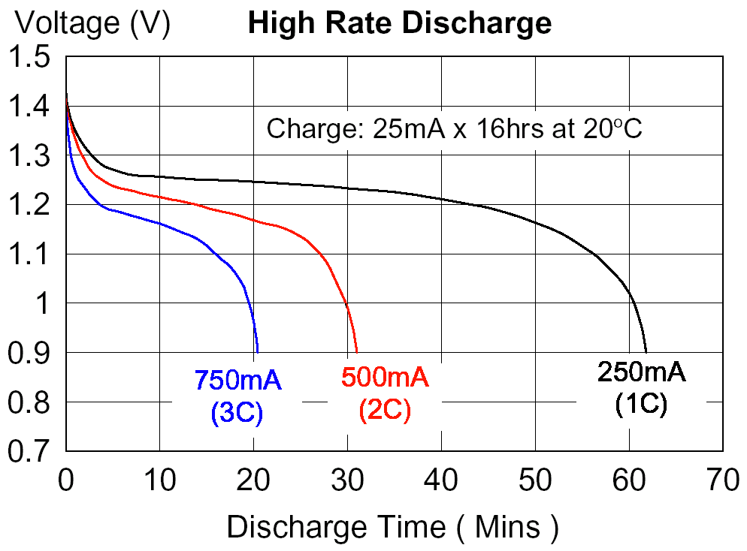

Slide 38
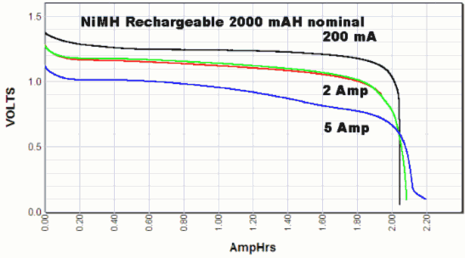
Discharge Rate – Secondary Cell

Slide 39
Nature of Science / TOK
Consumers want:
Longer battery life
Quicker recharge rates
Longer batter longevity
Battery hazards
Mercury, lead-acid, and cadmium are toxic
Lithium batteries can create intensely hot fires
Unused lithium batteries provide a convenient source of lithium metal for use as a reducing agent in methamphetamine labs

Slide 40
Nature of Science / TOK
How do we balance consumer desires with social and ecological responsibility?

Slide 41
Applications and skills:
Investigating practical electric cells (both primary and secondary)
Describing the discharge characteristic of a simple cell (variation of terminal potential difference with time)

Slide 42
Applications and skills:
Identifying the direction of current flow required to recharge a cell
Determining internal resistance experimentally
Solving problems involving emf, internal resistance and other electrical quantities

Slide 43
Understandings:
Cells
Internal resistance
Secondary cells
Terminal potential difference
Electromotive force (emf)

Slide 44
Essential idea:
Electric cells allow us to store energy in a chemical form.

Slide 45
Questions?

Slide 46
Homework
#30-36

Slide 47
Stopped here 4/22/15

