Slide 1
Devil physics The baddest class on campus IB Physics

Slide 2
Tsokos Lesson 1-2 Uncertainties and errors

Slide 3
Reading Activity Questions?

Slide 4
Essential Idea
Scientists aim towards designing experiments that can give a “true value” from their measurements, but due to the limited precision in measuring devices, they often quote their results with some form of uncertainty.

Slide 5
Nature Of Science
Uncertainties: “All scientific knowledge is uncertain… if you have made up your mind already, you might not solve it. When the scientist tells you he does not know the answer, he is an ignorant man. When he tells you he has a hunch about how it is going to work, he is uncertain about it. When he is pretty sure of how it is going to work, and he tells you, ‘This is the way it’s going to work, I’ll bet,’ he still is in some doubt. And it is of paramount importance, in order to make progress, that we recognize this ignorance and this doubt. Because we have the doubt, we then propose looking in new directions for new ideas.” (3.4) Feynman, Richard P. 1998. The Meaning of It All: Thoughts of a Citizen-Scientist. Reading, Massachusetts, USA. Perseus. P 13.

Slide 6
Theory Of Knowledge
“One aim of the physical sciences has been to give an exact picture of the material world. One achievement of physics in the twentieth century has been to prove that this aim is unattainable.” – Jacob Bronowski.
Can scientists ever be truly certain of their discoveries?

Slide 7
Understandings
Random and systematic errors
Absolute, fractional and percentage uncertainties
Error bars
Uncertainty of gradient and intercepts

Slide 8
Applications And Skills
Explaining how random and systematic errors can be identified and reduced
Collecting data that include absolute and/or fractional uncertainties and stating these as an uncertainty range (expressed as: best estimate ± uncertainty range)

Slide 9
Applications And Skills
Propagating uncertainties through calculations involving addition, subtraction, multiplication, division and raising to a power
Determining the uncertainty in gradients and intercepts

Slide 10
Guidance
Analysis of uncertainties will not be expected for trigonometric or logarithmic functions in examinations

Slide 11
Data Booklet Reference
If
Then
If
Then
If
then

Slide 12
Utilization
Students studying more than one group 4 subject will be able to use these skills across all subjects

Slide 13
Aims
Aim 4: it is important that students see scientific errors and uncertainties not only as the range of possible answers but as an integral part of the scientific process
Aim 9: the process of using uncertainties in classical physics can be compared to the view of uncertainties in modern (and particularly quantum) physics

Slide 14
Accuracy and Precision Video

Slide 15
Accuracy and Precision
Measurements can never be absolutely precise
Because of this, there will always be some amount of uncertainty in a measurement
As scientists, we must always strive to minimize uncertainty and to suggest ways to further minimize uncertainty in future experiments
As scientists, we must quantify and express the level of uncertainty in our data

Slide 16
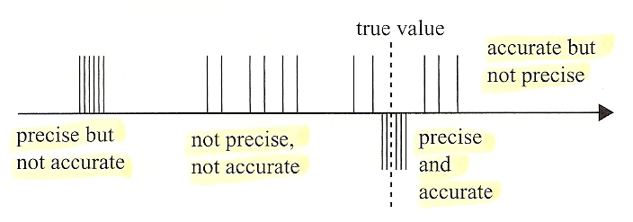
Accuracy and Precision
Measurements are accurate if the systematic error is small
Individual deviations may be high, but mean is close to actual value
Measurements are precise if random error is small
Individual deviations are low, but mean is significantly different from actual value

Slide 17
Accounting for Uncertainty

Slide 18
Errors of measurement
Random
almost always the fault of the observer
human error
outside factors, uncontrolled variables
not predictable
assumed to be sometimes high, sometimes low
can be minimized by averaging over repeated measurements
What are some examples?

Slide 19
Errors of measurement
Systematic
usually the fault of both the user and the instrument
error is in the same direction and in the same amount for each measurement
cannot be minimized by repeated measurements
What are some examples?

Slide 20
Errors of measurement
Ball Bounce Lab
Should you have an x- or y-intercept on the graph?

Slide 21
Errors of measurement
Reading or tool error
function of the precision of the instrument
assumed to be ± one half of the smallest division on an analog tool
If a ruler measures in mm, the reading/tool error is assumed to be ±0.5mm
Remember that you can estimate between divisions!
for digital instruments, the reading/tool error is assumed to be ± the smallest division
If a digital scale reads hundredths of a gram, the reading/ tool error is assumed to be ±0.01g

Slide 22
Errors of measurement
What is the measurement and error from the metre stick below?
25
26
27

Slide 23
Errors of measurement
What is the measurement and error from the metre stick below?
25
26
27
26.33 ± 0.05 cm, or
263.3 ± 0.5 mm

Slide 24
Errors of measurement
What is the measurement and error from the metre stick below?
25
26
27
For an analog measurement, your least significant digit is an estimate between the smallest division marks.

Slide 25
Accounting for Random Error
A measurement repeated many times can be assumed to be too high as often as it is too low
Random error is minimized by taking the average of many readings, the mean
You then must consider the standard deviation from the mean – the average of the distance from the mean for all of the measurements

Slide 26
Accounting for Random Error
Standard Deviation
Not evaluated on exams, good for IA
Half the Max Difference

Slide 27
Accounting for Random Error
If the standard deviation or half the max difference is greater than the reading error, you can use it as your uncertainty
A final, and the most conservative, method is to simply take the highest deviation from the mean and use that as your uncertainty – assuming it is greater than your assumed reading error

Slide 28
Accounting for Random Error
No right or wrong answer when it comes to method
But, you must account for uncertainty
Method chosen based on judgment
Some judgments better than others, some open to questioning
Explain your reasoning

Slide 29
How Long Is Your Table

Slide 30
How Long Is Your Table . . . Really
Measure each table
Enter into spreadsheet
What value will you use for the length of the table?
What will you use for the uncertainty?

Slide 31
How Long Is Your Table . . . Really
What error is involved in measuring the table?
How can you minimize the error?
What is the assumed tool error?
What are other methods for considering uncertainty other than tool error?

Slide 32
How Long Is Your Table . . . Really
What error is involved in measuring the table?
Random error, reading error
How can you minimize the error?
What is the assumed tool error?
What are other methods for considering uncertainty other than tool error?

Slide 33
How Long Is Your Table . . . Really
What error is involved in measuring the table?
Random error, reading error
How can you minimize the error?
Take multiple measurements and average
What is the assumed tool error?
What are other methods for considering uncertainty other than tool error?

Slide 34
How Long Is Your Table . . . Really
What error is involved in measuring the table?
Random error, reading error
How can you minimize the error?
Take multiple measurements and average
What is the assumed tool error?
Metre stick, ± 0.5 mm or ± 0.05 cm
But how many times?
What are other methods for considering uncertainty other than tool error?

Slide 35
How Long Is Your Table . . . Really
What error is involved in measuring the table?
Random error, reading error
How can you minimize the error?
Take multiple measurements and average
What is the assumed tool error?
Metre stick, ± 0.5 mm or ± 0.05 cm
But how many times?
What are other methods for considering uncertainty other than tool error?
Standard deviation of the mean
Half max difference
Using the greatest deviation from the mean

Slide 36
Systematic Error
Typically in the same direction and the same amount for every measurement
Calibration error
Zero error

Slide 37
Systematic Error
Human-induced systematic error
Making the same error in reading an instrument each time She takes a measurement
Parallax is a good example
Tilted graduated cylinder is another

Slide 38
Total System Error
Highest of the above?
Sum of random and systematic?
Sum of all the above?
Based on your judgment
Be realistic
Be conservative, but not overly so
Explain your reasoning – graded on making a reasoned approach

Slide 39
Significant Digits in Uncertainties
Just one, pretty much
Customarily

Slide 40
Propagation of Errors
a = the “real” or “actual” value
a₀ = the measured value
Δa = uncertainty or error
Δa/ a₀ = fractional uncertainty
Δa/ a₀ X 100% = percent uncertainty

Slide 41
Propagation of Errors
Addition and Subtraction
Absolute Error
a = the “real” or “actual” value
a₀ = the measured value
Δa = uncertainty or error
Δa/ a₀ = fractional uncertainty
Δa/ a₀ X 100% = percent uncertainty

Slide 42
Propagation of Errors
Addition and Subtraction
Absolute Error
a = the “real” or “actual” value
a₀ = the measured value
Δa = uncertainty or error
Δa/ a₀ = fractional uncertainty
Δa/ a₀ X 100% = percent uncertainty
Assumes Δa, Δb, and Δc all have the same units!!!

Slide 43
Propagation of Errors
Multiplication and Division – Fractional Error

Slide 44
Propagation of Errors
Multiplication and Division – Fractional Error
Units don’t matter!!!

Slide 45
Propagation of Errors
Multiplication and Division
Absolute Uncertainty

Slide 46
Propagation of Errors
Multiplication and Division
Absolute Uncertainty
Example
W = F x d

Slide 47
Propagation of Errors
Powers and Roots

Slide 48
Other Functions?

Slide 49
Other Functions
Don’t worry about it

Slide 50
Now what
You’ve got your data points
You’ve propagated your uncertainties
Now what?

Slide 51
Now what
You’ve got your data points
You’ve propagated your uncertainties
Now what?
Graphing – the ultimate data summary!

Slide 52
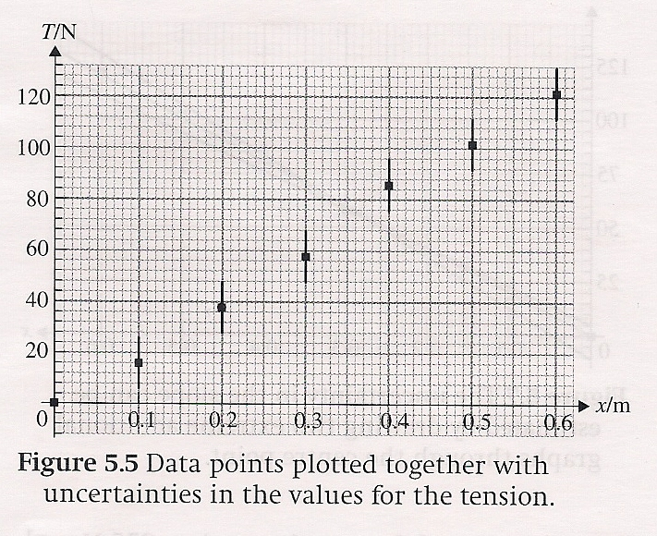
Uncertainties in Slope and Intercept
You graph your points -- What’s next?

Slide 53
Uncertainties in Slope and Intercept
You graph your points -- What’s next?
Error bars
What’s next?

Slide 54
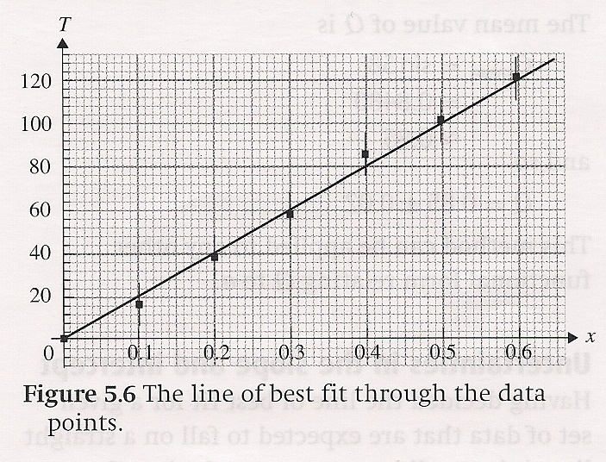
Uncertainties in Slope and Intercept
You graph your points -- What’s next?
Error bars
What’s next?
Line of Best Fit
What’s next?

Slide 55
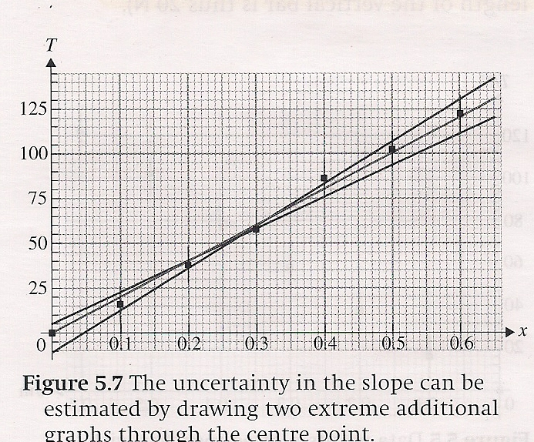
Uncertainties in Slope and Intercept
You graph your points -- What’s next?
Error bars
What’s next?
Line of Best Fit
What’s next?
Min/Max Slope
What’s next?

Slide 56
Uncertainties in Slope and Intercept
You graph your points -- What’s next?
Error bars
What’s next?
Line of Best Fit
What’s next?
Min/Max Slope
What’s next?
Uncertainty of slope and intercept

Slide 57
Line of Best Fit Video

Slide 58
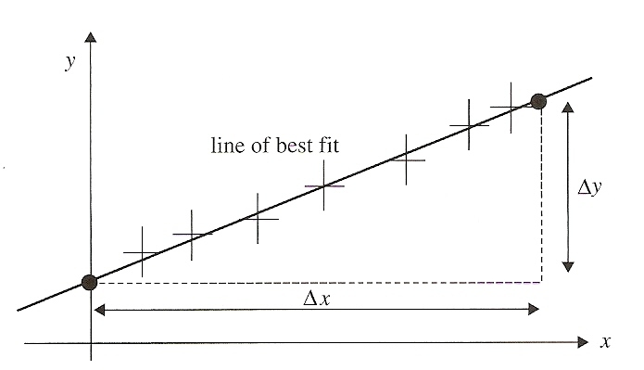
Line of Best Fit
Choosing a line which goes through as many error bars as possible in such a way that the distances between the line and the points on one side of it are, on average, the same as the distances between the line and points on the other side of it.
New

Slide 59
Line of Best Fit
The line of best fit will ideally pass through the vertical and horizontal error bars
NEVER connect the dots with straight-line segments
Let Excel do it
Works on curves too
Let Excel do it

Slide 60
Line of Best Fit - Slope
The slope of the line of best fit gives you the best relationship between your two variables
To find the slope,
Use points on line of best fit, NOT YOUR DATA POINTS!
Take points as far away from each other as possible

Slide 61
Line of Best Fit – Slope Uncertainty
You’ve accounted for the uncertainty in your data points through error bars
You’ve determined a relationship (slope) between two variables
Now, what is the
uncertainty in that
relationship (slope)?

Slide 62
Line of Best Fit – Min/Max Slope - Video

Slide 63
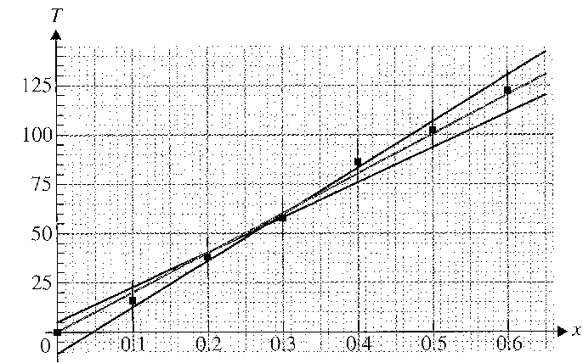
Line of Best Fit – Min/Max Slope
Used to determine the uncertainty of your slope
Min/Max lines are drawn to give you the least/greatest possible slopes while still passing through the error ‘area’ rectangles

Slide 64
Line of Best Fit – Min/Max Slope
You can determine the points for the min/max slope lines manually, or use guess-and-check in Excel

Slide 65
Line of Best Fit – Min/Max Slope
Once you have the points for the min/max slope lines, use Excel to compute their slopes

Slide 66
Line of Best Fit – Min/Max Slope
The slope of your line defines the relationship between your x and y variables
For example, if y = 7.63x, for every value of x, y will be 7.63 times x

Slide 67
Line of Best Fit – Min/Max Slope
Min/max slope gives you the uncertainty of the relationship, the range of possible actual values
“My constant of proportionality (slope) is 7.63, but could be as high as 8.12 or as low as 7.36.”
7.63, +0.49/-0.27
OR
7.63 ±0.49

Slide 68
Uncertainties in Slope and Intercept – Your Choice
Uncertainty of Slope
Slope +max/-min
Slope ± max difference
Slope ± average difference
Uncertainty of Intercept
Intercept +max/-min intercept
Intercept ± max difference in intercepts
Intercept ± average difference of intercepts

Slide 69
Uncertainties in Slope – Propagation
You also have the option of using standard propagation

Slide 70
Uncertainties in Non-Linear Lines of Best Fit

Slide 71
Uncertainties in Non-Linear Lines of Best Fit
Out of our league

Slide 72
Essential Idea
Scientists aim towards designing experiments that can give a “true value” from their measurements, but due to the limited precision in measuring devices, they often quote their results with some form of uncertainty.

Slide 73
Understandings
Random and systematic errors
Absolute, fractional and percentage uncertainties
Error bars
Uncertainty of gradient and intercepts

Slide 74
Applications And Skills
Explaining how random and systematic errors can be identified and reduced
Collecting data that include absolute and/or fractional uncertainties and stating these as an uncertainty range (expressed as: best estimate ± uncertainty range)

Slide 75
Applications And Skills
Propagating uncertainties through calculations involving addition, subtraction, multiplication, division and raising to a power
Determining the uncertainty in gradients and intercepts

Slide 76
Data Booklet Reference
If
Then
If
Then
If
then

Slide 77
Questions?

Slide 78
Homework
# 23-34

Slide 79
Stopped here on 8/27/14

