Slide 1
Devil physics The baddest class on campus IB Physics

Slide 2
Lsn 18-5 Electric Power Lsn 18-6 Power in household Circuits

Slide 3
Reading Activity Questions?

Slide 4
Big Idea:
Changes that occur as a result of interactions are constrained by conservation laws.

Slide 5
Enduring Understanding:
The energy of a system is conserved.

Slide 6
Essential Knowledge:
Energy can be transferred by an external force exerted on an object or system that moves the object or system through a distance; this energy transfer is called work.
Energy transfer in mechanical or electrical systems may occur at different rates.
Power is defined as the rate of energy transfer into, out of, or within a system.

Slide 7
Data Guide Equations
In Data Guide
$\left|\vec{F_{E}}\right|=k\frac{\left|q_{1}q_{2}\right|}{r^{2}}$
$I=\frac{∆q}{∆t}$
$R=\frac{ρl}{A}$
$I=\frac{∆V}{R}$
$P=I∆V$
${R }_{s}=\sum_{i}{{R }_{i}}$
$\frac{1}{{R }_{p}}=\sum_{i}{\frac{1}{{R }_{i}}}$
NOT in Data Guide
$V=IR$
$ρ_{T}=ρ_{0}[1+α\left(T−T_{0}\right)$
not in curriculum
$P=I^{2}R$
$P=\frac{V^{2}}{R}$

Slide 8
Electricity - Measurement of Power

Slide 9
Electric Power
We have seen that it requires work to move a charge across a potential
A current is a movement of charge so work is being done, and it is movement per unit time
Where there is work per unit time, there is POWER

Slide 10
Electric Power
This power is translated into mechanical work or thermal energy
We can re-write the formula for power for devices that obey Ohm’s law (ohmic behavior)

Slide 11
Electric Power
This power is translated into mechanical work or thermal energy
We can re-write the formula for power for devices that obey Ohm’s law (ohmic behavior)

Slide 12
Electric Power
Power is measured in watts (J/s)
Electrical devices are normally rated in watts (power) and volts (potential)

Slide 13
Electric Power
A light bulb rated as 60W at 110V (normal household voltage) means it will dissipate 60 watts of energy when a potential of 110 V is applied across it
So, what is the current and resistance?

Slide 14
Electric Power
A light bulb rated as 60W at 220V (normal household voltage) means it will dissipate 60 watts of energy when a potential of 220 V is applied across it
So, what is the current and resistance?

Slide 15
What Is This?

Slide 16
What Is This?
What’s wrong with calling this a ‘power bill’?
Do we pay for power?

Slide 17
What Is This?
It is charging me for 1642 KWH. What does KWH stand for?

Slide 18
What Is This?
It is charging me for 1642 KWH. What does KWH stand for?
Kilowatt-hour

Slide 19
What Is This?
What is a kilowatt-hour?

Slide 20
What Is This?
What is a kilowatt-hour?
$\frac{{10}^{3}J}{s}x3600s=3,600,000J$

Slide 21
Power Protection
Most houses have four methods of protection from electricity:
Fuses
Circuit Breakers
GFCI
Grounding posts

Slide 22
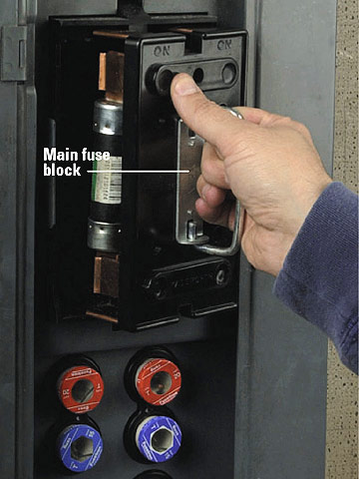
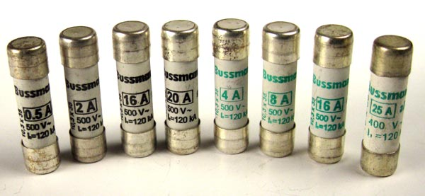
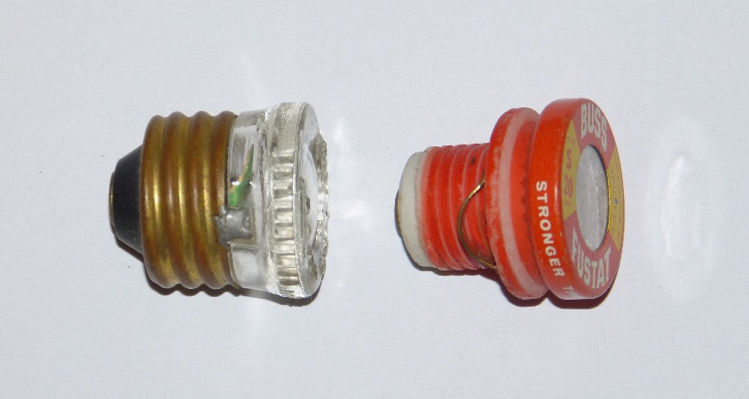
Power Protection
Most houses have four methods of protection from electricity:
Fuses
Circuit Breakers
GFCI
Grounding posts

Slide 23
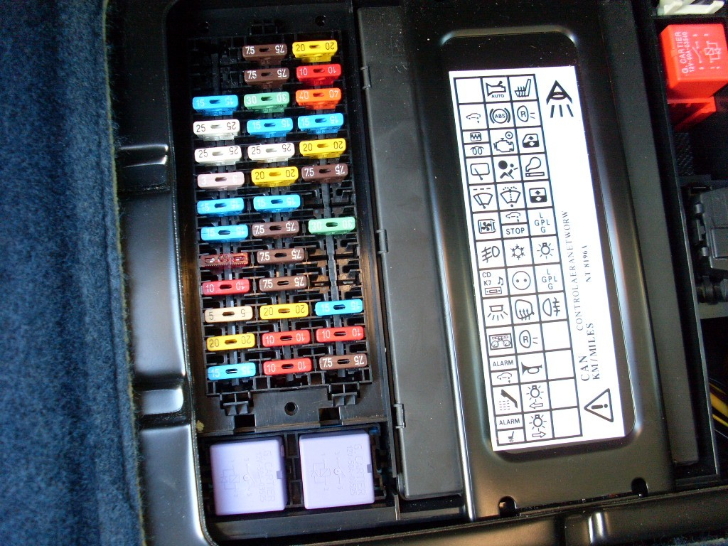
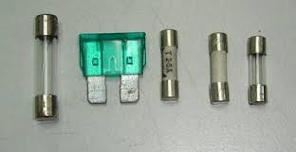
Power Protection
Most houses have four methods of protection from electricity:
Fuses
Circuit Breakers
GFCI
Grounding posts

Slide 24
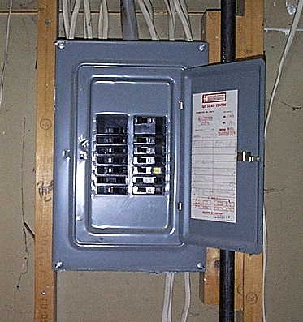
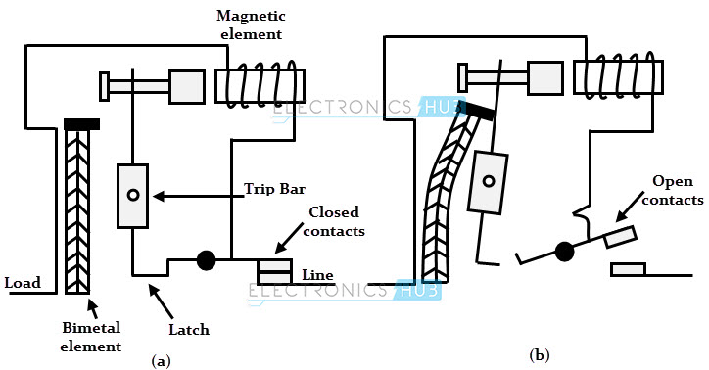
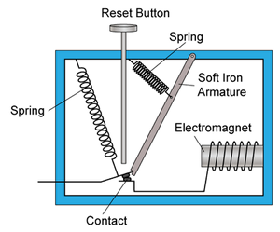
Power Protection
Most houses have four methods of protection from electricity:
Fuses
Circuit Breakers
GFI
Grounding posts

Slide 25
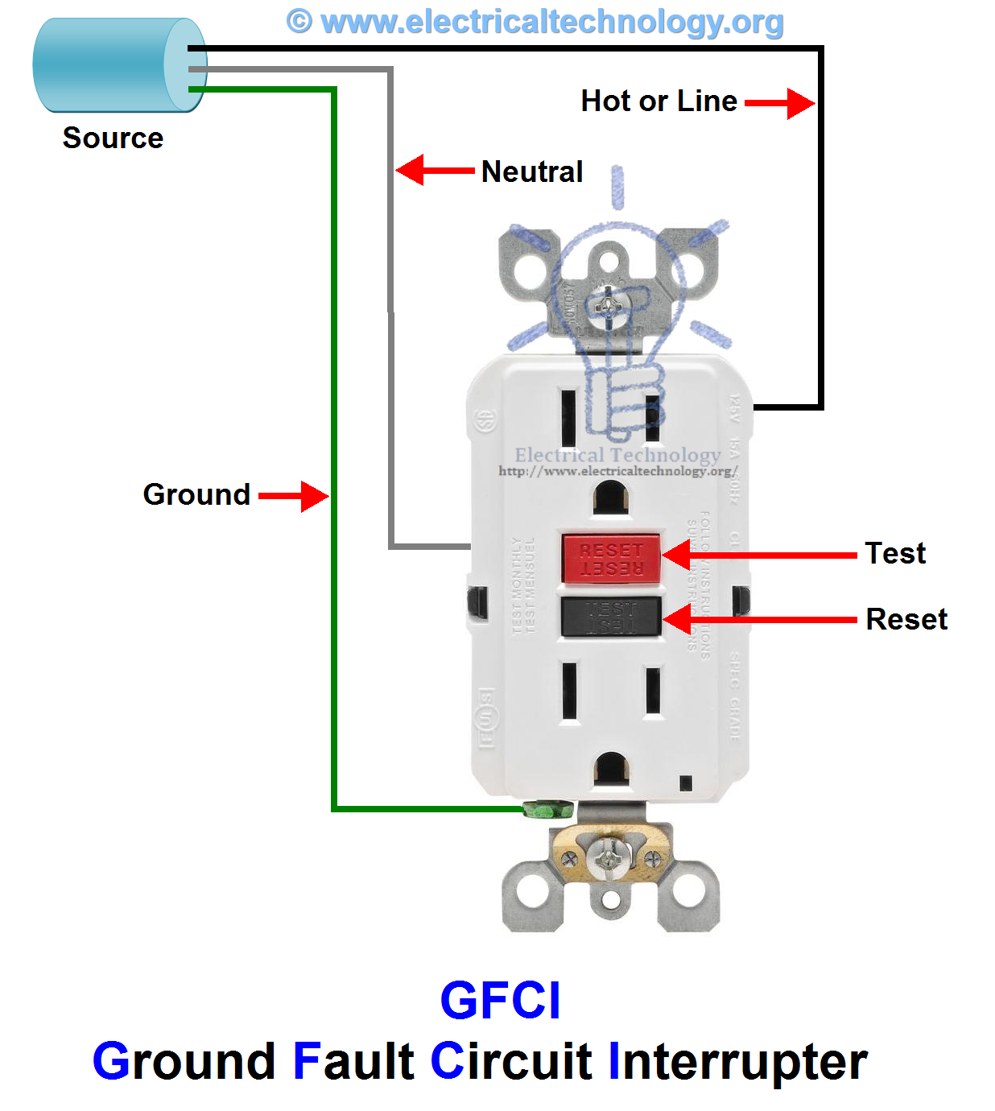
Power Protection
Most houses have four methods of protection from electricity:
Fuses
Circuit Breakers
GFCI
Grounding posts

Slide 26
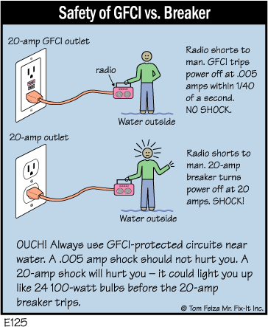
Power Protection
Most houses have four methods of protection from electricity:
Fuses
Circuit Breakers
GFCI
Grounding posts

Slide 27
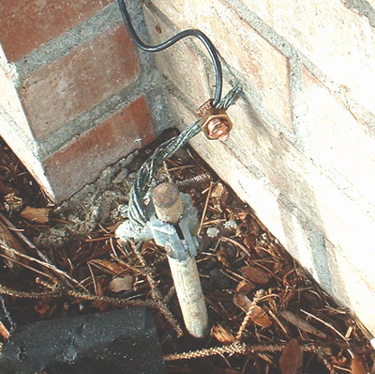
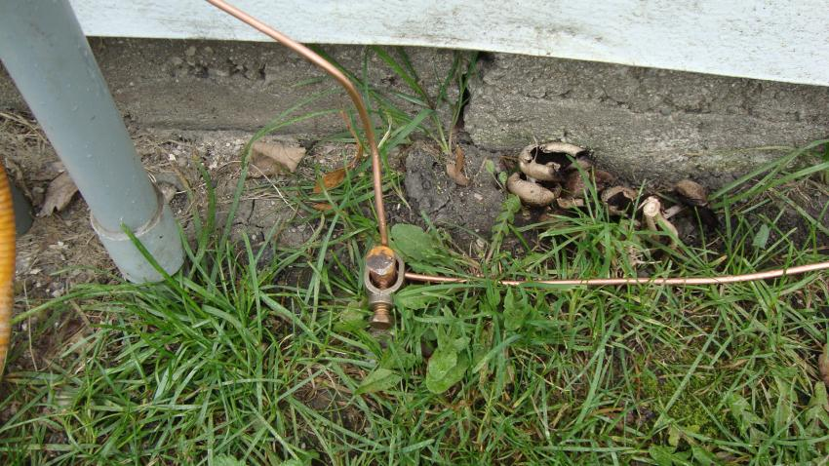
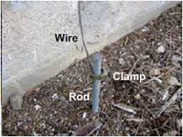
Power Protection
Most houses have four methods of protection from electricity:
Fuses
Circuit Breakers
GFCI
Grounding posts

Slide 28
Essential Knowledge:
Energy can be transferred by an external force exerted on an object or system that moves the object or system through a distance; this energy transfer is called work.
Energy transfer in mechanical or electrical systems may occur at different rates.
Power is defined as the rate of energy transfer into, out of, or within a system.

Slide 29
Data Guide Equations
In Data Guide
$\left|\vec{F_{E}}\right|=k\frac{\left|q_{1}q_{2}\right|}{r^{2}}$
$I=\frac{∆q}{∆t}$
$R=\frac{ρl}{A}$
$I=\frac{∆V}{R}$
$P=I∆V$
${R }_{s}=\sum_{i}{{R }_{i}}$
$\frac{1}{{R }_{p}}=\sum_{i}{\frac{1}{{R }_{i}}}$
NOT in Data Guide
$V=IR$
$ρ_{T}=ρ_{0}[1+α\left(T−T_{0}\right)$
not in curriculum
$P=I^{2}R$
$P=\frac{V^{2}}{R}$

Slide 30
Enduring Understanding:
The energy of a system is conserved.

Slide 31
Big Idea:
Changes that occur as a result of interactions are constrained by conservation laws.

Slide 32
Questions?

Slide 33
Homework
#26-39

Slide 34
Stopped here 4/21/15

