Slide 1

Devil physics
The baddest class on campus
IB Physics

Slide 2
Lsn 12-1A: Interactions Of Matter With Radiation

Slide 3
Questions From Reading Activity?

Slide 4
Essential Idea:
The microscopic quantum world offers a range of phenomena, the interpretation and explanation of which require new ideas and concepts not found in the classical world.

Slide 5
Nature Of Science:
Observations: Much of the work towards a quantum theory of atoms was guided by the need to explain the observed patterns in atomic spectra. The first quantum model of matter is the Bohr model for hydrogen.
Paradigm shift: The acceptance of the wave–particle duality paradox for light and particles required scientists in many fields to view research from new perspectives.

Slide 6
Theory Of Knowledge:
The duality of matter and tunneling are cases where the laws of classical physics are violated.
To what extent have advances in technology enabled paradigm shifts in science?

Slide 7
Understandings:
Photons
The photoelectric effect
Matter waves
Pair production and pair annihilation
Quantization of angular momentum in the Bohr model for hydrogen

Slide 8
Understandings:
The wave function
The uncertainty principle for energy and time and position and momentum
Tunneling, potential barrier and factors affecting tunneling probability

Slide 9
Applications And Skills:
Discussing the photoelectric effect experiment and explaining which features of the experiment cannot be explained by the classical wave theory of light
Solving photoelectric problems both graphically and algebraically

Slide 10
Applications And Skills:
Discussing experimental evidence for matter waves, including an experiment in which the wave nature of electrons is evident
Stating order of magnitude estimates from the uncertainty principle

Slide 11
Guidance:
The order of magnitude estimates from the uncertainty principle may include (but is not limited to) estimates of the energy of the ground state of an atom, the impossibility of an electron existing within a nucleus, and the lifetime of an electron in an excited energy state
Tunneling to be treated qualitatively using the idea of continuity of wave functions

Slide 12
Data Booklet References:

Slide 13
Utilization:
The electron microscope and the tunneling electron microscope rely on the findings from studies in quantum physics
Probability is treated in a mathematical sense in Mathematical studies SL sub-topics 3.6–3.7

Slide 14
Aims:
Aim 1: study of quantum phenomena introduces students to an exciting new world that is not experienced at the macroscopic level. The study of tunneling is a novel phenomenon not observed in macroscopic physics.

Slide 15
Aims:
Aim 6: the photoelectric effect can be investigated using LEDs
Aim 9: the Bohr model is very successful with hydrogen but not of any use for other elements

Slide 16

Introductory Video:
Wave-Particle Duality

Slide 17
All About Photons
Light is considered to be an electromagnetic wave
  Consists of oscillating electric and magnetic fields
Wave speed is, c = fλ
Light behaves as a wave
  Diffraction
  Interference
  Polarization
  Red and blue shifting

Slide 18
All About Photons
The photoelectric effect also shows that light behaves as a particle, namely
  Momentum
  Energy
Existence of photon’s momentum is supported by Compton effect: deflecting photons off electrons or protons

Slide 19
All About Photons
Einstein proposed that light should be considered as quanta of energy given by E = hf, moving at the speed of light.
Photon’s momentum:

Slide 20
All About Photons
Even though photons have energy and momentum, they have no mass and zero electric charge
Einstein’s theory of relativity, E=mc², implies that photons travel at the speed of light
Because they travel at the speed of light, their momentum is considered relativistic
Even though we treat light as photon particles, it still exhibits a wave nature

Slide 21
The Photoelectric Effect
When light or other electromagnetic radiation falls on a metallic surface, electrons may be emitted from that surface

Slide 22
The Photoelectric Effect
Electromagnetic radiation contains energy that can be transferred to electrons of the atoms of the photosurface, enabling them to pull themselves away from the attraction of the nuclei and leave the surface altogether
Photons giving electrons enough energy to separate themselves from atoms

Slide 23
The Photoelectric Effect
Millikan experiments
  Light radiated on a photosurface inside an evacuated tube
  Reflected onto a collecting plate connected to an electroscope or galvanometer
  Electrons that make it to the collecting plate create a current

Slide 24
The Photoelectric Effect
As the intensity of the radiation increases, induced current increases – intensity and current are directly proportional
  May be due to larger number of electrons emitted per second, OR;
  Electrons with higher speed emitted, OR;
  Both

Slide 25
The Photoelectric Effect
To determine which, you connect up a voltage source to the circuit to make the current drop to zero – a stopping voltage (V_{s})

Slide 26
The Photoelectric Effect
The energy of the stopping voltage, eV_{s}, must then be equal to the work done in moving the electrons from the cathode to the collecting plate, which is the same as the maximum kinetic energy of the electrons, E_{k}
E_{k} = eV_{s}

Slide 27
The Photoelectric Effect
The stopping voltage is the same regardless of light intensity
The intensity of the light has no effect on the maximum energy of the electrons
Thus the increase in the current is due to more electrons being emitted

Slide 28
The Photoelectric Effect
Miliken then varied the frequency / wavelength of the light
Surprise, Surprise

Slide 29
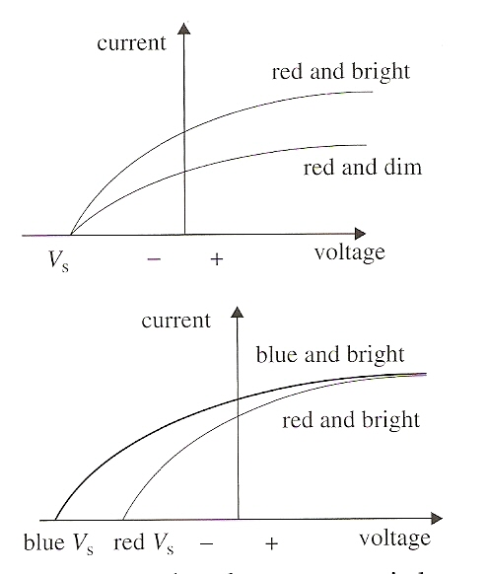
The Photoelectric Effect
Stopping voltage does not depend on intensity
HOWEVER,
Stopping voltage does depend on the frequency of the light source
The larger the frequency, the larger the required stopping voltage

Slide 30
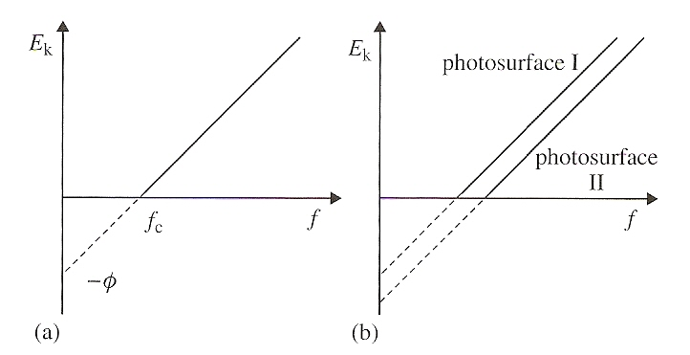
The Photoelectric Effect
Another twist:
  There does exist a critical or threshold frequency, f_{c} , such that sources emitting light below the threshold frequency will cause no electrons to be emitted no matter how intense the light

Slide 31
The Photoelectric Effect
  The critical frequency was different for different photosurfaces (the surface the light was shown on)
  Kinetic energy of the electrons is directly proportional to light frequency

Slide 32
The Photoelectric Effect
Four observations:
  The intensity of the incident light does not affect the energy of the emitted electrons
  The electron energy depends on the frequency of the incident light
  There is a certain minimum frequency below which no electrons are emitted.
  Electrons are emitted with no time delay, i.e. no “build-up” of energy
Is there a problem here?

Slide 33
The Photoelectric Effect
All four of these observations are in violation of the standard laws of physics
  A more intense beam of light should produce electrons with more energy
  Classical electromagnetism gives no explanation for the relationship between frequency and electron energy
  Classical electromagnetism gives no explanation for the reason for a minimum frequency to release electrons instantaneously
  With a low intensity light beam, the electrons should have to wait to build up energy before being emitted
So What’s Up With That?

Slide 34
The Photoelectric Effect
Big Al to the Rescue
  Einstein postulated that light, like any other form of electromagnetic radiation, consists of quanta which are ‘packets of energy and momentum’
  The energy of one such quantum is given by:
  E = hf
  where f is the frequency of the electromagnetic radiation and h = 6.63x10⁻³⁴ Js, a constant known as Planck’s constant

Slide 35
The Photoelectric Effect
Big Al to the Rescue
  These quanta of energy and momentum are photons, the particles of light
  This implies light behaves in some cases as particles do, but the energy of the photons is dependent on the frequency of the light, not the intensity, implying wave properties
  If a photon of frequency f is absorbed by an electron, the electron’s energy increases by hf

Slide 36
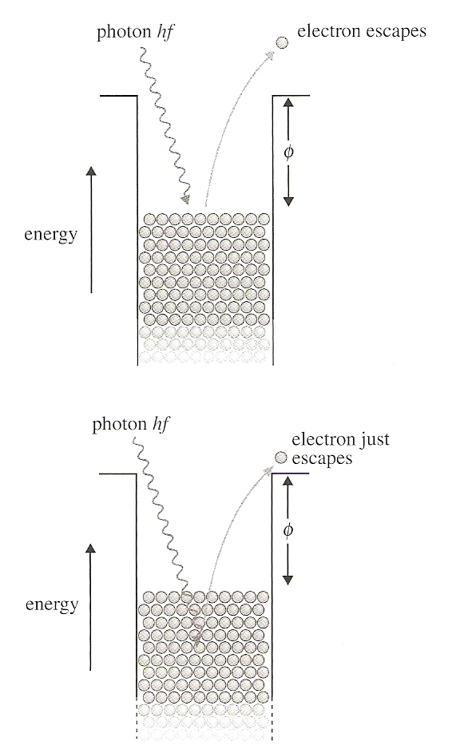
The Photoelectric Effect
Big Al to the Rescue
  If the energy required for the electron to break free of the nucleus and the photosurface is φ, then the electron will only be emitted if hf > φ

Slide 37
The Photoelectric Effect
Big Al to the Rescue
  The kinetic energy of the now free electron is:
  E_{k} = hf – φ
  φ is called the work function, the minimum amount of energy required to release an electron
At the critical frequency:
  hf_{c} = φ, and E_{k} = 0

Slide 38
The Photoelectric Effect
Big Al to the Rescue
  It’s kind of like the problem with the spring constant
  You had to apply a certain amount of force to get the spring to move
  After that, extension was proportional to force applied:

Slide 39
The Photoelectric Effect
To summarize:
eV_{s} = E_{k}
E_{k} = hf – φ
eV_{s} = hf – φ
V_{s} = (h/e) f – φ/e
  The graph of the stopping voltage versus frequency yields a straight line with slope h/e and an x-intercept representing the work function

Slide 40

Matter waves
Waves
Or, Waves Matter Too

Slide 41
DeBroglie’s Wavelength Hypothesis
He defined wavelength for a particle with momentum p:
Assigns wave-like properties to what was considered a particle
Referred to as the duality of matter – a particle that does the wave!

Slide 42
Electron as a Wave
If we call something a wave, then it must exhibit wave-like properties – such as diffraction
  A wave will only diffract around an object if its wavelength is comparable or bigger than the object
    Electron at v = 10⁵ m/s
    Momentum p = 9.1 x 10⁻²⁶ kg-m/s²
    Wavelength 7.2 x 10⁻⁹ m

Slide 43
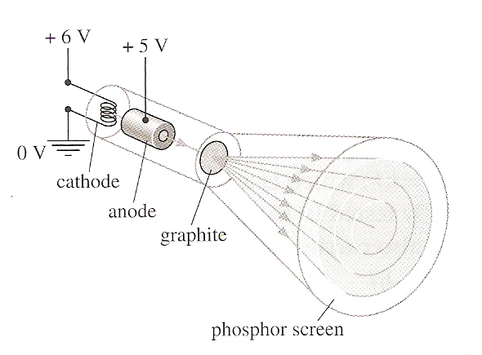
Electron as a Wave
Openings in some crystals are on the right order of magnitude ~ 10⁻⁸ m
    Electron at v = 10⁵ m/s
    Momentum p = 9.1 x 10⁻²⁶ kg-m/s²
    Wavelength 7.2 x 10⁻⁹ m

Slide 44
Electron as a Wave
Sir William Henry Bragg derived a relation between spacing of atoms in a crystal and wavelength of X-rays
  Bragg’s formula allows us to determine wavelength from crystal spacing or vice versa
    Electron at v = 10⁵ m/s
    Momentum p = 9.1 x 10⁻²⁶ kg-m/s²
    Wavelength 7.2 x 10⁻⁹ m

Slide 45
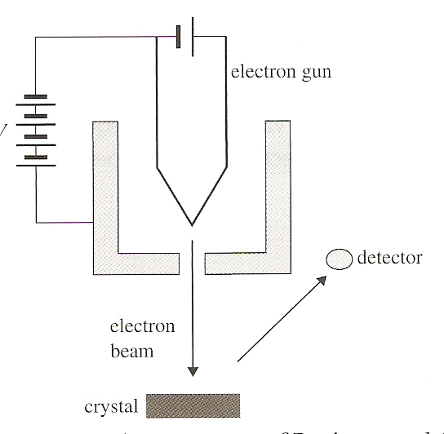
Electron as a Wave
Davisson-Germer experiment directed electrons toward a nickel surface where a single crystal had been grown
The electrons were scattered by the crystal similar to X-rays in previous experiments which confirmed the wave nature

Slide 46
Electron as a Wave
The Bragg formula was used to determine the wavelength which agreed with the de Broglie hypothesis
Thus, the Davisson-Germer experiments confirmed the de Broglie wavelength hypothesis

Slide 47
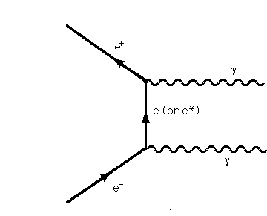
Pair Annihilation and Pair Production
Particle – Anti-Particle
  For every particle, there is an anti-particle
  Same mass, all other properties opposite
  When a particle collides with it’s anti-particle . . .

Slide 48

Pair Annihilation and Pair Production
Particle – Anti-Particle
  For every particle, there is an anti-particle
  Same mass, all other properties opposite
  When a particle collides with it’s anti-particle . . .
  Pair Annihilation

Slide 49
Pair Annihilation and Pair Production
Particle – Anti-Particle Collision
  Electron and positron travelling in opposite directions at the same speed
  Upon annihilation, 2 photons are emitted with the same energy, travelling in opposite directions at the same speed (conservation of energy and momentum)
  Their wavelength will be

Slide 50
Pair Annihilation and Pair Production
Particle – Anti-Particle Collision
  Assume the longest wavelength occurs when E_{K} = 0
  Electron rest mass = mc² = 0.511 MeV (Data Guide), so

Slide 51
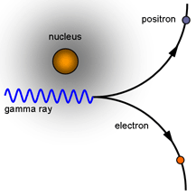
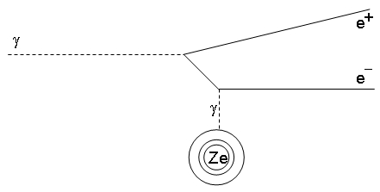
Pair Annihilation and Pair Production
Pair Production or Creation
  A single photon cannot create a particle – anti-particle pair due to inability to conserve energy and momentum
  However, it can interact with nucleus to do so
  Energy is, in effect, converted into matter

Slide 52
Understandings:
Photons
The photoelectric effect
Matter waves
Pair production and pair annihilation
Quantization of angular momentum in the Bohr model for hydrogen

Slide 53
Understandings:
The wave function
The uncertainty principle for energy and time and position and momentum
Tunneling, potential barrier and factors affecting tunneling probability

Slide 54
Guidance:
The order of magnitude estimates from the uncertainty principle may include (but is not limited to) estimates of the energy of the ground state of an atom, the impossibility of an electron existing within a nucleus, and the lifetime of an electron in an excited energy state
Tunneling to be treated qualitatively using the idea of continuity of wave functions

Slide 55
Data Booklet References:

Slide 56
Utilization:
The electron microscope and the tunneling electron microscope rely on the findings from studies in quantum physics
Probability is treated in a mathematical sense in Mathematical studies SL sub-topics 3.6–3.7

Slide 57
Essential Idea:
The microscopic quantum world offers a range of phenomena, the interpretation and explanation of which require new ideas and concepts not found in the classical world.

Slide 58
Questions?

Slide 59
Homework
#1-16, odd and evens only

