Slide 1
Devil physics The baddest class on campus AP Physics

Slide 2
Giancoli Lesson 10-7 Buoyancy and archimedes’ Principle

Slide 3
Video: Archimedes Principle

Slide 4
Buoyancy
Stuff floats
Stuff in water seems lighter than stuff on land
This is because the fluid is exerting a pressure on the object that opposes the gravity force (weight)
Fluid pressure increases with depth
When the fluid pressure equals the weight, the object will stop sinking

Slide 5
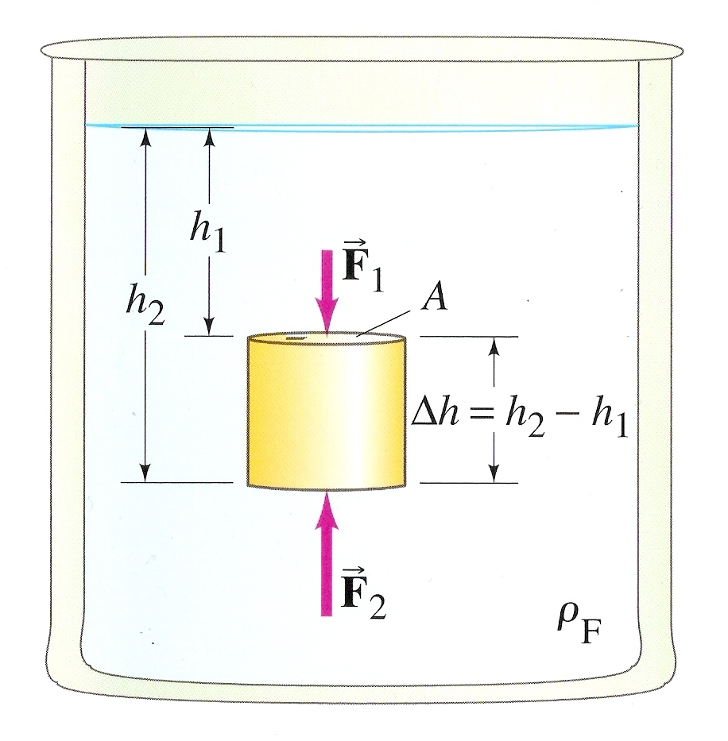
Buoyant Force
The force of fluid pressure that opposes weight

Slide 6
Buoyant Force
The force of fluid pressure that opposes weight

Slide 7
Buoyant Force
The force of fluid pressure that opposes weight

Slide 8
Buoyant Force
The force of fluid pressure that opposes weight

Slide 9
Archimedes’ Principle
The force of fluid pressure that opposes weight
The volume of the cylinder displaces the same volume of water that was there before the cylinder was immersed

Slide 10
Archimedes’ Principle
The force of fluid pressure that opposes weight
The buoyant force on a body immersed in a fluid is equal to the weight of the fluid displaced by that object

Slide 11
Sample Problem
An 180kg treasure chest sits 30m below the surface of the ocean. The dimensions of the chest are 0.6m x 0.4m x 0.4m. How much work will it take to bring it to the surface and then lift it 1.5m to the deck of the boat?

Slide 12
Sample Problem
An 180kg treasure chest sits 30m below the surface of the ocean. The dimensions of the chest are 0.6m x 0.4m x 0.4m. How much work will it take to bring it to the surface and then lift it 1.5m to the deck of the boat?
F_{pull}
F_{B}
F_{g}

Slide 13
Sample Problem
An 180kg treasure chest sits 30m below the surface of the ocean. The dimensions of the chest are 0.6m x 0.4m x 0.4m. How much work will it take to bring it to the surface and then lift it 1.5m to the deck of the boat?
F_{pull}
F_{B}
F_{g}

Slide 14
Sample Problem
An 180kg treasure chest sits 30m below the surface of the ocean. The dimensions of the chest are 0.6m x 0.4m x 0.4m. How much work will it take to bring it to the surface and then lift it 1.5m to the deck of the boat?
F_{pull}
F_{g}

Slide 15
Archimedes and the King’s Crown
The King asked Archimedes to determine whether his crown was pure gold or a fake
Archimedes knew the specific gravity of gold and could determine the mass of the crown, but could not figure out how to determine the volume of the irregularly shaped crown
One day when he got into the bathtub, the water spilled out over the sides

Slide 16
Archimedes and the King’s Crown
He realized that the increase in volume of the tub water was equal to his volume because his body was displacing the water
If he could weigh the water that was displaced, he could use the density of water to determine the volume of the displaced water and thus determine the volume of his body
The same could be done with the king’s crown

Slide 17
Archimedes and the King’s Crown
Let’s try it

Slide 18
Floating Objects
An object floats on a fluid if its density is less than that of water
An object sinks if its density is greater than that of water
What is your specific gravity?

Slide 19
Floating Objects
An object floats on a fluid if its density is less than that of water
An object sinks if its density is greater than that of water
What is your specific gravity?
1.003 to 1.030

Slide 20
Floating Objects
A log has a density of 0.6 x 10³ kg/m³ and has a mass of 1200kg.
Prove that it will float.
If it is held under water and then released, what will be its acceleration toward the surface?

Slide 21
Floating Objects
A log has a density of 0.6 x 10³ kg/m³ and has a mass of 1200kg.
Prove that it will float.
$F_{net}=ρgV−mg$
$F_{net}=\left(1x{10}^{3}\right)\left(9.81\right)\left(1200/0.6x{10}^{3}\right)−\left(1200\right)\left(9.81\right)$
$F_{net}=\text{7848}$
If it is held under water and then released, what will be its acceleration toward the surface?

Slide 22
Floating Objects
A log has a density of 0.6 x 10³ kg/m³ and has a mass of 1200kg.
Prove that it will float.
$F_{net}=\text{7848}$
If it is held under water and then released, what will be its acceleration toward the surface?
$F=ma$
$\frac{F}{m}=a=\frac{7848}{1200}=6.54m/{s^{2}}$

Slide 23
Questions?

Slide 24
Homework
#22-33

