Slide 1
Devil physics The baddest class on campus Ap Physics

Slide 2
Lsn 11-7: Wave motion Lsn 11-8: Types of Waves; longitudinal and transverse Lsn 11-9: Energy transported by waves

Slide 3
Physics of Waves

Slide 4
Questions From Reading Activity?

Slide 5
Big Idea(s):
Waves can transfer energy and momentum from one location to another without the permanent transfer of mass and serve as a mathematical model for the description of other phenomena.

Slide 6
Enduring Understanding(s):
A wave is a traveling disturbance that transfers energy and momentum.
A periodic wave is one that repeats as a function of both time and position and can be described by its amplitude, frequency, wavelength, speed, and energy.

Slide 7
Essential Knowledge(s):
Waves can propagate via different oscillation modes such as transverse and longitudinal.
Mechanical waves can be either transverse or longitudinal. Examples should include waves on a stretched string and sound waves.
For propagation, mechanical waves require a medium, while electromagnetic waves do not require a physical medium. Examples should include light traveling through a vacuum and sound not traveling through a vacuum.

Slide 8
Essential Knowledge(s):
The amplitude is the maximum displacement of a wave from its equilibrium value.
Classically, the energy carried by a wave depends upon and increases with amplitude. Examples should include sound waves.

Slide 9
Essential Knowledge(s):
For a periodic wave, the period is the repeat time of the wave. The frequency is the number of repetitions of the wave per unit time.
For a periodic wave, the wavelength is the repeat distance of the wave.

Slide 10
Essential Knowledge(s):
A simple wave can be described by an equation involving one sine or cosine function involving the wavelength, amplitude, and frequency of the wave.
For a periodic wave, wavelength is the ratio of speed over frequency.
The observed frequency of a wave depends on the relative motion of source and observer. This is a qualitative treatment only.

Slide 11
Learning Objective(s):
The student is able to use a visual representation to construct an explanation of the distinction between transverse and longitudinal waves by focusing on the vibration that generates the wave.
The student is able to describe representations of transverse and longitudinal waves.

Slide 12
Learning Objective(s):
The student is able to analyze data (or a visual representation) to identify patterns that indicate that a particular mechanical wave is polarized and construct an explanation of the fact that the wave must have a vibration perpendicular to the direction of energy propagation.
The student is able to describe sound in terms of transfer of energy and momentum in a medium and relate the concepts to everyday examples.

Slide 13
Learning Objective(s):
The student is able to contrast mechanical and electromagnetic waves in terms of the need for a medium in wave propagation.
The student is able to use graphical representation of a periodic mechanical wave to determine the amplitude of the wave.

Slide 14
Learning Objective(s):
The student is able to explain and/or predict qualitatively how the energy carried by a sound wave relates to the amplitude of the wave, and/or apply this concept to a real-world example.
The student is able to use a graphical representation of a periodic mechanical wave (position versus time) to determine the period and frequency of the wave and describe how a change in the frequency would modify features of the representation.

Slide 15
Learning Objective(s):
The student is able to use a visual representation of a periodic mechanical wave to determine wavelength of the wave.
The student is able to construct an equation relating the wavelength and amplitude of a wave from a graphical representation of the electric or magnetic field value as a function of position at a given time instant and vice versa, or construct an equation relating the frequency or period and amplitude of a wave from a graphical representation of the electric or magnetic field value at a given position as a function of time and vice versa.

Slide 16
Learning Objective(s):
The student is able to design an experiment to determine the relationship between periodic wave speed, wavelength, and frequency and relate these concepts to everyday examples.
The student is able to create or use a wave front diagram to demonstrate or interpret qualitatively the observed frequency of a wave, dependent upon relative motions of source and observer.

Slide 17
Properties of Waves

Slide 18
What is a wave?
Video: Pulses and Waves

Slide 19
What is a wave?
Examples:
Life is a beach
Light from the sun
Soprano breaking a glass
Light travels in a vacuum – no medium required – an electromagnetic wave
Sound and water require a medium – mechanical waves

Slide 20
What is a wave?
Waves occur because something is disturbed (some thing not someone)
A wave is a disturbance that travels, transferring energy and momentum from one place to another, but without the actual large-scale motion of a material body. The direction of energy transfer is the direction of propagation of the wave.

Slide 21
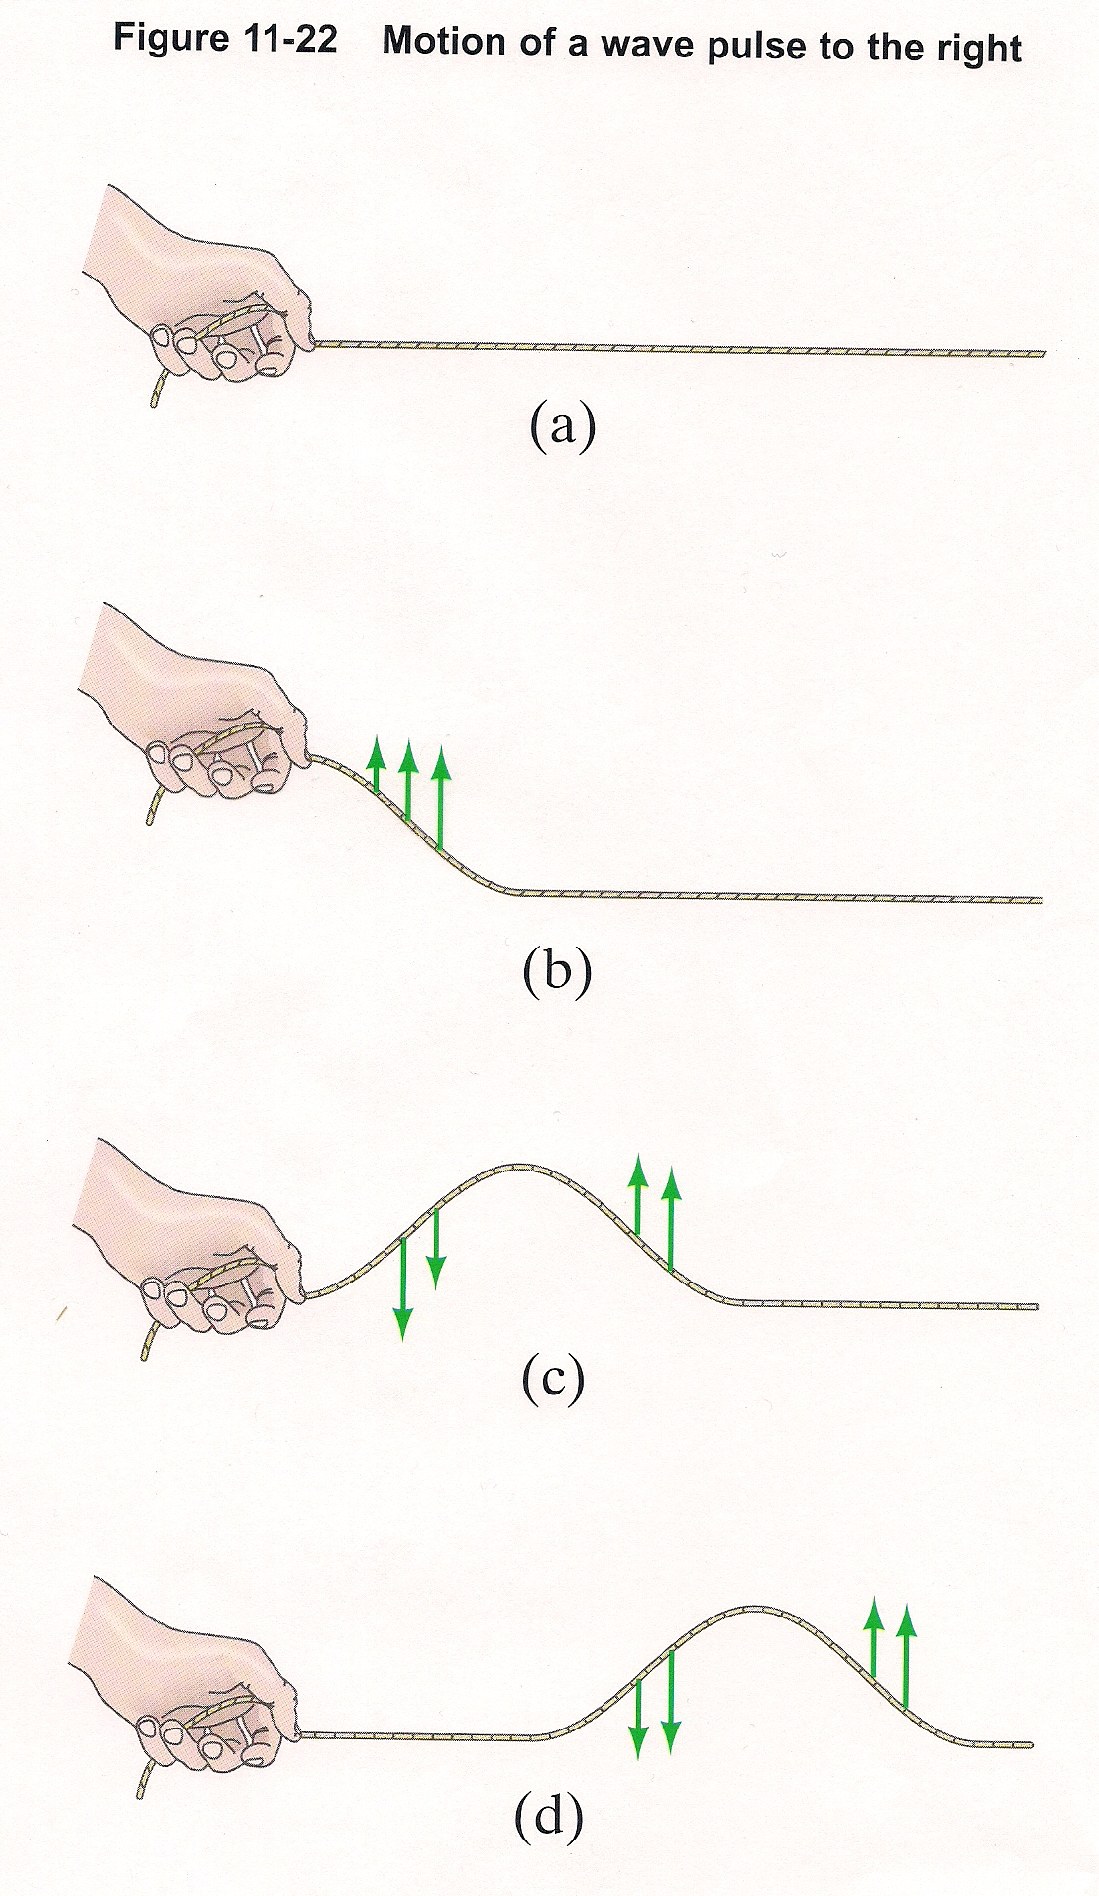
Wave pulses
rope tricks
half-pulse vs. full pulse

Slide 22
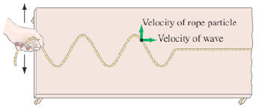
Wave pulses
Wave pulses travel with a given speed

Slide 23
Wave pulses
Wave pulses travel with a given speed
speed is distance divided by time
period is defined as the time it takes one complete pulse (one wavelength) to pass a given point
so wave speed can be defined as,

Slide 24
Wave pulses
Wave pulses travel with a given speed
wave speed in a rope is determined by the tension in the rope and mass per unit length, μ = m/L

Slide 25
Wave pulses
Wave pulses travel with a given speed
the speed of the wave is determined by the properties of the medium and not by how the wave is created,
i.e. independent of shape or how fast you produced it

Slide 26
Harmonic/Continuous/Periodic Waves
Source is a disturbance that is continuous and oscillating – a vibration
If the source vibrates sinusoidally, the wave will exhibit SHM

Slide 27
Harmonic/Continuous/Periodic Waves
Definitions:
amplitude (A): maximum height of a crest or depth of a trough relative to the equilibrium level
wavelength (λ) – length of a wave (surprise!), distance between any two successive, identical points on a wave

Slide 28
Harmonic/Continuous/Periodic Waves
Definitions:
frequency (f) – number of crests (or complete cycles) per unit time
equal to 1/T
unit is s⁻¹ or Hz
period (T) – time to complete one full wave or cycle
equal to 1/f
unit is s

Slide 29
Harmonic/Continuous/Periodic Waves
Definitions:
velocity (v) – equal to one wavelength (m) per the period (s)

Slide 30
Harmonic/Continuous/Periodic Waves
Definitions:
displacement (y) – height obtained above or below the undisturbed point due to the disturbance
it is a function of the distance (x) and time (t)
amplitude is max displacement

Slide 31
Sample Problem
WQYK broadcasts at a frequency of 99.5 MHz. What is the wavelength of the waves emitted? (Since they are electromagnetic waves, they travel at the speed of light, 3x10⁸ m/s)

Slide 32
Sample Problem
A WQYK broadcasts at a frequency of 99.5 MHz. What is the wavelength of the waves emitted? (Since they are electromagnetic waves, they travel at the speed of light, 3x10⁸ m/s)

Slide 33
Sample Problem #2
A sound wave of frequency 450Hz is emitted from A and travels towards B, a distance of 150m away. Take the speed of sound to be 341 m s⁻¹ . How many wavelengths fit in the distance from A to B?

Slide 34
Sample Problem #2
A sound wave of frequency 450Hz is emitted from A and travels towards B, a distance of 150m away. Take the speed of sound to be 341 m s⁻¹ . How many wavelengths fit in the distance from A to B?

Slide 35
Transverse and Longitudinal Waves
Video: Longitudinal and Transverse Waves

Slide 36
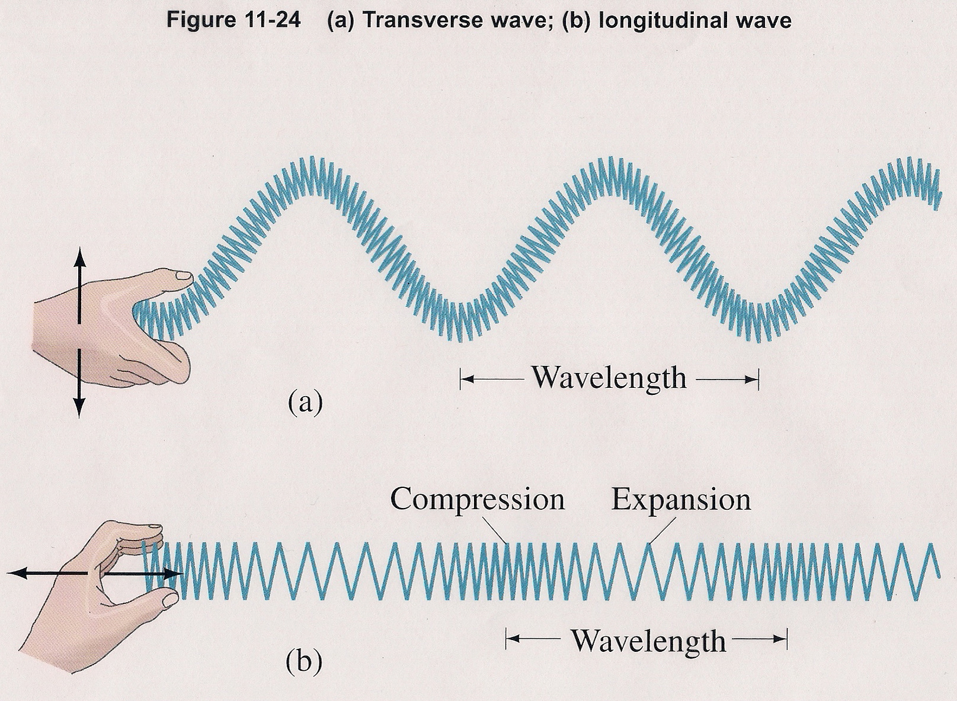
Transverse and Longitudinal Waves

Slide 37
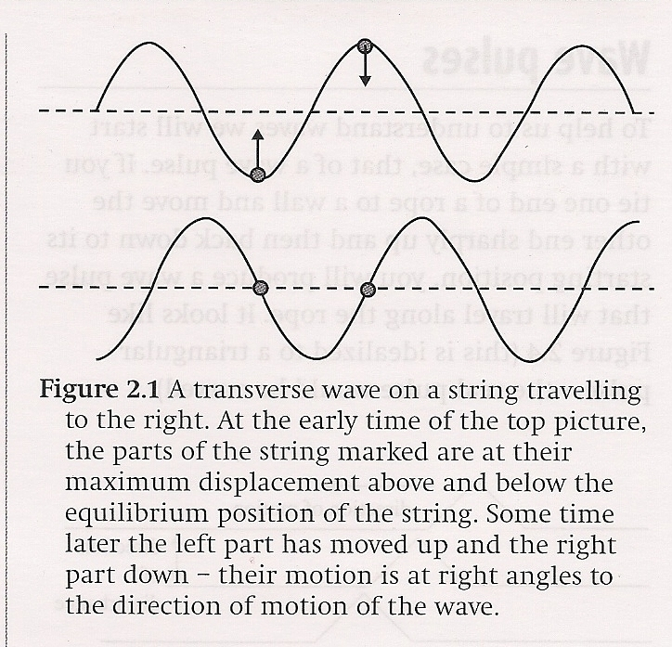
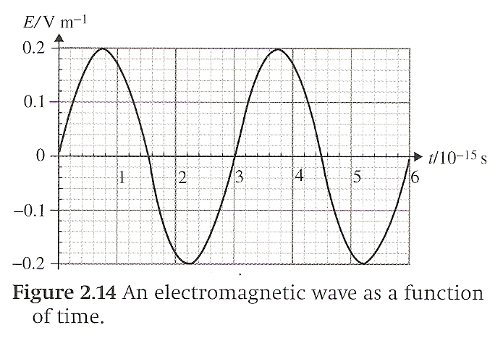
Transverse and Longitudinal Waves
Transverse – waves in which the disturbance is at right angles to the direction of energy transfer
rope tricks
Electromagnetic
waves

Slide 38
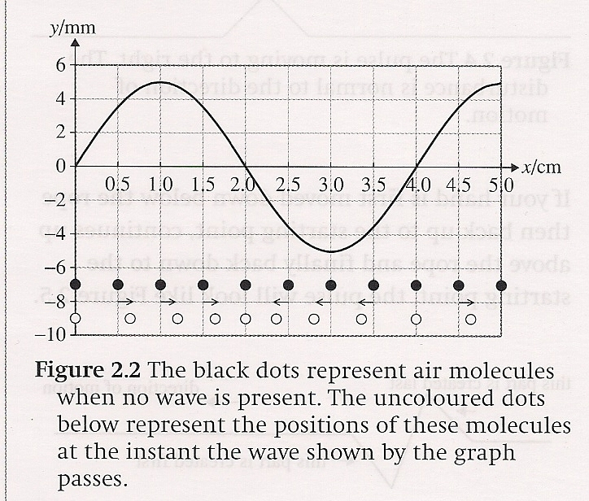
Transverse and Longitudinal Waves
Longitudinal -- waves in which the disturbance is along the direction of energy transfer
dominos
sound waves

Slide 39
Transverse and Longitudinal Waves
Longitudinal -- waves in which the disturbance is along the direction of energy transfer
energy propagated through a series of compressions (region of higher than normal density) and expansions or rarefactions (region of lower than normal density)

Slide 40
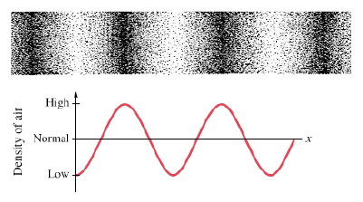
Transverse and Longitudinal Waves
Longitudinal -- waves in which the disturbance is along the direction of energy transfer
When wave movement is dependent on the medium (like for sound [compression] waves), displacement is given in terms of density or in terms of pressure

Slide 41
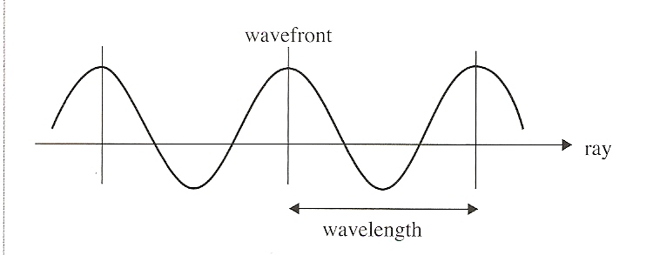
Wave Propagation
When we study the characteristics of waves, we tend to think of them one-dimensionally
Rays instead of wavefronts

Slide 42
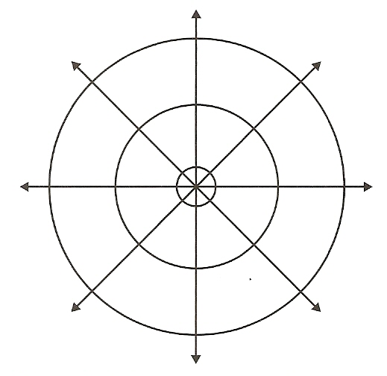
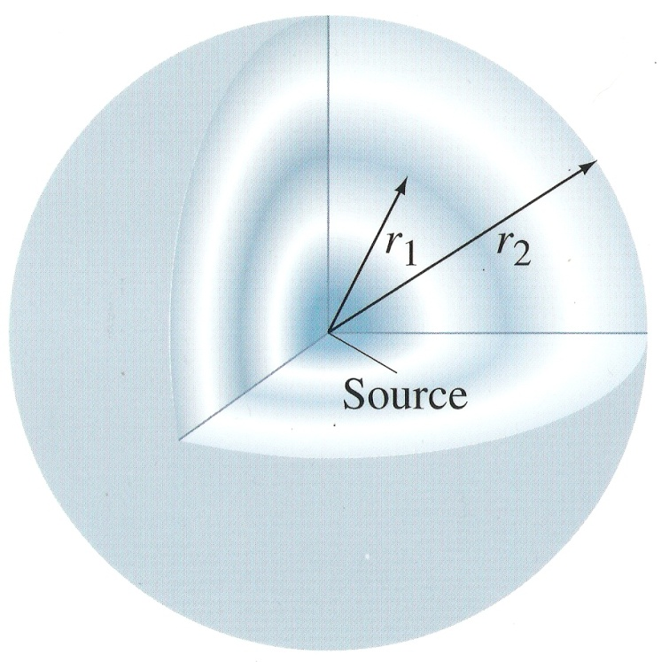
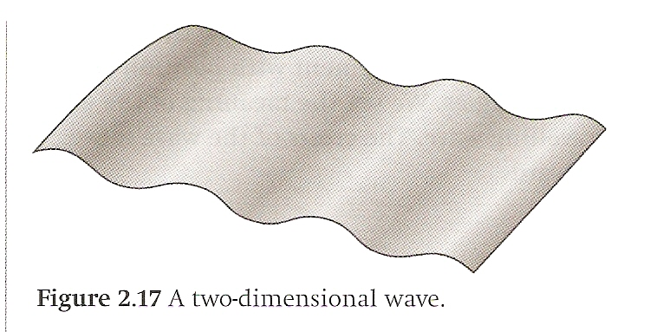
Wave Propagation
Most waves actually are propagated in multiple directions simultaneously
Pebble in a pond
Sound waves
Light waves

Slide 43
Wave Propagation
Wave propagation is all about propagation of energy
As waves spread out, the energy also spreads out
Same energy over a larger area means a drop in intensity

Slide 44
Wave Propagation
For particles exhibiting SHM,
Energy is a function of amplitude so,
The energy transported by a wave is proportional to the square of the amplitude

Slide 45
Wave Propagation
Intensity – The power (energy per unit time) transported across a unit area perpendicular to the direction of energy flow.

Slide 46
Wave Propagation
Spherical Wave – A wave that spreads out symmetrically in all directions from its source.

Slide 47
Wave Propagation

Slide 48
Wave Propagation

Slide 49
Wave Propagation

Slide 50
Wave Propagation – One-Dimension
What’s different for a one-dimensional wave like along a solid bar or within a tube?

Slide 51
Wave Propagation – One-Dimension
What’s different for a one-dimensional wave like along a solid bar or on a string?
Area remains constant
Amplitude remains constant so,
Intensity remains constant

Slide 52
Wave Propagation – Real Life
What’s different in real life?

Slide 53
Wave Propagation – Real Life
What’s different in real life?
Frictional damping
Amplitude, energy and intensity DO decrease in one dimensional waves
Intensity decreases more than the equations predict for spherical waves

Slide 54
Summary Video

Slide 55
Questions?

Slide 56
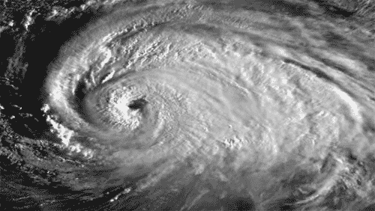
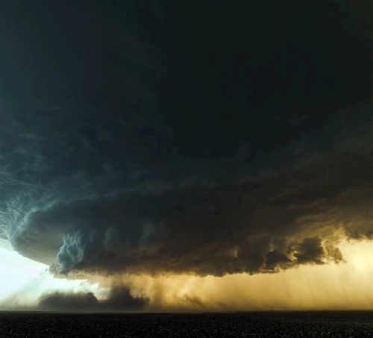
Homework
A-students, #36-44, 46, 47
All others, #36-47, skip 45

Slide 57
Stopped here on 4/21/15

