Slide 1
Devil physics The baddest class on campus AP Physics

Slide 2
Lsn 10-1: Phases of Matter Lsn 10-2: density and specific gravity

Slide 3
Introductory Video: Chemical Properties - Density

Slide 4
Objectives:
Name the four states of matter.
Describe the characteristics that differentiate the four states of matter.
Define density.
Solve problems involving density.
Define specific gravity.
Determine the specific gravity of a given substance.

Slide 5
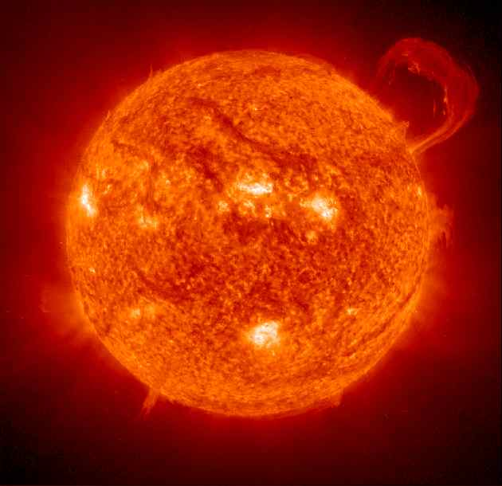
Phases (States) of Matter:
Solid
Liquid
Gas
Plasma
What characteristics differentiate these four?
Notes:
Phases (States) of Matter:
Solid – maintains a fixed shape and fixed size even if a large force is applied
Liquid – does not maintain a fixed shaped (takes on the shape of its container) but is not readily compressible and its volume can only be changed by a significant force
Gas – has neither a fixed shape or fixed volume, it will expand to fit its container
Plasma – a fourth state of matter that only occurs at very high temperatures and consists of ionized atoms (those that have electrons separated from the nuclei

Slide 9
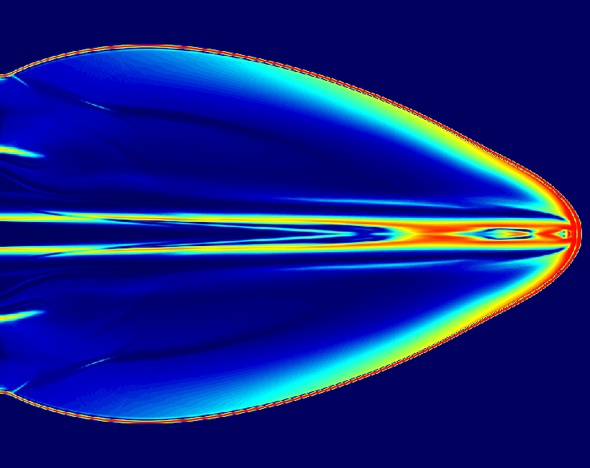
Fluids
Liquid
Gas
What properties do they have in common?
Notes:
Note: since gas and liquid do not have a fixed shape and have the ability to flow, they are often referred to collectively as fluids

Slide 10
Density (ρ)
Mass per unit volume
A characteristic property of any pure substance
SI unit is kg/m³
1 kg/m³ = 1x10-³ g/cm³
1x10³ kg/m³ = 1 g/cm³

Slide 11
Density (ρ)
SI unit is kg/m³
1 kg = 1000 (1x10³ ) g
1 m³ = 1m x 1m x 1m
= 100cm x 100cm x 100cm
= 1000000 (1x 10⁶) cm³
1kg/m³ = (1x10³ ) g / (1x 10⁶) cm³
1kg/m³ = 1x10-³ g / cm³
1kg/m³ = 0.001 g / cm³
1 ml of water = 1 g = 1 cm³ of water

Slide 12
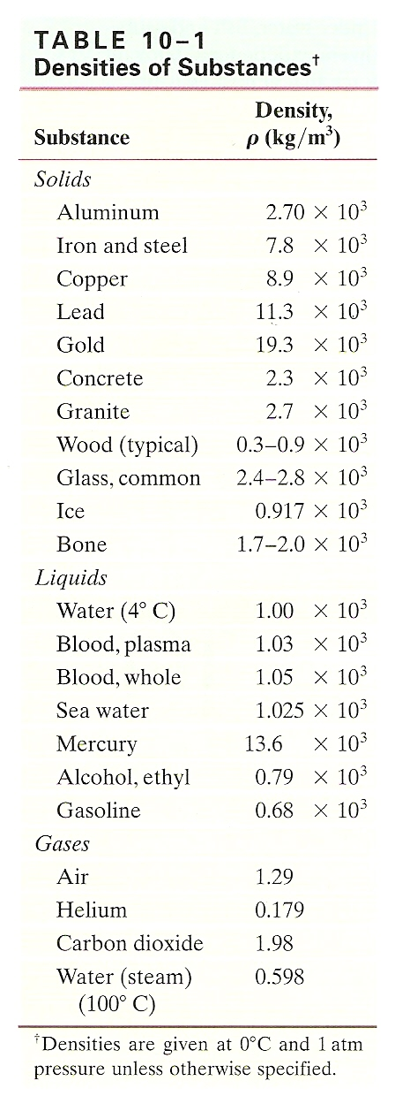
Density (ρ) Table 10-1
Water = 1x10³ kg/m³
Ice = 0.917x10³ kg/m³
Steam = 0.598 kg/m³

Slide 13
Density (ρ) Table 10-1
Specifies a temperature and pressure
Negligible effect on solids and liquids, more pronounced with gases

Slide 14
Density (ρ)
Example: A certain material has a mass of 11,700kg and a volume of 1.5m³. What is the material?

Slide 15
Density (ρ)
Example: A certain material has a mass of 11,700kg and a volume of 1.5m³. What is the material?
ρ = m/v = (11,700kg)/(1.5m³)
ρ = 7.8x10³ kg/m³
The object is iron or steel

Slide 16
Specific Gravity
Ratio of the density of a substance to that of water at 4.0℃ (1000 kg/m³)
Once the density is found in kg/m³, you can simply divide it by 1000 (10³)
Since it is a ratio of like units, SG is unitless

Slide 17
Specific Gravity
Example: What is the specific gravity of gold?

Slide 18
Specific Gravity
Example: What is the specific gravity of gold?
ρ_{gold} = 19.3x10³ kg/m³
SG = (ρ_{object})/(ρ_{water})
SG = (ρ_{gold})/(ρ_{water})
SG = (19.3x10³ kg/m³)/(1x10³ kg/m³)
SG = 19.3

Slide 19
Sample Problems
How much volume would 100kg of aluminum occupy?
m = 100kg
ρ = ?

Slide 20
Sample Problems
How much volume would 100kg of aluminum occupy?
m = 100kg
ρ = m/V
V = ?

Slide 21
Sample Problems
How much volume would 100kg of aluminum occupy?
m = 100kg
ρ = m/V
V = m/ρ
ρ_{AL} = ?

Slide 22
Sample Problems
How much volume would 100kg of aluminum occupy?
m = 100kg
ρ = m/V
V = m/ρ
ρ_{AL} = 2.7x10³ kg/m³
V = (100kg)/(2.7x10³ kg/m³)
V = ?

Slide 23
Sample Problems
How much volume would 100kg of aluminum occupy?
m = 100kg
ρ = m/V
V = m/ρ
ρ_{AL} = 2.7x10³ kg/m³
V = (100kg)/(2.7x10³ kg/m³)
V = 0.037 m³ or 3.7x10⁻² m³

Slide 24
Sample Problems
How much volume would 100kg of aluminum occupy?
m = 100kg
V = 0.037 m³ or 3.7x10⁻² m³
How many cm³?

Slide 25
Sample Problems
How much volume would 100kg of aluminum occupy?
m = 100kg
V = 0.037 m³ or 3.7x10⁻² m³
How many cm³?
V = 3.7x10⁻² m³ x 10⁶ cm³ / 1 m³
V = 3.7x10⁴ cm³

Slide 26
Sample Problems
What is the mass of 3m³ of gold?
V = 3m³
ρ = ?

Slide 27
Sample Problems
What is the mass of 3m³ of gold?
V = 3m³
ρ = m/V
m = ?

Slide 28
Sample Problems
What is the mass of 3m³ of gold?
V = 3m³
ρ = m/V
m = ρV
ρ_{Au} = ?

Slide 29
Sample Problems
What is the mass of 3m³ of gold?
V = 3m³
ρ = m/V
m = ρV
ρ_{Au} = 19.3x10³ kg/m³
m = (19.3x10³ kg/m³) x (3m³)
m = ?

Slide 30
Sample Problems
What is the mass of 3m³ of gold?
V = 3m³
ρ = m/V
m = ρV
ρ_{Au} = 19.3x10³ kg/m³
m = (19.3x10³ kg/m³) x (3m³)
m = 5.79x10⁴ kg

Slide 31
Summary:
What are the four states of matter?

Slide 32
Summary:
What are the four states of matter?
How do the four states of matter differ from one another?

Slide 33
Summary:
What are the four states of matter?
How do the four states of matter differ from one another?
What is density?

Slide 34
Summary:
What are the four states of matter?
How do the four states of matter differ from one another?
What is density?
How do you solve problems involving density?

Slide 35
Summary:
What are the four states of matter?
How do the four states of matter differ from one another?
What is density?
How do you solve problems involving density?
What is specific gravity?

Slide 36
Summary:
What are the four states of matter?
How do the four states of matter differ from one another?
What is density?
How do you solve problems involving density?
What is specific gravity?
How can you determine the specific gravity of a given substance?

Slide 37
Questions?

Slide 38
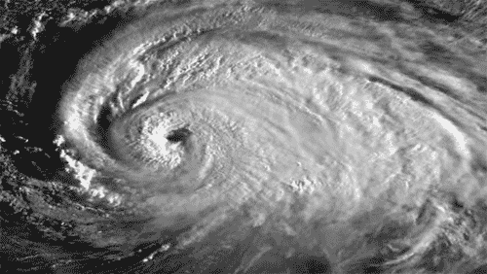
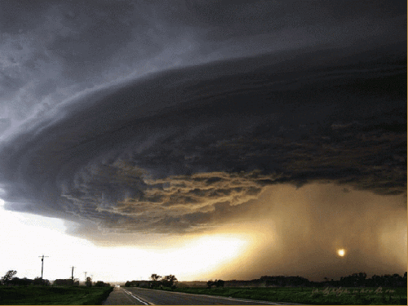
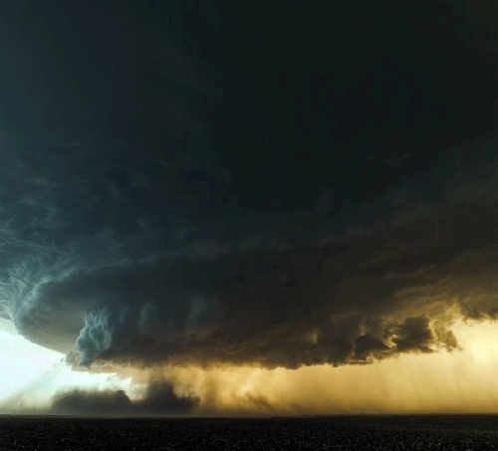
Homework
#1-6

Slide 39
Summary Video: Hydroelectric

