Slide 1
Devil physics The baddest class on campus IB Physics

Slide 2
Tsokos Option b-2B Thermodynamics (B2.6 thru B2.9)

Slide 3
Essential Idea:
The first law of thermodynamics relates the change in internal energy of a system to the energy transferred and the work done. The entropy of the universe tends to a maximum.

Slide 4
Nature Of Science:
Variety of perspectives: With three alternative and equivalent statements of the second law of thermodynamics, this area of physics demonstrates the collaboration and testing involved in confirming abstract notions such as this.

Slide 5
International-Mindedness:
The development of this topic was the subject of intense debate between scientists of many countries in the 19th century.

Slide 6
Understandings:
The first law of thermodynamics
The second law of thermodynamics
Entropy
Cyclic processes and pV diagrams
Isovolumetric, isobaric, isothermal and adiabatic processes
Carnot cycle
Thermal efficiency

Slide 7
Applications And Skills:
Describing the first law of thermodynamics as a statement of conservation of energy
Explaining sign convention used when stating the first law of thermodynamics as Q = ΔU + W
Solving problems involving the first law of thermodynamics

Slide 8
Applications And Skills:
Describing the second law of thermodynamics in Clausius form, Kelvin form and as a consequence of entropy
Describing examples of processes in terms of entropy change
Solving problems involving entropy changes

Slide 9
Applications And Skills:
Sketching and interpreting cyclic processes
Solving problems for adiabatic processes for monatomic gases using pV^{5/3} = constant
Solving problems involving thermal efficiency

Slide 10
Guidance:
If cycles other than the Carnot cycle are used quantitatively, full details will be provided
Only graphical analysis will be required for determination of work done on a pV diagram when pressure is not constant

Slide 11
Data Booklet Reference:
(for monatomic gases)

Slide 12
Utilization:
This work leads directly to the concept of the heat engines that play such a large role in modern society
The possibility of the heat death of the universe is based on ever-increasing entropy
Chemistry of entropy (see Chemistry sub-topic 15.2)

Slide 13
Aims:
Aim 5: development of the second law demonstrates the collaboration involved in scientific pursuits
Aim 10: the relationships and similarities between scientific disciplines are particularly apparent here

Slide 14
Reading Activity Questions?

Slide 15
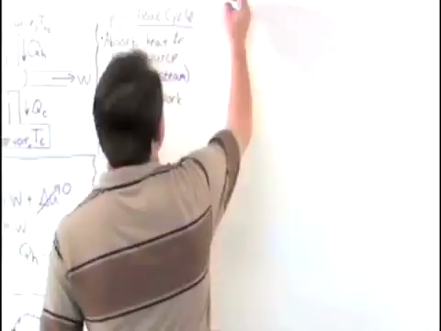
Introductory Video: Efficiency and the Second Law of Thermodynamics

Slide 16
Second Law of Thermodynamics
Impossible processes consistent with the First Law
The spontaneous (i.e. without the action of another agent) transfer of thermal energy from a cold body to a hotter body
The air in a room suddenly occupying just one half of the room and leaving the other half empty
A glass of water at room temperature suddenly freezing, causing the temperature of the room to rise

Slide 17
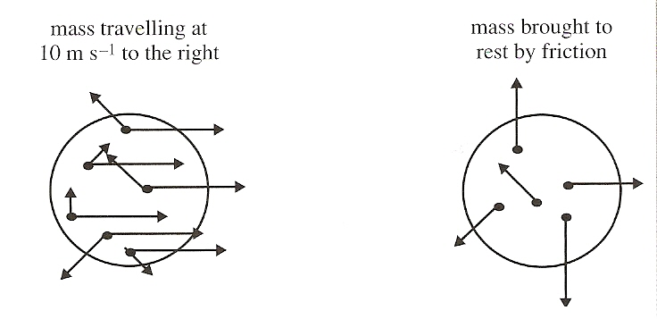
Second Law of Thermodynamics
Order and Disorder – Consider a bowling ball rolled down the hall in between classes
Between collision with students and friction, the ball eventually comes to a stop.

Slide 18
Second Law of Thermodynamics
Once the ball comes to a stop, the ordered kinetic energy can’t be recovered because it has been degraded.
All that is left is the disordered heat energy caused by friction

Slide 19
Second Law of Thermodynamics
The Second Law of Thermodynamics deals with the limitations imposed on heat engines, devices whose aim is to convert thermal energy (disordered energy) into mechanical energy (ordered energy).

Slide 20
Second Law of Thermodynamics
Reversibility
All natural processes are irreversible
They lead to a state of increased disorder
Measure of Disorder – Entropy
State function – once the state of the function is specified, so is the entropy

Slide 21
Entropy
During an isothermal expansion of a gas, the gas must receive heat
During an isothermal compression of a gas, the gas expels heat
The net change in entropy is zero

Slide 22
Entropy
The entropy of heat flowing from a hot object to a cold one
The hot object loses heat, the cold one gains heat
Entropy increases

Slide 23
Entropy
The entropy of heat flowing to a hot object from a cold one
The hot object gains heat, the cold one loses heat
Entropy decreases
Ain’t Gonna Happen!

Slide 24
Second Law of Thermodynamics (finally!)
General Statement:
The entropy of an isolated system never decreases. In such a system, entropy increases in realistic irreversible processes and stays the same in theoretical, idealized reversible processes.
Other Statements:
It is impossible for thermal energy to flow from a cold to a hot object without performing work.
It is impossible, in a cyclic process, to completely convert heat into mechanical work.

Slide 25
Video: Cyclic Heat Engines

Slide 26
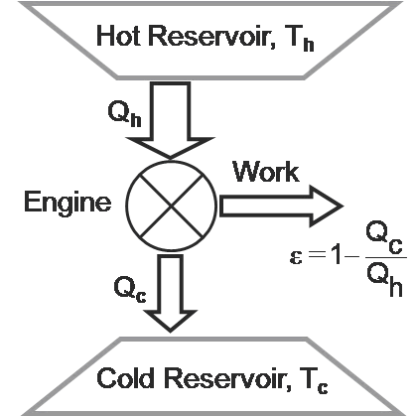
Heat Engines
A device that converts thermal energy into work
A hot reservoir at temperature T_{H} transfers heat into the engine
Think of the engine as a cylinder of gas with a movable piston
The expanding gas pushes the piston which does mechanical work

Slide 27
Heat Engines
A device that converts thermal energy into work
Not all of the heat can be turned into mechanical work
Some is ejected into a sink, or cold reservoir, at temperature T_{C}

Slide 28
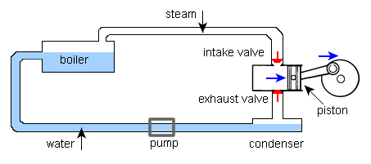
Heat Engines
A device that converts thermal energy into work
If we assume the temperature (internal energy) remains constant, the work done is equal to heat in Q_{H} minus heat out Q_{C}

Slide 29
Heat Engines
A device that converts thermal energy into work
Refrigerators and heat pumps use mechanical work to remove heat

Slide 30
Heat Engines
Not all of the heat can be turned into mechanical work

Slide 31
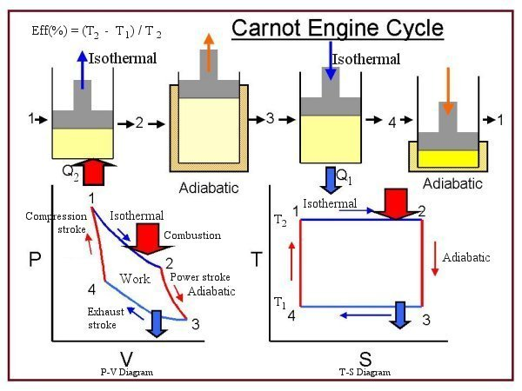
Carnot Engine
No engine is more efficient than a Carnot engine operating between the same temperatures.

Slide 32
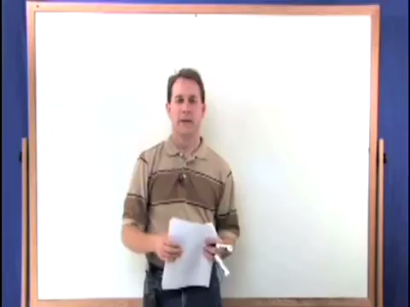
Carnot Engine

Slide 33
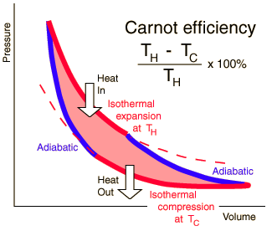
Carnot Engine
Starts with an isothermal compression (work done on the gas and heat is extracted, Q_{C})
Next the gas is further compressed adiabatically (work done on the gas and increase in temperature)

Slide 34
Carnot Engine
Gas then expands isothermally (work done by the gas, heat Q_{H} is drawn in from the hot reservoir)
Lastly, the gas continues to expand but now adiabatically (work done by the gas, decrease in temperature)

Slide 35
Carnot Engine
Since heat is exchanged during isothermal processes,
And efficiency becomes

Slide 36
Energy Degradation
The flow of energy from a hotter to a colder object tends to equalize the two temperatures and deprives us of the opportunity to do work.

Slide 37
Energy Degradation
It is a consequence of the second law that energy, while always being conserved, becomes less useful – this is energy degradation.

Slide 38
Energy Degradation of the Universe
Consider the universe to be a big bag of gas
As far as we know, the universe is a closed system – no heat is entering the universe
Since the universe is expanding, positive work is being done

Slide 39
Energy Degradation of the Universe
Thus the internal energy of the universe, i.e. its temperature, is constantly decreasing
This aligns with the idea that the temperature during the BIG BANG was millions of degrees and today, wavelength measurements of electromagnetic radiation left over from the BIG BANG show the temperature
of the universe to be about
2.7K

Slide 40
Energy Degradation of the Universe
The inevitable result of the constant cooling of the universe is,

Slide 41
Energy Degradation of the Universe
HEAT DEATH OF THE UNIVERSE
COMING TO A THEATER NEAR YOU,
JUN 6, 2016

Slide 42
Understandings:
The first law of thermodynamics
The second law of thermodynamics
Entropy
Cyclic processes and pV diagrams
Isovolumetric, isobaric, isothermal and adiabatic processes
Carnot cycle
Thermal efficiency

Slide 43
Guidance:
If cycles other than the Carnot cycle are used quantitatively, full details will be provided
Only graphical analysis will be required for determination of work done on a pV diagram when pressure is not constant

Slide 44
Data Booklet Reference:
(for monatomic gases)

Slide 45
Applications And Skills:
Describing the first law of thermodynamics as a statement of conservation of energy
Explaining sign convention used when stating the first law of thermodynamics as Q = ΔU + W
Solving problems involving the first law of thermodynamics

Slide 46
Applications And Skills:
Describing the second law of thermodynamics in Clausius form, Kelvin form and as a consequence of entropy
Describing examples of processes in terms of entropy change
Solving problems involving entropy changes

Slide 47
Applications And Skills:
Sketching and interpreting cyclic processes
Solving problems for adiabatic processes for monatomic gases using pV^{5/3} = constant
Solving problems involving thermal efficiency

Slide 48
Essential Idea:
The first law of thermodynamics relates the change in internal energy of a system to the energy transferred and the work done. The entropy of the universe tends to a maximum.

Slide 49
questions?

Slide 50
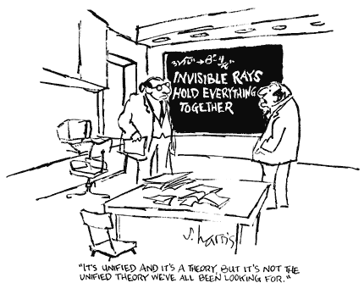
Homework
#29-37

Slide 51
We Stopped Here on 2/8

