Slide 1
Devil physics The baddest class on campus IB Physics

Slide 2
Tsokos Option b-2A Thermodynamics (B2.1 thru B2.5)

Slide 3
Essential Idea:
The first law of thermodynamics relates the change in internal energy of a system to the energy transferred and the work done. The entropy of the universe tends to a maximum.

Slide 4
Nature Of Science:
Variety of perspectives: With three alternative and equivalent statements of the second law of thermodynamics, this area of physics demonstrates the collaboration and testing involved in confirming abstract notions such as this.

Slide 5
International-Mindedness:
The development of this topic was the subject of intense debate between scientists of many countries in the 19th century.

Slide 6
Understandings:
The first law of thermodynamics
The second law of thermodynamics
Entropy
Cyclic processes and pV diagrams
Isovolumetric, isobaric, isothermal and adiabatic processes
Carnot cycle
Thermal efficiency

Slide 7
Applications And Skills:
Describing the first law of thermodynamics as a statement of conservation of energy
Explaining sign convention used when stating the first law of thermodynamics as Q = ΔU + W
Solving problems involving the first law of thermodynamics

Slide 8
Applications And Skills:
Describing the second law of thermodynamics in Clausius form, Kelvin form and as a consequence of entropy
Describing examples of processes in terms of entropy change
Solving problems involving entropy changes

Slide 9
Applications And Skills:
Sketching and interpreting cyclic processes
Solving problems for adiabatic processes for monatomic gases using pV^{5/3} = constant
Solving problems involving thermal efficiency

Slide 10
Guidance:
If cycles other than the Carnot cycle are used quantitatively, full details will be provided
Only graphical analysis will be required for determination of work done on a pV diagram when pressure is not constant

Slide 11
Data Booklet Reference:
(for monatomic gases)

Slide 12
Utilization:
This work leads directly to the concept of the heat engines that play such a large role in modern society
The possibility of the heat death of the universe is based on ever-increasing entropy
Chemistry of entropy (see Chemistry sub-topic 15.2)

Slide 13
Aims:
Aim 5: development of the second law demonstrates the collaboration involved in scientific pursuits
Aim 10: the relationships and similarities between scientific disciplines are particularly apparent here

Slide 14
Reading Activity Questions?

Slide 15
Internal Energy
The total kinetic energy of the molecules of the gas plus the potential energy associated with the intermolecular forces
For an ideal gas, the intermolecular forces are assumed to be zero

Slide 16
Internal Energy
Average kinetic energy of the molecules is given by
where
the Boltzmann constant

Slide 17
Internal Energy
Internal energy, U, of an ideal gas with N molecules is given by
and since
then

Slide 18
Internal Energy
In this equation, n is the number of moles
The change in internal energy due to a change in temperature is thus

Slide 19
Internal Energy
This formula shows that the internal energy of a fixed number of moles of an ideal gas depends only on temperature and not on the nature of the gas, its volume, or any other variable

Slide 20
System
Means the complete set of objects under consideration
Does not include the surroundings
Open system – mass can enter or leave
Closed system – mass cannot enter or leave
Isolated system – no energy in any form can enter or leave

Slide 21
System State
Refers to the complete set of parameters that define the system
Not to be confused with states of matter (or states that matter, for that matter)
Any process that change the state of an ideal gas (temperature, pressure or volume) is called a thermodynamic process
Examples are adding/subtracting heat or doing work on the system

Slide 22
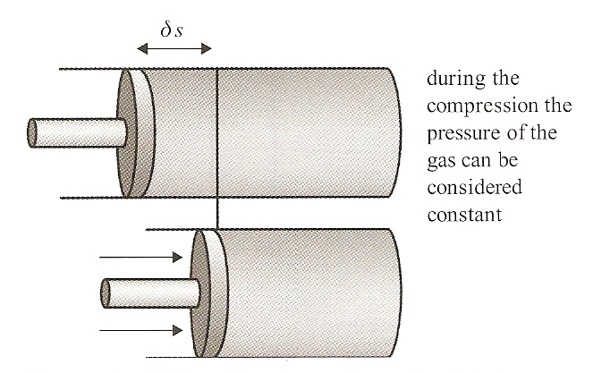
Work Done On or By A Gas
Compressing a gas with a piston, the (small) work done is given by:

Slide 23
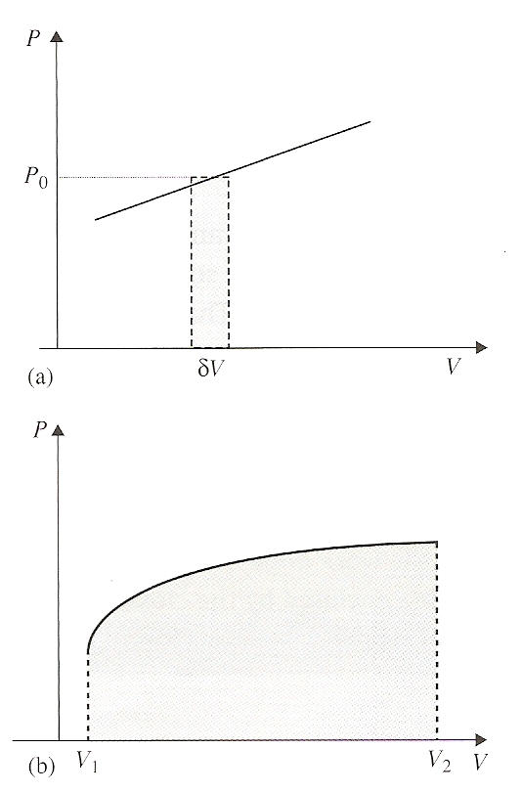
Work Done On or By A Gas
For large changes in volume, the pressure will increase with each incremental change so it must be integrated

Slide 24
Work Done On or By A Gas
The total work done when a gas expands by an arbitrary amount is the area under the graph of a pressure-volume diagram.

Slide 25
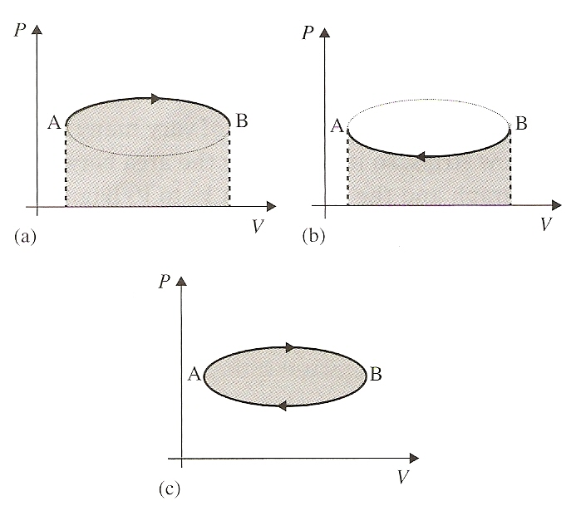
Work Done On or By A Gas
The net work done is the work done by the gas minus the work done on the gas.
It equals the area enclosed by the closed loop (i.e., the area between the upper and lower curves)

Slide 26
Thermodynamic Processes
Isobaric – The gas expands or contracts under constant pressure

Slide 27
Thermodynamic Processes
Isovolumetric (Isochoric) – The volume of the gas remains the same as pressure increases or decreases

Slide 28
Thermodynamic Processes
Isothermal – The temperature of the gas remains the same as pressure and volume change
Adiabatic – the gas does not absorb or release any thermal energy (Q = 0)

Slide 29
Thermodynamic Processes
Isothermal – The temperature of the gas remains the same as pressure and volume change
Adiabatic – the gas does not absorb or release any thermal energy (Q = 0)
Key is to observe the steepness of the slope – adiabatic steep, isothermal not so steep

Slide 30
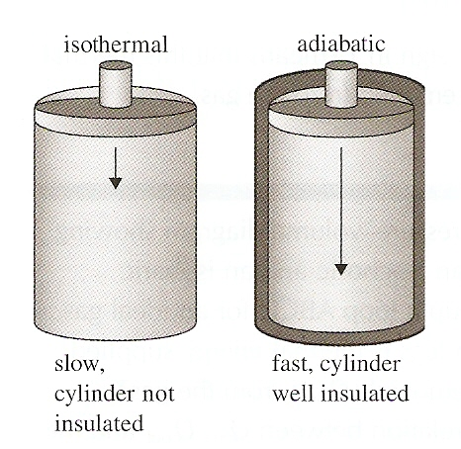
Thermodynamic Processes
Isothermal – The temperature of the gas remains the same as pressure and volume change
Adiabatic – the gas does not absorb or release any thermal energy (Q = 0)

Slide 31
Thermodynamic Processes
Isothermal – The temperature of the gas remains the same as pressure and volume change
Adiabatic – the gas does not absorb or release any thermal energy (Q = 0)

Slide 32
First Law of Thermodynamics
When a small amount of thermal energy Q is given to a gas, the gas will absorb that energy and use it to increase its internal energy and/or do work by expanding.
Conservation of energy demands that

Slide 33
First Law of Thermodynamics
+ Q = thermal energy absorbed by the gas (Q_{in})
- Q = thermal energy lost by the gas (Q_{out})
+ W = work done by the gas (W_{out}) as it expands
- W = work done on the gas (W_{in}) to compress it
+ U = increase in internal energy/temperature
- U = decrease in internal energy/temperature

Slide 34
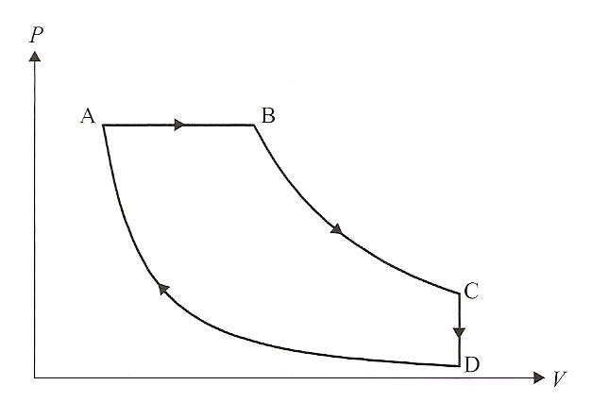
What is going on here?

Slide 35
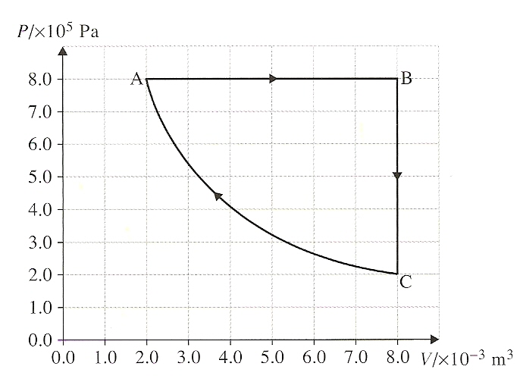
What is going on here?
T_{A} = 400K
U_{A-B} = 7.2 kJ
U_{C-A} = 2.2kJ
Find:
T_{B}
Q_{A-B}
Q_{B-C}
Net Work

Slide 36
Understandings:
The first law of thermodynamics
The second law of thermodynamics
Entropy
Cyclic processes and pV diagrams
Isovolumetric, isobaric, isothermal and adiabatic processes
Carnot cycle
Thermal efficiency

Slide 37
Guidance:
If cycles other than the Carnot cycle are used quantitatively, full details will be provided
Only graphical analysis will be required for determination of work done on a pV diagram when pressure is not constant

Slide 38
Data Booklet Reference:
(for monatomic gases)

Slide 39
Applications And Skills:
Describing the first law of thermodynamics as a statement of conservation of energy
Explaining sign convention used when stating the first law of thermodynamics as Q = ΔU + W
Solving problems involving the first law of thermodynamics

Slide 40
Applications And Skills:
Describing the second law of thermodynamics in Clausius form, Kelvin form and as a consequence of entropy
Describing examples of processes in terms of entropy change
Solving problems involving entropy changes

Slide 41
Applications And Skills:
Sketching and interpreting cyclic processes
Solving problems for adiabatic processes for monatomic gases using pV^{5/3} = constant
Solving problems involving thermal efficiency

Slide 42
Essential Idea:
The first law of thermodynamics relates the change in internal energy of a system to the energy transferred and the work done. The entropy of the universe tends to a maximum.

Slide 43
questions?

Slide 44
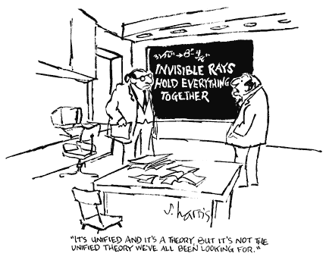
Homework
#18-28

Slide 45
We Stopped Here on 2/8

