Slide 1
Devil Physics Baddest Class on Campus
IB Physics

Slide 2
Option B-1B: rotational dynamics

Slide 3
Essential Idea:
The basic laws of mechanics have an extension when equivalent principles are applied to rotation. Actual objects have dimensions and they require the expansion of the point particle model to consider the possibility of different points on an object having different states of motion and/or different velocities.

Slide 4
Nature Of Science:
Modelling: The use of models has different purposes and has allowed scientists to identify, simplify and analyse a problem within a given context to tackle it successfully. The extension of the point particle model to actually consider the dimensions of an object led to many groundbreaking developments in engineering.

Slide 5
Theory Of Knowledge:
Models are always valid within a context and they are modified, expanded or replaced when that context is altered or considered differently.
Are there examples of unchanging models in the natural sciences or in any other areas of knowledge?

Slide 6
Understandings:
Torque
Moment of inertia
Rotational and translational equilibrium
Angular acceleration
Equations of rotational motion for uniform angular acceleration
Newton’s second law applied to angular motion
Conservation of angular momentum

Slide 7
Applications And Skills:
Calculating torque for single forces and couples
Solving problems involving moment of inertia, torque and angular acceleration
Solving problems in which objects are in both rotational and translational equilibrium

Slide 8
Applications And Skills:
Solving problems using rotational quantities analogous to linear quantities
Sketching and interpreting graphs of rotational motion
Solving problems involving rolling without slipping

Slide 9
Guidance:
Analysis will be limited to basic geometric shapes
The equation for the moment of inertia of a specific shape will be provided when necessary
Graphs will be limited to angular displacement–time, angular velocity–time and torque–time

Slide 10
Data Booklet Reference:
$Γ=Fr\sin{θ}$
$I=mr^{2}$
$Γ=Iα$
$ω=2πf$
$ω_{f}=ω_{i}+αt$
${ω_{f}}^{2}={ω_{i}}^{2}+2αθ$
$θ=ω_{i}t+\frac{1}{2}αt^{2}$
$L=Iω$
$E_{K_{rot}}=\frac{1}{2}Iω^{2}$

Slide 11
Utilization:
Structural design and civil engineering rely on the knowledge of how objects can move in all situations

Slide 12
Aims:
Aim 7: technology has allowed for computer simulations that accurately model the complicated outcomes of actions on bodies

Slide 13
review

Slide 14
Overview of Rotational Equations of Motion

Slide 15
Kinematics
Linear
Rotational
Position: x (meters)
Velocity: $v=\frac{∆x}{∆t}$ (m/s)
Linear Acceleration: $a=\frac{∆v}{∆t}$
(m/s²)
Radial Acceleration: $a_{r}=\frac{v^{2}}{r}$
Position: θ (radians)
Angular Velocity: $ω=\frac{∆θ}{∆t}$ (rad/s)
$v_{tan}=ωr$
Angular Accl: $α=\frac{∆ω}{∆t}$ (rad/s²)
$a_{tan}=αr$
$a_{r}=ω^{2}r$

Slide 16
Kinematics
Linear
Rotational

Slide 17
Torque
However, only the component of the force perpendicular to the moment arm produces torque
F
r
F⊥
θ

Slide 18
Equilibrium
Translational
No movement in any direction or movement in a constant direction at constant velocity
The net force on the body treated as a point mass is equal to zero.
The net force acting on the center of mass is zero.

Slide 19
Equilibrium
Rotational
No rotation of the body
The net torque on the body is equal to zero.

Slide 20
Kinetic Energy of a Body
Translational
v

Slide 21
Kinetic Energy of a Body
Rotational
There has to be a better way
ω

Slide 22
Moment of Inertia
This works for a single point mass, but not much else

Slide 23
Moment of Inertia

Slide 24
Kinetic Energy of a Body
Rotational
ω

Slide 25
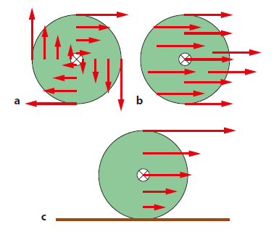
Rolling Motion (Without Slipping)
Three Cases:
Rotation
Sliding
Rolling without slipping

Slide 26
Rolling Motion (Without Slipping)
Three Cases:
Rotation
Sliding
Rolling without slipping
Depends on where the force is applied and the relationship between torque and friction

Slide 27
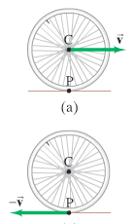
Rolling Motion (Without Slipping)
Rolling motion involves translational and rotational motion
In the diagram, the axis of rotation (C) is exhibiting translational motion
Meanwhile, all other points on the body of the wheel are exhibiting clockwise rotational motion

Slide 28
Rolling Motion (Without Slipping)
What will be the tangential velocity at point P?

Slide 29
Rolling Motion (Without Slipping)
What will be the tangential velocity at point P?
What will be the tangential velocity at the top of the wheel?

Slide 30
Rolling Motion (Without Slipping)
What will be the tangential velocity at point P?
What will be the tangential velocity at the top of the wheel?

Slide 31
Rolling Motion (Without Slipping)
The linear speed of the wheel will be
This equation is only valid if there is no slipping of the wheel on the surface
No slipping depends on a high enough friction force between the wheel and the surface

Slide 32
Rotational Kinetic Energy
Linear Kinetic Energy is
To convert tangential (linear ) velocity to angular velocity
Rotational kinetic energy is then
For the entire mass it is

Slide 33
Rotational Kinetic Energy
Kinetic energy for the entire mass it is
But, the moment of inertia is
So, kinetic energy in terms of the moment of inertia is

Slide 34
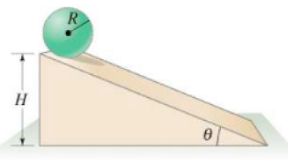
Total Kinetic Energy
But what happens if some-thing has both rotational and translational motion
This is when depression sets in
The total kinetic energy is the sum of the translational kinetic energy and the rotational kinetic energy

Slide 35
Sample Problem
The height of the ramp is 3m, the mass of the ball is 3kg, and the radius of the ball is 0.3m. What is the velocity of the ball at the bottom of the ramp?

Slide 36
Sample Problem
The height of the ramp is 3m, the mass of the ball is 3kg, and the radius of the ball is 0.3m. What is the velocity of the ball at the bottom of the ramp?
It depends
Which velocity, angular or linear?

Slide 37
Sample Problem
The height of the ramp is 3m, the mass of the ball is 3kg, and the radius of the ball is 0.3m. What is the velocity of the ball at the bottom of the ramp?

Slide 38
Question 1?
How would the situation change if I told you that there was a high coefficient of friction between the ball and the ramp?

Slide 39
Question 1?
How would the situation change if I told you that there was a high coefficient of friction between the ball and the ramp?
Not at all. In fact the situation assumes a high coefficient of friction to make the ball roll instead of slide.

Slide 40
Question 2?
How would the situation change if I told you that the ramp was frictionless?

Slide 41
Question 2?
How would the situation change if I told you that the ramp was frictionless?
The ball would slide instead of rolling. There would be no rotational kinetic energy, just translational – the same as a box sliding down a ramp.

Slide 42
Question 3?
Which would be going faster at the bottom: the ball on a high friction ramp or the ball on a frictionless ramp?

Slide 43
Question 3?
Which would be going faster at the bottom: the ball on a high friction ramp or the ball on a frictionless ramp?
The ball on the frictionless ramp. In this case, all of the potential energy is converted into translational kinetic energy. On a ramp with friction, some of the PE must be translated into rotational KE.

Slide 44
Work Done By Friction
Speaking of friction, how do you calculate the work done by friction on a ball sliding down a ramp?

Slide 45
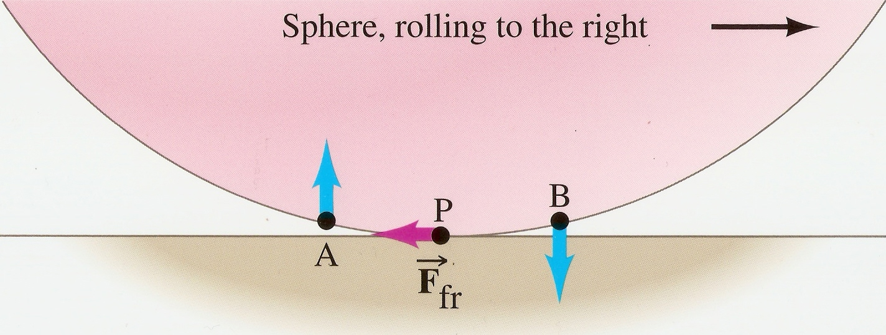
Work Done By Friction
Speaking of friction, how do you calculate the work done by friction on a ball sliding down a ramp?
Trick question – you don’t – there is no work done by friction. At the point of contact, the surface of the ball moves up, perpendicular to the force of friction. Force must be in direction of motion to do work.

Slide 46
Conservation of Energy
If a ramp has friction, is energy conserved when a ball slides down a ramp?

Slide 47
Conservation of Energy
If a ramp has friction, is energy conserved when a ball slides down a ramp?
It depends
Total energy is always conserved. Mechanical energy is not conserved because friction converts some of the potential energy to heat.

Slide 48
Conservation of Energy
If a ramp has friction, is energy conserved when a ball rolls down a ramp without slipping?

Slide 49
Conservation of Energy
If a ramp has friction, is energy conserved when a ball rolls down a ramp without slipping?
Definitely. Since friction does no work when rolling without slipping, mechanical energy is conserved in the sum of rotational and translational kinetic energy.

Slide 50
Conservation of Energy
If a ball rolls down a ramp without slipping, does it gather any moss?

Slide 51
Conservation of Energy
If a ball rolls down a ramp without slipping, does it gather any moss?
Definitely not. Everyone knows that a rolling stone (or bowling ball) gathers no moss.

Slide 52
Work Done By Torque
Does torque do work?

Slide 53
Work Done By Torque
Does torque do work?
Yes

Slide 54
Work Done By Torque
Does torque do work?
Yes
Oh, you want an explanation?

Slide 55
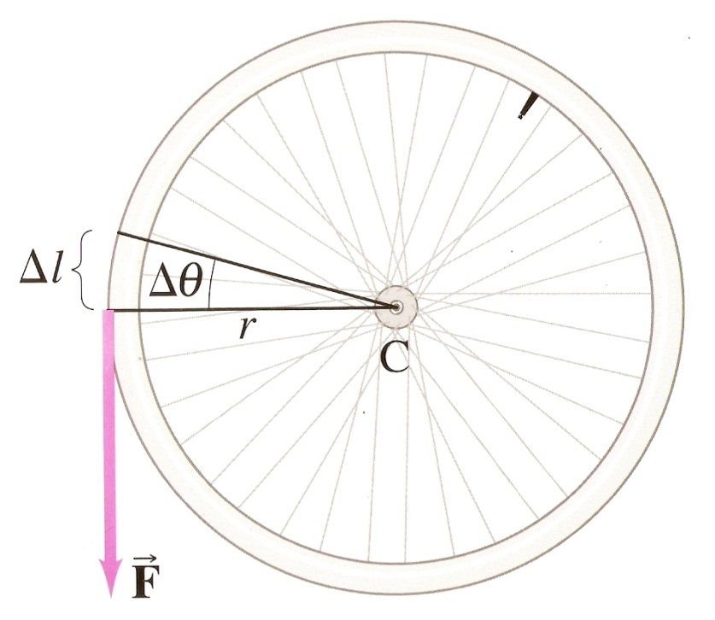
Work Done By Torque
Torque is force times a moment arm
Work is force times distance
A small amount of rotation (small Δθ) will produce a Δl and we know

Slide 56
Work Done By Torque
Torque is force times a moment arm
Work is force times distance
For small changes in θ, the force can be considered in the direction of motion so torque does work

Slide 57
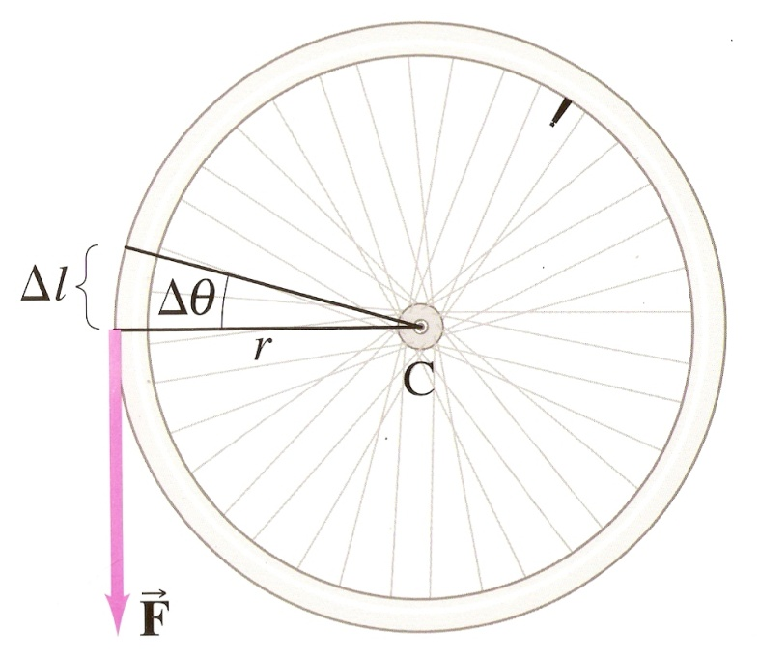
Work Done By Torque
Torque is force times a moment arm
Work is force times distance
Using the marvels of Algebra,

Slide 58
Power Generated By Torque
Power is work divided by time so,

Slide 59
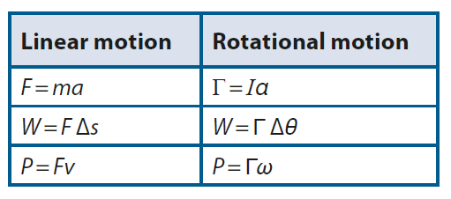
Work, Energy and Power

Slide 60
Moment of Inertia
Angular acceleration is proportional to the net torque applied to it
Force along a moment arm is torque
More force means more acceleration
F
m

Slide 61
Moment of Inertia
Everything in life relates to Newton’s Second Law
F
m

Slide 62
Moment of Inertia
Moment of Inertia defined:
Note that the moment of inertia is much more affected by distance than by mass.
Determination of the axis of rotation (reference point) is critical!
F
m

Slide 63
Moment of Inertia
Moment of Inertia defined:
This is Newton’s Second Law for rotation!
F
m

Slide 64
Angular momentum

Slide 65
Angular Momentum

Slide 66
Angular Momentum
Linear momentum
Angular momentum (L)
I = moment of inertia
ω = angular velocity

Slide 67
Angular Momentum
Newton’s Second Law
In terms of linear momentum

Slide 68
Angular Momentum
Newton’s Second Law
In terms of angular momentum and re-written in terms of torque
Στ = net torque acting to rotate the object
ΔL = change in angular momentum
Δt = time interval

Slide 69
Conservation of Angular Momentum
The total angular momentum of a rotating object remains constant if the net torque acting on it is zero

Slide 70
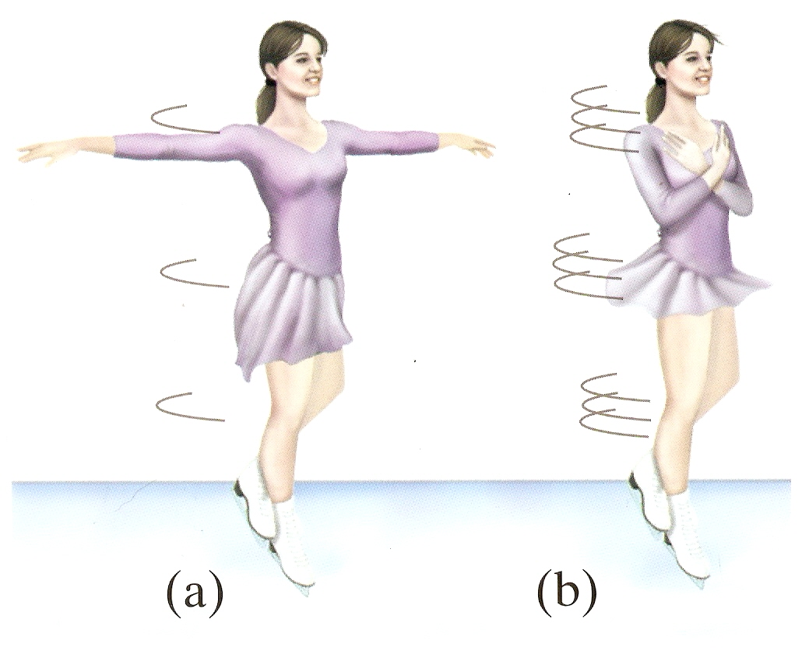
Conservation of Angular Momentum
What happens when a spinning figure skater extends and retracts her arms?

Slide 71
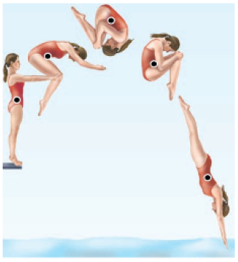
Conservation of Angular Momentum
Why does a 2 ½ in the pike position have a higher degree of difficulty than the same dive in the tuck position?

Slide 72
Conservation of Angular Momentum
For angular momentum to be conserved,
Net torque must be 0
Net force must be 0
Both a and b
Neither a nor b
It depends

Slide 73
Conservation of Angular Momentum
For angular momentum to be conserved,
Net torque must be 0
Net force must be 0
Both a and b
Neither a nor b
It depends

Slide 74
Summary Video: The Mechanical Universe-Angular Momentum

Slide 75
Guidance:
Analysis will be limited to basic geometric shapes
The equation for the moment of inertia of a specific shape will be provided when necessary
Graphs will be limited to angular displacement–time, angular velocity–time and torque–time

Slide 76
Understandings:
Torque
Moment of inertia
Rotational and translational equilibrium
Angular acceleration
Equations of rotational motion for uniform angular acceleration
Newton’s second law applied to angular motion
Conservation of angular momentum

Slide 77
Data Booklet Reference:
$Γ=Fr\sin{θ}$
$I=mr^{2}$
$Γ=Iα$
$ω=2πf$
$ω_{f}=ω_{i}+αt$
${ω_{f}}^{2}={ω_{i}}^{2}+2αθ$
$θ=ω_{i}t+\frac{1}{2}αt^{2}$
$L=Iω$
$E_{K_{rot}}=\frac{1}{2}Iω^{2}$

Slide 78
Guidance:
Analysis will be limited to basic geometric shapes
The equation for the moment of inertia of a specific shape will be provided when necessary
Graphs will be limited to angular displacement–time, angular velocity–time and torque–time

Slide 79
Applications And Skills:
Calculating torque for single forces and couples
Solving problems involving moment of inertia, torque and angular acceleration
Solving problems in which objects are in both rotational and translational equilibrium

Slide 80
Applications And Skills:
Solving problems using rotational quantities analogous to linear quantities
Sketching and interpreting graphs of rotational motion
Solving problems involving rolling without slipping

Slide 81
Essential Idea:
The basic laws of mechanics have an extension when equivalent principles are applied to rotation. Actual objects have dimensions and they require the expansion of the point particle model to consider the possibility of different points on an object having different states of motion and/or different velocities.

Slide 82
Devil Physics IB Physics
Questions?

Slide 83
Homework
#8-15

