Slide 1
Devil physics The baddest class on campus IB Physics

Slide 2
Tsokos Lesson 8-2 Thermal energy transfer

Slide 3
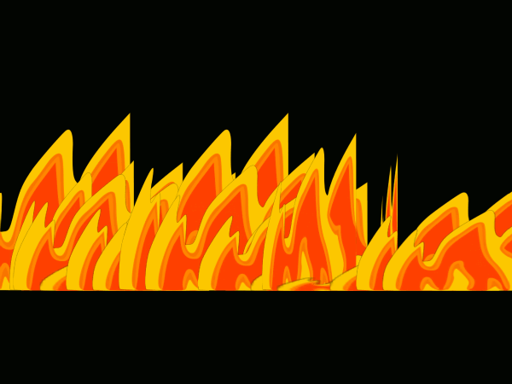
Emissivity demo

Slide 4
Essential Idea:
For simplified modeling purposes the Earth can be treated as a black-body radiator and the atmosphere treated as a grey-body.

Slide 5
Nature Of Science:
Simple and complex modeling: The kinetic theory of gases is a simple mathematical model that produces a good approximation of the behavior of real gases. Scientists are also attempting to model the Earth’s climate, which is a far more complex system. Advances in data availability and the ability to include more processes in the models together with continued testing and scientific debate on the various models will improve the ability to predict climate change more accurately.

Slide 6
International-Mindedness:
The concern over the possible impact of climate change has resulted in an abundance of international press coverage, many political discussions within and between nations, and the consideration of people, corporations, and the environment when deciding on future plans for our planet. IB graduates should be aware of the science behind many of these scenarios.

Slide 7
Theory Of Knowledge:
The debate about global warming illustrates the difficulties that arise when scientists cannot always agree on the interpretation of the data, especially as the solution would involve large-scale action through international government cooperation.
When scientists disagree, how do we decide between competing theories?

Slide 8
Understandings:
Conduction, convection and thermal radiation
Black-body radiation
Albedo and emissivity
The solar constant
The greenhouse effect
Energy balance in the Earth surface–atmosphere system

Slide 9
Applications And Skills:
Sketching and interpreting graphs showing the variation of intensity with wavelength for bodies emitting thermal radiation at different temperatures
Solving problems involving the Stefan–Boltzmann law and Wien’s displacement law

Slide 10
Applications And Skills:
Describing the effects of the Earth’s atmosphere on the mean surface temperature
Solving problems involving albedo, emissivity, solar constant and the Earth’s average temperature

Slide 11
Guidance:
Discussion of conduction and convection will be qualitative only
Discussion of conduction is limited to intermolecular and electron collisions
Discussion of convection is limited to simple gas or liquid transfer via density differences

Slide 12
Guidance:
The absorption of infrared radiation by greenhouse gases should be described in terms of the molecular energy levels and the subsequent emission of radiation in all directions
The greenhouse gases to be considered are CH4, H2O, CO2 and N2O. It is sufficient for students to know that each has both natural and man-made origins.

Slide 13
Guidance:
Earth’s albedo varies daily and is dependent on season (cloud formations) and latitude. The global annual mean albedo will be taken to be 0.3 (30%) for Earth.

Slide 14
Data Booklet Reference:

Slide 15
Utilization:
Climate models and the variation in detail/processes included
Environmental chemistry (see Chemistry option topic C)
Climate change (see Biology sub-topic 4.4 and Environmental systems and societies topics 5 and 6)
The normal distribution curve is explored in Mathematical studies SL sub-topic 4.1

Slide 16
Aims:
Aim 4: this topic gives students the opportunity to understand the wide range of scientific analysis behind climate change issues
Aim 6: simulations of energy exchange in the Earth surface–atmosphere system

Slide 17
Aims:
Aim 8: while science has the ability to analyse and possibly help solve climate change issues, students should be aware of the impact of science on the initiation of conditions that allowed climate change due to human contributions to occur. Students should also be aware of the way science can be used to promote the interests of one side of the debate on climate change (or, conversely, to hinder debate).

Slide 18
Introductory Video

Slide 19
Reading Activity Questions?

Slide 20
Thermal Energy Transfer
Three Types:
Conduction
Convection
Radiation

Slide 21
Thermal Energy Transfer
Three Types:
Conduction: high temperature on one side of a solid mean electrons have higher kinetic energy and molecules a higher vibrational energy. Electrons pass kinetic energy through collisions, molecules by ‘tugging’ along molecular bonds
Convection
Radiation

Slide 22
Thermal Energy Transfer
Three Types:
Conduction
Convection: heat transfer through a liquid or gas due to expansion
Radiation

Slide 23
Thermal Energy Transfer
Three Types:
Conduction
Convection
Radiation: only transfer method that doesn’t require a medium, it involves the emittance and absorption of electromagnetic energy

Slide 24
Black Body Law
All bodies that are kept at some absolute (Kelvin) temperature radiate energy in the form of electromagnetic waves
The power radiated by a body is governed by the Stefan-Boltzmann Law

Slide 25
Stefan-Boltzmann Law
The amount of energy per second (power) radiated by a body depends on its surface area A, absolute (Kelvin) temperature T, and the properties of the surface (emissivity, e)
This is the Stefan-Boltzmann Law
σ is the Stefan-Boltzmann constant

Slide 26
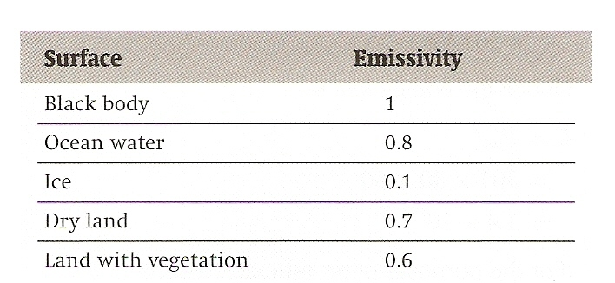
Emissivity
Dimensionless number from 0 to 1 that states a surface’s ability to radiate energy
For a theoretical perfect emitter, a black body, e = 1
Dark and dull surfaces will have a higher emissivity
Light and shiny surfaces will have a lower emissivity

Slide 27
Emissivity demo

Slide 28
Net Power
A body that radiates power will also absorb power with the same emissivity values
Net power is the difference between the two
At equilibrium, P_{net} = 0 and the body loses as much energy as it gains, the temperature remains constant and equal to its surroundings

Slide 29
Net Power
At equilibrium, Pnet = 0 and the earth as a system maintains constant average temperature
If the power absorbed is greater than the power radiated, the earth system increases in temperature

Slide 30
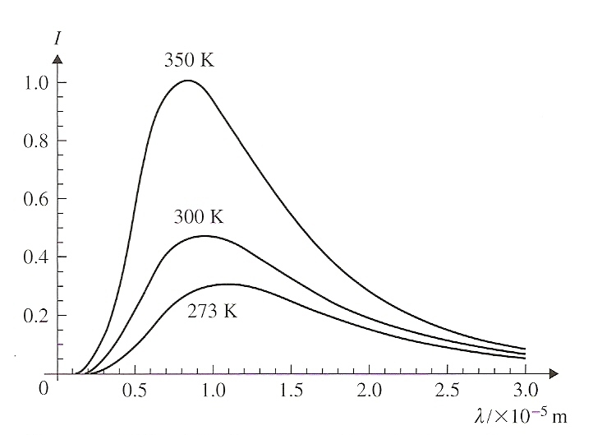
Emitted Radiation Wavelength
Black-body radiation is emitted over an infinite range of wavelengths, BUT
Most is emitted at a specific wavelength depending on the body’s temperature
Higher temperature, lower wavelength, higher frequency

Slide 31
Emitted Radiation Wavelength
Most of the energy emitted is an infrared wavelength
That is why we associate emitted radiation with heat

Slide 32
Wien’s Law
The relationship between the peak temperature and the peak wavelength (wavelength at which most of the energy is emitted) is given by

Slide 33
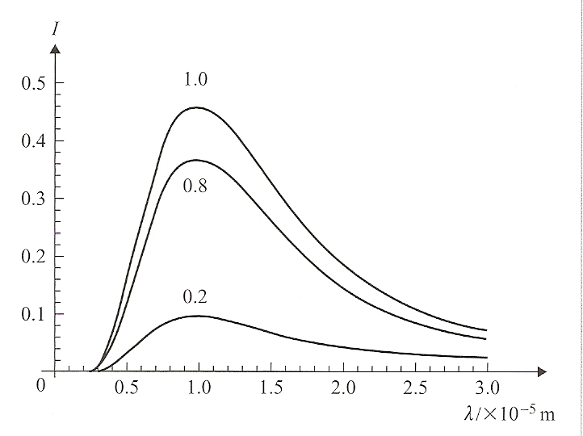
Emitted Radiation vs Emissivity
Graph of intensity versus wavelength for bodies with the same temperature, but different values of emissivity
Peak of the curve remains the same, but slope of the curve increases with increased emissivity

Slide 34
Solar Radiation
Sun is considered a perfect emitter, i.e. a black-body
Sun’s power output is 3.9 x 10²⁶ W
The earth receives only a small fraction of this power equal to
Where a is the area used to collect the power and d is the earth-to-sun distance

Slide 35
Intensity
Power of radiation received per unit area of the receiver

Slide 36
Solar Constant
Substituting values into the intensity equation we get
Which is the solar constant, S
S ≈ 1400 Wm⁻²
This is the intensity of the sun reaching the earth’s atmosphere, NOT the surface!

Slide 37
Solar Constant
If intensity is power per unit area, then power received is equal to intensity times the area of the receiver

Slide 38
Albedo
Ratio of radiation power reflected to the power incident on a body
Light-colored, shiny objects have a high albedo, dark and dull objects have low albedo
The earth as a whole has an average albedo of 0.3

Slide 39
Emissivity
Dimensionless number from 0 to 1 that states a surface’s ability to radiate energy
For a theoretical perfect emitter, a black body, e = 1
Dark and dull surfaces will have a higher emissivity
Light and shiny surfaces will have a lower emissivity

Slide 40
Emissivity demo

Slide 41
Intermediate Summary
A portion of the Sun’s power reaches the earth
Part of that power is reflected, part is absorbed (≈ 30%/70%)
When a body absorbs energy, the kinetic energy of its molecules increases and temperature increases
All bodies emit black body radiation which is proportional to temperature
Constant temperature occurs when P_{net} = 0

Slide 42
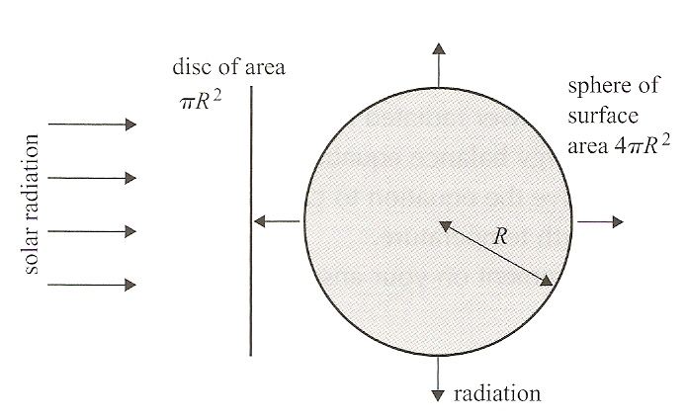
Radiation Reaching the Earth
The solar constant,
S = 1400 W/m², is the
amount of solar power
striking a given area of
the atmosphere
At any given time, the area of the earth’s surface exposed to this radiation is equal to the area of a circle, πR², using the radius of the earth

Slide 43
Radiation Reaching the Earth
The total surface area
of a sphere is 4πR², so
the ‘exposure’ area is
only 1/4th the surface
area of the earth
Therefore, the radiation
received per square
meter on the surface of
the earth at any given
time is,

Slide 44
Radiation Reaching the Earth
Since 30% of this energy
is reflected (albedo = 0.3,
the actual radiation the
Earth’s surface receives
at any given moment is

Slide 45
Energy Balance
The earth has a more or less constant average temperature and behaves like a black body
Therefore, the energy input to the earth must equal (balance) the energy radiated into space

Slide 46
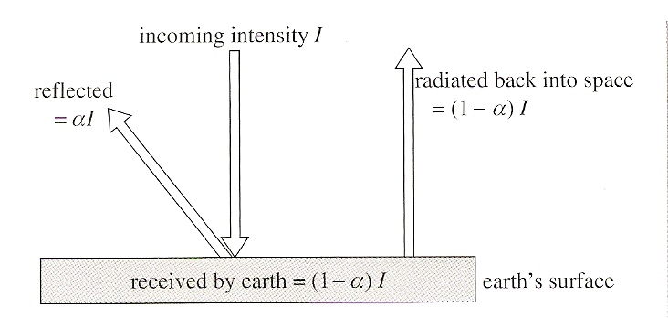
Energy Balance
Simplified Energy Diagram

Slide 47
Energy Balance
Problems with the Simplified Energy Diagram
Not all of the earth’s radiated energy escapes the atmosphere
Some of the energy is absorbed by the atmosphere and re-radiated back toward the earth (this is the greenhouse effect)

Slide 48
Energy Balance
Problems with the Simplified Energy Diagram
Model fails to consider other interactions with the atmosphere:
Latent heat flows
Thermal energy flows in oceans by currents
Thermal energy transfers (essentially conduction) between the surface and the atmosphere due to temperature differences

Slide 49
Greenhouse Effect
Most of the solar radiation reaching earth is in the visible wavelength band
The atmosphere only reflects about 30% of this
The average temperature of the earth’s surface is 288K
Using Wien’s Law, the radiation emitted by the earth is in the infrared wavelength range

Slide 50
Greenhouse Effect
Remember from the photoelectric effect and quantum physics that energy is dependent on wavelength and molecular energy absorption and emission are dependent on energy levels
Certain gases in the atmosphere (greenhouse gases) will allow the sun’s visible light to pass through, but will absorb the earth’s radiated infrared energy (emission/absorption spectrum)

Slide 51
Greenhouse Effect
The absorbed energy is quickly re-radiated in all directions (as from a sphere)
Some of that energy is re-radiated back to the earth’s surface providing added warmth

Slide 52
Greenhouse Effect
The Greenhouse Effect is a good thing
With the greenhouse effect the average temperature is 288 K / 15°C / 59°F
Without the greenhouse effect the average temperature is estimated to be 256 K / -17°C / 1°F
Primary greenhouse gases are water vapour, carbon dioxide, methane and nitrous oxide

Slide 53
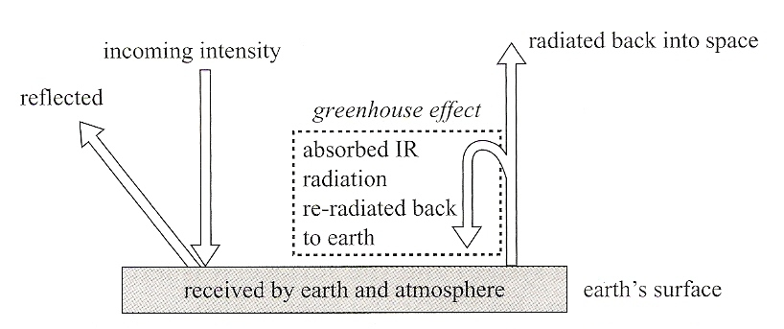
Greenhouse Effect
Energy Diagram Including Greenhouse Effect

Slide 54
Greenhouse Effect
Even this diagram doesn’t include:
Latent heat flows
Thermal energy flows in oceans by currents
Thermal energy transfers (essentially conduction) between the surface and the atmosphere due to temperature differences

Slide 55
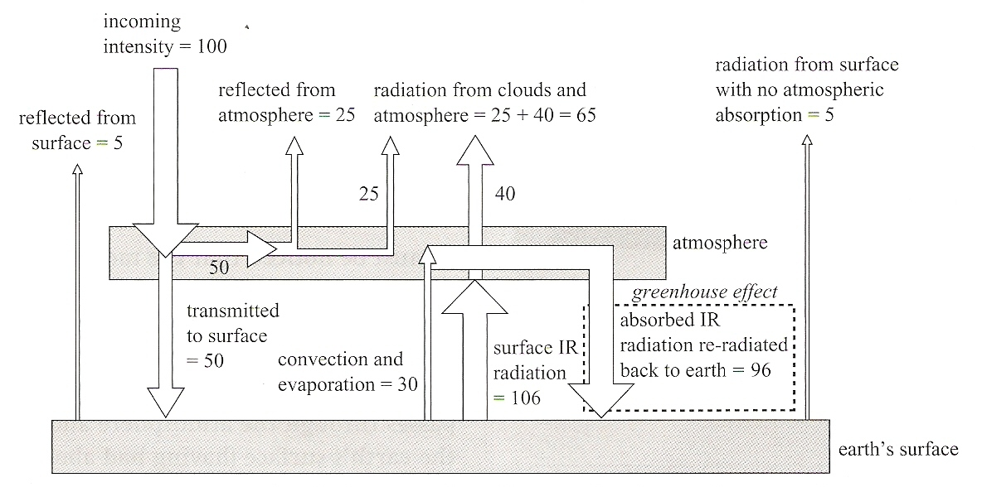
Greenhouse Effect
All-Encompassing Energy Diagram

Slide 56
Enhanced Greenhouse Effect
Unlike laundry detergent, enhanced is not necessarily better
Greenhouse gases keep the earth warm and toasty, but if we increase the amount of greenhouse gases, the place gets downright hot
More greenhouse gases means more energy radiated from the atmosphere back to the earth which means higher temperatures

Slide 57
Enhanced Greenhouse Effect
Greenhouse gases have natural as well as anthropogenic (geek speak for man-made) sources

Slide 58
Enhanced Greenhouse Effect

Slide 59
Enhanced Greenhouse Effect
On the upside, there are sinks (mechanisms for removal) for greenhouse gases
Carbon dioxide absorbed by plants during photosynthesis and dissolved in oceans
Methane is destroyed in lower atmosphere by chemical reactions with hydroxyl radicals
Nitrous oxide destroyed in the atmosphere by photochemical reactions

Slide 60
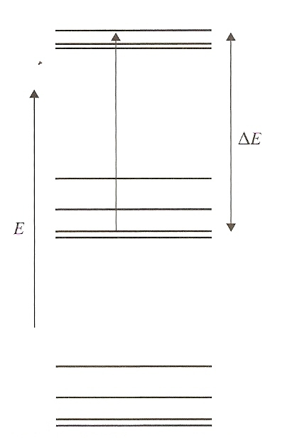
Mechanism of Photon Absorption
Energy of molecules due to their vibrational and rotational motion is quantized like the energy levels of electrons
In greenhouse gases, the energy levels of the molecules corresponds to the energies of the infrared photons

Slide 61
Mechanism of Photon Absorption
Molecules will absorb these photons and be excited to higher energy levels
GG molecules, however, are a lot like an IB student on a Saturday morning, i.e. they prefer the lower energy state and emit the photon back out into the atmosphere

Slide 62
Mechanism of Photon Absorption
The atoms of a GG molecule can be thought of as being connected by bi-directional springs
The molecules oscillate back and forth at their natural frequency
Photons traveling (wave properties) with a frequency close to the natural frequency of a molecule will be absorbed

Slide 63
Remaining slides are Extended information – time permitting

Slide 64
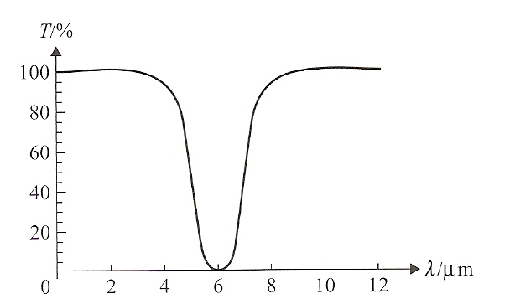
Transmittance Curves
Transmittance curves show what percent of radiation will be transmitted through a gas without absorption for a given wavelength

Slide 65
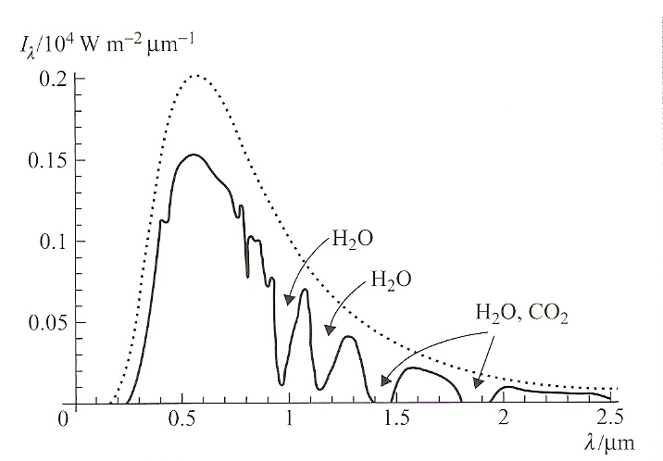
Transmittance Curves
This curve shows the sun’s intensity that is incident on the atmosphere (dotted line) and what is actually observed on the earth surface (solid line)

Slide 66
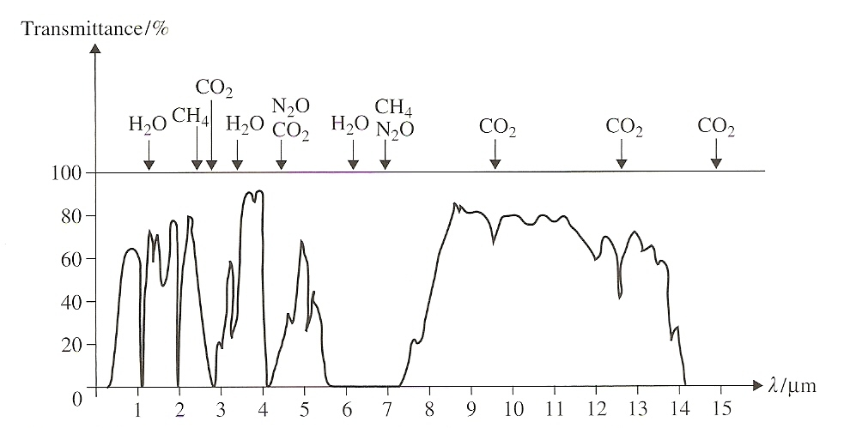
Transmittance Curves
This curve shows the transmittance of the earth’s infrared radiation and the gases that absorb the energy at various wavelengths

Slide 67
Surface Heat Capacity (C_{S})
The energy required to increase the temperature of 1 m² of a surface by 1 K

Slide 68
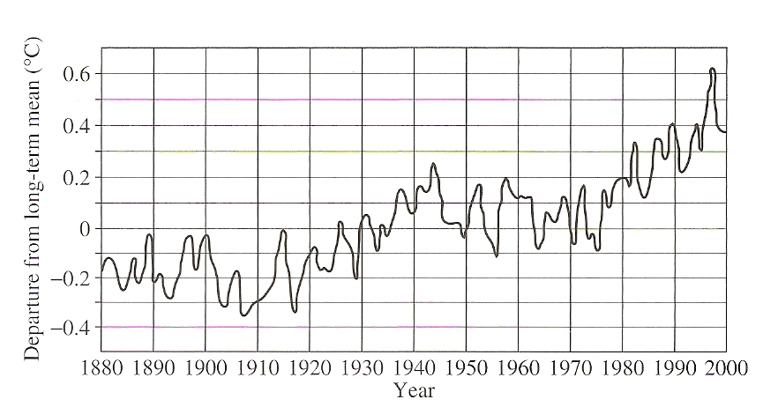
Global Warming
Graph below shows deviation of the earth’s global average surface temperature from the expected long-term average

Slide 69
Global Warming
The graph shows that concentrations of carbon monoxide, methane, and nitrous oxide in the atmosphere have shown a dramatic increase
This corresponds to the temperature increases shown in the previous slide
This data is supported by analysis of ice cores from Antarctica and Greenland that show a correlation between greenhouse gas concentrations and atmospheric temperature

Slide 70
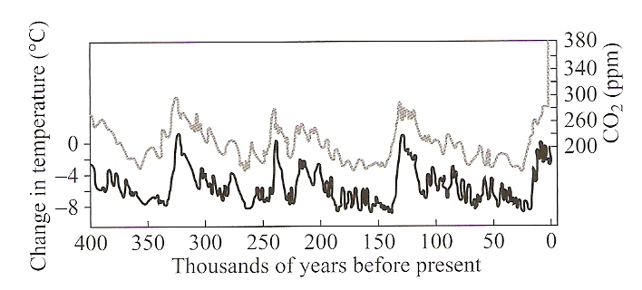
Global Warming
The graph below shows global average temperatures and CO2 concentrations over the last 400,000 years relative to present temperatures and levels

Slide 71
Global Warming - Questions
What is the best estimate for the temperature increase over a given period of time?
What will be the effects of a higher temperature on the amount of rainfall?
How much ice will melt?
What will be the rise in sea level?
Will there be areas of extra dryness and drought and if so, where will they be?

Slide 72
Global Warming - Questions
Will the temperature of the oceans be affected and if so, by how much?
Will ocean currents be affected and if so, how?
Will there be periods of extreme climate variability?
Will the frequency and intensity of tropical storms increase?
What is the effect of sulphate aerosols in the atmosphere? Do they offset global warming?

Slide 73
Global Warming - Questions
What are the feedback mechanisms affecting global climate?
Can the observed temperature increase be blamed on greenhouse gases exclusively?
Given the long lifetime of carbon dioxide in the atmosphere, can the process of global warming be reversed even if present emissions are drastically reduced?

Slide 74
Global Warming - Questions
What are the ecological implications of the expected changes in the habitats of many species?
What will be the effects on agriculture?
Will there be more diseases?
What are the social and economic effects of all of the above?
Will it be enough to keep people from Ohio from coming to Florida to complain?

Slide 75
Global Warming – Other Possibilities
Increased solar activity
Increased greenhouse gases due to volcanic activity
Changes in the earth’s orbit (both eccentricity and tilt)

Slide 76
Global Warming – Other Possibilities
Spike in the cycle

Slide 77
Sea Level
Sea level varies naturally due to:
Atmospheric pressure
Plate tectonic movements
Wind
Tides
River flow
Changes in salinity
Etc.

Slide 78
Sea Level
Changes in sea level affect the amount of water that can evaporate and the amount of thermal energy that can be exchanged with the atmosphere.
In addition, changes in sea level affect ocean currents.
The presence of these currents is vital in transferring thermal energy from the warm tropics to colder regions.

Slide 79
Melting Ice
Important to distinguish between land ice and sea ice
Melting sea ice will not change sea levels (thanks Mr. Archimedes)
Land ice will result in an increase in sea level
Overall, warmer temperatures result in a rise in sea level due to melted land ice and the expansion of water due to warmer temperatures

Slide 80
Melting Ice
Remember the anomalous behavior of water between 0° and 4°C?
As it is heated from 0° to 4°C, it will contract, then expand as temperature exceeds 4°C
The change in volume of a given mass of water is given by,

Slide 81
Melting Ice
The change in volume of a given mass of water is given by,
The coefficient of thermal expansion, γ, for water is dependent on temperature
Thus, the change in volume will be different, even if the temperature change (Δθ) is the same depending on the initial temperature

Slide 82
Effects of Global Warming on Climate
Higher average global temperature means a higher sea level
Higher sea level means greater area covered by water (low albedo), less area covered by land (higher albedo)
This lowers the overall earth albedo which means more energy is absorbed which in turn increases temperature
This is an example of a positive feedback mechanism

Slide 83
Effects of Global Warming on Climate
Higher sea level means increase in evaporation rate
Cooling of earth’s surface due to more energy removed for evaporation process
More cloud cover which means more reflected energy which means more cooling
More precipitation – may promote more vegetation
Another example of a negative feedback mechanism

Slide 84
Effects of Global Warming on Climate
Higher water temperatures decreases ability of sea water to dissolve carbon dioxide
More carbon dioxide in the atmosphere enhances the enhanced greenhouse effect and increases temperature

Slide 85
Effects of Global Warming on Climate
Do we really need to save the rainforests?
Rainforests absorb carbon dioxide
But that carbon dioxide is released when the trees die and decompose
Rainforests produce methane which is a greenhouse gas that enhances the enhanced greenhouse effect
In general, cutting down a rainforest will increase albedo which will lower temperatures

Slide 86
Measures to Reduce Global Warming
Focus is on reducing carbon dioxide
Fuel efficient, hybrid and electric cars
Increase efficiency of coal-burning power plants
Replace coal-burning with natural gas-fired power plants
Consider methods of capturing and storing the carbon dioxide produced in power plants
Increasing the amounts of power produced by wind and solar generators
Increased use of nuclear power

Slide 87
Measures to Reduce Global Warming
Focus is on reducing carbon dioxide
Being energy conscious with buildings, appliances, transportation, industrial processes and entertainment
Stopping deforestation

Slide 88
Fool-Proof Methods of Reducing Greenhouse Gas Production
Global Ban on Mexican Food
Global Ban on all Forms of Exercise
Limit Political Speeches to 2 minutes
Increase sleep rates by 80%
Eliminate undesirables
And the measure with the highest potential for success . . .

Slide 89
Fool-Proof Methods of Reducing Greenhouse Gas Production
Global Ban on Mexican Food
Global Ban on all Forms of Exercise
Limit Political Speeches to 2 minutes
Increase sleep rates by 80%
Eliminate undesirables
World-Wide Hold Your Breath Day

Slide 90
Understandings:
Conduction, convection and thermal radiation
Black-body radiation
Albedo and emissivity
The solar constant
The greenhouse effect
Energy balance in the Earth surface–atmosphere system

Slide 91
Guidance:
Discussion of conduction and convection will be qualitative only
Discussion of conduction is limited to intermolecular and electron collisions
Discussion of convection is limited to simple gas or liquid transfer via density differences

Slide 92
Guidance:
The absorption of infrared radiation by greenhouse gases should be described in terms of the molecular energy levels and the subsequent emission of radiation in all directions
The greenhouse gases to be considered are CH4, H2O, CO2 and N2O. It is sufficient for students to know that each has both natural and man-made origins.

Slide 93
Guidance:
Earth’s albedo varies daily and is dependent on season (cloud formations) and latitude. The global annual mean albedo will be taken to be 0.3 (30%) for Earth.

Slide 94
Data Booklet Reference:

Slide 95
Essential Idea:
For simplified modeling purposes the Earth can be treated as a black-body radiator and the atmosphere treated as a grey-body.

Slide 96
Questions?

Slide 97
Homework
#26-44

