Slide 1
Devil physics The baddest class on campus IB Physics

Slide 2
Tsokos Lesson 7-2 Nuclear reactions

Slide 3
Review Videos-Radioactivity2

Slide 4
Review Videos - Strong and Weak Nuclear Forces

Slide 5
Essential Idea:
Energy can be released in nuclear decays and reactions as a result of the relationship between mass and energy.

Slide 6
Nature Of Science:
Patterns, trends and discrepancies: Graphs of binding energy per nucleon and of neutron number versus proton number reveal unmistakable patterns.
This allows scientists to make predictions of isotope characteristics based on these graphs.

Slide 7
Theory Of Knowledge:
The acceptance that mass and energy are equivalent was a major paradigm shift in physics.
How have other paradigm shifts changed the direction of science?
Have there been similar paradigm shifts in other areas of knowledge?

Slide 8
Understandings:
The unified atomic mass unit
Mass defect and nuclear binding energy
Nuclear fission and nuclear fusion

Slide 9
Applications And Skills:
Solving problems involving mass defect and binding energy
Solving problems involving the energy released in radioactive decay, nuclear fission and nuclear fusion

Slide 10
Applications And Skills:
Sketching and interpreting the general shape of the curve of average binding energy per nucleon against nucleon number

Slide 11
Guidance:
Students must be able to calculate changes in terms of mass or binding energy
Binding energy may be defined in terms of energy required to completely separate the nucleons or the energy released when a nucleus is formed from its nucleons

Slide 12
Data Booklet Reference:

Slide 13
Utilization:
Our understanding of the energetics of the nucleus has led to ways to produce electricity from nuclei but also to the development of very destructive weapons
The chemistry of nuclear reactions (see Chemistry option sub-topics C.3 and C.7)

Slide 14
Aims:
Aim 5: some of the issues raised by the use of nuclear power transcend national boundaries and require the collaboration of scientists from many different nations

Slide 15
Aims:
Aim 8: the development of nuclear power and nuclear weapons raises very serious moral and ethical questions:
who should be allowed to possess nuclear power and nuclear weapons?
who should make these decisions?
There also serious environmental issues associated with the nuclear waste of nuclear power plants.

Slide 16
Define the unified mass unit (u)
Equal to 1/12 of the mass of a Carbon-12 atom
Mass of a mole of Carbon-12 is 12g
Avogadro's number gives atoms per mole
Therefore the mass of a Carbon-12 atom is

Slide 17
Define the unified mass unit (u)
Equal to 1/12 of the mass of a Carbon-12 atom
So 1 atomic mass unit is:

Slide 18
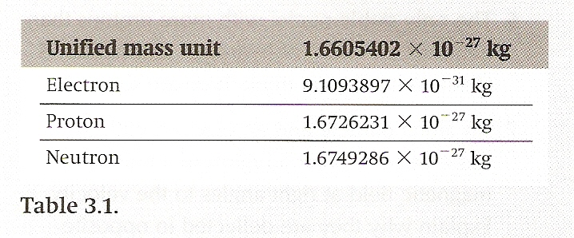
Define the unified mass unit (u)
Find the mass of an electron, proton and neutron in amu’s

Slide 19
Define the unified mass unit (u)
Find the mass of an electron, proton and neutron in amu’s
Electron: 0.0005486 u
Proton: 1.007276 u
Neutron: 1.008665 u

Slide 20
State the meaning of the terms mass defect and binding energy and solve related problems
The mass of the nucleus is equal to the atomic mass minus the mass of the electrons:
The atomic mass is given by the periodic table and the electron mass is given in the previous table

Slide 21
State the meaning of the terms mass defect and binding energy and solve related problems
The mass of a helium nucleus would thus be:
However, if we add the masses of the individual nucleons we get:
What’s up with that?

Slide 22
State the meaning of the terms mass defect and binding energy and solve related problems
The mass of the protons plus the mass of the neutrons is larger than the atomic mass
The difference between the two is called the mass defect

Slide 23
State the meaning of the terms mass defect and binding energy and solve related problems
Find the mass defect of a gold nucleus in amu’s if the atomic mass given on the periodic table is 196.967 u

Slide 24
State the meaning of the terms mass defect and binding energy and solve related problems
Find the mass defect of a gold nucleus in amu’s if the atomic mass given on the periodic table is 196.967 u

Slide 25
State the meaning of the terms mass defect and binding energy and solve related problems
Find the mass defect of a gold nucleus in amu’s if the atomic mass given on the periodic table is 196.967 u

Slide 26
State the meaning of the terms mass defect and binding energy and solve related problems
Find the mass defect of a gold nucleus if the atomic mass given on the periodic table is 196.967 u
Answer: 1.67 u which is the equivalent of 1.7 neutrons

Slide 27
State the meaning of the terms mass defect and binding energy and solve related problems
Einstein’s mass-energy formula
What happened to the missing mass?
Einstein said, “No worries, it’s all relative.”
His theory of special relativity states that mass and energy are equivalent and can be converted into each other.
Throw a match into a bucket of gasoline and note the conversion of mass into energy BUT, this reaction is not reversible!

Slide 28
State the meaning of the terms mass defect and binding energy and solve related problems
Einstein’s mass-energy formula
Conversion of energy into mass is not as common, but explains why photons have momentum
The mass defect of the nucleus has been converted into energy – binding energy (E_{b}) – and is stored in the nucleus

Slide 29
State the meaning of the terms mass defect and binding energy and solve related problems
Binding Energy
The binding energy of a nucleus is the work (energy) required to completely separate the nucleons of a nucleus
The work required to remove one nucleon from the nucleus is very roughly the binding energy divided by the number of nucleons
More importantly, the binding energy of a nucleus is a measure of how stable it is – higher the binding energy, the more stable the nucleus is

Slide 30
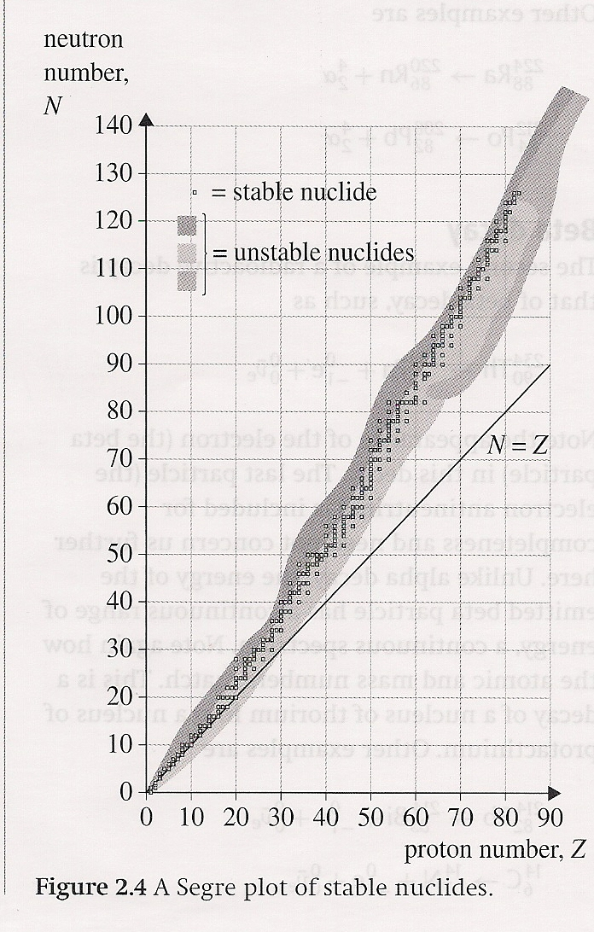
Segre Plots
At low Z numbers, stable nuclides have N = Z
At higher Z numbers, N > Z

Slide 31
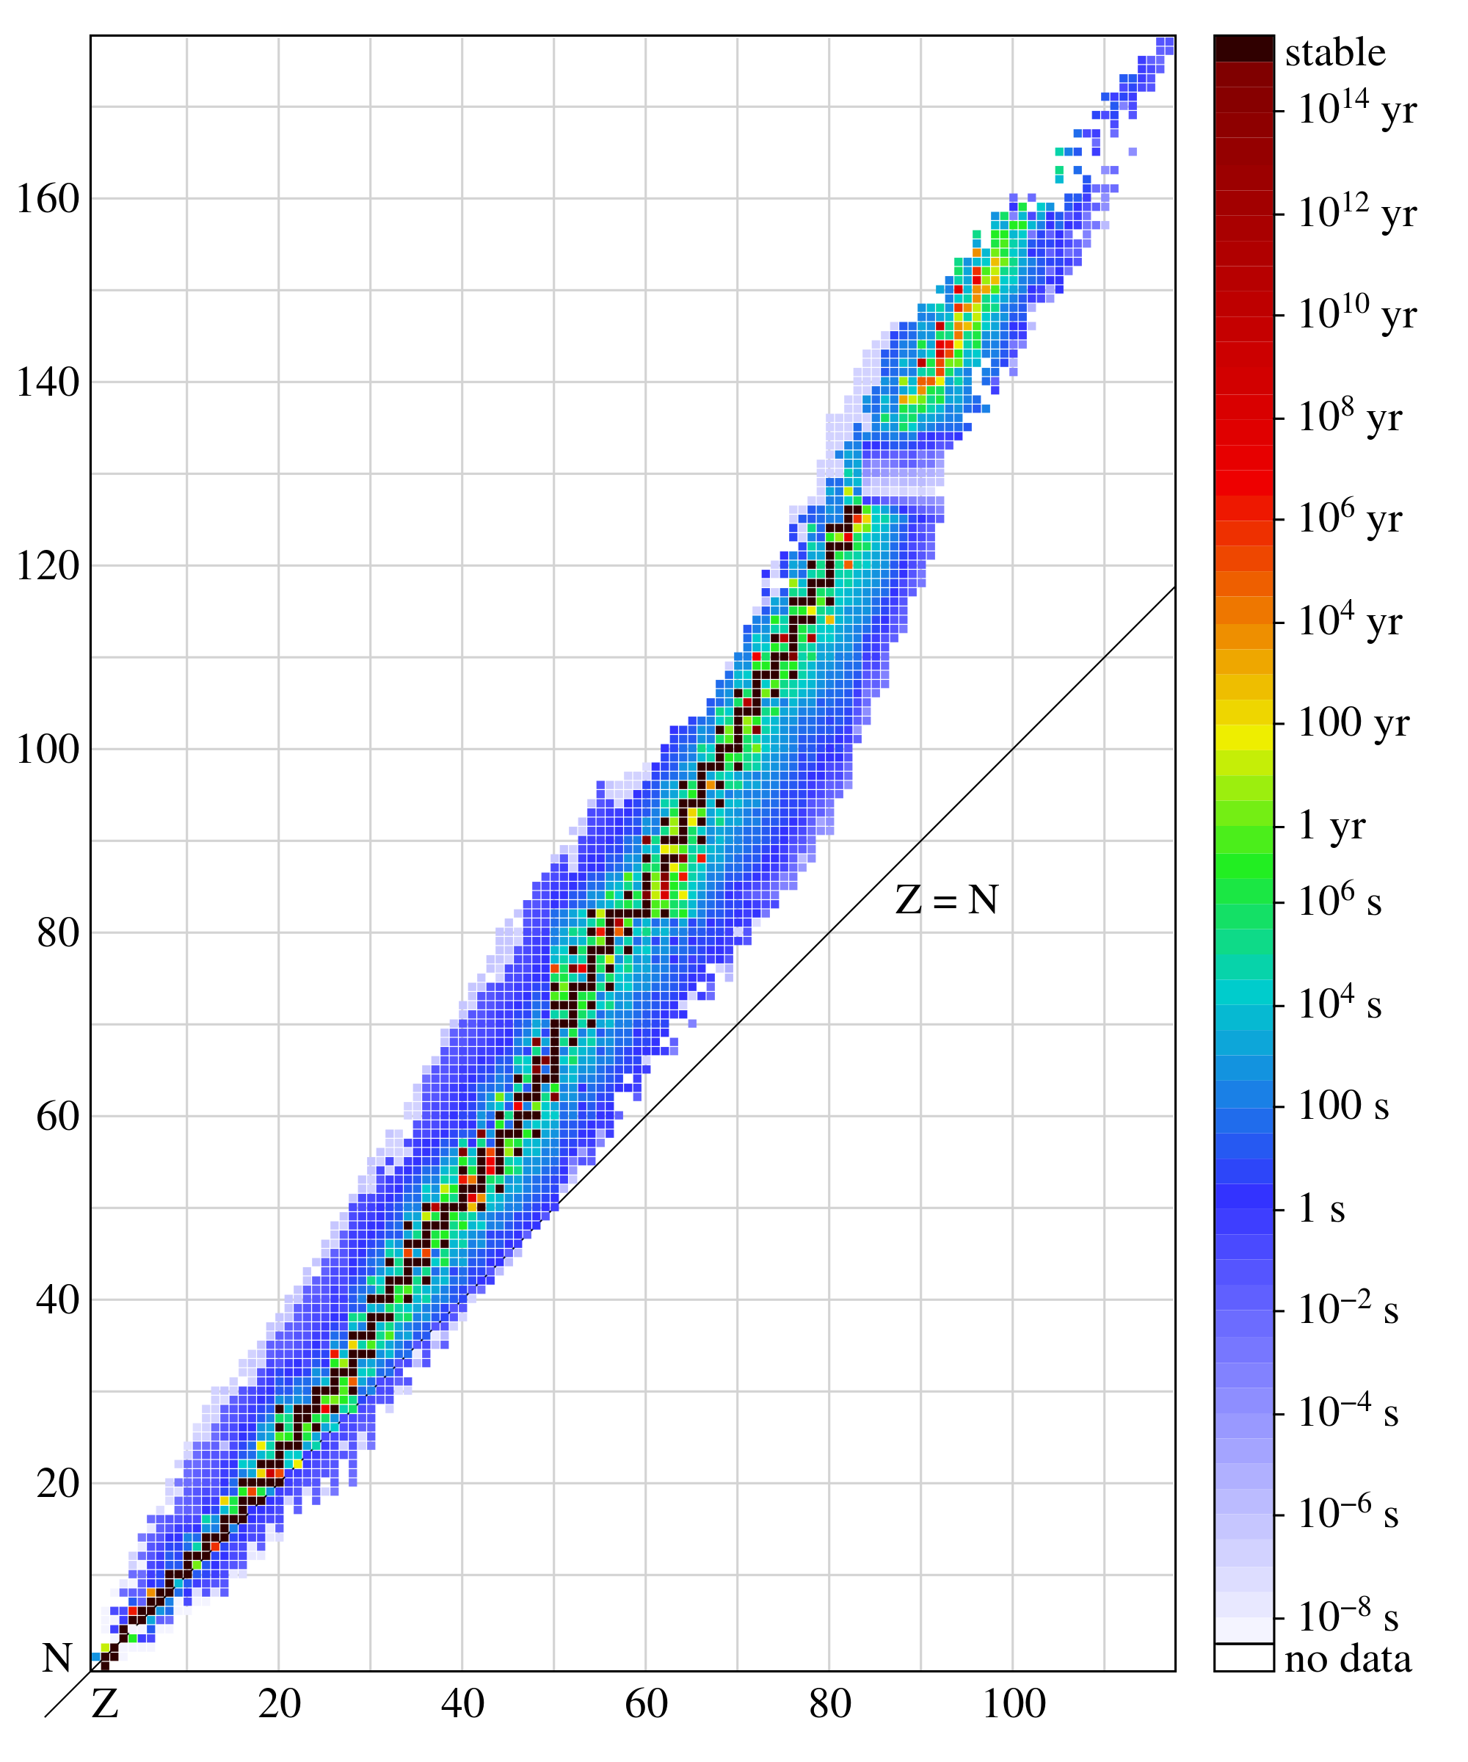
Segre Plots
Most nuclides are unstable
Unstable nuclides emit particles that carry energy away from the nucleus
This is called radioactivity

Slide 32
State the meaning of the terms mass defect and binding energy and solve related problems
How much binding energy is there in 1u of mass defect?

Slide 33
State the meaning of the terms mass defect and binding energy and solve related problems
How much binding energy is there in 1u of mass defect?

Slide 34
State the meaning of the terms mass defect and binding energy and solve related problems
How much binding energy is there in 1u of mass defect?
Converting this to electronvolts:

Slide 35
State the meaning of the terms mass defect and binding energy and solve related problems
This gives us an important relationship – the binding energy per unit of mass defect
What is the binding energy of a helium nucleus?

Slide 36
State the meaning of the terms mass defect and binding energy and solve related problems
What is the binding energy of a helium nucleus?
Recall that the mass defect of helium is 0.0304u
This is extremely high and explains why alpha particles are emitted when unstable nuclei decay

Slide 37
State the meaning of the terms mass defect and binding energy and solve related problems
What is the binding energy per nucleon of a helium nucleus?
Most nuclei have a binding energy per nucleon of approximately 7-9 MeV
The following chart shows binding energy per nucleon vs. number of nucleons

Slide 38
Understand the meaning of the graph of binding energy per nucleon versus mass number

Slide 39
Understand the meaning of the graph of binding energy per nucleon versus mass number

Slide 40
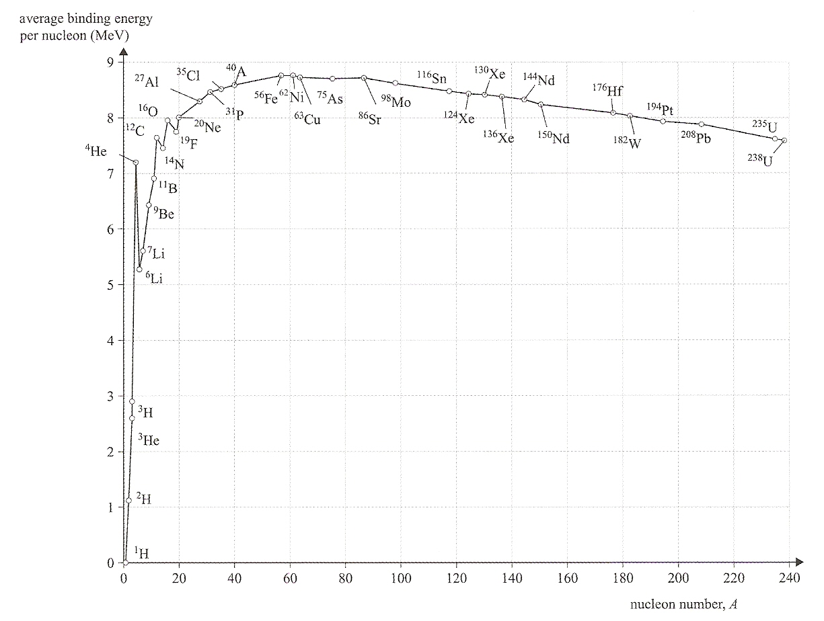
Understand the meaning of the graph of binding energy per nucleon versus mass number

Slide 41
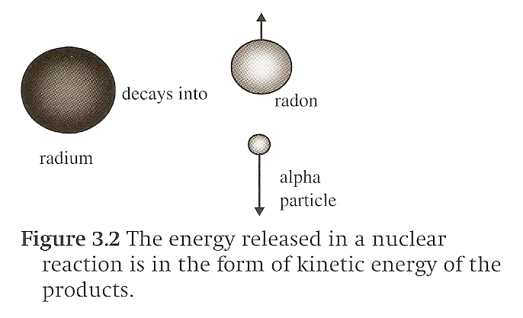
Energy released in a decay
Consider this decay of radium into radon plus an alpha particle:
The mass/energy to the left of the arrow must equal the mass/energy to the right of the arrow – including kinetic energy

Slide 42
Energy released in a decay
Consider this decay of radium into radon plus an alpha particle:
Energy is based on nuclear mass, not atomic mass, but since the atomic number is conserved here (no loss of electrons) and since we are only interested in mass differences, we can use atomic mass
i.e. electron mass will cancel out and not affect the mass difference

Slide 43
Energy released in a decay
Consider this decay of radium into radon plus an alpha particle:
If energy is to be released in this reaction, the mass of the radium atom must be greater than the mass of the radon atom plus the mass of the alpha particle
Difference in masses provides kinetic energy
Assume the radium atom is at rest

Slide 44
Energy released in a decay
Consider this decay of radium into radon plus an alpha particle:
Mass of radium = 226.0254 u
Mass of radon = 222.0176 u
+ Mass of helium = 4.0026 u
Sum = 226.0202 u
Mass difference = 0.0052 u

Slide 45
Energy released in a decay
Consider this decay of radium into radon plus an alpha particle:
Mass difference = 0.0052 u
The energy released in this decay is

Slide 46
Energy released in a decay
Consider this decay of radium into radon plus an alpha particle:
The energy released in one decay is 4.84 MeV
What is the energy release by 50-g of radium?

Slide 47
Energy released in a decay
Consider this decay of radium into radon plus an alpha particle:
The energy released in one decay is 4.84 MeV
What is the energy release by 50-g of radium?

Slide 48
Energy released in a decay
Consider this decay of radium into radon plus an alpha particle:
What happens to the energy
released by 50-g of radium? Use
conservation of momentum and
assume they go in opposite
directions.

Slide 49
Energy released in a decay
Consider this decay of radium into radon plus an alpha particle:

Slide 50
Write nuclear reaction equations and balance the atomic and mass numbers
Consider a reaction in which the mass on the left side is less than the mass on the right side. Can this occur?

Slide 51
Write nuclear reaction equations and balance the atomic and mass numbers
Consider a reaction in which the mass on the left side is less than the mass on the right side. Can this occur?
Yes. Consider:
While the atomic numbers and mass numbers are balanced, the masses are not.
The sum of the nucleon masses on the left is 18.0057 while the sum on the right is 18.0070

Slide 52
Write nuclear reaction equations and balance the atomic and mass numbers
Consider a reaction in which the mass on the left side is less than the mass on the right side.
The mass on the left is 18.0057u
The mass on the right is 18.0070u
The reaction can only occur if the alpha particle has enough kinetic energy to overcome the mass difference and the kinetic energy that will result from the reaction.

Slide 53
Write nuclear reaction equations and balance the atomic and mass numbers
Reaction of 4 particles
Energy release/requirements given by the mass difference:
Energy will be released if Δm is positive
Energy is required if Δm is negative

Slide 54
Write nuclear reaction equations and balance the atomic and mass numbers
The amount of energy released is given by:

Slide 55
Summary – Part A
Define the unified mass unit
State the meaning of the terms mass defect and binding energy and solve related problems
Understand the meaning of the graph of binding energy per nucleon versus mass number
Write nuclear reaction equations and balance the atomic and mass numbers

Slide 56
Summary – Part B
State the meaning of and difference between fission and fusion
Understand that nuclear fusion takes place in the core of the stars
Solve problems of fission and fusion reactions

Slide 57
State the meaning of and difference between fission and fusion

Slide 58
State the meaning of and difference between fission and fusion
Nuclear fission is the process in which a heavy nucleus splits into lighter nuclei
A typical reaction occurs when the nucleus of U-235 absorbs an extra neutron to become U-236
This “triggers” the reaction by making the U-235 more unstable

Slide 59
State the meaning of and difference between fission and fusion
This occurs only momentarily as the atom then splits into lighter nuclei
One of several possibilities is,

Slide 60
State the meaning of and difference between fission and fusion
Note that in this reaction, three neutrons are released
These three neutrons have enough energy to start three more reactions
Those three start another three each and the result is a chain reaction

Slide 61
State the meaning of and difference between fission and fusion
A minimum mass is required to start a chain reaction
This is known as the critical mass

Slide 62
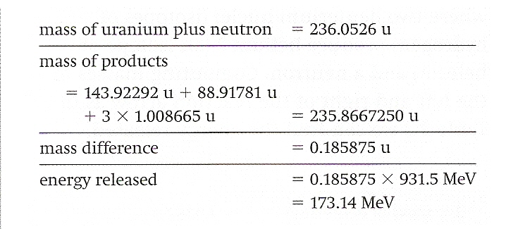
State the meaning of and difference between fission and fusion
The energy released in this fission reaction is given below

Slide 63
State the meaning of and difference between fission and fusion
This excess energy is translated into kinetic energy
Conservation of momentum and energy equations are used to determine particle velocities

Slide 64
State the meaning of and difference between fission and fusion
What is a natural by-product of increased kinetic energy of atoms?

Slide 65
State the meaning of and difference between fission and fusion

Slide 66
State the meaning of and difference between fission and fusion
Energy released in 1kg of U-235

Slide 67
State the meaning of and difference between fission and fusion
Energy released in 1kg of U-235
7.1 x 10¹³ J
Energy released in 1kg of nitroglycerin
6.7 x 10⁶ J
U-235 fission is roughly 10 million times more powerful than nitroglycerine

Slide 68
State the meaning of and difference between fission and fusion
The rate of reaction in nuclear reactors must be controlled in order to prevent an explosion
This is done mainly by control rods that absorb some of the neutrons given off in the reactions
Also by the water surrounding the fuel rods that slow down the released neutrons

Slide 69
State the meaning of and difference between fission and fusion
Fusion is the joining of two lighter nuclei into one heavier one
An example reaction is,
Two deuterium nuclei produce helium-3 and a neutron

Slide 70
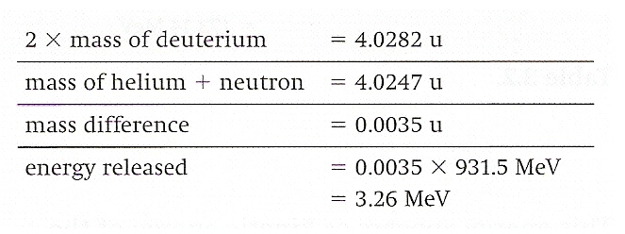
State the meaning of and difference between fission and fusion
The energy given off by this reaction is,

Slide 71
State the meaning of and difference between fission and fusion
The energy given off by one kilogram of deuterium is roughly 1x10¹³ J
This is seven times less than the fission reaction, but when you’re talking about a 10¹³ order of magnitude, who’s gonna notice?

Slide 72
State the meaning of and difference between fission and fusion
Fusion requires extremely high temperatures to overcome electrostatic repulsion
High temperature means high kinetic energy of atoms
High kinetic energy allows them to get close enough for the strong nuclear force to take over

Slide 73
State the meaning of and difference between fission and fusion
Temperatures required (10⁹ K) turn everything into plasma
In stars, only 10⁶ K required due to the tremendous pressure created by gravitational attraction
How do you contain the reactants?

Slide 74
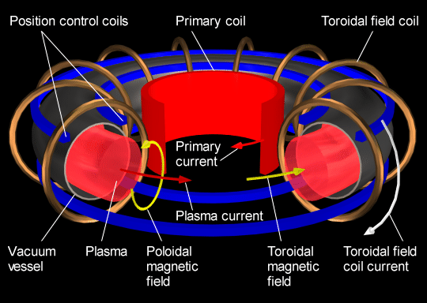
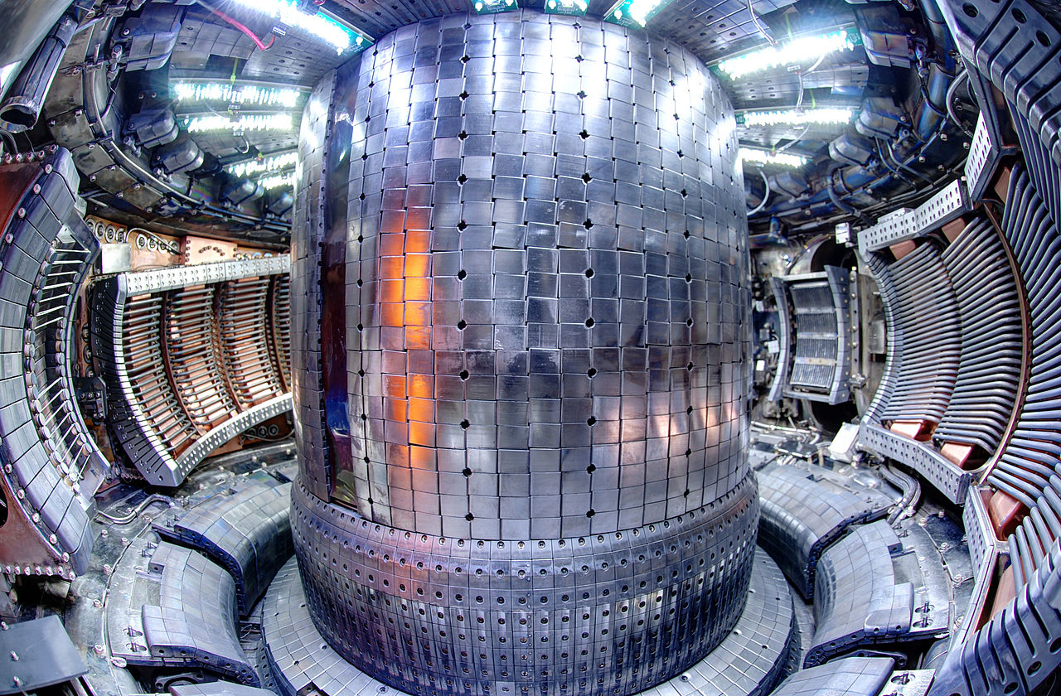
State the meaning of and difference between fission and fusion
Temperatures required turn everything into plasma
How do you contain the reactants?
Electromagnetic fields in machines called Tokamaks
This is why fusion energy has not become commercially feasible in spite of all the environmental benefits

Slide 75
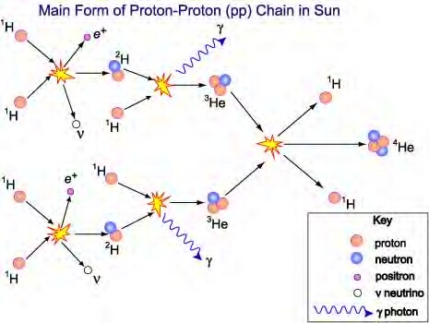
Understand that nuclear fusion takes place in the core of the stars
Typical reaction:
Fusion is the energy engine for stars
Stars exist in a plasma state
Extremely high temperatures
Extremely high pressures

Slide 76
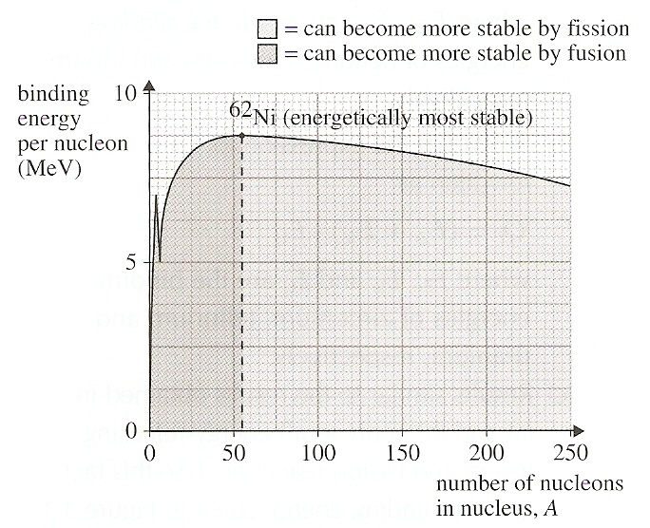
Fission OR Fusion???
Recall the binding energy per nucleon plot:

Slide 77
Understand that nuclear fusion takes place in the core of the stars
Stars are also element factories producing all of the elements contained in our bodies
More on this in astrophysics (optional)

Slide 78
Summary – Part A
Define the unified mass unit
State the meaning of the terms mass defect and binding energy and solve related problems
Understand the meaning of the graph of binding energy per nucleon versus mass number
Write nuclear reaction equations and balance the atomic and mass numbers

Slide 79
Summary – Part B
State the meaning of and difference between fission and fusion
Understand that nuclear fusion takes place in the core of the stars
Solve problems of fission and fusion reactions

Slide 80
Understandings:
The unified atomic mass unit
Mass defect and nuclear binding energy
Nuclear fission and nuclear fusion

Slide 81
Applications And Skills:
Solving problems involving mass defect and binding energy
Solving problems involving the energy released in radioactive decay, nuclear fission and nuclear fusion

Slide 82
Applications And Skills:
Sketching and interpreting the general shape of the curve of average binding energy per nucleon against nucleon number

Slide 83
Guidance:
Students must be able to calculate changes in terms of mass or binding energy
Binding energy may be defined in terms of energy required to completely separate the nucleons or the energy released when a nucleus is formed from its nucleons

Slide 84
Data Booklet Reference:

Slide 85
Essential Idea:
Energy can be released in nuclear decays and reactions as a result of the relationship between mass and energy.

Slide 86
Questions?

Slide 87
Homework
#16-

