Slide 1
Devil physics The baddest class on campus IB Physics

Slide 2
Tsokos Lesson 7-1B radioactivity

Slide 3
Essential Idea:
In the microscopic world energy is discrete.

Slide 4
Nature Of Science:
Accidental discovery:
Radioactivity was discovered by accident when Becquerel developed photographic film that had accidentally been exposed to radiation from radioactive rocks.
The marks on the photographic film seen by Becquerel probably would not lead to anything further for most people.
What Becquerel did was to correlate the presence of the marks with the presence of the radioactive rocks and investigate the situation further.

Slide 5
International-Mindedness:
The geopolitics of the past 60+ years have been greatly influenced by the existence of nuclear weapons

Slide 6
Understandings:
Radioactive decay
Alpha particles, beta particles and gamma rays
Half-life
Absorption characteristics of decay particles
Background radiation

Slide 7
Applications And Skills:
Completing decay equations for alpha and beta decay
Determining the half-life of a nuclide from a decay curve
Investigating half-life experimentally (or by simulation)

Slide 8
Applications And Skills:
Completing decay equations for alpha and beta decay
Determining the half-life of a nuclide from a decay curve
Investigating half-life experimentally (or by simulation)

Slide 9
Guidance:
Students will be required to solve problems on radioactive decay involving only integral numbers of half-lives
Students will be expected to include the neutrino and antineutrino in beta decay equations

Slide 10
Data Booklet Reference:

Slide 11
Utilization:
Knowledge of radioactivity, radioactive substances and the radioactive decay law are crucial in modern nuclear medicine
How to deal with the radioactive output of nuclear decay is important in the debate over nuclear power stations (see Physics sub-topic 8.1)
Carbon dating is used in providing evidence for evolution (see Biology sub-topic 5.1)
Exponential functions (see Mathematical studies SL sub-topic 6.4; Mathematics HL sub-topic 2.4)

Slide 12
Aims:
Aim 8: the use of radioactive materials poses environmental dangers that must be addressed at all stages of research
Aim 9: the use of radioactive materials requires the development of safe experimental practices and methods for handling radioactive materials

Slide 13
Introductory Video

Slide 14
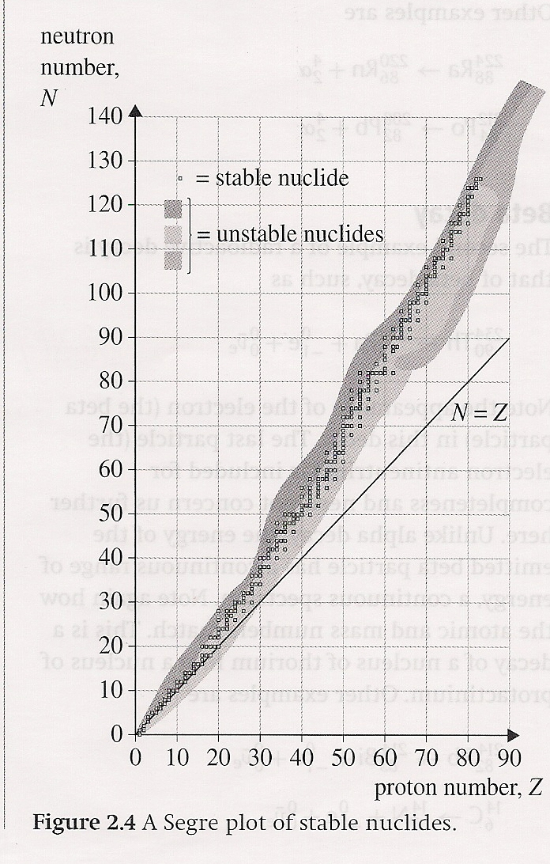
Segre Plots
At low Z numbers, stable nuclides have N = Z
At higher Z numbers, N > Z

Slide 15
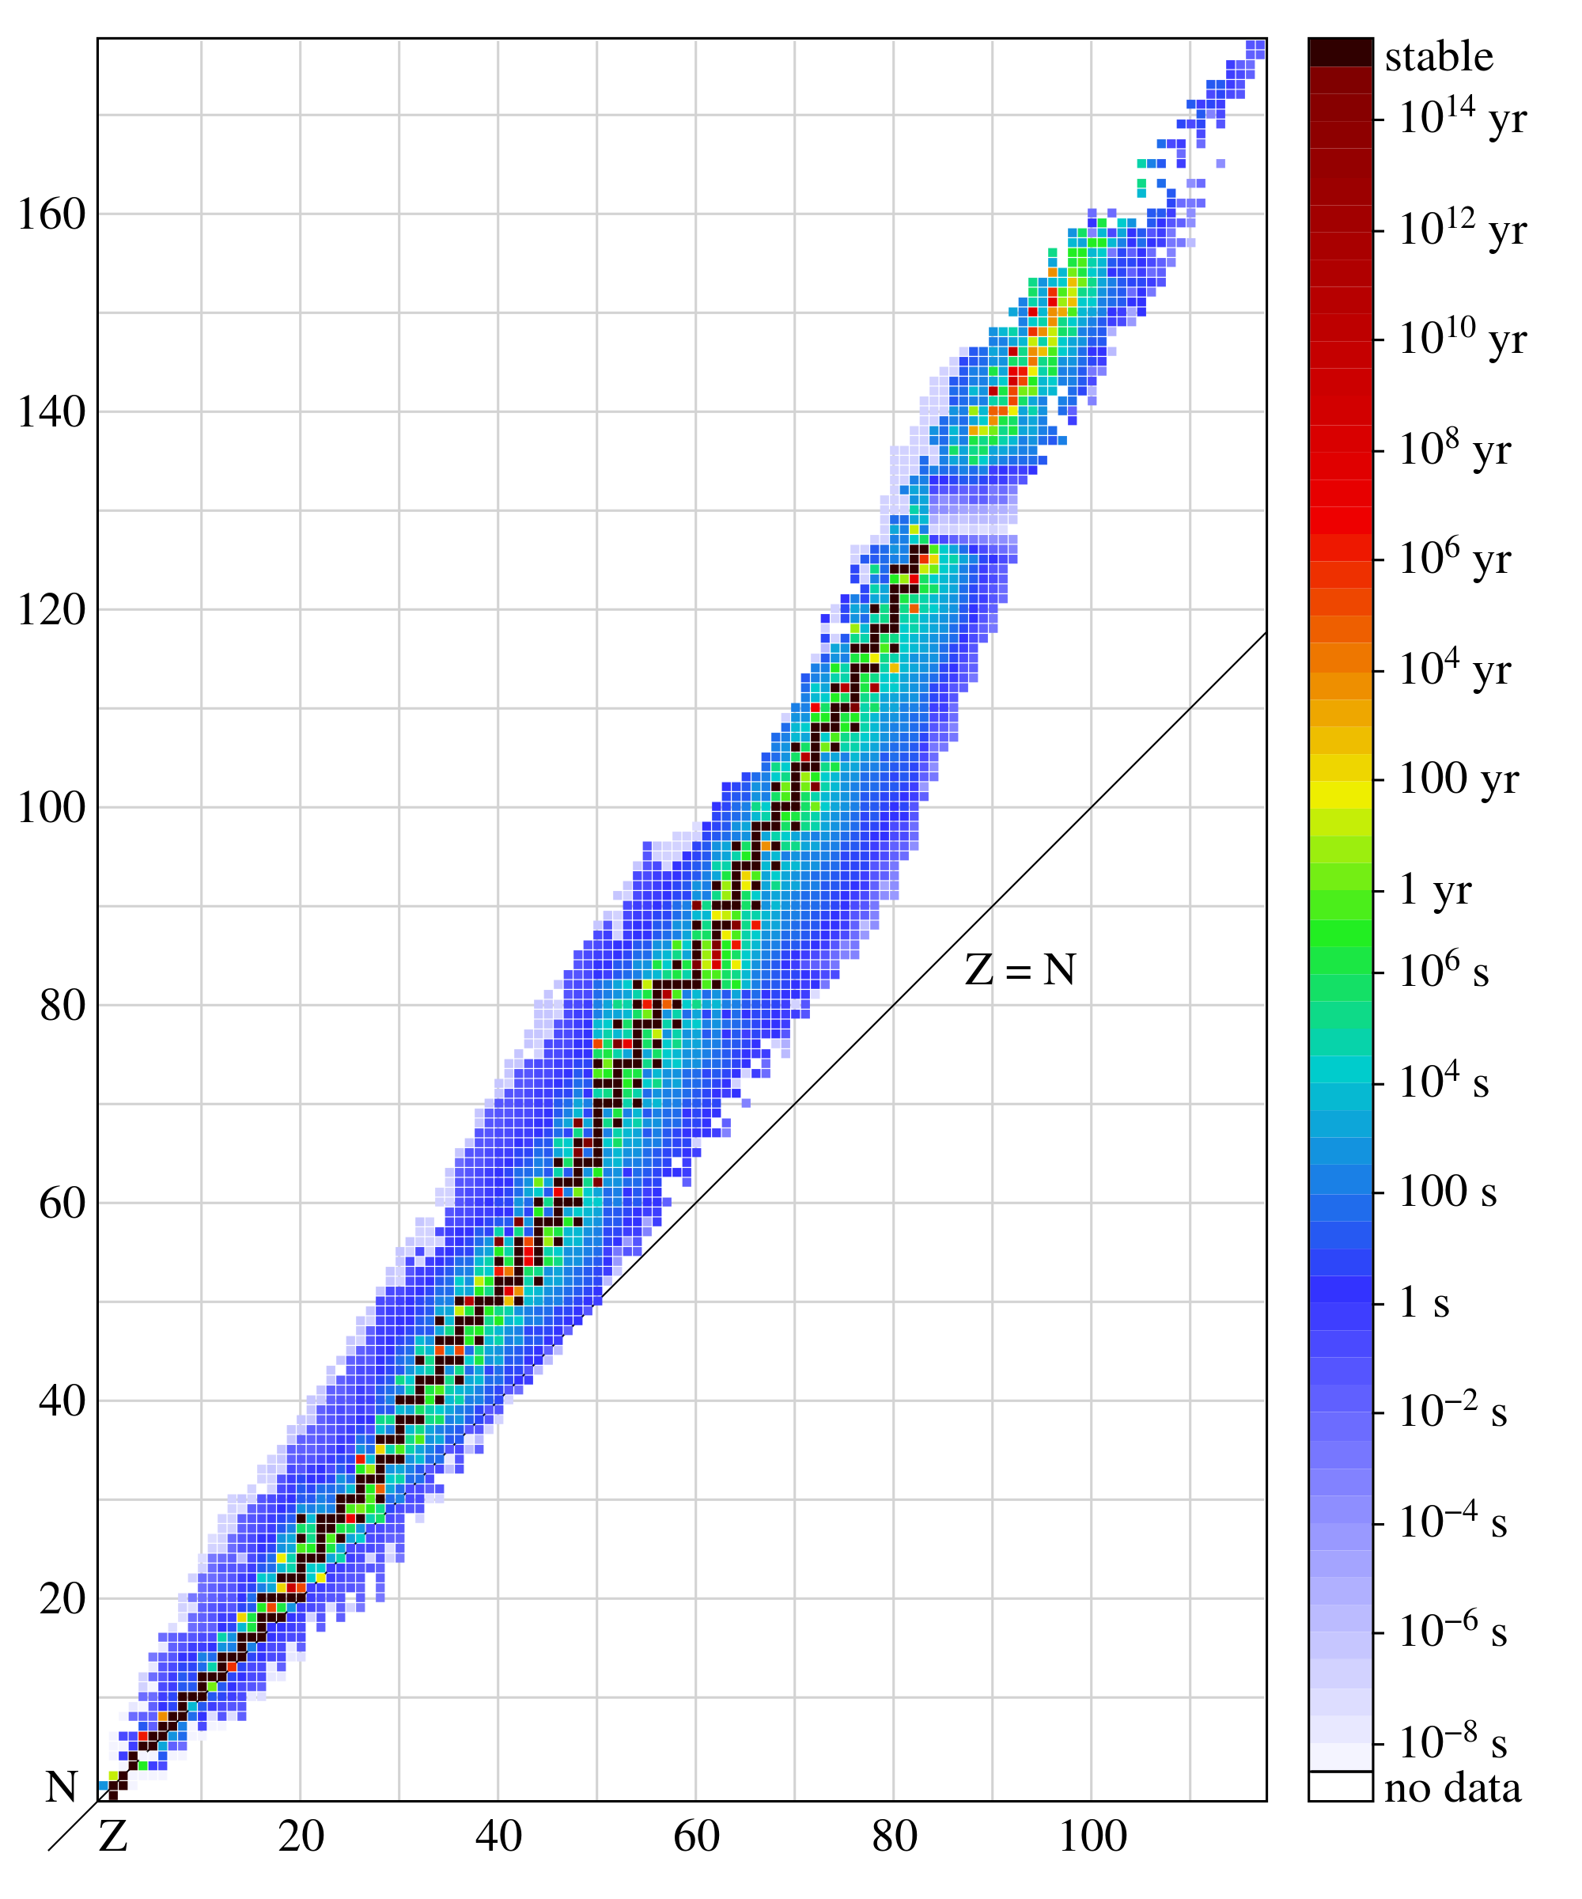
Segre Plots
Most nuclides are unstable
Unstable nuclides emit particles that carry energy away from the nucleus
This is called radioactivity

Slide 16
Alpha, Beta and Gamma Radiations
Distinguished by their ionizing and penetrating power
These particles ionize the air they pass through, i.e. they knock electrons off atoms of the gases in the air
Alpha particle (α) of energy 2 MeV produces 10,000 ion pairs per mm
Beta particle (β) of energy 2 MeV produces 100 ion pairs per mm
Gamma particle (γ) of energy 2 MeV produces 1 ion pair per mm

Slide 17
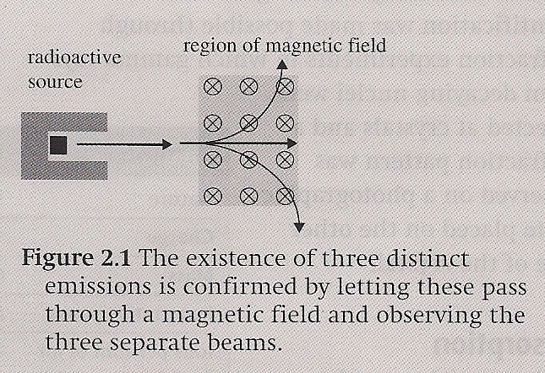
Alpha, Beta and Gamma Radiations
When passed through a magnetic field, one of the particles was found to be positively charged, one negatively charged, and one neutral.
Which is which?

Slide 18
Alpha Particles
Positively charged
Identified by Rutherford and Royds as helium nuclei stripped of its electrons
Charge is equal to +2e
Easiest to absorb
Stopped by a few cm of air

Slide 19
Alpha Particles

Slide 20
Alpha Decay

Slide 21
Beta Particles
Negatively charged electrons (₋₁e) or sometimes a positron (₊₁e)
Identified by Thompson’s charge-to-mass experiments
Found that these ratios decreased as velocity increased
Consistent with theory of special relativity – mass increases as speed approaches speed of light
Beta particles stopped by a few cm of paper or metal a few mm thick

Slide 22
Beta Minus Decay
A neutron (larger mass) decays into a proton (smaller mass)
Emits an electron (₋₁e) and an anti-neutrino
Mass difference translated into particle energy (E = mc²)

Slide 23
Beta Plus Decay
A proton (smaller mass) decays into a neutron (larger mass)
Emits an positron (₊₁e) and a neutrino
Increase in mass from proton to neutron indicates energy must be added to make this happen

Slide 24
Gamma Rays
Neutrally charged photons (same photons in electromagnetic radiation) with very small wavelengths
λ ≤ 10⁻¹² m
Smaller than X-ray wavelengths
Identified through measuring diffraction patterns of decaying nuclei passing through a crystal
Stopped only by several centimeters of lead

Slide 25
Gamma Decay
Nucleus emits a high frequency photon
Nucleus does not change composition
Nucleus moving from a higher to a lower energy level

Slide 26
Gamma Decay
Nucleus emits a high frequency photon
Nucleus does not change composition
Nucleus moving from a higher to a lower energy level

Slide 27
Energies
Alpha particles have discrete energies
Beta particles have a continuous range of energies
Gamma rays from a particular nucleus have a few discrete energy levels with maximum energies of about 1 MeV

Slide 28
Speeds
Alpha particles are slow (~ 6% of the speed of light)
Beta particles are fast (~ 98% of the speed of light)
Gamma rays, since they are photons, travel at the speed of light

Slide 31
Detecting Radiation

Slide 32
Decay Series
Diagram of changes in atomic number and mass number as an element undergoes several decays
Shows different possible decay paths
Decays continue until all nuclei are stable

Slide 33
Thorium Decay

Slide 35
Law of Radioactive Decay
The law of radioactive decay states that the number of nuclei that will decay per second (i.e. the rate of decay) is proportional to the number of atoms present that have not yet decayed.
Decay of individual nuclei is random and spontaneous

Slide 36
Law of Radioactive Decay
But, the number of nuclei that will decay per second (rate of decay) is proportional to the number of undecayed nuclei
This means that the number of radioactive nuclei decreases exponentially

Slide 37
Law of Radioactive Decay

Slide 38
Half-Life
There exists a certain interval of time, called the half-life, such that after each half-life the number of nuclei that have not yet decayed is reduced by a factor of 2.
Activity (A) – the number of nuclei decaying per second
Becquerel (Bq) – 1Bq = 1 decay per second

Slide 39
Half-Life and Probability
After one half-life, the probability that a given nucleus will have decayed is 50%
After two half-lives, the probability that a given nucleus will have decayed is the sum of the first and second half-life probabilities

Slide 40
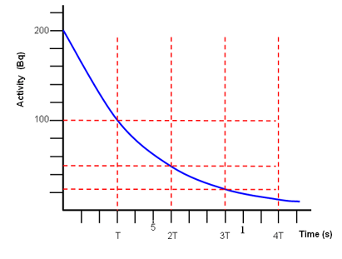
Half-Life and Probability

Slide 41
Radioactive Decay
What is the half-life?

Slide 42
Activity
Activity (A) – the number of nuclei decaying per second
Becquerel (Bq) – 1Bq = 1 decay per second
Activity can also be used to determine half-life

Slide 43
Background Radiation

Slide 44
Background Radiation
To get an accurate measure of half-life, we must subtract background radiation (assuming a constant value) from all measurements

Slide 45
Fundamental Forces
Electromagnetic Interaction:
Acts on any particle that has an electric charge
Force is given by Coulomb’s law
Infinite range

Slide 46
Fundamental Forces
Weak Nuclear Interaction:
Acts on protons, neutrons, electrons, and neutrinos in order to bring about beta decay
Very short range (10⁻¹⁸ m)

Slide 47
Fundamental Forces
Strong Nuclear Interaction:
[Mainly] attractive force acts on protons and neutrons to keep them bound to each other inside nuclei
Short range (10⁻¹⁵ m)

Slide 48
Fundamental Forces
Gravitational Interaction:
Force of attraction between masses
Small mass of atomic particles makes this force irrelevant for atomic and nuclear physics
Infinite range

Slide 49
Fundamental Forces

Slide 50
Fundamental Forces

Slide 51
Fundamental Forces

Slide 52
Understandings:
Radioactive decay
Alpha particles, beta particles and gamma rays
Half-life
Absorption characteristics of decay particles
Background radiation

Slide 53
Applications And Skills:
Completing decay equations for alpha and beta decay
Determining the half-life of a nuclide from a decay curve
Investigating half-life experimentally (or by simulation)

Slide 54
Applications And Skills:
Completing decay equations for alpha and beta decay
Determining the half-life of a nuclide from a decay curve
Investigating half-life experimentally (or by simulation)

Slide 55
Guidance:
Students will be required to solve problems on radioactive decay involving only integral numbers of half-lives
Students will be expected to include the neutrino and antineutrino in beta decay equations

Slide 56
Data Booklet Reference:

Slide 57
Utilization:
Knowledge of radioactivity, radioactive substances and the radioactive decay law are crucial in modern nuclear medicine
How to deal with the radioactive output of nuclear decay is important in the debate over nuclear power stations (see Physics sub-topic 8.1)
Carbon dating is used in providing evidence for evolution (see Biology sub-topic 5.1)
Exponential functions (see Mathematical studies SL sub-topic 6.4; Mathematics HL sub-topic 2.4)

Slide 58
Aims:
Aim 8: the use of radioactive materials poses environmental dangers that must be addressed at all stages of research
Aim 9: the use of radioactive materials requires the development of safe experimental practices and methods for handling radioactive materials

Slide 59
Essential Idea:
In the microscopic world energy is discrete.

Slide 60
Questions?

Slide 61
Homework
#8-15

