Slide 1
Devil physics The baddest class on campus IB Physics

Slide 2
Tsokos Lesson 6-2 The law of gravitation

Slide 3
Essential Idea:
The Newtonian idea of gravitational force acting between two spherical bodies and the laws of mechanics create a model that can be used to calculate the motion of planets.

Slide 4
Nature Of Science:
Laws: Newton’s law of gravitation and the laws of mechanics are the foundation for deterministic classical physics. These can be used to make predictions but do not explain why the observed phenomena exist.

Slide 5
Theory Of Knowledge:
The laws of mechanics along with the law of gravitation create the deterministic nature of classical physics.
Are classical physics and modern physics compatible?
Do other areas of knowledge also have a similar division between classical and modern in their historical development?

Slide 6
Understandings:
Newton’s law of gravitation
Gravitational field strength

Slide 7
Applications And Skills:
Describing the relationship between gravitational force and centripetal force
Applying Newton’s law of gravitation to the motion of an object in circular orbit around a point mass

Slide 8
Applications And Skills:
Solving problems involving gravitational force, gravitational field strength, orbital speed and orbital period
Determining the resultant gravitational field strength due to two bodies

Slide 9
Guidance:
Newton’s law of gravitation should be extended to spherical masses of uniform density by assuming that their mass is concentrated at their centre
Gravitational field strength at a point is the force per unit mass experienced by a small point mass at that point
Calculations of the resultant gravitational field strength due to two bodies will be restricted to points along the straight line joining the bodies

Slide 10
Data Booklet Reference:

Slide 11
Utilization:
The law of gravitation is essential in describing the motion of satellites, planets, moons and entire galaxies
Comparison to Coulomb’s law (see Physics sub-topic 5.1)

Slide 12
Aim 4:
The theory of gravitation when combined and synthesized with the rest of the laws of mechanics allows detailed predictions about the future position and motion of planets

Slide 13
Introductory Video The Force of Gravity

Slide 14
Newton’s 2nd Law
Newton’s second law (F=ma) implies that if a mass is accelerating, there must be a force acting on it
An object falls (accelerates toward the earth) because of gravity
What holds planets in their orbits?

Slide 15
Newton’s 2nd Law
Newton’s second law (F=ma) implies that if a mass is accelerating, there must be a force acting on it
An object falls (accelerates toward the earth) because of gravity
What holds planets in their orbits?
Gravitational Force

Slide 16
Newton’s Law of Gravitation
The attractive force between two point masses is,
Where,
M1 and M2 are the masses of the attracting bodies
r is the distance between them
G is Newton’s constant of universal gravitation and has a value of 6.667 x 10⁻¹¹ N m² kg⁻²

Slide 17
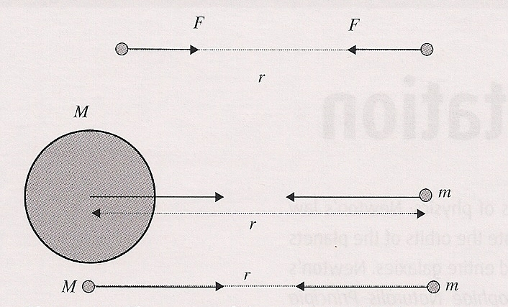
Newton’s Law of Gravitation
The direction of the force is along the line joining the two masses,

Slide 18
Newton’s Law of Gravitation
The formula applies to point masses, which means the masses are small in relation to the separation between them

Slide 19
Newton’s Law of Gravitation
When the radii of two planets is small in comparison to the distance between them, we consider them to be point masses

Slide 20
Newton’s Law of Gravitation
What is the gravitational force between the earth and the sun?

Slide 21
Newton’s Law of Gravitation
What is the gravitational force between the earth and the sun?

Slide 22
Newton’s Law of Gravitation
How does this compare to the gravitational force between the earth and you?

Slide 23
Newton’s Law of Gravitation
How does this compare to the gravitational force between the earth and you?

Slide 24
Newton’s Law of Gravitation
Since F=ma, what value of a does this yield?

Slide 25
Newton’s Law of Gravitation
Since F=ma, what value of a does this yield?
Sound Familiar?

Slide 26
Gravitational Field Strength
The gravitational field strength at a certain point is the force per unit mass experienced by a small point mass, m, at that point.

Slide 27
Gravitational Field Strength
The units of gravitational field strength are N⋅kg⁻¹
1N = 1 kg ⋅m ⋅ s⁻²
So units become m ⋅ s⁻², acceleration!

Slide 28
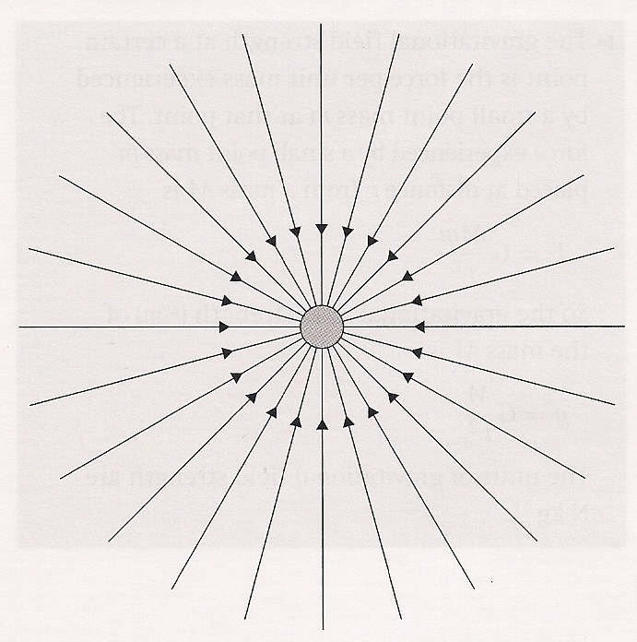
Gravitational Field Strength
Gravitational field strength is a vector quantity whose direction is given by the direction of the force a point mass would experience if placed at the point of interest.

Slide 29
Gravitational Field Strength
The gravitational field strength around a single point mass is radial which means it is the same for all points equidistant from the center of mass and directed toward the center.

Slide 30
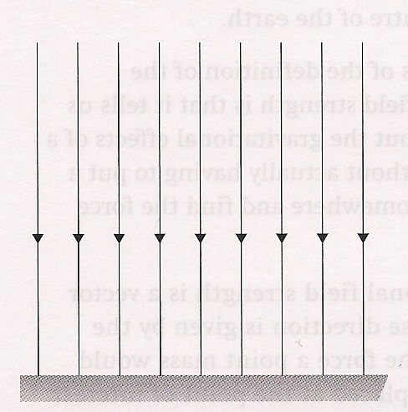
Gravitational Field Strength
On a micro- versus macro-level (like the projectile motion of a football), the field strength can be considered to be uniform with a constant value.

Slide 31
The Law of Gravitation and Planetary Motion

Slide 32
Orbital Motion
In order for a body to move in a circular or elliptical path, there must be a force to cause centripetal acceleration
For planets, that force is the force of gravity

Slide 33
Orbital Motion
Solving for v, we get the velocity a body must maintain to remain in an orbit

Slide 34
Orbital Motion
Using rotational velocity, we see that the square of the period is proportional to the cube of the distance between the two masses

Slide 35
Orbital Motion
From this we can develop a relationship between the orbits of two planets orbiting around the same central body (like the planets in our solar system orbiting the sun)

Slide 36
Kepler and His Three Laws of Motion

Slide 37
Understandings:
Newton’s law of gravitation
Gravitational field strength

Slide 38
Data Booklet Reference:

Slide 39
Applications And Skills:
Describing the relationship between gravitational force and centripetal force
Applying Newton’s law of gravitation to the motion of an object in circular orbit around a point mass

Slide 40
Applications And Skills:
Solving problems involving gravitational force, gravitational field strength, orbital speed and orbital period
Determining the resultant gravitational field strength due to two bodies

Slide 41
Essential Idea:
The Newtonian idea of gravitational force acting between two spherical bodies and the laws of mechanics create a model that can be used to calculate the motion of planets.

Slide 42
Questions?

Slide 43
Homework
#15-25

