Slide 1
Devil physics The baddest class on campus IB Physics

Slide 2
Tsokos lesson 4-1 simple harmonic motion

Slide 3
Introductory Video: Simple Harmonic Motion

Slide 4
Essential Idea:
A study of oscillations underpins many areas of physics with simple harmonic motion (SHM), a fundamental oscillation that appears in various natural phenomena.

Slide 5
Nature Of Science:
Models: Oscillations play a great part in our lives, from the tides to the motion of the swinging pendulum that once governed our perception of time. General principles govern this area of physics, from water waves in the deep ocean or the oscillations of a car suspension system. This introduction to the topic reminds us that not all oscillations are isochronous. However, the simple harmonic oscillator is of great importance to physicists because all periodic oscillations can be described through the mathematics of simple harmonic motion.

Slide 6
International-Mindedness:
Oscillations are used to define the time systems on which nations agree so that the world can be kept in synchronization.
This impacts most areas of our lives including the provision of electricity, travel and location-determining devices and all microelectronics.

Slide 7
Theory Of Knowledge:
The harmonic oscillator is a paradigm for modeling where a simple equation is used to describe a complex phenomenon.
How do scientists know when a simple model is not detailed enough for their requirements?

Slide 8
Understandings:
Simple harmonic oscillations
Time period, frequency, amplitude, displacement and phase difference
Conditions for simple harmonic motion

Slide 9
Applications And Skills:
Qualitatively describing the energy changes taking place during one cycle of an oscillation
Sketching and interpreting graphs of simple harmonic motion examples

Slide 10
Guidance:
Graphs describing simple harmonic motion should include displacement– time, velocity–time, acceleration–time and acceleration–displacement
Students are expected to understand the significance of the negative sign in the relationship:

Slide 11
Data Booklet Reference:

Slide 12
Utilization:
Isochronous oscillations can be used to measure time
Many systems can approximate simple harmonic motion: mass on a spring, fluid in U-tube, models of icebergs oscillating vertically in the ocean, and motion of a sphere rolling in a concave mirror
Simple harmonic motion is frequently found in the context of mechanics (see Physics topic 2)

Slide 13
Aims:
Aim 6: experiments could include (but are not limited to): mass on a spring; simple pendulum; motion on a curved air track
Aim 7: IT skills can be used to model the simple harmonic motion defining equation; this gives valuable insight into the meaning of the equation itself

Slide 14
Oscillation vs. Simple Harmonic Motion
An oscillation is any motion in which the displacement of a particle from a fixed point keeps changing direction and there is a periodicity in the motion i.e. the motion repeats in some way.

Slide 15
Oscillation vs. Simple Harmonic Motion
In simple harmonic motion, the displacement from an equilibrium position and the force/acceleration are proportional and opposite to each other.
There must be a restoring force in the direction of the equilibrium position

Slide 16
Simple Harmonic Motion: Spring

Slide 17
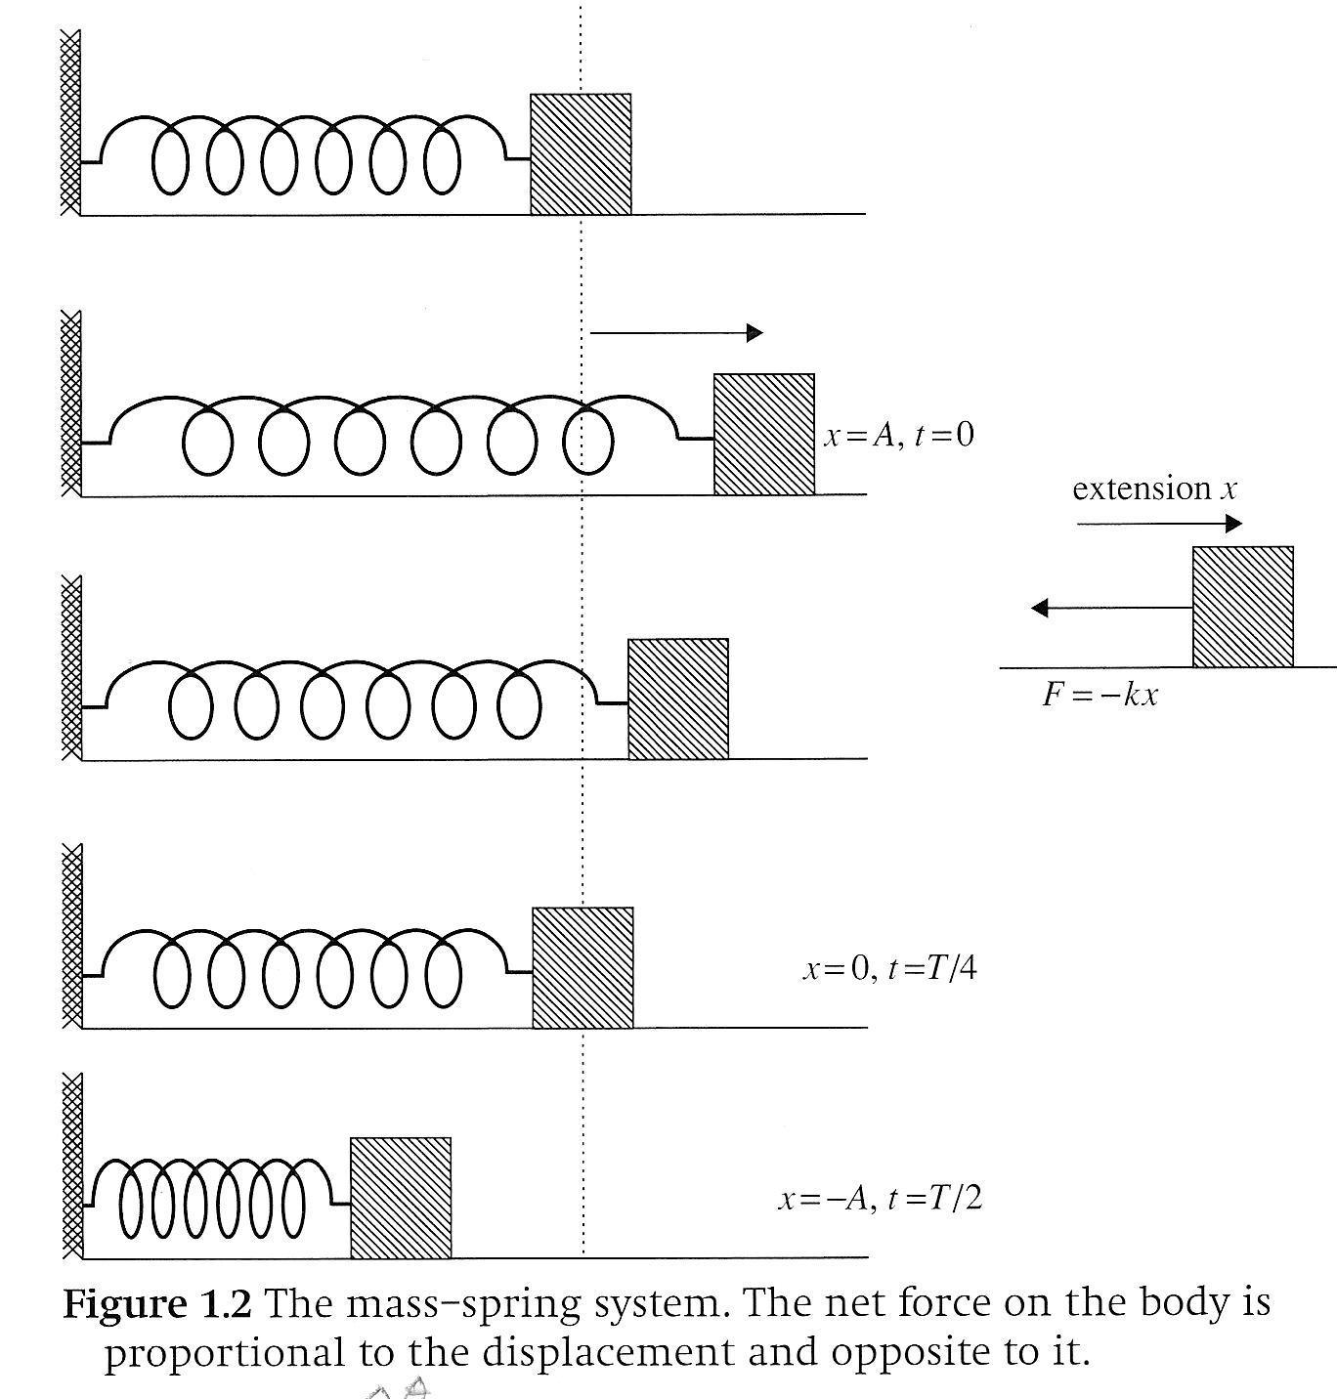
Definitions
Period – time to complete one full oscillation (time to return to starting point)
Amplitude – maximum displacement from the equilibrium position

Slide 18
Characteristics of SHM
Period and amplitude are constant
Period is independent of the amplitude
Displacement, velocity, and acceleration are sine or cosine functions of time

Slide 19
Simple Harmonic Motion: Spring
The spring possesses an intrinsic restoring force that attempts to bring the object back to equilibrium:
This is Hooke’s Law
k is the spring constant (kg/s²)
The negative sign is because the force acts in the direction opposite to the displacement -- restoring force

Slide 20
Simple Harmonic Motion: Spring
Meanwhile, the inertia of the mass executes a force opposing the spring, F=ma:
spring executing force on mass
mass executing force on spring

Slide 21
Simple Harmonic Motion: Spring
These forces remain in balance throughout the motion:
The relationship between acceleration and displacement is thus,

Slide 22
Simple Harmonic Motion: Spring
Satisfies the requirement for SHM that displacement from an equilibrium position and the force/acceleration are proportional and opposite to each other

Slide 23
Simple Harmonic Motion: Spring

Slide 24
Relating SHM to Motion Around A Circle

Slide 25
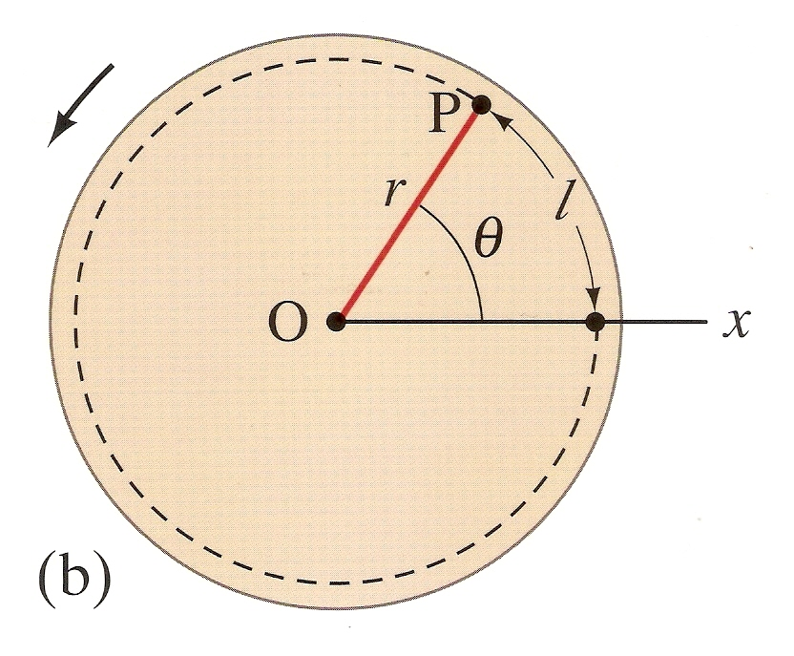
Radians
One radian is defined as the angle subtended by an arc whose length is equal to the radius

Slide 26
Radians

Slide 27
Angular Velocity

Slide 28
Angular Acceleration

Slide 29
Period

Slide 30
Frequency

Slide 31
Relating SHM to Motion Around A Circle
The period in one complete oscillation of simple harmonic motion can be likened to the period of one complete revolution of a circle.
angle swept
Time taken = ----------------------
angular speed (ω)

Slide 32
Relating SHM to Motion Around A Circle

Slide 33
Relating SHM to Motion Around A Circle
Using,
We then derive

Slide 34
Relating SHM to Motion Around A Circle
These equations yield the following graphs

Slide 35
Relating SHM to Motion Around A Circle
These equations yield the following graphs

Slide 36
Relating SHM to Motion Around A Circle
These equations yield the following graphs

Slide 37
Relating SHM to Motion Around A Circle
These equations yield the following graphs
What is the difference between

Slide 38
Relating SHM to Motion Around A Circle
These equations yield the following graphs
What is the difference between

Slide 39
Relating SHM to Motion Around A Circle
These equations yield the following graphs

Slide 40
Definitions
Understand the terms displacement, amplitude and period
displacement (x) – distance from the equilibrium or zero point
amplitude (A) – maximum displacement from the equilibrium or zero point
period (T) – time it takes to complete one oscillation and return to starting point

Slide 41
Definitions

Slide 42
Definitions

Slide 43
Definitions
Understand the terms period and frequency
frequency (f) – How many oscillations are completed in one second, equal to the inverse of the period
period (T) – Time for one complete oscillation, equal to the inverse of the frequency

Slide 44
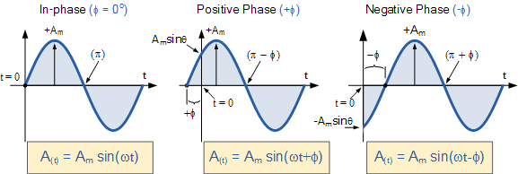
Definitions
Understand the term phase;
phase (𝝋) – the difference between the actual position of a sine wave at t=0 and zero. The value of 𝝋 determines the displacement at t=0

Slide 45
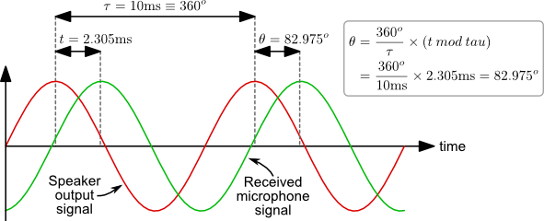
Phase Shift

Slide 46
Energy in Simple Harmonic Motion
Conservation of Energy (assuming no dissipative forces
In simple harmonic motion there is continuous transformation of energy from kinetic energy into elastic potential energy and vice versa

Slide 47
Simple Harmonic Motion: Spring
no displ, no energy, no accl
max displ, max PE, max accl, zero KE
half max displ, half max PE, half max accl, half max KE
max displ, max PE, max accl, zero KE
zero displ, zero PE, zero accl, max KE

Slide 48
Simple Harmonic Motion: Spring

Slide 49
Energy in SHM

Slide 50
Understandings:
Simple harmonic oscillations
Time period, frequency, amplitude, displacement and phase difference
Conditions for simple harmonic motion

Slide 51
Data Booklet Reference:

Slide 52
Applications And Skills:
Qualitatively describing the energy changes taking place during one cycle of an oscillation
Sketching and interpreting graphs of simple harmonic motion examples

Slide 53
Utilization:
Isochronous oscillations can be used to measure time
Many systems can approximate simple harmonic motion: mass on a spring, fluid in U-tube, models of icebergs oscillating vertically in the ocean, and motion of a sphere rolling in a concave mirror
Simple harmonic motion is frequently found in the context of mechanics (see Physics topic 2)

Slide 54
Essential Idea:
A study of oscillations underpins many areas of physics with simple harmonic motion (SHM), a fundamental oscillation that appears in various natural phenomena.

Slide 55
Tacoma Narrows Bridge Collapse

Slide 56
Homework
#Page 152, #1-5
Beautiful
Resonance

Slide 57
Stopped Here 2/21/2013

