Slide 1
Devil physics The baddest class on campus IB Physics-2

Slide 2
Tsokos Lesson 3-2 modeling a gas

Slide 3
Essential Idea:
The properties of ideal gases allow scientists to make predictions of the behavior of real gases.

Slide 4
Nature Of Science:
Collaboration: Scientists in the 19th century made valuable progress on the modern theories that form the basis of thermodynamics, making important links with other sciences, especially chemistry. The scientific method was in evidence with contrasting but complementary statements of some laws derived by different scientists. Empirical and theoretical thinking both have their place in science and this is evident in the comparison between the unattainable ideal gas and real gases.

Slide 5
Theory Of Knowledge:
When does modeling of “ideal” situations become “good enough” to count as knowledge?

Slide 6
Understandings:
Pressure
Equation of state for an ideal gas
Kinetic model of an ideal gas
Mole, molar mass and the Avogadro constant
Differences between real and ideal gases

Slide 7
Applications And Skills:
Solving problems using the equation of state for an ideal gas and gas laws
Sketching and interpreting changes of state of an ideal gas on pressure– volume, pressure–temperature and volume–temperature diagrams
Investigating at least one gas law experimentally

Slide 8
Guidance:
Students should be aware of the assumptions that underpin the molecular kinetic theory of ideal gases
Gas laws are limited to constant volume, constant temperature, constant pressure and the ideal gas law
Students should understand that a real gas approximates to an ideal gas at conditions of low pressure, moderate temperature and low density

Slide 9
Data Booklet Reference:

Slide 10
Utilization:
Transport of gases in liquid form or at high pressures/densities is common practice across the globe. Behaviour of real gases under extreme conditions needs to be carefully considered in these situations.
Consideration of thermodynamic processes is essential to many areas of chemistry (see Chemistry sub-topic 1.3)
Respiration processes (see Biology sub-topic D.6)

Slide 11
Aims:
Aim 3: this is a good topic to make comparisons between empirical and theoretical thinking in science
Aim 6: experiments could include (but are not limited to): verification of gas laws; calculation of the Avogadro constant; virtual investigation of gas law parameters not possible within a school laboratory setting

Slide 12
Video – Developing the Gas Laws

Slide 13
Avogadro (avocado) Constant
“One mole of a substance contains the same number of molecules as in 12 grams of carbon-12.”
“One mole of any substance is that quantity of the substance whose mass in grams is equal to the substance’s molar mass, µ.”

Slide 14
Avogadro (avocado) Constant
The number of moles of a substance, n, is equal to the number of molecules in the substance, N, divided by the Avocado constant, N_{A}

Slide 15
Avogadro (avocado) Constant
The mass in grams, m , is equal to the number of moles, n, times the molar mass, µ.

Slide 16
Avogadro (avocado) Constant
The mass in grams, m , is equal to the number of moles, n, times the molar mass, µ.

Slide 17
Avogadro (avocado) Constant
How many moles and atoms are there in 10 grams of plutonium (µ = 244)?

Slide 18
Avogadro (avocado,acevedo) Constant
How many moles and atoms are there in 10 grams of plutonium (µ = 244)?

Slide 19
Moles of Gases
Convenient to use moles (not the furry kind)
Avogadro's Avocado number
Atomic Mass = Molar Mass = grams/mol

Slide 20
Moles of Gases
The number of moles can be found by dividing the number of molecules, N, by the Avogadro's Avocado number
Also found by dividing the mass of the gas in grams by the Atomic / Molar Mass

Slide 21
Kinetic Theory of Gases
Explained through a simple mechanical model
Several basic assumptions must be made

Slide 22
Kinetic Theory of Gases
Basic Assumptions:
Gas consists of a large number of molecules
Molecules move with a range of speeds
Volume of individual molecules is negligible compared to volume of the container
Collisions between the molecules and between molecules and the container are elastic
Molecules exert no forces on each other or on the container except when in contact (i.e., no intermolecular forces)

Slide 23
Kinetic Theory of Gases
Basic Assumptions:
Duration of collisions (impulse) is small compared to time between collisions
Molecules follow the laws of Newtonian mechanics

Slide 24
Kinetic Theory of Gases
Basic Assumptions:
That’s why they call it an ‘Ideal’ Gas

Slide 25
Kinetic Theory of Gases
Boltzmann Equation:
The v² term is the average of the squares of the speeds of the molecules of the gas
This is called the root mean square (rms) speed
Not the average speed, but close enough that the terms are used interchangeably

Slide 26
Kinetic Theory of Gases
Boltzmann Equation:
k is the Bolzmann constant and is equal to 1.38 x 10⁻²³ J/K
It is a ratio of the gas constant R to the Avogadro (avocado) number
Note that temperature in this equation must be in Kelvin

Slide 27
Kinetic Theory of Gases
Boltzmann Equation:
k is the Bolzmann constant and is equal to 1.38 x 10⁻²³ J/K
It is a ratio of the gas constant R to the Avogadro (avocado) number
Note that temperature in this equation must be in Kelvin

Slide 28
Kinetic Theory of Gases
Boltzmann Equation:
The importance of this equation is that it shows how absolute temperature is directly proportional to the average kinetic energy of the molecules of a gas

Slide 29
Molecular Explanation of Pressure
Pressure in a gas is a result of collisions of the molecules with the walls of the container
Each collision results in a momentum change in the molecule
The wall must exert a force on the molecule to effect this change in momentum
Newton’s third law says that the molecule must then exert an equal and opposite force on the wall of the container

Slide 30
Molecular Explanation of Pressure
Pressure then is the total force created by all colliding molecules divided by the surface area of the container
Pressure results from collisions of molecules with the container, NOT from collisions with each other
Elastic collisions between molecules result in individual changes in velocity and energy, but momentum and kinetic energy are conserved

Slide 31
Molecular Explanation of Pressure
The two factors that affect pressure are speed of the molecules and frequency of the collisions
When the gas is heated, speed increases and collision frequency increases as a result
When gas is heated isothermally, speed stays the same but collision frequency increases due to less separation distance

Slide 32
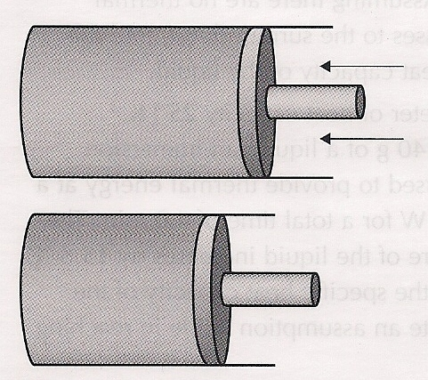
Molecular Explanation of Pressure
The two factors that affect pressure are speed of the molecules and frequency of the collisions
So what do you think will
happen if a gas is compressed
rapidly with a piston?

Slide 33
Molecular Explanation of Pressure
The two factors that affect pressure are speed of the molecules and frequency of the collisions
What if a gas is compressed
extremely slowly with the
piston?

Slide 34
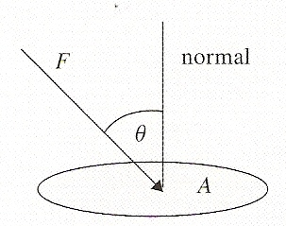
Pressure
Force per unit area
Only the force normal to the area
Unit is the Pascal (Pa) or Nm⁻²
Atmospheric pressure is 1.013 x 10⁵ Pa

Slide 35
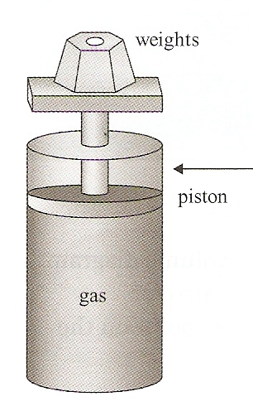
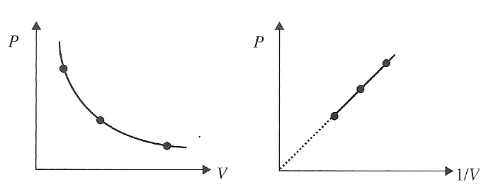
Boyle-Mariotte Law
At constant temperature and with a constant quantity of gas, pressure is inversely proportional to volume
The graph of pressure versus volume is a hyperbola, aka an isothermal curve

Slide 36
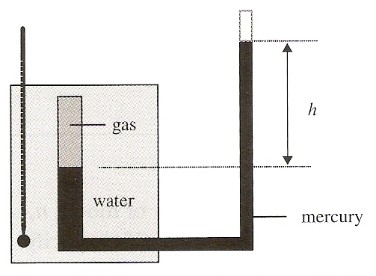
Volume-Temperature Law
When the temperature is expressed in Kelvin and pressure is kept constant, volume and temperature are proportional to each other

Slide 37
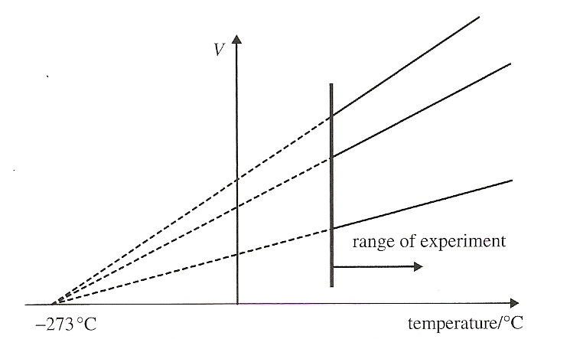
Volume-Temperature Law
When the temperature is expressed in Kelvin and pressure is kept constant, volume and temperature are proportional to each other
Graph of different quantities of the same gas or same gas at different pressures

Slide 38
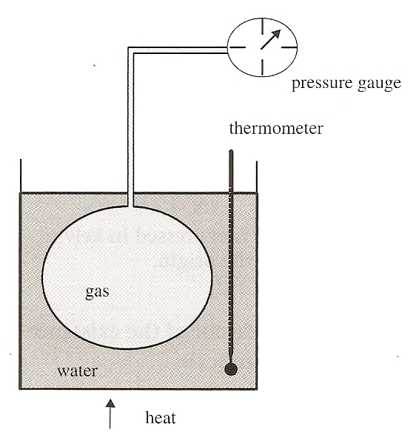
Pressure-Temperature Law
When the temperature is expressed in Kelvin and volume is kept constant, pressure and temperature are proportional to each other

Slide 39
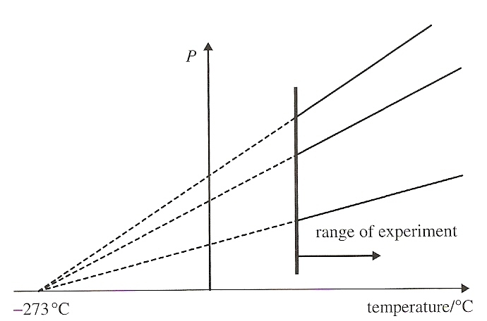
Pressure-Temperature Law
When the temperature is expressed in Kelvin and volume is kept constant, pressure and temperature are proportional to each other

Slide 40
Equation of State

Slide 41
Ideal Gas Law
An ideal gas will obey this law at all temperatures, pressures and volumes.
Real gases obey this law only for a certain range of temperatures, pressures and volumes.

Slide 42
Understandings:
Pressure
Equation of state for an ideal gas
Kinetic model of an ideal gas
Mole, molar mass and the Avogadro constant
Differences between real and ideal gases

Slide 43
Applications And Skills:
Solving problems using the equation of state for an ideal gas and gas laws
Sketching and interpreting changes of state of an ideal gas on pressure– volume, pressure–temperature and volume–temperature diagrams
Investigating at least one gas law experimentally

Slide 44
Data Booklet Reference:

Slide 45
Utilization:
Transport of gases in liquid form or at high pressures/densities is common practice across the globe. Behaviour of real gases under extreme conditions needs to be carefully considered in these situations.
Consideration of thermodynamic processes is essential to many areas of chemistry (see Chemistry sub-topic 1.3)
Respiration processes (see Biology sub-topic D.6)

Slide 46
Aims:
Aim 3: this is a good topic to make comparisons between empirical and theoretical thinking in science
Aim 6: experiments could include (but are not limited to): verification of gas laws; calculation of the Avogadro constant; virtual investigation of gas law parameters not possible within a school laboratory setting

Slide 47
Essential Idea:
The properties of ideal gases allow scientists to make predictions of the behavior of real gases.

Slide 48
Questions

Slide 49
Homework
#13-32

Slide 50
Stopped here 1/13/15

