Slide 1
Devil physics The baddest class on campus IB Physics

Slide 2
Lsn 3-1, Thermal Concepts

Slide 3
Questions From Reading Activity?

Slide 4
Essential Idea:
Thermal physics deftly demonstrates the links between the macroscopic measurements essential to many scientific models with the microscopic properties that underlie these models.

Slide 5
Nature Of Science:
Evidence through experimentation:
Scientists from the 17th and 18th centuries were working without the knowledge of atomic structure and sometimes developed theories that were later found to be incorrect, such as phlogiston and perpetual motion capabilities.
Our current understanding relies on statistical mechanics providing a basis for our use and understanding of energy transfer in science.

Slide 6
International-Mindedness:
Heat exists in every known country.
The topic of thermal physics is a good example of the use of international systems of measurement that allow scientists to collaborate effectively.
The concept of temperature is nearly universally accepted except among Phlogistonaries.

Slide 7
Theory Of Knowledge:
Observation through sense perception plays a key role in making measurements.
Does sense perception play different roles in different areas of knowledge?

Slide 8
Understandings:
Molecular theory of solids, liquids and gases
Temperature and absolute temperature
Internal energy
Specific heat capacity
Phase change
Specific latent heat

Slide 9
Applications And Skills:
Describing temperature change in terms of internal energy
Using Kelvin and Celsius temperature scales and converting between them
Applying the calorimetric techniques of specific heat capacity or specific latent heat experimentally

Slide 10
Applications And Skills:
Describing phase change in terms of molecular behaviour
Sketching and interpreting phase change graphs
Calculating energy changes involving specific heat capacity and specific latent heat of fusion and vaporization

Slide 11
Guidance:
Internal energy is taken to be the total intermolecular potential energy + the total random kinetic energy of the molecules
Phase change graphs may have axes of temperature versus time or temperature versus energy
The effects of cooling should be understood qualitatively but cooling correction calculations are not required

Slide 12
Data Booklet Reference:

Slide 13
Utilization:
Pressure gauges, barometers and manometers are a good way to present aspects of this sub-topic
Higher level students, especially those studying option B, can be shown links to thermodynamics (see option sub-topic B.4)
Particulate nature of matter (see Chemistry sub-topic 1.3) and measuring energy changes (see Chemistry sub-topic 5.1)
Water (see Biology sub-topic 2.2)

Slide 14
Aims:
Aim 3: an understanding of thermal concepts is a fundamental aspect of many areas of science
Aim 6: experiments could include (but are not limited to): transfer of energy due to temperature difference; calorimetric investigations; energy involved in phase changes

Slide 15
Introductory Video: Summary of Thermodynamics

Slide 16
Temperature
“Temperature is the intuitive concept of ‘hotness’ or ‘coldness’ of a substance
It is an indicator of the total energy of a substance but not a direct measurement of that energy

Slide 17
Measuring Temperature
We can measure temperature by calibrating properties of a substance (expansion / contraction, resistance, pressure or electric potential) to measure temperature
Most common device is a mercury thermometer – expansion/contraction of mercury in a tube
Any gas or liquid can be used so long as the scale is calibrated

Slide 18
Measuring Temperature
Boiling Point of Water
100º C
212º F
Freezing Point of Water
0º C
32º F

Slide 19
Measuring Temperature
Boiling Point of Water
100º C
212º F
100º
180º
Freezing Point of Water
0º C
32º F

Slide 20
Measuring Temperature
Boiling Point of Water
100º C
212º F
100º
180º
Freezing Point of Water
0º C
32º F

Slide 21
Measuring Temperature
Thermometers indicate the temperature of their own substance
To measure other objects, they must be brought into thermal contact with the object and allowed to reach thermal equilibrium with that object
This is an example of a thermal interaction which is a fancy way of saying heat exchange

Slide 22
Absolute Temperature
Based on absolute zero (0°K, -273°C) which is the temperature at which all molecular movement stops
Uses the Kelvin scale
Degrees are same magnitude as Celsius, but starts at absolute zero

Slide 23
Heat as Energy
“Heat is energy that is transferred from one body and into another as a result of a difference in temperature.”
All substances consist of molecules that are in constant motion and thus have kinetic energy
The temperature of an object reflects the total kinetic energy of the object:
Higher temperature = higher kinetic energy
Lower temperature = lower kinetic energy

Slide 24
Heat as Energy
There are also intermolecular bonds which determine the cohesiveness of an object
Solids have very strong bonds
Gases have very weak bonds
Liquids, ehhhhh
It takes work to separate molecules
Work = Energy, so
Energy (heat) is required to transform objects with strong bonds into objects with weaker bonds (liquids and gases)

Slide 25
Internal Energy
“The total kinetic energy of the molecules of a substance, plus any potential energy associated with forces between the molecules.”

Slide 26
Internal Energy
Shaking a box of lead pellets will ‘heat up’ the pellets which makes their temperature rise
Heat is not transferred, but rather work (shaking) has been transformed into energy
Placing those heated pellets in cool water will cause the pellets to cool down (heat is lost, temperature goes down) and the water to heat up (heat is gained, temperature increases)
Continues until reaching thermal equilibrium

Slide 27
Interrelationships
Heat – Internal Energy – Work
Separate concepts
Interact with one another
All three measured in Joules

Slide 28
Absolute Temperature
“Absolute temperature is a measure of the average kinetic energy of the molecules of a substance.”
“The average kinetic energy of the molecules is directly proportional to the absolute temperature in Kelvin.”

Slide 29
Specific Heat Capacity, c
When you add heat (thermal energy) to an object it will, most of the time, heat up
Specific heat capacity is the amount of thermal energy needed to raise the temperature of a mass of one kilogram of a substance by one Kelvin.

Slide 30
Specific Heat Capacity, c
The units for specific heat capacity are J/kg•K
Does the temperature have to be in Kelvin?
Can it be Celcius/centigrade?
Can it be Fahrenheit?

Slide 31
Specific Heat Capacity, c
The units for specific heat capacity are J/kg•K
Does the temperature have to be in Kelvin?
Can it be Celcius/centigrade? YES
Can it be Fahrenheit? NO

Slide 32
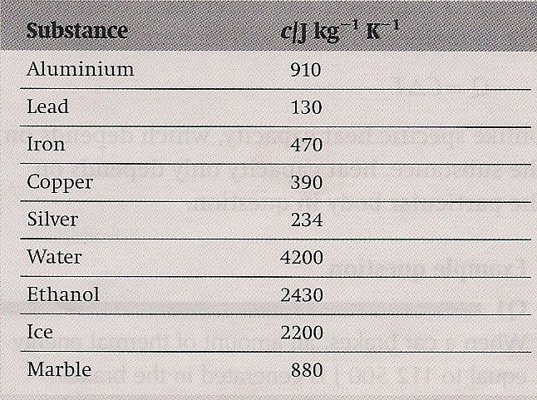
Specific Heat Capacity, c
Specific heat capacity is a property of the material you are dealing with.
To be specific, specific heat capacity is specific to each specific material, specifically speaking.

Slide 33
Specific Heat Capacity, c
What is the difference in thermal energy required to raise the temperature of 10kg of aluminum and lead by 10 K?

Slide 34
Specific Heat Capacity, c
What is the difference in thermal energy required to raise the temperature of 10kg of aluminum and lead by 10 K?
Aluminum = 91,000 J
Lead = 13,000 J
78,000 J
Al is 600% more than Pb

Slide 35
Specific Heat Capacity, c
What is the difference in thermal energy required to raise the temperature of 1 mol of aluminum and lead by 10 K?

Slide 36
Specific Heat Capacity, c
What is the difference in thermal energy required to raise the temperature of 1 mol of aluminum and lead by 10 K?
mol_{Al} = 27 g = 246 J
mol_{Pb} = 207 g = 269 J
= 23 J
Pb is 9% more than Al
How come?

Slide 37
Specific Heat Capacity, c
Thermal energy increases the kinetic energy of the molecules which causes temperature to increase.
1 kg of each substance gives a large difference in the number of molecules
1 mol of each substance gives the same number of molecules with a negligible difference in masses

Slide 38
Heat Capacity, C
Equal to mass times specific heat capacity
The amount of thermal energy required to change the temperature of a body by one Kelvin
Useful when dealing with a system of objects
If we know the heat capacity of the system,

Slide 39
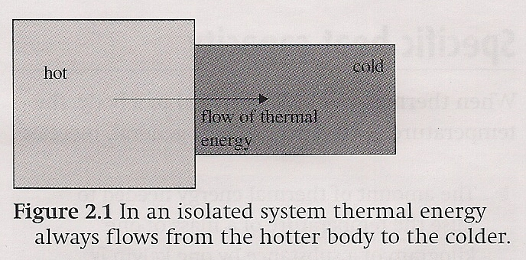
Thermal Equilibrium
Thermal energy will always flow from a hot body to a colder body
As long as there is a means of conducting that energy, the energy will flow until both bodies are at the same temperature which is, thermal equilibrium

Slide 40
Phases of Matter
Solid
High density – high potential energy
Molecules in fixed positions
Vibrations with small displacement
Liquid
Lower density – lower potential energy
Molecules can move freely
Gas
Least dense – large separation between molecules
Almost no potential energy
Almost no resistance to molecular movement

Slide 41
Phases of Matter
Intermolecular forces highest in solids, lowest in gases
As heat is added to solids, molecules remain fixed in position, but amplitude of vibrations increases – higher temperature
Eventually reach a point where kinetic energy of molecules overcomes intermolecular bonds and the solid melts – a phase transition – but intermolecular forces are still significant (liquids hold their cohesiveness)

Slide 42
Phases of Matter
If more heat is added, the separation of the molecules increases to the point where intermolecular forces (attraction) become insignificant and the molecules go willy nilly all over the place like freshman on lunch break – i.e. the object has become a gas

Slide 43
Change of State
One example is golfer Phil Mickelson moving from California to Texas to avoid paying state income taxes
What we are more concerned with is the change in the physical state of matter
There are four states of matter:
Solid
Liquid
Gas
Plasma

Slide 44
Change of State
Solid
Liquid
Gas
Plasma
In general, these states of matter are a function of temperature with solids being the coldest and plasma being the hottest
When thermal energy is added to a body, it increases in temperature
Temperature increases until the body reaches a transition point determined by its physical and chemical properties
Further energy added will cause a change of state

Slide 45
Change of State
Solid
Liquid
Gas
Plasma
Melting point
Point at which a substance transitions from a solid to a liquid or vice versa if thermal energy is being extracted
Once the melting point is reached, further energy is required to provide the work needed to overcome the intermolecular bonds which hold the solid together
Temperature will remain constant during this transition
Once melting is complete, additional energy added will increase the temperature of the liquid

Slide 46
Change of State
Solid
Liquid
Gas
Plasma
Melting point
The thermal energy required to melt a given substance is called the specific latent heat of fusion, L_{f}
The units for specific latent heat of fusion are, J/kg

Slide 47
Change of State
Solid
Liquid
Gas
Plasma
Boiling point
Point at which a substance transitions from a liquid to a gas or vice versa if thermal energy is being extracted
Once the boiling point is reached, further energy is required to provide the work needed to overcome the intermolecular forces which hold the liquid together, i.e. to further separate them
Temperature will remain constant during this transition
Once boiling is complete, additional energy added will increase the temperature of the gas

Slide 48
Change of State
Solid
Liquid
Gas
Plasma
Boiling point
The thermal energy required to turn a given liquid into a gas is called the specific latent heat of vaporization, L_{v}

Slide 49
Change of State
Solid
Liquid
Gas
Plasma
Gas to Plasma
Not assessed by IB or discussed in Tsokos
At extremely high temperatures, electrons have so much energy that it overcomes the electromagnetic attraction of the nucleus
Electrons separate from the nucleus and we are left with a mixture of electrons and nuclei

Slide 50
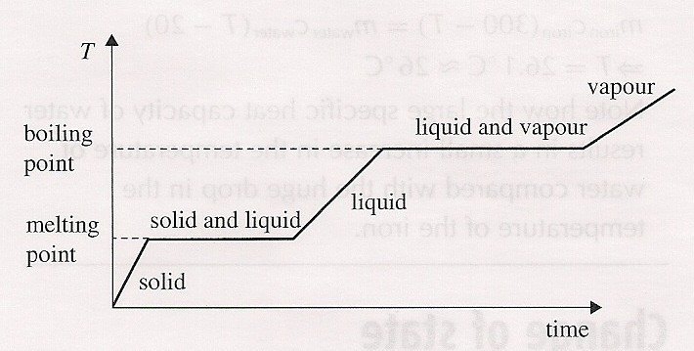
Change of State
Solid
Liquid
Gas
Sample Problem
How much heat is required to completely vaporize 10 kg of lead at 25° C?

Slide 51
Change of State
Solid
Liquid
Gas
Plasma
Specific Latent Heats
Amount of heat needed to change the state of a unit mass of a material at its specific melting / boiling point
Latent Heats (Not Specific)
The amount of heat needed to change the state of a material irrespective of mass

Slide 52
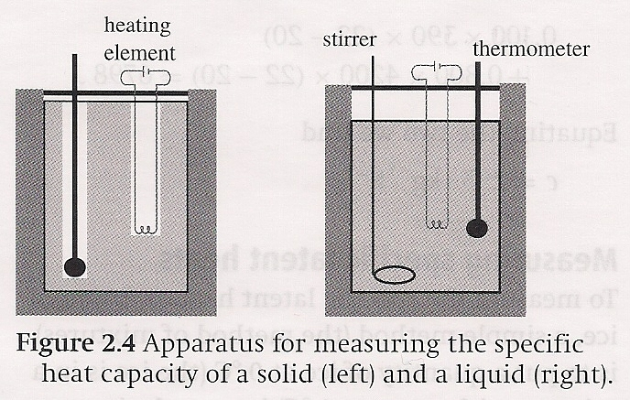
Measuring Specific Heat – Method of Mixtures
In order to determine the specific heat of a substance, we need to measure
The amount of heat added
Mass of the substance
The change in temperature
Calorimetry

Slide 53
Measuring Specific Heat – Method of Mixtures
A second method is to drop a hot substance into a cold liquid whose specific heat is known
By obtaining an equilibrium temperature we can calculate the unknown specific heat
Calorimetry

Slide 54
Measuring Specific Latent Heats
A similar method can be used to determine the latent heat of fusion
Drop a cold solid substance at its melting temperature into a warm liquid mixture of the same substance
By measuring the temperature change of the liquid we can calculate the energy given up by the liquid that was used to melt the solid

Slide 55
Measuring Specific Latent Heats
Specific heat of vaporization can be measured using the device shown at right
Measure the amount of heat added to a liquid in a double container
As the liquid vaporizes, it leaves the inner container, condenses on the outer container, and then drips down and is collected in a beaker at the bottom

Slide 56
Evaporation
The molecules of a liquid are constantly moving at various speeds
At the surface of the liquid, the fastest of these molecules may contain enough energy to break free and enter the atmosphere as vapour (vapor)
When that molecule has left, the total kinetic energy of the liquid has decreased which means its temperature will drop

Slide 57
Evaporation
Rate of evaporation increases with surface area and temperature of the liquid
In an enclosed system, the escaping vapour creates vapour pressure above the surface of the liquid causing some of the molecules to re-enter the liquid
Evaporation continues until equilibrium is reached where as many molecules leave the liquid as those that return
The air is then considered saturated

Slide 58
Understandings:
Molecular theory of solids, liquids and gases
Temperature and absolute temperature
Internal energy
Specific heat capacity
Phase change
Specific latent heat

Slide 59
Data Booklet Reference:

Slide 60
Applications And Skills:
Describing temperature change in terms of internal energy
Using Kelvin and Celsius temperature scales and converting between them
Applying the calorimetric techniques of specific heat capacity or specific latent heat experimentally

Slide 61
Applications And Skills:
Describing phase change in terms of molecular behaviour
Sketching and interpreting phase change graphs
Calculating energy changes involving specific heat capacity and specific latent heat of fusion and vaporization

Slide 62
Essential Idea:
Thermal physics deftly demonstrates the links between the macroscopic measurements essential to many scientific models with the microscopic properties that underlie these models.

Slide 63
Questions?

Slide 64
Homework
#1-12

