Slide 1
Devil Physics Baddest Class on Campus IB Physics

Slide 2
Lesson 2-1C Projectile Motion Fluid Resistance

Slide 3
Introduction Videos
Projectile Motion 1
Useful Applications of Projectile Motion

Slide 4
Essential Idea:
Motion may be described and analyzed by the use of graphs and equations.

Slide 5
Nature Of Science:
Observations: The ideas of motion are fundamental to many areas of physics, providing a link to the consideration of forces and their implication. The kinematic equations for uniform acceleration were developed through careful observations of the natural world.

Slide 6
International-Mindedness:
International cooperation is needed for tracking shipping, land-based transport, aircraft and objects in space.

Slide 7
Theory Of Knowledge:
The independence of horizontal and vertical motion in projectile motion seems to be counter-intuitive.
How do scientists work around their intuitions?
How do scientists make use of their intuitions?

Slide 8
Understandings:
Projectile motion
Fluid resistance and terminal speed

Slide 9
Applications And Skills:
Analyzing projectile motion, including the resolution of vertical and horizontal components of acceleration, velocity and displacement.
Qualitatively describing the effect of fluid resistance on falling objects or projectiles, including reaching terminal speed.

Slide 10
Guidance:
Calculations will be restricted to those neglecting air resistance.
Projectile motion will only involve problems using a constant value of g close to the surface of the Earth.
The equation of the path of a projectile will not be required.

Slide 11
Data Booklet Reference:

Slide 12
Utilization:
Diving, parachuting and similar activities where fluid resistance affects.
The accurate use of ballistics requires careful analysis.
Quadratic functions (see Mathematics HL sub-topic 2.6; Mathematics SL sub-topic 2.4; Mathematical studies SL sub-topic 6.3).
The kinematic equations are treated in calculus form in Mathematics HL sub-topic 6.6 and Mathematics SL sub-topic 6.6.

Slide 13
Aims:
Aim 2: much of the development of classical physics has been built on the advances in kinematics

Slide 14
Aims:
Aim 6: experiments, including use of data logging, could include (but are not limited to): determination of g, estimating speed using travel timetables, analyzing projectile motion, and investigating motion through a fluid

Slide 15
Aims:
Aim 7: technology has allowed for more accurate and precise measurements of motion, including video analysis of real-life projectiles and modeling/simulations of terminal velocity

Slide 16
Where We’ve Been
One Dimensional Motion

Slide 17
Horizontal Motion

Slide 18
Kinematic Equations for Horizontal Motion

Slide 19
Vertical Motion – Drop Problems

Slide 20
Vertical Motion with Vertical Velocity

Slide 21
Kinematic Equations
Horizontal
Vertical

Slide 22
Kinematic Equations
IB Style

Slide 23
Where We’ve Been
Vectors

Slide 24
Vectors and Scalars

Slide 25
Vector Addition - Graphically

Slide 26
Vector Subtraction - Graphically

Slide 27
Breaking Vectors Down Into Components

Slide 28
Adding Vectors Using Components

Slide 29
Putting It All Together

Slide 30
Two Dimensional Projectile Motion – Case 1

Slide 31
Two Dimensional Projectile Motion – Case 2

Slide 32
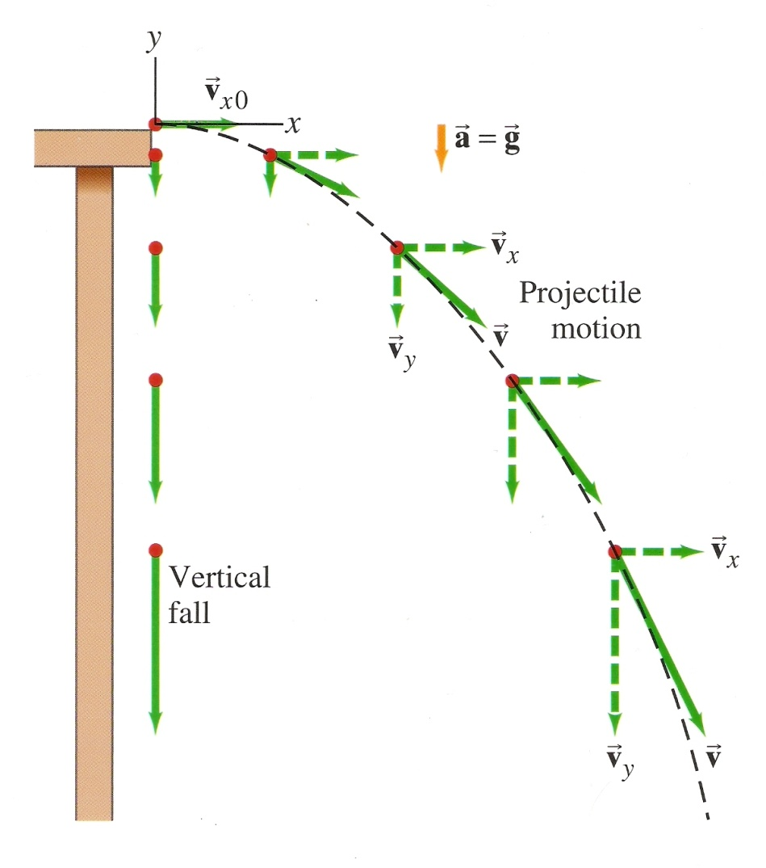
Thanks, Galileo

Slide 33
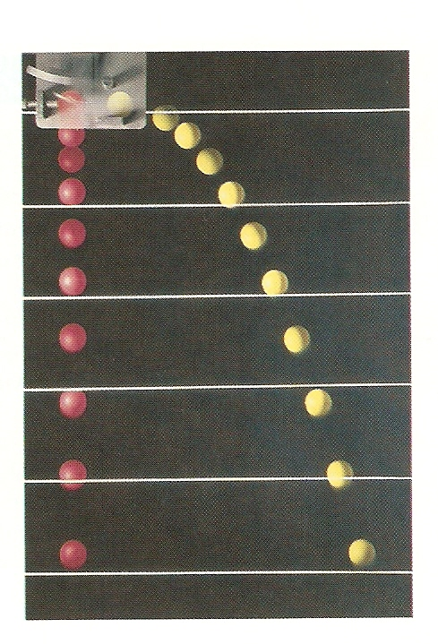
One Key Finding
The time it takes for an object to fall from a given height is the same whether it is simply dropped or if it begins with a horizontal velocity.
Demonstration

Slide 34
Kinematic Equations
Horizontal
Vertical

Slide 35
Assumptions
We consider motion only after it has been projected and is moving freely through the air
We don’t consider the acceleration it took to reach that velocity
We consider air resistance to be negligible
When the object is moving through the air, both horizontally and vertically, it doesn’t slow down due to air resistance

Slide 36
Make the Math Easier
No horizontal acceleration, horizontal velocity remains constant
Y-axis positive up, gravity negative down
Acceleration in Parabolic Motion

Slide 37
Kinematic Equations for Projectile Motion

Slide 38
Kinematic Equations for Projectile Motion

Slide 39
Problem Solving Process – Extra Steps
Read the problem carefully and draw a picture
Choose origin and x-y coordinate system
If given an initial velocity, resolve it into x- and y-components.
Analyze horizontal (x) and vertical (y) motion separately
Continue with problem solving process for kinematic equations

Slide 40
Manipulation of Variables Projectile Motion Simulator

Slide 41
Fluid Resistance
Fluid resistance, or drag force, acts opposite to the direction of motion.
The force due to drag is given by the equation (not testable)
For our purposes, fluid resistance is proportional to velocity at low speeds and velocity squared at high speeds

Slide 42
Effect of Fluid Resistance

Slide 43
Fluid Resistance
Sequence of events:
An object starts falling under the force of gravity with acceleration of 9.81 m/s² and no resistance
As velocity increases, fluid resistance increases and acceleration decreases
Eventually, the object reaches a speed where fluid resistance equals the force of gravity, acceleration has decreased to zero, and velocity is constant
This constant velocity is known as terminal velocity or terminal speed

Slide 44
Terminal Velocity
The equation for terminal velocity based on the drag force is given to the right
For our purposes, we will assume low speed (F_{D} ≈ v) and terminal velocity will be

Slide 45
Data Booklet Reference:

Slide 46
Applications And Skills:
Analyzing projectile motion, including the resolution of vertical and horizontal components of acceleration, velocity and displacement.
Qualitatively describing the effect of fluid resistance on falling objects or projectiles, including reaching terminal speed.

Slide 47
Understandings:
Projectile motion
Fluid resistance and terminal speed

Slide 48
Essential Idea:
Motion may be described and analyzed by the use of graphs and equations.

Slide 49
Questions?

Slide 50
Homework
Pg. 56-57, #25-33

Slide 51
Weightlessness
On Skis
On A Motorcycle
Sphere of Death

