Slide 1
Devil physics The baddest class on campus IB Physics

Slide 2
Tsokos Lesson 10-1 Describing Fields

Slide 3
Essential Idea:
Electric charges and masses each influence the space around them and that influence can be represented through the concept of fields.

Slide 4
Nature Of Science:
Paradigm shift: The move from direct, observable actions being responsible for influence on an object to acceptance of a field’s “action at a distance” required a paradigm shift in the world of science.

Slide 5
Theory Of Knowledge:
Although gravitational and electrostatic forces decrease with the square of distance and will only become zero at infinite separation, from a practical standpoint they become negligible at much smaller distances.
How do scientists decide when an effect is so small that it can be ignored?

Slide 6
Understandings:
Gravitational fields
Electrostatic fields
Electric potential and gravitational potential
Field lines
Equipotential surfaces

Slide 7
Applications And Skills:
Representing sources of mass and charge, lines of electric and gravitational force, and field patterns using an appropriate symbolism
Mapping fields using potential
Describing the connection between equipotential surfaces and field lines

Slide 8
Guidance:
Electrostatic fields are restricted to the radial fields around point or spherical charges, the field between two point charges and the uniform fields between charged parallel plates
Gravitational fields are restricted to the radial fields around point or spherical masses and the (assumed) uniform field close to the surface of massive celestial bodies and planetary bodies

Slide 9
Guidance:
Students should recognize that no work is done in moving charge or mass on an equipotential surface

Slide 10
Data Booklet References:

Slide 11
Utilization:
Knowledge of vector analysis is useful for this sub-topic

Slide 12
Aim
Models developed for electric and gravitational fields using lines of forces allow predictions to be made but have limitations in terms of the finite width of a line

Slide 13
Introductory Video The Force of Gravity

Slide 14
Newton’s 2nd Law
Newton’s second law (F=ma) implies that if a mass is accelerating, there must be a force acting on it
An object falls because of gravity
What holds planets in their orbits?

Slide 15
Newton’s 2nd Law
Newton’s second law (F=ma) implies that if a mass is accelerating, there must be a force acting on it
An object falls because of gravity
What holds planets in their orbits?
Gravitational Force

Slide 16
Newton’s Law of Gravitation
The attractive force between two point masses is,
Where,
M1 and M2 are the masses of the attracting bodies
r is the distance between them
G is Newton’s constant of universal gravitation and has a value of 6.667 x 10⁻¹¹ N m² kg⁻²

Slide 17
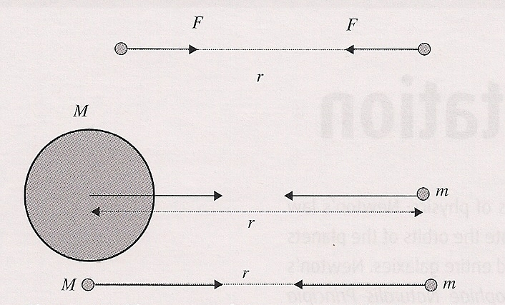
Newton’s Law of Gravitation
The direction of the force is along the line joining the two masses,

Slide 18
Newton’s Law of Gravitation
The formula applies to point masses, which means the masses are small in relation to the separation between them

Slide 19
Gravitational Field Strength
The gravitational field strength at a certain point is the force per unit mass experienced by a small point mass, m, at that point.

Slide 20
Gravitational Field Strength
The units of gravitational field strength are N⋅kg⁻¹
1N = 1 kg ⋅m ⋅ s⁻²
So units become m ⋅ s⁻²

Slide 21
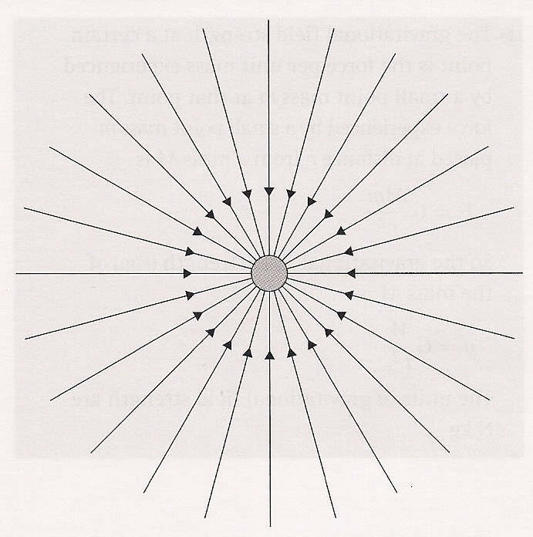
Gravitational Field Strength
Gravitational field strength is a vector quantity whose direction is given by the direction of the force a point mass would experience if placed at the point of interest.

Slide 22
Gravitational Field Strength
The gravitational field strength around a single point mass is radial which means it is the same for all points equidistant from the center of mass and directed toward the center.

Slide 23
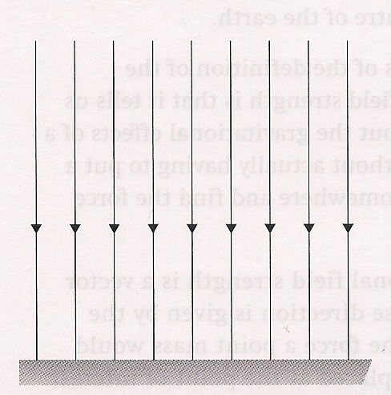
Gravitational Field Strength
On a micro- versus macro-level (like the projectile motion of a football), the field strength can be considered to be uniform with a constant value.

Slide 24
Gravitational Potential Energy
The gravitational potential energy of two bodies is the work that was done in bringing the bodies to their present position from infinitely far apart.
Negative sign signifies a force of attraction

Slide 25
Gravitational Potential Energy
The gravitational potential at a point P in a gravitational field is the work done per unit mass in bringing a small point mass m from infinity to point P.

Slide 26
Gravitational Potential Energy
Gravitational potential is a scalar quantity
Units are J/kg (work per unit mass)

Slide 27
Gravitational Potential Energy
If a point mass m is moved from point P to point Q, it has a change in potential
It takes work to do this, thus it also has a change in potential energy

Slide 28
Gravitational Potential Energy
The work done is dependent only on the change in position, not on the path taken
The movement must be done at a very small constant speed so that kinetic energy is not involved

Slide 29
Introductory Video: Electric Fields and Potential

Slide 30
Electric Field
An electric field exists around any charged object and extends/radiates either into or out of the object
By convention, charge flows from positive to negative so,
For a positively charged object, the field lines extend outward

Slide 31
Electric Field
For a positively charged object, the field lines extend outward
For a negatively charged object, the field lines extend inward
+
-

Slide 32
Electric Field
The field does not “exist” unless shown to exist by a charge
We use a small positive test charge, q, to determine if a field exists – bring the test charge close and if it experiences a force, then a field exists

Slide 33
Electric Field
Electric field is defined as the force per unit charge experienced by a small positive test charge, q,
The electric field is a vector with direction being the same as the force a positive charge would experience at the given point
+

Slide 34
Electric Field
Units for electric field is N/C

Slide 35
Electric Field
The electric field from a single point charge, Q, at a point a distance r away is

Slide 36
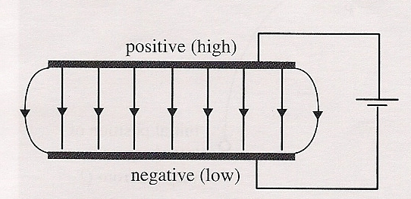
Electric Potential Energy
Consider an electric field and a positive test charge q
In order to move the charge from its equilibrium position, work must be done

Slide 37
Electric Potential Energy
If held in that new position, the test charge now has potential energy like a compressed spring because it wants to go back to its equilibrium position

Slide 38
Electric Potential Energy
It takes work to move the charge from one places to another
The amount of work is equal to the change in potential energy

Slide 39
Electric Potential Energy
Just as gravitational potential (V_{g}) is equal to work per unit mass, electric potential (V_{e}) is equal to work per unit charge

Slide 40
Electric Potential Energy
The electric potential at a point P is the amount of work done per unit charge as a small positive test charge q is moved from infinity to the point P.
The unit of potential is the volt (V), and 1V = 1J/C

Slide 41
Electric Potential
“V” is the electric potential and is defined in terms of the work, W, needed to bring a positive test charge, q, from very far away to a position close to the charged body
Remember that work is based on displacement and not distance travelled!

Slide 42
Potential Difference
The amount of work needed to move a test charge from one point to another is equal to the change in potential energy of the charge
Just like gravity

Slide 43
Summary
Potential
Force Field Potential Energy
Gravity
Electricity

Slide 44
Video: Equipotentials and Fields

Slide 45
Equipotential Surfaces
What is this?

Slide 46
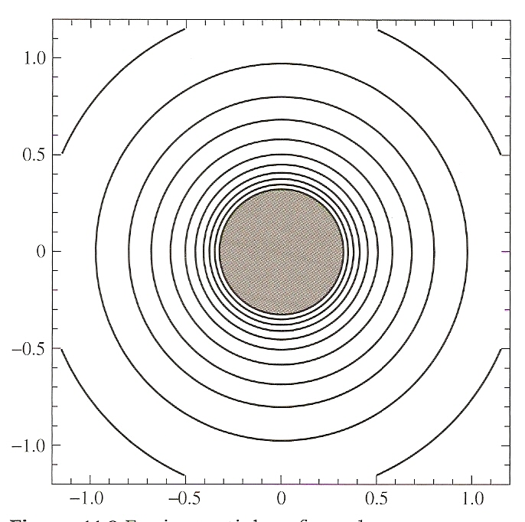
Equipotential Surfaces
Gravitational potential is given by
An equipotential surface consists of those points that have the same potential

Slide 47
Equipotential Surfaces

Slide 48
Equipotential Surfaces

Slide 49
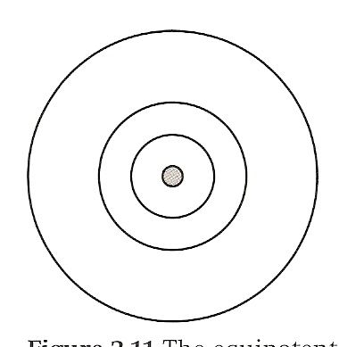
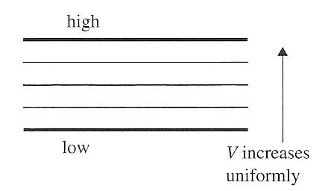
Equipotential Surfaces
For electricity, equipotential surfaces or lines are areas where the potential around a charge are equal, just like the contour lines on a topographical map

Slide 50
Equipotential Surfaces
All points a given distance from the center of a sphere will have the same potential
All points a given perpendicular distance from a parallel plate will have the same potential

Slide 51
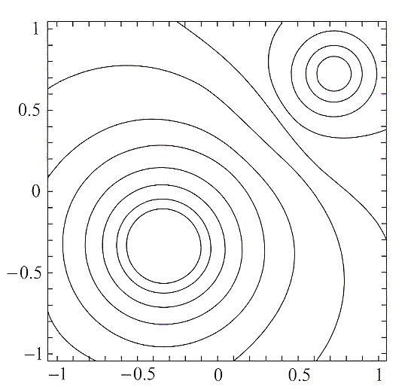
Equipotential Surfaces
Equipotential lines for two opposite charges of different magnitudes
Movement along an equipotential line requires no work because there is no change in potential

Slide 52
Connection Between Electric Field and Electric Potential
The electric field strength (E) is equal to the change in potential divided by the distance over which that change takes place
Thus the field strength is equal to the potential gradient
If the potential is constant, the field strength is zero
Potential inside a sphere is constant so the field is zero

Slide 53
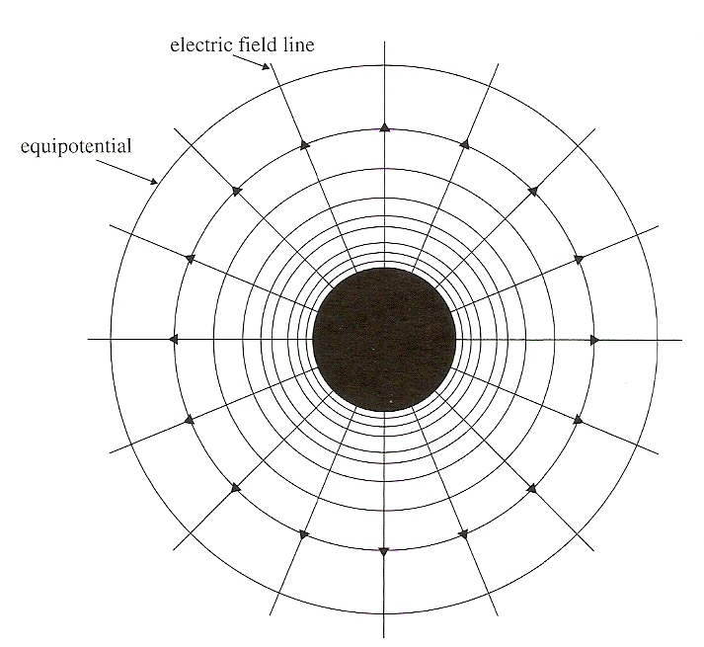
Connection Between Electric Field and Electric Potential
Since there is no potential difference along an equipotential line, the field is zero along those lines

Slide 54
Connection Between Electric Field and Electric Potential
Since there IS a potential difference BETWEEN equipotential lines, and because field strength is based on displacement, the electric field is must be normal to those lines

Slide 55
Connection Between Electric Field and Electric Potential
The surfaces of conductors are areas of equipotential
Field lines run perpendicular to the surface of conductors
If they didn’t there would be a component parallel to the equipotential surface and that can’t happen

Slide 56
Connection Between Electric Field and Electric Potential

Slide 57
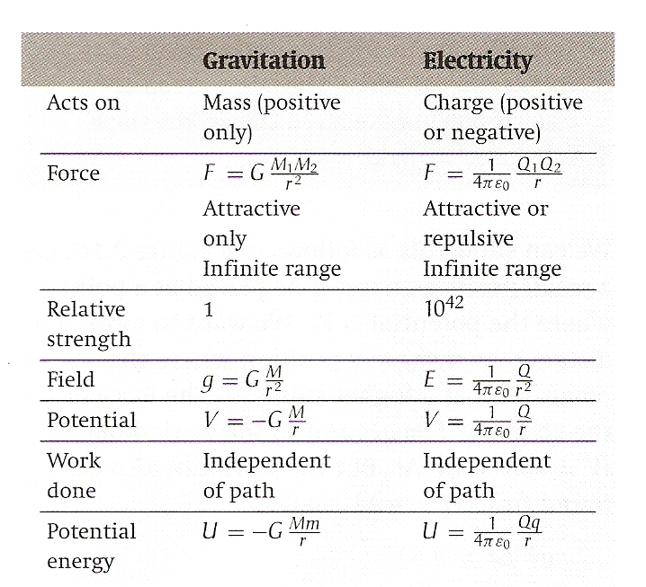
Electricity Vs Gravitation
Comparison of Newton’s Law of Gravitation and Coulomb’s Law

Slide 58
Parallel Plates
Uniform Electric Field exists when the field has a constant magnitude and direction such as that generated by two oppositely charged parallel plates.

Slide 59
Parallel Plates
The field lines at the edges begin to curve
The field is uniform if the length of the field is large compared to the distance between the plates

Slide 60
Electric Field between parallel plates
The electric field, E, between two parallel plates is equal to the potential difference between the plates, V, divided by the distance between the plates, d
Note that E is the electric field – E does not stand for energy!

Slide 61
Understandings:
Gravitational fields
Electrostatic fields
Electric potential and gravitational potential
Field lines
Equipotential surfaces

Slide 62
Guidance:
Electrostatic fields are restricted to the radial fields around point or spherical charges, the field between two point charges and the uniform fields between charged parallel plates
Gravitational fields are restricted to the radial fields around point or spherical masses and the (assumed) uniform field close to the surface of massive celestial bodies and planetary bodies

Slide 63
Guidance:
Students should recognize that no work is done in moving charge or mass on an equipotential surface

Slide 64
Data Booklet References:

Slide 65
Applications And Skills:
Representing sources of mass and charge, lines of electric and gravitational force, and field patterns using an appropriate symbolism
Mapping fields using potential
Describing the connection between equipotential surfaces and field lines

Slide 66
Essential Idea:
Electric charges and masses each influence the space around them and that influence can be represented through the concept of fields.

Slide 67
Questions?

Slide 68
Homework
#1-21

