Slide 1
Devil Physics Baddest Class on Campus IB Physics

Slide 2
Lesson 6-1 Circular Motion and Gravitation

Slide 3
Review Quiz
Give the equation for work done by a force.
Given a graph of force versus displacement, how would you determine the work done by a varying force?
State the equations for:
Kinetic energy,
Gravitational potential energy,
Elastic potential energy,
True or False. Gravitational potential energy can only be calculated by measuring heights from the lowest point to the highest point.

Slide 4
Review Quiz
True or False. When friction forces are absent, the total mechanical energy is not conserved.
State the work-kinetic energy relation
When external forces are present, what is the relationship between work done and mechanical energy?

Slide 5
Review Quiz
State the definition of power, and its very useful form in mechanics.
True or False. In all collisions momentum is always conserved, but kinetic energy is only conserved in elastic collisions

Slide 6
Review Quiz -- Answers
Give the equation for work done by a force.
Given a graph of force versus displacement, how would you determine the work done by a varying force?
Understand that the work done by a varying force is given by the area under the graph of force versus displacement
State the equations for:
Kinetic energy,
Gravitational potential energy,
Elastic potential energy,

Slide 7
Review Quiz -- Answers
True or False. Gravitational potential energy can only be calculated by measuring heights from the lowest point to the highest point.
True or False. When friction forces are absent, the total mechanical energy is not conserved.
State the work-kinetic energy relation
When external forces are present, what is the relationship between work done and mechanical energy?

Slide 8
Review Quiz -- Answers
State the definition of power, , and its very useful form in mechanics,
True or False. In all collisions momentum is always conserved, but that kinetic energy is only conserved in elastic collisions

Slide 9
Britannica Concise Encyclopedia uniform circular motion
Motion of a particle moving at a constant speed on a circle. Though the magnitude of the velocity of such an object may be constant, the object is constantly accelerating because its direction is constantly changing. At any given instant its direction is perpendicular to a radius of the circle drawn to the point of location of the object on the circle. The acceleration is strictly a change in direction and is a result of a force directed toward the centre of the circle. This centripetal force causes centripetal acceleration.

Slide 10
Uniform Circular Motion

Slide 11
Essential Idea:
A force applied perpendicular to its displacement can result in circular motion.

Slide 12
Nature Of Science:
Observable universe: Observations and subsequent deductions led to the realization that the force must act radially inwards in all cases of circular motion.

Slide 13
International-Mindedness:
International collaboration is needed in establishing effective rocket launch sites to benefit space programs.

Slide 14
Theory Of Knowledge:
Foucault’s pendulum gives a simple observable proof of the rotation of the earth, which is largely unobservable.
How can we have knowledge of things that are unobservable?

Slide 15
Understandings:
Period, frequency, angular displacement and angular velocity
Centripetal force
Centripetal acceleration

Slide 16
Applications And Skills:
Identifying the forces providing the centripetal forces such as tension, friction, gravitational, electrical, or magnetic

Slide 17
Applications And Skills:
Solving problems involving centripetal force, centripetal acceleration, period, frequency, angular displacement, linear speed and angular velocity

Slide 18
Applications And Skills:
Qualitatively and quantitatively describing examples of circular motion including cases of vertical and horizontal circular motion

Slide 19
Guidance:
Banking will be considered qualitatively only

Slide 20
Data Booklet Reference:

Slide 21
Utilization:
Motion of charged particles in magnetic fields (see Physics sub-topic 5.4)
Mass spectrometry (see Chemistry sub-topics 2.1 and 11.3)
Playground and amusement park rides often use the principles of circular motion in their design

Slide 22
Aims:
Aim 6: experiments could include (but are not limited to): mass on a string; observation and quantification of loop-the-loop experiences; friction of a mass on a turntable
Aim 7: technology has allowed for more accurate and precise measurements of circular motion, including data loggers for force measurements and video analysis of objects moving in circular motion

Slide 23
Circular Motion and Centripetal Acceleration
T is the period in seconds – the time it takes to make one revolution
2πR is the circumference or distance around the circle

Slide 24
Circular Motion and Centripetal Acceleration
Angular Speed
In one period, the object will sweep out an angle of 2π radians (one circle)
Units are radians per second or just s⁻¹

Slide 25
Circular Motion and Centripetal Acceleration
Angular Speed
Since frequency is the inverse of period, angular speed can also be given in terms of frequency

Slide 26
Circular Motion and Centripetal Acceleration
Even though speed is constant, velocity is not because it is constantly changing direction
Since the velocity changes, we have acceleration

Slide 27
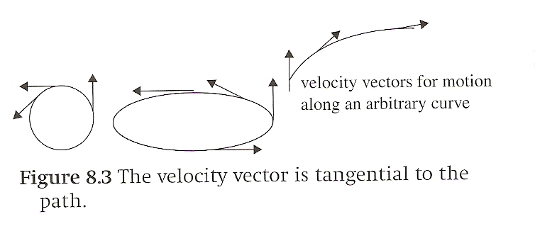
Circular Motion and Centripetal Acceleration
In any non-linear motion, velocity is a vector that is always tangent to the displacement

Slide 28
Circular Motion and Centripetal Acceleration
In circular motion, velocity is a vector that is always tangent to the circle

Slide 29
Circular Motion and Centripetal Acceleration
When Δt is taken to be infinitely small, the difference between Δr and Δs, the arc length, becomes insignificant

Slide 30
Circular Motion and Centripetal Acceleration

Slide 31
Circular Motion and Centripetal Acceleration
A body moving along a circle of radius R with a speed v experiences centripetal acceleration that has magnitude given by
and is directed toward the centre of the circle

Slide 32
Circular Motion and Centripetal Acceleration
In terms of angular speed,

Slide 33
Circular Motion and Centripetal Acceleration
In terms of angular speed,

Slide 34
Tangential Acceleration
If the magnitude of the velocity changes, we have tangential acceleration.
This is a vector in the same direction as the velocity vector if speed is increasing, in the opposite direction if decreasing

Slide 35
Tangential and Centripetal Acceleration
When velocity direction and magnitude are changing, we have both centripetal acceleration and tangential acceleration
The total acceleration is the vector sum of the vectors representing these accelerations

Slide 36
Centripetal Forces
If a mass moves in a circle, there must be a force present because we have mass and acceleration
If the speed is constant (no tangential acceleration), the direction of the acceleration, and therefore the force, are toward the centre of the circle

Slide 37
Centripetal Forces

Slide 38
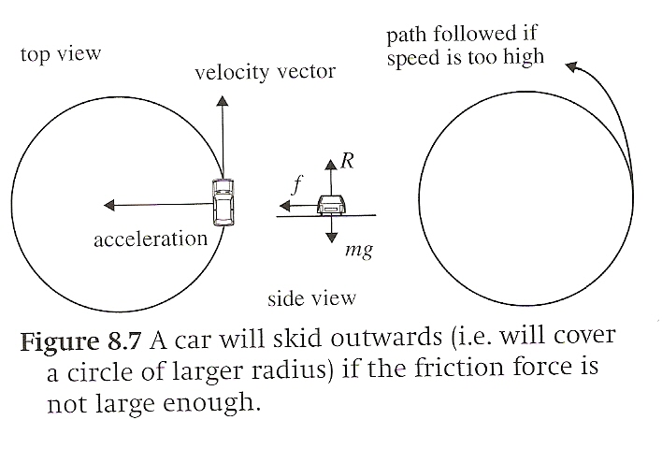
Centripetal Forces
Think of a car driving in a circle;
The force of friction between the tires and the road provide the centripetal force

Slide 39
Centripetal Forces
Since the centripetal force is at right angles to the motion, there is never any work done

Slide 40
Ball on a String
Can a ball on a string rotate in a plane parallel to the earth’s surface, i.e. horizontally?

Slide 41
Ball on a String
F_{g}
Can a ball on a string rotate in a plane parallel to the earth’s surface, i.e. horizontally?
If so, what is supporting its weight?

Slide 42
Ball on a String
F_{T-x} = F_{c}
F_{T-y} = F_{g}
F_{T}
F_{g}

Slide 43
Summary Video

Slide 44
Understandings:
Period, frequency, angular displacement and angular velocity
Centripetal force
Centripetal acceleration

Slide 45
Data Booklet Reference:

Slide 46
Applications And Skills:
Identifying the forces providing the centripetal forces such as tension, friction, gravitational, electrical, or magnetic

Slide 47
Applications And Skills:
Solving problems involving centripetal force, centripetal acceleration, period, frequency, angular displacement, linear speed and angular velocity

Slide 48
Applications And Skills:
Qualitatively and quantitatively describing examples of circular motion including cases of vertical and horizontal circular motion

Slide 49
Essential Idea:
A force applied perpendicular to its displacement can result in circular motion.

Slide 50
Devil Physics IB Physics
Questions?

Slide 51
Homework
Page 257-258, #1-14

