Slide 1
Devil physics The baddest class on campus IB Physics

Slide 2
Lsn 2-3: Work, Energy and Power

Slide 3
Questions From Reading Activity?

Slide 4
Essential Idea:
The fundamental concept of energy lays the basis upon which much of science is built.

Slide 5
Nature Of Science:
Theories:
Many phenomena can be fundamentally understood through application of the theory of conservation of energy.
Over time, scientists have utilized this theory both to explain natural phenomena and, more importantly, to predict the outcome of previously unknown interactions.
The concept of energy has evolved as a result of recognition of the relationship between mass and energy.

Slide 6
Theory Of Knowledge:
To what extent is scientific knowledge based on fundamental concepts such as energy?
What happens to scientific knowledge when our understanding of such fundamental concepts changes or evolves?

Slide 7
Understandings:
Kinetic energy
Gravitational potential energy
Elastic potential energy
Work done as energy transfer
Power as rate of energy transfer
Principle of conservation of energy
Efficiency

Slide 8
Applications And Skills:
Discussing the conservation of total energy within energy transformations
Sketching and interpreting force–distance graphs
Determining work done including cases where a resistive force acts
Solving problems involving power
Quantitatively describing efficiency in energy transfers

Slide 9
Guidance:
Cases where the line of action of the force and the displacement are not parallel should be considered
Examples should include force–distance graphs for variable forces

Slide 10
Data Booklet Reference:

Slide 11
Utilization:
Energy is also covered in other group 4 subjects (for example, see: Biology topics 2, 4 and 8; Chemistry topics 5, 15, and C; Sports, exercise and health science topics 3, A.2, C.3 and D.3; Environmental systems and societies topics 1, 2, and 3)

Slide 12
Utilization:
Energy conversions are essential for electrical energy generation (see Physics topic 5 and sub-topic 8.1)
Energy changes occurring in simple harmonic motion (see Physics sub-topics 4.1 and 9.1)

Slide 13
Aims:
Aim 6: experiments could include (but are not limited to): relationship of kinetic and gravitational potential energy for a falling mass; power and efficiency of mechanical objects; comparison of different situations involving elastic potential energy

Slide 14
Aims:
Aim 8: by linking this sub-topic with topic 8, students should be aware of the importance of efficiency and its impact of conserving the fuel used for energy production.

Slide 15
Here it comes

Slide 16
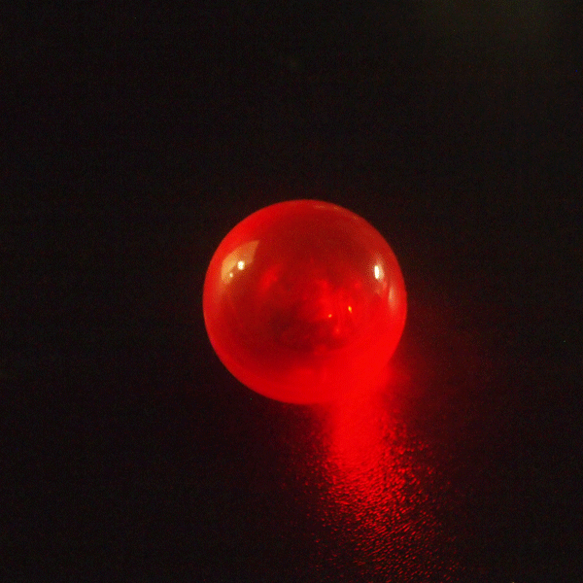
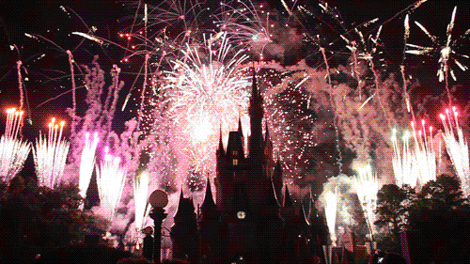
GOALS AND SCALES IB PHYSICS 1, UNIT 2: MECHANICS
4.0 | I know the concepts listed below so well I can evaluate (make judgments based on evidence) presented or obtained data to determine their compliance and/or relevance to these concepts. Motion Forces Work, Energy and Power
3.0 | I can analyze the concepts listed below using key elements and use these elements to apply the knowledge to solve problems. Motion Forces Work, Energy and Power
2.0 | I can explain the concepts listed below in detail with both reasons and causes. Motion Forces Work, Energy and Power
1.0 | I can describe the concepts listed below in detail. Motion Forces Work, Energy and Power
0.0 | I do not get it.

Slide 17
Introductory Video: Work

Slide 18
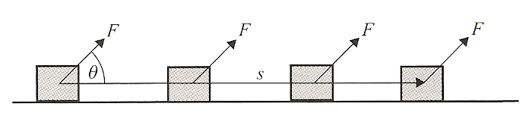
Work done by a force
The work, W, done by a force, F, is shown by:
Where 𝛉 is the angle between the force and the direction of movement
Because cos𝛉 can be positive, negative, or zero, work can be positive, negative, or zero

Slide 19
Work done by a force
Work is equal to the force times the distance moved by the object in the direction of the force.
This applies for a constant force
If the force is not constant, we must graph force vs. distance and take the area under the curve to be the work done
The unit for work is the Joule: 1J = 1 Nm

Slide 20
Work done by a spring
The tension (or force) applied to a spring is given by T = kx, where k is the spring constant and x is the distance the spring is extended or compressed
The greater the extension or compression, the more tension, or more force required

Slide 21
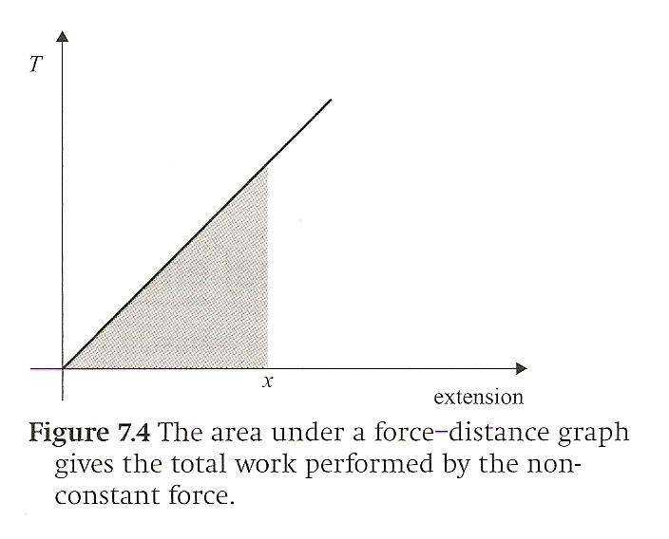
Work done by a spring
If we graph force (tension, T = kx) vs. distance extended or compressed, we get the graph below
The area under the line is work
Since it is a triangle, the area is

Slide 22
Work done by a spring
Look familiar?

Slide 23
GOALS AND SCALES IB PHYSICS 1, UNIT 2: MECHANICS
4.0 | I know the concepts listed below so well I can evaluate (make judgments based on evidence) presented or obtained data to determine their compliance and/or relevance to these concepts. Motion Forces Work, Energy and Power
3.0 | I can analyze the concepts listed below using key elements and use these elements to apply the knowledge to solve problems. Motion Forces Work, Energy and Power
2.0 | I can explain the concepts listed below in detail with both reasons and causes. Motion Forces Work, Energy and Power
1.0 | I can describe the concepts listed below in detail. Motion Forces Work, Energy and Power
0.0 | I do not get it.

Slide 24
Work done by gravity
Force is equal to mass times acceleration (F = ma), and weight is mass times acceleration due to gravity (mg), so weight (mg) is a force that always acts vertically because gravity acts vertically

Slide 25
Work done by gravity
When movement is horizontal, work due to gravity is zero. Why is this so?

Slide 26
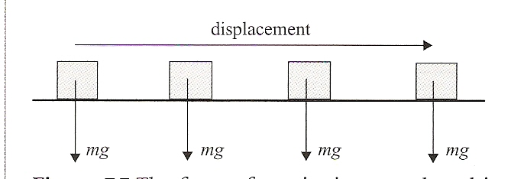
Work done by gravity
When movement is horizontal, work due to gravity is zero. Why is this so?
If a mass is moved horizontally, the work done by gravity is zero because the angle between horizontal and vertical is 90° and cosine of 90° is zero

Slide 27
Work done by gravity
If movement is in the vertical direction (displacement s = height h), the work done by gravity is equal to ±mgh since the movement is parallel to the force (𝛉 = 0) and cos 0° = 1
When is the work due to gravity positive, and when is it negative?

Slide 28
Work done by gravity
When is the work due to gravity positive, and when is it negative?
If the movement is downward, work is +mgh because force is in same direction as movement
If the movement is upward, work is -mgh because force is in opposite direction of movement

Slide 29
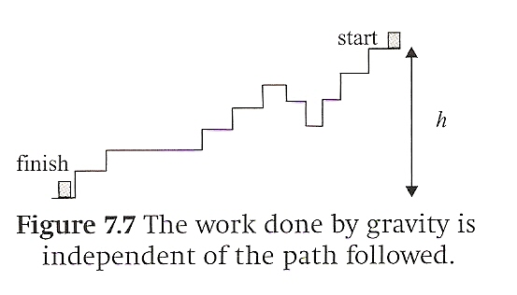
Work done by gravity
Regardless of the path taken, the work done by gravity is always mgh where h is the net change in height (vertical displacement)
Gravity does no work during horizontal movement, and since any downward movement is cancelled by an equal upward movement, total work (net work) is equal to mgh

Slide 30
Work done by gravity
In the diagram below, if the ramps were frictionless, would I do more work pushing a box up the short ramp to the left, or up the long ramp to the right?

Slide 31
Work done by gravity
In the diagram below, if the ramps were frictionless, would I do more work pushing the box up the short ramp to the left, or up the long ramp to the right?
If the net change in height is the same, the work due to gravity is the same
However, it may take more power

Slide 32
Work done by gravity
In the diagram below, if the ramps were not frictionless, would I do more work pushing a box up the short ramp to the left, or up the long ramp to the right?

Slide 33
Work done by gravity
In the diagram below, if the ramps were not frictionless, would I do more work pushing a box up the short ramp to the left, or up the long ramp to the right?
Since W = Fs, the work done by friction is greater on the ramp to the left

Slide 34
Work done in holding something still
If I asked you to hold your 5kg textbook in your right hand with your arm fully extended for 5 minutes, how much work would you have to do?

Slide 35
Work done in holding something still
If I asked you to hold your 5kg textbook in your right hand with your arm fully extended for 5 minutes, how much work would you have to do?
Even though your arm would get really tired, you would do no work on the book because there is no net movement
You would expend a lot of energy, but you would do no work

Slide 36
GOALS AND SCALES IB PHYSICS 1, UNIT 2: MECHANICS
4.0 | I know the concepts listed below so well I can evaluate (make judgments based on evidence) presented or obtained data to determine their compliance and/or relevance to these concepts. Motion Forces Work, Energy and Power
3.0 | I can analyze the concepts listed below using key elements and use these elements to apply the knowledge to solve problems. Motion Forces Work, Energy and Power
2.0 | I can explain the concepts listed below in detail with both reasons and causes. Motion Forces Work, Energy and Power
1.0 | I can describe the concepts listed below in detail. Motion Forces Work, Energy and Power
0.0 | I do not get it.

Slide 37
Energy

Slide 38
Potential Energy
Potential energy is the ability or potential to do work
Think of it as stored work waiting to be used

Slide 39
Gravitational potential energy
Work is force applied over a distance
If I lift a brick 1m above the ground, hold it there, then drop it, what work is done and by whom or what?

Slide 40
Gravitational potential energy
If I lift a brick 1m above the ground, hold it there, then drop it, what work is done and by whom or what?
We do work on a brick by lifting it 1m above the ground equal to mgh
If we let go of the brick, gravity will do work on the brick equal to mgh

Slide 41
Gravitational potential energy
If I lift a brick 1m above the ground, hold it there, then drop it, what work is done and by whom or what?
While the brick is held up in the air, the brick has the potential to do work equal to mgh, but does not do any work because there is no movement
The potential to do work is what is called potential energy, or in this case, gravitational potential energy
The amount of potential energy an object has is dependent on your frame of reference

Slide 42
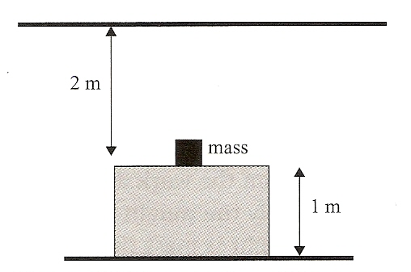
Gravitational potential energy
What is the potential energy of the 10 kg mass below?

Slide 43
Gravitational potential energy
What is the potential energy of the 10 kg mass below (g = 10 m/s²)?
If your reference is the floor, the mass has a potential energy of 100J
If your reference is the table, the mass has a potential energy of 0 since h is zero

Slide 44
Gravitational potential energy
What is the potential energy of the 10 kg mass below (g = 10 m/s²)?
If your reference is the ceiling, the mass has a potential energy of -200J because the reference is in the opposite direction of the force of gravity
Therefore, any given mass can have different potential energies depending on the reference used

Slide 45
Elastic Potential Energy
How much work is required to extend a spring a distance x?

Slide 46
Elastic Potential Energy
How much work is required to extend a spring a distance x?
The work required is equal to W = 1/2kx² where k is the spring constant for the given spring
If the spring is held in the extended position, the work done has been stored in the spring as elastic potential energy equal to E_{p} = 1/2kx²

Slide 47
Potential Energy
When an external force changes the state of a system without acceleration and does work W in the process, the work so performed is stored as potential energy in the new state of the system.

Slide 48
GOALS AND SCALES IB PHYSICS 1, UNIT 2: MECHANICS
4.0 | I know the concepts listed below so well I can evaluate (make judgments based on evidence) presented or obtained data to determine their compliance and/or relevance to these concepts. Motion Forces Work, Energy and Power
3.0 | I can analyze the concepts listed below using key elements and use these elements to apply the knowledge to solve problems. Motion Forces Work, Energy and Power
2.0 | I can explain the concepts listed below in detail with both reasons and causes. Motion Forces Work, Energy and Power
1.0 | I can describe the concepts listed below in detail. Motion Forces Work, Energy and Power
0.0 | I do not get it.

Slide 49
Work-Kinetic Energy Relation
From earlier lessons we learned that when a single force acts on a mass, it produces an acceleration
and that acceleration is equal to

Slide 50
Work-Kinetic Energy Relation
Let’s say that a mass moving at a constant velocity is acted upon by a force. That force causes the mass to accelerate to a new, higher velocity. What work has been done? How is energy involved?

Slide 51
Work-Kinetic Energy Relation
Let’s say that a mass moving at a constant velocity is acted upon by a force. That force causes the mass to accelerate to a new, higher velocity. What work has been done? How is energy involved?
From kinematics we know
If we substitute a = F/m in to this equation, we get

Slide 52
Work-Kinetic Energy Relation
Let’s say that a mass moving at a constant velocity is acted upon by a force. That force causes the mass to accelerate to a new, higher velocity. What work has been done? How is energy involved?
We know that Fs is work, and this shows that it is equal to a change in 1/2mv²
The quantity 1/2mv² is energy
In the same way work equates to a change in potential energy, work can equate to a change in the energy of motion called kinetic energy

Slide 53
Work-Kinetic Energy Relation
Let’s say that a mass moving at a constant velocity is acted upon by a force. That force causes the mass to accelerate to a new, higher velocity. What work has been done? How is energy involved?
The work done by a net force acting on a body is equal to the change in kinetic energy of that body.

Slide 54
GOALS AND SCALES IB PHYSICS 1, UNIT 2: MECHANICS
4.0 | I know the concepts listed below so well I can evaluate (make judgments based on evidence) presented or obtained data to determine their compliance and/or relevance to these concepts. Motion Forces Work, Energy and Power
3.0 | I can analyze the concepts listed below using key elements and use these elements to apply the knowledge to solve problems. Motion Forces Work, Energy and Power
2.0 | I can explain the concepts listed below in detail with both reasons and causes. Motion Forces Work, Energy and Power
1.0 | I can describe the concepts listed below in detail. Motion Forces Work, Energy and Power
0.0 | I do not get it.

Slide 55
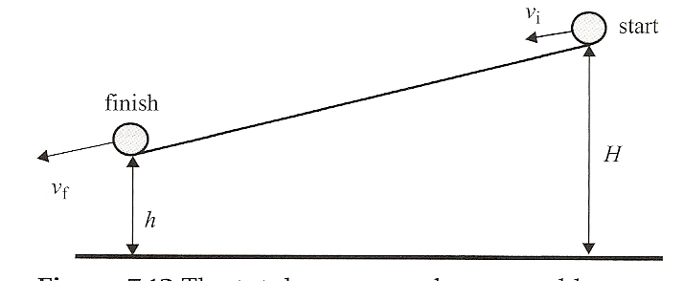
Conservation Of Energy
Suppose that you have a ball at the top of an incline and the only force acting on it is gravity.
What will happen?

Slide 56
Conservation Of Energy
Suppose that you have a ball at the top of an incline and the only force acting on it is gravity.
What will happen?
The ball will roll down hill
It will accelerate and velocity will increase
Gravity will do positive work on the ball
Potential energy lost, kinetic energy gained

Slide 57
Conservation Of Energy
What work is done by the normal/reaction force in this problem? Why?

Slide 58
Conservation Of Energy
What work is done by the normal/reaction force in this problem? Why?
None
The normal/reaction force is normal (duh) to the direction of motion, W = Fscosθ

Slide 59
Conservation Of Energy
The work done by gravity is W = mg(H-h), and work is equal to the change in kinetic energy W = 1/2mv² - 1/2mu², so our equation becomes,

Slide 60
Conservation Of Energy
What we find here is that the sum of the potential and kinetic energies at the top of the incline is the same as the sum of the energies at the bottom – energy is conserved
We know from experience that the ball will speed up and we now know that potential energy decreases with decreases in height
Therefore, some of the potential energy at the top of the incline converted to kinetic energy at the bottom of the incline

Slide 61
GOALS AND SCALES IB PHYSICS 1, UNIT 2: MECHANICS
4.0 | I know the concepts listed below so well I can evaluate (make judgments based on evidence) presented or obtained data to determine their compliance and/or relevance to these concepts. Motion Forces Work, Energy and Power
3.0 | I can analyze the concepts listed below using key elements and use these elements to apply the knowledge to solve problems. Motion Forces Work, Energy and Power
2.0 | I can explain the concepts listed below in detail with both reasons and causes. Motion Forces Work, Energy and Power
1.0 | I can describe the concepts listed below in detail. Motion Forces Work, Energy and Power
0.0 | I do not get it.

Slide 62
Frictional forces
Potential energy and kinetic energy are called mechanical energies and are caused by conservative forces
When frictional or other external forces (nonconservative forces) are present, total energy will still be conserved, but mechanical energy will not

Slide 63
Frictional forces
In this case we can write,
where W equals total work done by the external forces and ∆E is the change in the mechanical energy of the system

Slide 64
Frictional forces
The total energy does not change, but some of the mechanical energy has been transformed into another form of energy such as;
thermal energy (heat)
sound
electricity
Within a system, total energy remains constant.
Energy cannot be created or destroyed, but merely transformed from one form to another.

Slide 65
GOALS AND SCALES IB PHYSICS 1, UNIT 2: MECHANICS
4.0 | I know the concepts listed below so well I can evaluate (make judgments based on evidence) presented or obtained data to determine their compliance and/or relevance to these concepts. Motion Forces Work, Energy and Power
3.0 | I can analyze the concepts listed below using key elements and use these elements to apply the knowledge to solve problems. Motion Forces Work, Energy and Power
2.0 | I can explain the concepts listed below in detail with both reasons and causes. Motion Forces Work, Energy and Power
1.0 | I can describe the concepts listed below in detail. Motion Forces Work, Energy and Power
0.0 | I do not get it.

Slide 66
Power

Slide 67
Power
Not only is it important to know how much work is being done, but also how fast the work is being done
Power is the rate at which work is being performed
The unit for power is the watt (W) and one watt is equal to one joule per second, 1W = 1J/s

Slide 68
Power
Remembering that work is defined as force times distance,
which applies when v is the instantaneous or constant velocity of the mass

Slide 69
GOALS AND SCALES IB PHYSICS 1, UNIT 2: MECHANICS
4.0 | I know the concepts listed below so well I can evaluate (make judgments based on evidence) presented or obtained data to determine their compliance and/or relevance to these concepts. Motion Forces Work, Energy and Power
3.0 | I can analyze the concepts listed below using key elements and use these elements to apply the knowledge to solve problems. Motion Forces Work, Energy and Power
2.0 | I can explain the concepts listed below in detail with both reasons and causes. Motion Forces Work, Energy and Power
1.0 | I can describe the concepts listed below in detail. Motion Forces Work, Energy and Power
0.0 | I do not get it.

Slide 70
Efficiency
Because of those nasty non-conservative forces that pervade our society, not all energy is transformed into useful work
Efficiency gives us the fractional or percent work done/energy out per unit work/energy input
Also applies to power since power is a function of work

Slide 71
Summary Video: What is Energy

Slide 72
Applications And Skills:
Discussing the conservation of total energy within energy transformations
Sketching and interpreting force–distance graphs
Determining work done including cases where a resistive force acts
Solving problems involving power
Quantitatively describing efficiency in energy transfers

Slide 73
Understandings:
Kinetic energy
Gravitational potential energy
Elastic potential energy
Work done as energy transfer
Power as rate of energy transfer
Principle of conservation of energy
Efficiency

Slide 74
Data Booklet Reference:

Slide 75
Essential Idea:
The fundamental concept of energy lays the basis upon which much of science is built.

Slide 76
Questions?

Slide 77
Homework
Pg. 96-97, #55-71

