Slide 1
Devil physics The baddest class on campus IB Physics

Slide 2
Tsokos Lesson 2-4 Momentum and impulse

Slide 3
Essential Idea:
Conservation of momentum is an example of a law that is never violated.

Slide 4
Nature Of Science:
The concept of momentum and the principle of momentum conservation can be used to analyze and predict the outcome of a wide range of physical interactions, from macroscopic motion to microscopic collisions.

Slide 5
International-Mindedness:
Automobile passive safety standards have been adopted across the globe based on research conducted in many countries.

Slide 6
Theory Of Knowledge:
Do conservation laws restrict or enable further development in physics?

Slide 7
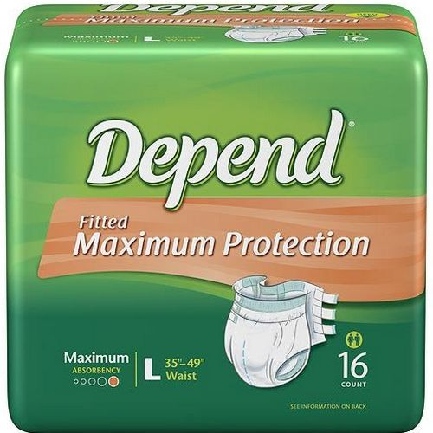
Theory Of Knowledge:
Do conservation laws restrict or enable further development in physics?

Slide 8
Understandings:
Newton’s second law expressed in terms of rate of change of momentum
Impulse and force–time graphs
Conservation of linear momentum
Elastic collisions, inelastic collisions and explosions

Slide 9
Applications And Skills:
Applying conservation of momentum in simple isolated systems including (but not limited to) collisions, explosions, or water jets
Using Newton’s second law quantitatively and qualitatively in cases where mass is not constant

Slide 10
Applications And Skills:
Sketching and interpreting force–time graphs
Determining impulse in various contexts including (but not limited to) car safety and sports
Qualitatively and quantitatively comparing situations involving elastic collisions, inelastic collisions and explosions

Slide 11
Guidance:
Students should be aware that is the equivalent of only when mass is constant
Solving simultaneous equations involving conservation of momentum and energy in collisions will not be required

Slide 12
Guidance:
Calculations relating to collisions and explosions will be restricted to one-dimensional situations
A comparison between energy involved in inelastic collisions (in which kinetic energy is not conserved) and the conservation of (total) energy should be made

Slide 13
Data Booklet Reference:

Slide 14
Utilization:
Jet engines and rockets

Slide 15
Aims:
Aim 3: conservation laws in science disciplines have played a major role in outlining the limits within which scientific theories are developed

Slide 16
Aims:
Aim 6: experiments could include (but are not limited to): analysis of collisions with respect to energy transfer; impulse investigations to determine velocity, force, time, or mass; determination of amount of transformed energy in inelastic collisions

Slide 17
Aims:
Aim 7: technology has allowed for more accurate and precise measurements of force and momentum, including video analysis of real-life collisions and modeling/simulations of molecular collisions

Slide 18
Introductory Video

Slide 19
Concept of Momentum
Momentum is a product of the mass and the velocity of an object
Momentum is a vector quantity whose direction is the same as the velocity
Unit of momentum is
But is often referred to as N·s

Slide 20
Newton’s Second Law
The average net force on a body equals the rate of change of a body’s momentum

Slide 21
Example 1
A 0.100 kg ball moving left to right at 5 m/s bounces off a vertical wall with no change in speed. If the collision lasted for 0.1 s, what force did the wall exert on the ball?
0 N
5 N
10 N
-10 N
Cannot be determined from the information

Slide 22
Example 1
A 0.100 kg ball moving left to right at 5 m/s bounces off a vertical wall with no change in speed. If the collision lasted for 0.1 s, what force did the wall exert on the ball?
.
.
.
-10 N
.

Slide 23
Impulse
The desire to do something without thinking, usually based on emotion
If Δt is large, then F_{net} represents average force on the body
If Δt is infinitely small, then F_{net} represents instantaneous force on the body and,
is called the impulse of the force

Slide 24
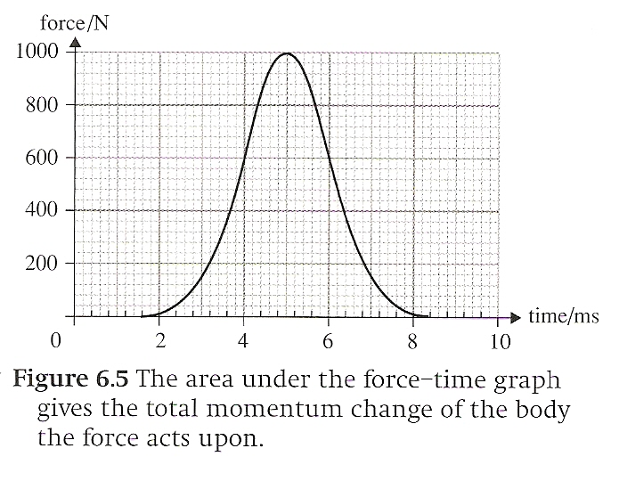
Impulse
Impulse is the area under the curve of a force-time graph and equals the total momentum change

Slide 25
Impulse
Q. I push a box with one hand, then with two hands. Can I do this with the same impulse each time?

Slide 26
Impulse
Q. I push a box with one hand, then with two hands. Can I do this with the same impulse each time?
A. Yes. The push with two hands will involve a larger force, but if done over a shorter period of time it will have the same impulse as with one hand.

Slide 27
Impulse
Q. What impact will this have (pun intended) on a car accident with or without an airbag?

Slide 28
Impulse
Q. What impact will this have (pun intended) on a car accident with or without an airbag?
A. Without an airbag, the force is applied over a short period of time as the driver hits the steering wheel. With an airbag, the momentum changes over a longer period of time so the net force is reduced.

Slide 29
Conservation of Momentum

Slide 30
Conservation of Momentum
The total momentum of a system is defined as the vector sum of the individual momenta
When no external forces act on a system, the total momentum of the system stays the same

Slide 31
Conservation of Momentum
If a car runs into a wall and the wall doesn’t move, how is momentum conserved?
If I jump off a chair and land on the ground, how is momentum conserved?

Slide 32
Where does momentum go?

Slide 33
Two Dimensional Collisions
Momentum is a vector quantity and is conserved as a vector quantity
When bodies collide at an angle, momentum is conserved in the resolved x- and y-axes

Slide 34
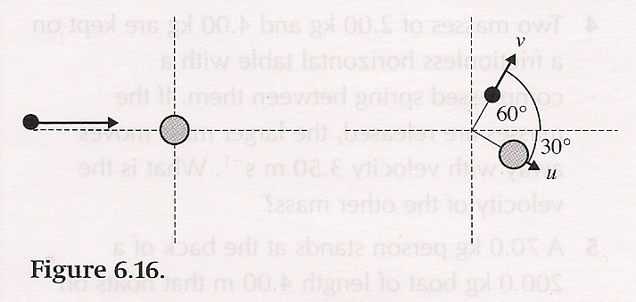
Two Dimensional Collisions
Consider a collision of the above two masses
The smaller is 4.0kg moving at 12m/s
The larger is 12.0kg at rest
After the collision, the smaller deflects at a 60 degree angle above the horizontal
The larger deflects 30 degrees below the horizontal

Slide 35
Two Dimensional Collisions
m_{1i} = 4.0kg
v_{1i} = 12m/s
m_{2i} = 12.0kg
v_{2i} = 0

Slide 36
Two Dimensional Collisions
m_{1i} = 4.0kg
v_{1i} = 12m/s
m_{2i} = 12.0kg
v_{2i} = 0

Slide 37
Two Dimensional Collisions
m_{1i} = 4.0kg
v_{1i} = 12m/s
m_{2i} = 12.0kg
v_{2i} = 0
Solve equations simultaneously

Slide 38
Kinetic Energy and Momentum
Momentum is always conserved in all collisions
Kinetic energy is only conserved in tooootaly elastic collisions
This because in a perfectly elastic collision, no energy is lost to heat, sound or outside objects
When two objects stick together after a collision, the collision is said to be toooooooootaly inelastic (or plastic)

Slide 39
Rocket Equation
M = mass of rocket + fuel (m)
δv = change in velocity
δm = change in mass of fuel
u = velocity of the exhaust gases
After time δt, the mass of the exhaust is δm, the mass of the rocket is M - δm, the speed of the rocket is v + δv, and the speed of the exhaust is u – (v + δv)

Slide 40
Rocket Equation
M = mass of rocket + fuel (m)
δv = change in velocity
δm = change in mass of fuel
u = velocity of the exhaust gases
After time δt, the mass of the exhaust is δm, the mass of the rocket is M - δm, the speed of the rocket is v + δv, and the speed of the exhaust is u – (v + δv)

Slide 41
Rocket Equation
M = mass of rocket + fuel (m)
δv = change in velocity
δm = change in mass of fuel
u = velocity of the exhaust gases
After time δt, the mass of the exhaust is δm, the mass of the rocket is M - δm, the speed of the rocket is v + δv, and the speed of the exhaust is u – (v + δv)

Slide 42
Understandings:
Newton’s second law expressed in terms of rate of change of momentum
Impulse and force–time graphs
Conservation of linear momentum
Elastic collisions, inelastic collisions and explosions

Slide 43
Data Booklet Reference:

Slide 44
Applications And Skills:
Applying conservation of momentum in simple isolated systems including (but not limited to) collisions, explosions, or water jets
Using Newton’s second law quantitatively and qualitatively in cases where mass is not constant

Slide 45
Applications And Skills:
Sketching and interpreting force–time graphs
Determining impulse in various contexts including (but not limited to) car safety and sports
Qualitatively and quantitatively comparing situations involving elastic collisions, inelastic collisions and explosions

Slide 46
questionÈs¡

Slide 47
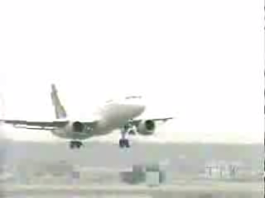
Homework
Pg. 109-110, #72-83

