Slide 1
Devil physics The baddest class on campus IB Physics

Slide 2
Tsokos lesson 1-1 Measurements in physics

Slide 3
Questions from Reading Activity?

Slide 4
Essential Idea
Since 1948, the Système International d’Unités (SI) has been used as the preferred language of science and technology across the globe and reflects current best measurement practice.

Slide 5
Nature Of Science
Common terminology: Since the 18th century, scientists have sought to establish common systems of measurements to facilitate international collaboration across science disciplines and ensure replication and comparability of experimental findings. (1.6)
Improvement in instrumentation: An improvement in apparatus and instrumentation, such as using the transition of cesium-133 atoms for atomic clocks, has led to more refined definitions of standard units. (1.8)
Certainty: Although scientists are perceived as working towards finding “exact” answers, the unavoidable uncertainty in any measurement always exists. (3.6)

Slide 6
International-Mindedness
Scientific collaboration is able to be truly global without the restrictions of national borders or language due to the agreed standards for data representation.

Slide 7
Theory Of Knowledge
What has influenced the common language used in science?
To what extent does having a common standard approach to measurement facilitate the sharing of knowledge in physics?

Slide 8
Understandings
Fundamental and derived SI units
Scientific notation and metric multipliers
Significant figures
Orders of magnitude
Estimation

Slide 9
Applications And Skills
Using SI units in the correct format for all required measurements, final answers to calculations and presentation of raw and processed data
Using scientific notation and metric multipliers
Quoting and comparing ratios, values and approximations to the nearest order of magnitude
Estimating quantities to an appropriate number of significant figures

Slide 10
Data Booklet Reference
Metric (SI) multipliers can be found on page 5 of the physics data booklet

Slide 11
Orders of Magnitude
Physics deals with stuff that is really small and stuff that is really big
The mass of an electron is about 10⁻³⁰ kg
The mass of the universe is about 10⁵³ kg
Consider the relative size of objects in the universe
Planets
IB Physics will use scientific notation much more than Pre-IB

Slide 12
Orders of Magnitude Powers of ten – Scales of the Universe

Slide 13
Orders of Magnitude - Length

Slide 14
Orders of Magnitude - Mass

Slide 15
Orders of Magnitude - Time

Slide 16
Scientific Notation Review

Slide 17
Scientific Notation Review

Slide 18
SI Units - Systeme Internationale
Units and Standards
Unit – name for a measurement commonly used
Standard – the device that defines the unit

Slide 19
SI Units - Systeme Internationale
Meter (m) -- unit of length. The standard for a meter has, at various times, been:
Distance from the tip of your nose to the tip of your longest finger when arm is extended horizontally. Problem?
One ten-millionth of the distance from the earth’s equator to either pole. Problem?
Distance between two finely engraved marks on a particular bar of a platinum-iridium alloy. Problem?

Slide 20
SI Units - Systeme Internationale
Meter (m) -- unit of length. The standard for a meter has, at various times, been:
For greater precision and reproducibility, changed in 1960 to 1,650,763.73 wavelengths of an orange light emitted by krypton 86 gas. Problem?
Current: length of path traveled by light in 1/299,792,458th’s of a second. Problem?

Slide 21
SI Units - Systeme Internationale
Kilogram (kg) – unit of mass. Equal to the mass of a platinum-iridium alloy bar kept at the Bureau International des Poids et Mesures in France

Slide 22
SI Units - Systeme Internationale
Second (s) – unit of time. Duration of 9,192,631,770 full oscillations of the electromagnetic radiation emitted in a transition between two hyperfine energy levels in the ground state of a cesium-133 atom

Slide 23
SI Units - Systeme Internationale
Ampere (A) – unit of electric current. The amount of current which, when flowing in two parallel conductors 1m apart, produces a force of 2x10⁻⁷ N on a length of 1m of the conductors.

Slide 24
SI Units - Systeme Internationale
Kelvin (K) – unit of temperature. It is 1/273.16th of the thermodynamic temperature of the triple point of water.

Slide 25
SI Units - Systeme Internationale
Mole (mol) – One mole of a substance contains as many molecules as there are atoms in 12g of carbon-12. This special number of molecules is called Avagadro’s number and is approximately 6.02x10²³.

Slide 26
SI Units - Systeme Internationale
Candela (cd) – unit of luminous intensity. It is the intensity of a source of frequency 5.40x10¹⁴ Hz emitting W per steradian. (Not used in our book).

Slide 27
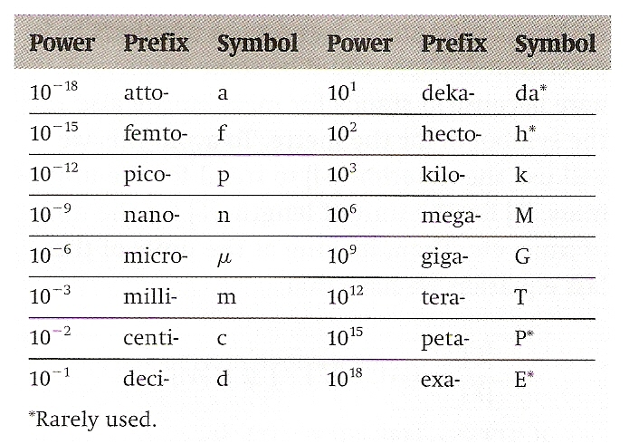
SI Units - Systeme Internationale
SI Prefixes – Page 5 of Data Guide

Slide 28
Working With Units Using Numbers and Units

Slide 29
Working With Units
Derived units
d = m
v = m/s
a = m/s²
F = ma = N = kg·m/s²
W = Fd = J = kg·m²/s²

Slide 30
Working With Units
Ensure the units in an equation are balanced
Working with constants
Convert ‘givens’ to same units as constant

Slide 31
Accuracy and Precision Video

Slide 32
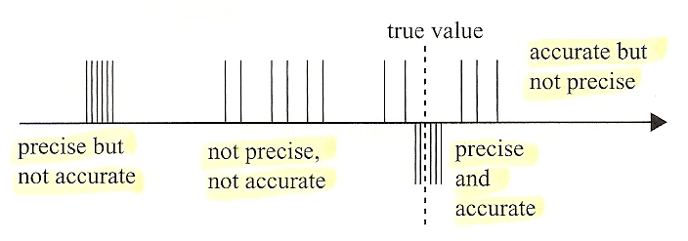
Accuracy and Precision
Measurements are accurate if the systematic error is small
Individual deviations may be high, but mean is close to actual value
Measurements are precise if random error is small
Individual deviations are low, but mean is not significantly different from actual value

Slide 33
Significant Digits – Da Rules
The leftmost non-zero digit is significant and is in fact the most significant digit in the number.
If the number has no decimal point, the rightmost non-zero digit is significant and is in fact the least significant.
If the number does have a decimal point, the least significant digit is the rightmost digit (which may be zero).
The number of significant digits of a number is the number of digits from the most to the least significant.

Slide 34
Significant Digits – How Many?
63
0.63
0.06301
0.00630
630
630.0

Slide 35
Significant Digits – How Many?
63
0.63
0.06301
0.00630
630
630.0
2

Slide 36
Significant Digits – How Many?
63
0.63
0.06301
0.00630
630
630.0
2
2

Slide 37
Significant Digits – How Many?
63
0.63
0.06301
0.00630
630
630.0
2
2
4

Slide 38
Significant Digits – How Many?
63
0.63
0.06301
0.00630
630
630.0
2
2
4
3

Slide 39
Significant Digits – How Many?
63
0.63
0.06301
0.00630
630
630.0
2
2
4
3
2

Slide 40
Significant Digits – How Many?
63
0.63
0.06301
0.00630
630
630.0
2
2
4
3
2
4

Slide 41
Significant Digits – Scientific Notation
63
0.63
0.06301
0.00630
630
630.0

Slide 42
Significant Digits – Scientific Notation
63
0.63
0.06301
0.00630
630
630.0
6.3 x 10¹

Slide 43
Significant Digits – Scientific Notation
63
0.63
0.06301
0.00630
630
630.0
6.3 x 10¹
6.3 x 10⁻¹

Slide 44
Significant Digits – Scientific Notation
63
0.63
0.06301
0.00630
630
630.0
6.3 x 10¹
6.3 x 10⁻¹
6.301 x 10⁻²

Slide 45
Significant Digits – Scientific Notation
63
0.63
0.06301
0.00630
630
630.0
6.3 x 10¹
6.3 x 10⁻¹
6.301 x 10⁻²
6.30 x 10⁻³

Slide 46
Significant Digits – Scientific Notation
63
0.63
0.06301
0.00630
630
630.0
6.3 x 10¹
6.3 x 10⁻¹
6.301 x 10⁻²
6.30 x 10⁻³
6.3 x 10²

Slide 47
Significant Digits – Scientific Notation
63
0.63
0.06301
0.00630
630
630.0
6.3 x 10¹
6.3 x 10⁻¹
6.301 x 10⁻²
6.30 x 10⁻³
6.3 x 10²
6.300 x 10²

Slide 48
Significant Digits
In multiplication, division, powers and roots, the result must only have as many significant digits as those of the number with the least number of significant digits entering the operations.
In addition and subtraction, the answer must have the same number of digits after the decimal point as the number in the problem with the least number of digits after the decimal.

Slide 49
Significant Digits
Always use the numbers that you have been given, perform the math operations, and THEN round THE ANSWER to correct number of significant digits
Carry all digits in your calculator, write the answer in significant digits
Defined conversions don’t count (1cm = 10mm)
Constants or derived conversions do (s = 3.00 x 10⁸ m/s) (1 AU = 1.5 x 10⁶ km)

Slide 50
Essential Idea
Since 1948, the Système International d’Unités (SI) has been used as the preferred language of science and technology across the globe and reflects current best measurement practice.

Slide 51
Understandings
Fundamental and derived SI units
Scientific notation and metric multipliers
Significant figures
Orders of magnitude
Estimation

Slide 52
Applications And Skills
Using SI units in the correct format for all required measurements, final answers to calculations and presentation of raw and processed data
Using scientific notation and metric multipliers
Quoting and comparing ratios, values and approximations to the nearest order of magnitude
Estimating quantities to an appropriate number of significant figures

Slide 53
Questions?

Slide 54
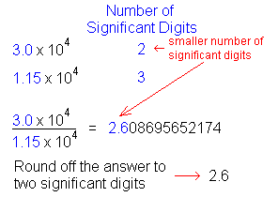
Homework
#1-22

