Slide 1
Devil physics The baddest class on campus IB Physics

Slide 2
IB Topic 1-3 Vectors and scalars

Slide 3
Essential Idea
Some quantities have direction and magnitude, others have magnitude only, and this understanding is the key to correct manipulation of quantities. This sub-topic will have broad applications across multiple fields within physics and other sciences.

Slide 4
Nature Of Science
Models: First mentioned explicitly in a scientific paper in 1846, scalars and vectors reflected the work of scientists and mathematicians across the globe for over 300 years on representing measurements in three-dimensional space.

Slide 5
International-Mindedness
Vector notation forms the basis of mapping across the globe

Slide 6
Theory Of Knowledge
What is the nature of certainty and proof in mathematics?

Slide 7
Understandings
Vector and scalar quantities
Combination and resolution of vectors

Slide 8
Applications And Skills
Solving vector problems graphically and algebraically

Slide 9
Guidance
Resolution of vectors will be limited to two perpendicular directions
Problems will be limited to addition and subtraction of vectors and the multiplication and division of vectors by scalars

Slide 10
Data Booklet Reference

Slide 11
Utilization
Navigation and surveying (see Geography SL/HL syllabus: Geographic skills)
Force and field strength (see Physics sub-topics 2.2, 5.1, 6.1 and 10.1)
Vectors (see Mathematics HL sub-topic 4.1; Mathematics SL sub-topic 4.1)

Slide 12
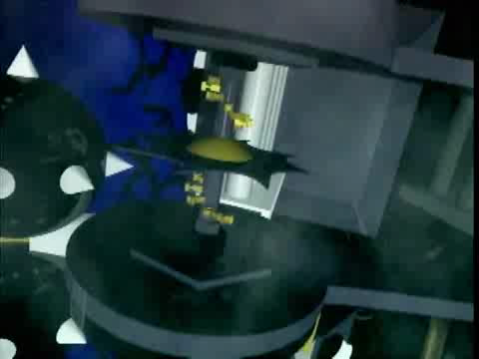
Introductory Video What are scalars and vectors?

Slide 13
Scalars
Require only a number to represent them
No direction involved

Slide 14
Vectors
Cannot be fully specified without both a number (magnitude) and direction
Represented by an arrow from left to right over the variable
Two vectors are equal only if both their magnitude and direction are the same

Slide 15
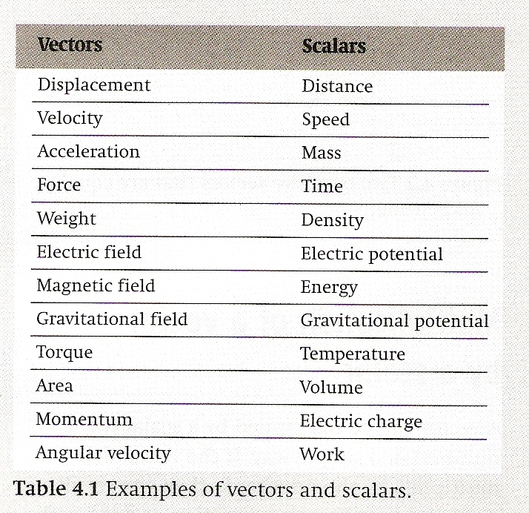
Examples of Vectors and Scalars

Slide 16
Multiplying a Vector by a Scalar
Multiplication of a vector by a scalar only affects the magnitude and not the direction

Slide 17
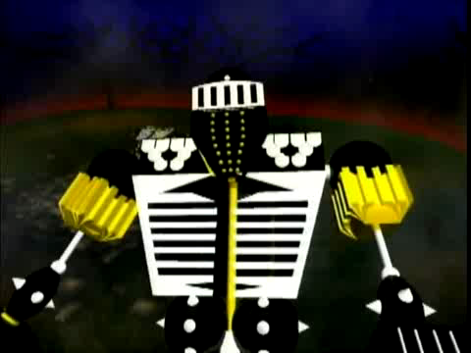
Introductory Video Adding Vectors

Slide 18
Adding Vectors Parallelogram Method

Slide 19
Adding Vectors Head-To-Tail Method

Slide 20
Subtracting Vectors Head-To-Tail Method

Slide 21
Adding Vectors Head-To-Tail by Components

Slide 22
Adding Vectors Head-To-Tail by Components

Slide 23
Adding Vectors Head-To-Tail by Components

Slide 24
Trigonometry Revisited

Slide 25
Adding Vectors Component Method

Slide 26
Adding Vectors Component Method

Slide 27
Adding Vectors Component Method

Slide 28
Adding Vectors Component Method

Slide 29
Essential Idea
Some quantities have direction and magnitude, others have magnitude only, and this understanding is the key to correct manipulation of quantities. This sub-topic will have broad applications across multiple fields within physics and other sciences.

Slide 30
Understandings
Vector and scalar quantities
Combination and resolution of vectors

Slide 31
Applications And Skills
Solving vector problems graphically and algebraically

Slide 32
Questions?

Slide 33
Homework
#35-46

