Slide 1

Devil physics
The baddest class on campus
IB Physics

Slide 2
Option B-4 forced vibrations and resonance

Slide 3
Essential Idea:
In the real world, damping occurs in oscillators and has implications that need to be considered.

Slide 4
Nature Of Science:
Risk assessment:
  The ideas of resonance and forced oscillation have application in many areas of engineering ranging from electrical oscillation to the safe design of civil structures.
  In large-scale civil structures, modeling all possible effects is essential before construction.

Slide 5
International-Mindedness:
Communication through radio and television signals is based on resonance of the broadcast signals

Slide 6
Understandings:
Natural frequency of vibration
Q factor and damping
Periodic stimulus and the driving frequency
Resonance

Slide 7
Applications And Skills:
Qualitatively and quantitatively describing examples of under-, over- and critically-damped oscillations
Graphically describing the variation of the amplitude of vibration with driving frequency of an object close to its natural frequency of vibration

Slide 8
Applications And Skills:
Describing the phase relationship between driving frequency and forced oscillations
Solving problems involving Q factor
Describing the useful and destructive effects of resonance

Slide 9
Guidance:
Only amplitude resonance is required

Slide 10
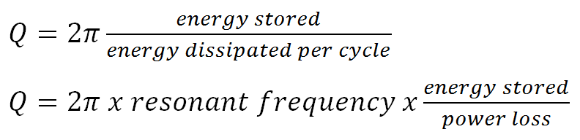
Data Booklet Reference:

Slide 11
Utilization:
Science and technology meet head-on when the real behaviour of damped oscillating systems is modelled

Slide 12
Aims:
Aim 6: experiments could include (but are not limited to): observation of sand on a vibrating surface of varying frequencies; investigation of the effect of increasing damping on an oscillating system, such as a tuning fork; observing the use of a driving frequency on forced oscillations

Slide 13
Aims:
Aim 7: to investigate the use of resonance in electrical circuits, atoms/molecules, or with radio/television communications is best achieved through software modelling examples

Slide 14
Oscillation vs. Simple Harmonic Motion
An oscillation is any motion in which the displacement of a particle from a fixed point keeps changing direction and there is a periodicity in the motion i.e. the motion repeats in some way.
In simple harmonic motion, the displacement from an equilibrium position and the force/acceleration are proportional and opposite to each other.

Slide 15
Energy in SHM

Slide 16
Damping
In the ideal world, SHM can go on forever without energy loss
In the real world, energy is lost and the motion eventually stops
The rate at which energy is lost is called damping

Slide 17
Light Damping or Underdamped
Oscillations decrease slowly with time
Energy loss is exponential with all damping

Slide 18
Heavy Damping or Overdamped

Slide 19
Critical Damping

Slide 20
Over-Damping

Slide 21
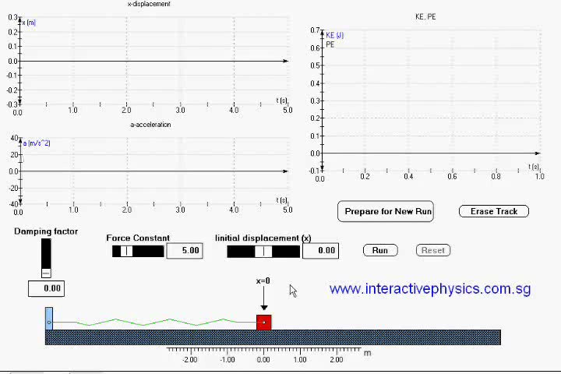
Damping

Slide 22
Q-Factor
Describes how quickly an underdamped system will die out
Can be expressed in terms of energy and/or power

Slide 23
Forced Oscillations
We can apply a force to overcome damping and maintain a constant amplitude (grandfather clock)
Or, we can apply a force to increase amplitude
However, the frequency of the applied force (driving force), f_{D} must be close to or the same as the natural frequency, f₀

Slide 24
Forced Oscillations
With Damping
Without Damping

Slide 25
Phase Difference
Phase difference between the displacement of the system and the displacement of the driver

Slide 26

Forced Oscillations

Slide 27
Resonance
The state in which the frequency of the externally applied periodic force equals the natural frequency of the system is called resonance. This results in oscillations with large amplitude.

Slide 28
Resonance
Resonance occurs whenever a system that is capable of oscillation or vibration is subjected to an external disturbance with a frequency equal to the natural frequency of the system itself
  In that case, the amplitude of the oscillations will increase
  If the frequencies don’t match, the amplitude is smaller or cyclical

Slide 29
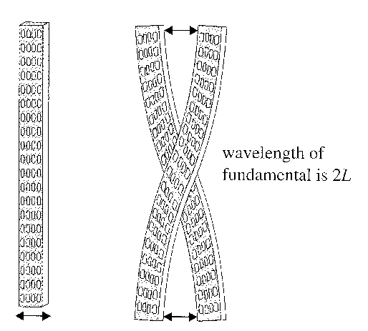
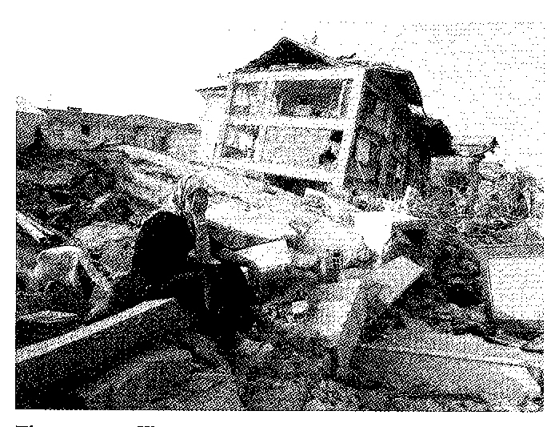
Resonance
Examples of resonance
  Unbalanced tire
  Ceiling fan
  Rubbing a finger over the top of a glass
  Buildings in earthquakes
    Height of the building determines its natural frequency

Slide 30
Fun With PhET

Slide 31
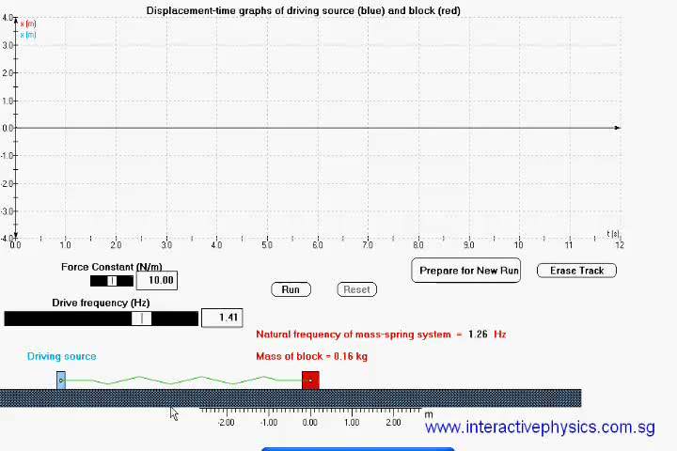
Resonance and Forced Oksilations

Slide 32
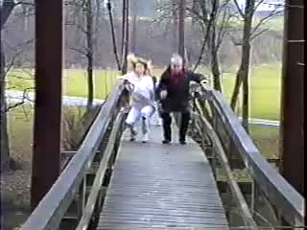
Resonance

Slide 33
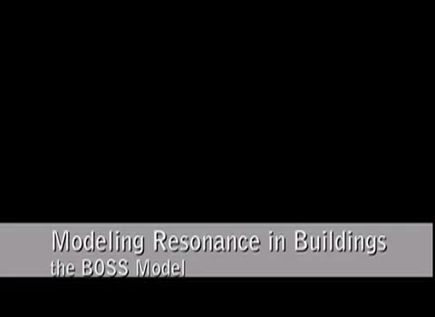
Resonance

Slide 34

Effects of Resonance on Buildings

Slide 35
Understandings:
Natural frequency of vibration
Q factor and damping
Periodic stimulus and the driving frequency
Resonance

Slide 36
Data Booklet Reference:

Slide 37
Guidance:
Only amplitude resonance is required

Slide 38
Applications And Skills:
Qualitatively and quantitatively describing examples of under-, over- and critically-damped oscillations
Graphically describing the variation of the amplitude of vibration with driving frequency of an object close to its natural frequency of vibration

Slide 39
Applications And Skills:
Describing the phase relationship between driving frequency and forced oscillations
Solving problems involving Q factor
Describing the useful and destructive effects of resonance

Slide 40
Essential Idea:
In the real world, damping occurs in oscillators and has implications that need to be considered.

Slide 41

Tacoma Narrows Bridge Collapse

Slide 42

Homework
#58-64 Beautiful Resonance

