Slide 1

Devil physics
The baddest class on campus
IB Physics

Slide 2

Option B-3:
 Fluids

Slide 3
Essential Idea:
Fluids cannot be modelled as point particles. Their distinguishable response to compression from solids creates a set of characteristics that require an in-depth study.

Slide 4
Nature Of Science:
Human understandings: Understanding and modelling fluid flow has been important in many technological developments such as designs of turbines, aerodynamics of cars and aircraft, and measurement of blood flow.

Slide 5
International-Mindedness:
Water sources for dams and irrigation rely on the knowledge of fluid flow. These resources can cross national boundaries leading to sharing of water or disputes over ownership and use.

Slide 6
Theory Of Knowledge:
The mythology behind the anecdote of Archimedes’ “Eureka!” moment of discovery demonstrates one of the many ways scientific knowledge has been transmitted throughout the ages.
What role can mythology and anecdotes play in passing on scientific knowledge?
What role might they play in passing on scientific knowledge within indigenous knowledge systems?

Slide 7
Understandings:
Density and pressure
Buoyancy and Archimedes’ principle
Pascal’s principle
Hydrostatic equilibrium
The ideal fluid
Streamlines

Slide 8
Understandings:
The continuity equation
The Bernoulli equation and the Bernoulli effect
Stokes’ law and viscosity
Laminar and turbulent flow and the Reynolds number

Slide 9
Applications And Skills:
Determining buoyancy forces using Archimedes’ principle
Solving problems involving pressure, density and Pascal’s principle
Solving problems using the Bernoulli equation and the continuity equation

Slide 10
Applications And Skills:
Explaining situations involving the Bernoulli effect
Describing the frictional drag force exerted on small spherical objects in laminar fluid flow
Solving problems involving Stokes’ law
Determining the Reynolds number in simple situations

Slide 11
Guidance:
Ideal fluids will be taken to mean fluids that are incompressible and non-viscous and have steady flows
Applications of the Bernoulli equation will involve (but not be limited to) flow out of a container, determining the speed of a plane (pitot tubes), and venturi tubes

Slide 12
Guidance:
Proof of the Bernoulli equation will not be required for examination purposes
Laminar and turbulent flow will only be considered in simple situations
Values of R 103 <will be taken to represent conditions for laminar flow

Slide 13
Data Booklet Reference:

Slide 14
Utilization:
Hydroelectric power stations
Aerodynamic design of aircraft and vehicles
Fluid mechanics is essential in understanding blood flow in arteries
Biomechanics (see Sports, exercise and health science SL sub-topic 4.3)

Slide 15
Aims:
Aim 2: fluid dynamics is an essential part of any university physics or engineering course
Aim 7: the complexity of fluid dynamics makes it an ideal topic to be visualized through computer software

Slide 16
Reading Activity Questions?

Slide 17
Pressure
Pressure, P, is defined as force per unit area where the force is understood to be acting perpendicular to the surface area, A

Slide 18
Pressure in Fluids
Fluid exerts a pressure in all directions
Fluid pressure is exerted perpendicular to whatever surface it is in contact with
Fluid pressure increases with depth

Slide 19
Pressure in Fluids
Think of a disk 5 cm (0.05 m) in diameter (A = πr² = 1.96 cm² = 0.00196 m² )
You place it in water 30 cm (0.30 m) below the surface
The pressure on that disk is equal to the weight of a column of water that has a 5 cm diameter and is 30 cm high (h = height of water)

Slide 20
Pressure in Fluids
Like a graduated cylinder
  A_{disk} = 0.00196 m²
  The volume of the cylinder is A x h (πr²h) = 589 cm³ = 5.89 x 10⁻⁴ m³

Slide 21
Pressure in Fluids
Like a graduated cylinder
  A_{disk} = 0.00196 m²
  V = 5.89 x 10⁻⁴ m³
  m = 0.589 kg

Slide 22
Pressure in Fluids
Like a graduated cylinder
  A_{disk} = 0.00196 m²
  V = 5.89 x 10⁻⁴ m³
  m = 0.589 kg
  F = 5.78 N
That’s way too much work!
How about a formula?

Slide 23
Pressure in Fluids
Like a graduated cylinder
  P = 2.9 x 10³ N/m²
That’s way too much work!
How about a formula?

Slide 24
Pressure in Fluids
Like a graduated cylinder
  P = 2.9 x 10³ N/m²
That’s way too much work!
How about a formula?

Slide 25
Pressure in Fluids
Pressure at equal depths within a uniform liquid is the same
IMPORTANT: The pressure the water exerts on an object at a certain depth is the same on all parts of a body.
In other words, if you hold a cube 30cm under water, each side of that cube will feel the same pressure exerted on it – not just the top, but the bottom and all four sides!!!

Slide 26
Pressure in Fluids
It follows from this that a change in depth is directly proportional to a change in pressure
Note: An important assumption here is that the fluid is incompressible, because if it were compressible, the density would change with depth!

Slide 27
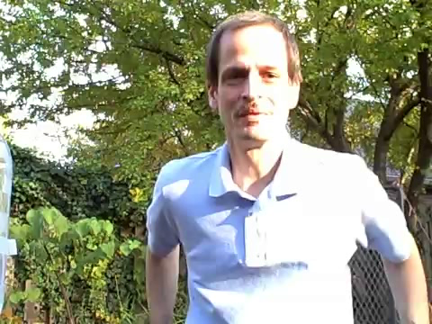
Pressure in Fluids

Slide 28
Pascal’s Principle
The pressure applied to a confined fluid increases the pressure throughout the fluid by the same amount.
Examples
  A cube at the bottom of a bucket of water. It has the pressure of the water acting on it, but also the atmospheric pressure pushing on the water.
  The brake system in a car. You apply pressure via the brake pedal and that pressure gets transmitted via a fluid to the brake pads on the wheel

Slide 29
Pascal’s Principle
The pressure applied to a confined fluid increases the pressure throughout the fluid by the same amount.

Slide 30
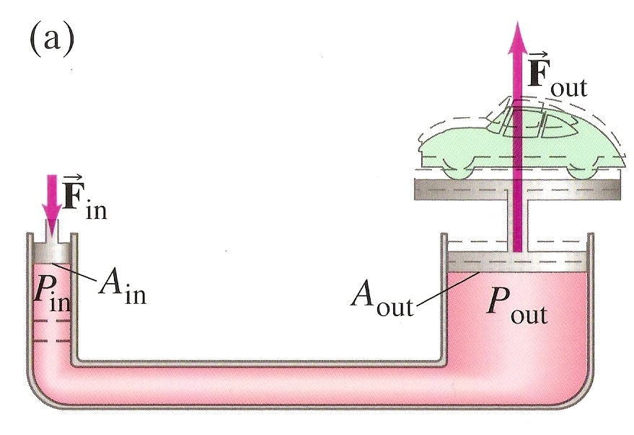
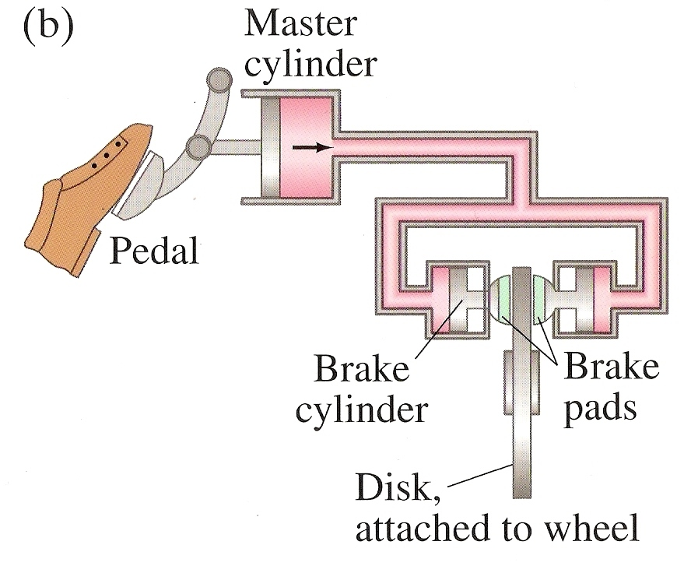
Pascal’s Principle
Examples

Slide 31
Pascal’s Principle
If I want the force applied to my brakes to be 10 times the force I apply to the pedal, by what factor would the diameter of the piston at the brakes exceed that of the piston at the brake pedal?

Slide 32
Pascal’s Principle
If I want the force applied to my brakes to be 10 times the force I apply to the pedal, by what factor would the diameter of the piston at the brakes exceed that of the piston at the brake pedal?

Slide 33

Video: Archimedes Principle

Slide 34
Buoyancy
Stuff floats
Stuff in water seems lighter than stuff on land
This is because the fluid is exerting a pressure on the object that opposes the gravity force (weight)
Fluid pressure increases with depth
When the fluid pressure equals the weight, the object will stop sinking

Slide 35
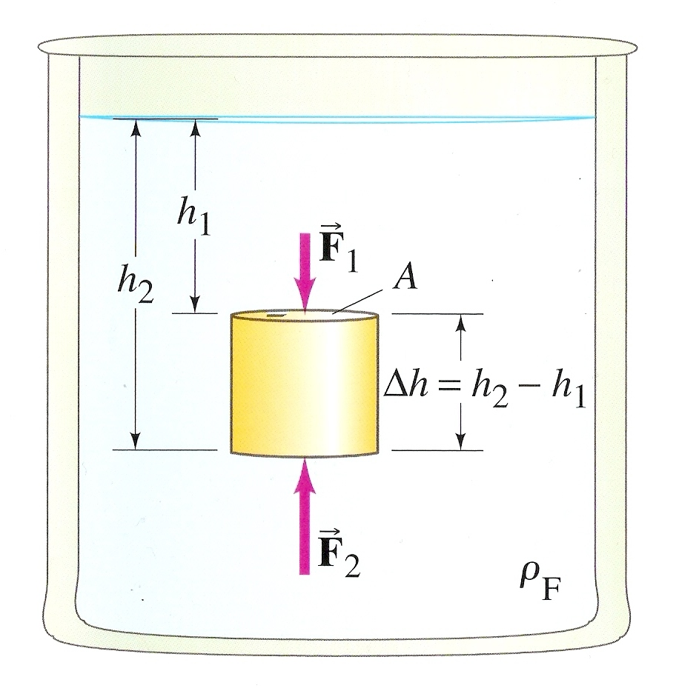
Buoyant Force
The force of fluid pressure that opposes weight

Slide 36
Buoyant Force
The force of fluid pressure that opposes weight

Slide 37
Buoyant Force
The force of fluid pressure that opposes weight

Slide 38
Buoyant Force
The force of fluid pressure that opposes weight

Slide 39
Archimedes’ Principle
The force of fluid pressure that opposes weight
The volume of the cylinder displaces the same volume of water that was there before the cylinder was immersed

Slide 40
Archimedes’ Principle
The force of fluid pressure that opposes weight
The buoyant force on a body immersed in a fluid is equal to the weight of the fluid displaced by that object

Slide 41
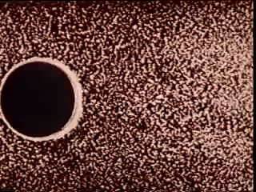

Fluids In Motion
Fluid Dynamics – study of fluids in motion
Hydrodynamics – study of water in motion
Streamline or laminar flow – flow is smooth, neighboring layers of fluid slide by each other smoothly, each particle of the fluid follows a smooth path and the paths do not cross over one another

Slide 42

Fluids In Motion
Turbulent flow – characterized by erratic, small whirlpool-like circles called eddy currents or eddies
  Eddies absorb a great deal energy through internal friction
Viscosity – measure of the internal friction in a flow

Slide 43
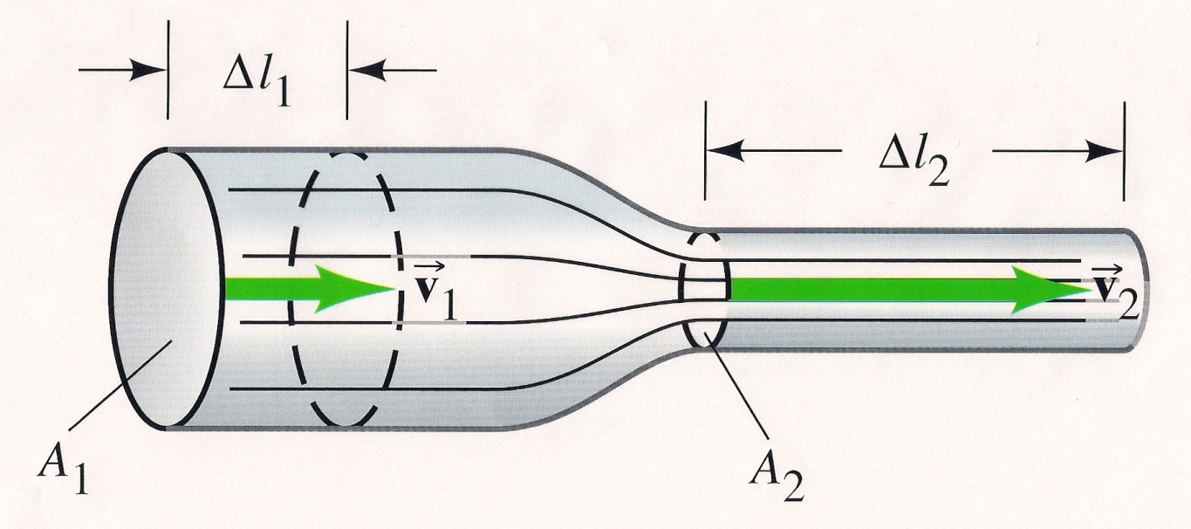
Speed Changes In Changing Diameter Of Tubes
Assumes laminar flow
Flow rate – the mass (Δm) of fluid that passes through a given point per unit time (Δt)

Slide 44
Speed Changes In Changing Diameter Of Tubes
Mass is equal to density times volume

Slide 45
Speed Changes In Changing Diameter Of Tubes
The volume (V) of fluid passing that point in time (Δt) is the cross-sectional area of the pipe (A) times the distance (Δl) travelled over the time (Δt)

Slide 46
Speed Changes In Changing Diameter Of Tubes
The velocity is equal to the distance divided by the time so, mass flow rate becomes ρAv

Slide 47
Speed Changes In Changing Diameter Of Tubes
Since no fluid escapes, the mass flow rate at both ends of this tube are the same

Slide 48
Speed Changes In Changing Diameter Of Tubes
If we assume the fluid is incompressible, density is the same and,
Equation of Continuity
and
Volume Rate of Flow

Slide 49
Speed Changes In Changing Diameter Of Tubes
When cross-sectional area is large, velocity is small. When the cross-sectional area is small, velocity is high
Equation of Continuity
and
Volume Rate of Flow

Slide 50
Speed Changes In Changing Diameter Of Tubes
That’s why you put your thumb over the end of the hose to squirt people at car washes
Equation of Continuity
and
Volume Rate of Flow

Slide 51
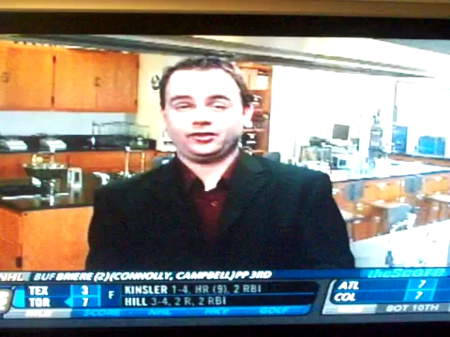
Bernoulli’s Equation

Slide 52
Bernoulli’s Equation
Daniel Bernoulli (1700-1782) is the only reason airplanes can fly
Ever wonder why:
  The shower curtain keeps creeping toward you?
  Smoke goes up a chimney and not in your house?
  When you see a guy driving with a piece of plastic covering a broken car window, that the plastic is always bulging out?

Slide 53
Bernoulli’s Equation
Ever wonder why:
  Why a punctured aorta will squirt blood up to 75 feet, but yet waste products can flow into the blood stream at the capillaries against the blood’s pressure?
  How in the world Roberto Carlos made the impossible goal?
It’s Bernoulli’s fault

Slide 54

Bernoulli’s Principle

Slide 55
Bernoulli’s Equation
Bernoulli’s principle states, where the velocity of a fluid is high, the pressure is low, and where the velocity is low, the pressure is high
BLOWING PAPER DEMO
Not as straight forward as it sounds
Consider this,

Slide 56
Bernoulli’s Equation
We just said that as the fluid flows from left to right, the velocity of the fluid increases as the area gets smaller
You would think the pressure would increase in the smaller area, but it doesn’t, it gets smaller
But, the pressure in area 1 does get larger
How come?

Slide 57
Bernoulli’s Equation
When you wash a car, your thumb cramps up holding it over the end of the hose.
  This is because of the pressure built up behind your thumb.

Slide 58
Bernoulli’s Equation
If you stuck your pinky inside the hose, you would feel pressure at the tip of your finger, a decrease in the pressure along the sides of your finger, and an increase in the velocity of the water coming out of the hose.
You would also get squirted in the face but that’s your own fault for sticking your finger in a hose!

Slide 59
Bernoulli’s Equation
It makes sense from Newton’s Second Law
In order for the mass flow to accelerate from the larger pipe to the smaller pipe, there must be a decrease in pressure

Slide 60
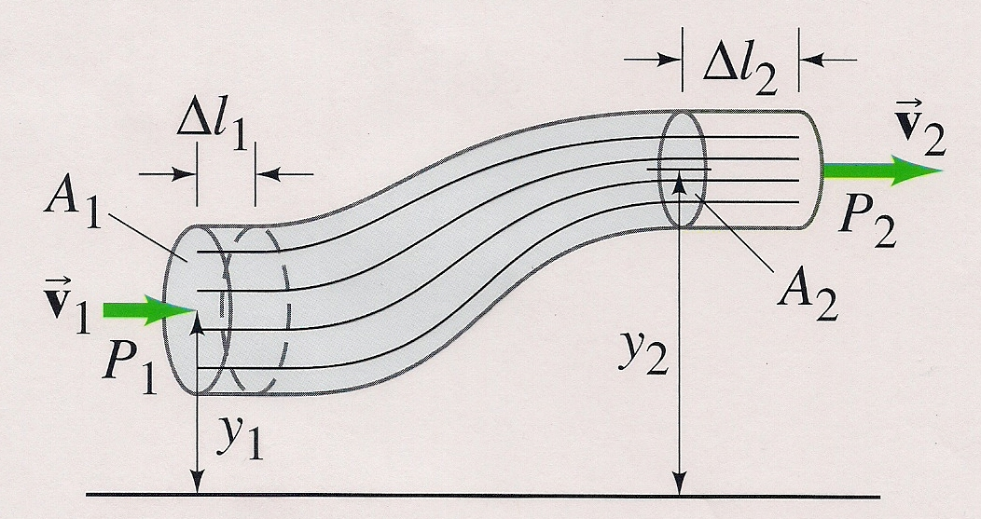
Bernoulli’s Equation
Assumptions:
  Flow is steady and laminar
  Fluid is incompressible
  Viscosity is small enough to be ignored
Consider flow in the diagram below:

Slide 61
Bernoulli’s Equation
We want to move the blue fluid on the left to the white area on the right
  On the left, the fluid must move a distance of Δl₁
  Since the right side of the tube is narrower, the fluid must move farther (Δl₂) in order to move the same volume that is in Δl₁

Slide 62
Bernoulli’s Equation
Work must be done to move the fluid along the tube and we have pressure available to do it

Slide 63
Bernoulli’s Equation
There is also work done by gravity (since the pipe has an increase in elevation) which acts on the entire body of fluid that you are trying to move
Force of gravity is mg, work is force times distance, so:

Slide 64
Bernoulli’s Equation
Total work done is then the sum of the three:

Slide 65
Bernoulli’s Equation
Anything we can do to make this longer?

Slide 66
Bernoulli’s Equation
Anything we can do to make this longer?
How about the work – energy principle?

Slide 67
Bernoulli’s Equation
Better, but it needs to be cleaned up a little.
Substitute for m, then since A₁Δl₁ = A₂Δl₂, we can divide them out

Slide 68
Bernoulli’s Equation
Manageable,
but let’s make it look like something a little more familiar

Slide 69
Bernoulli’s Equation
Look familiar,
like Conservation of Energy?

Slide 70
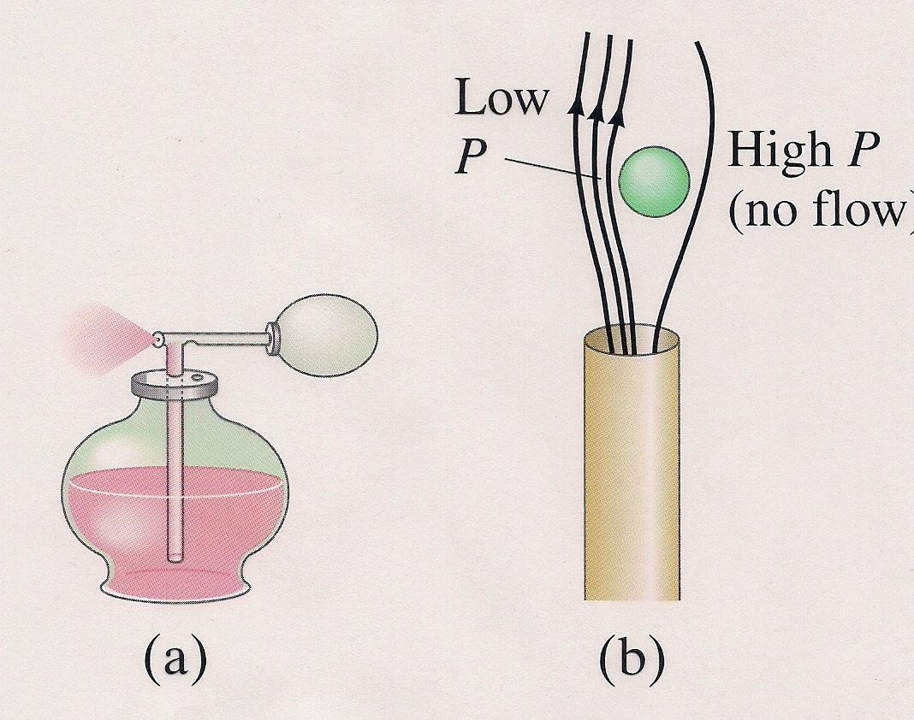
Applications: Atomizers and Ping Pong Balls

Slide 71

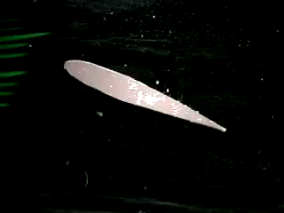
Applications: Airfoils

Slide 72
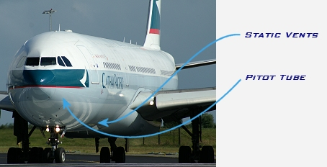
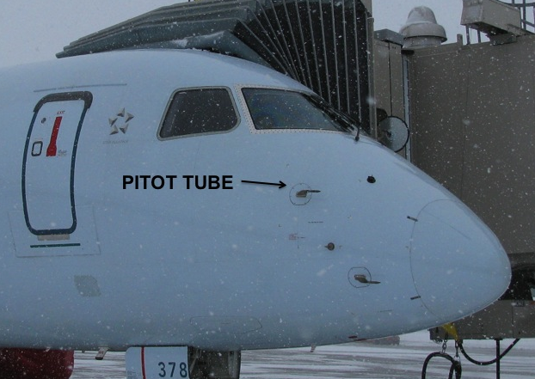
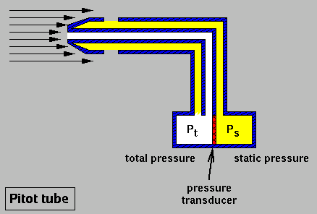
Pitot-Prandtl Tube
Measures airspeed by comparing static and dynamic pressure

Slide 73
Viscosity
A friction force between adjacent layers of fluid as the layers move past one another
In liquids, it is mainly due to the cohesive forces between molecules
In gases, it is caused by collisions between molecules.
Coefficient of viscosity, η (lowercase eta) (Pa-s)

Slide 74
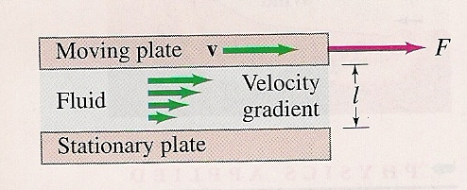
Viscosity
Determined by measuring the force required to move a plate over a stationary one with a given amount of liquid between them

Slide 75
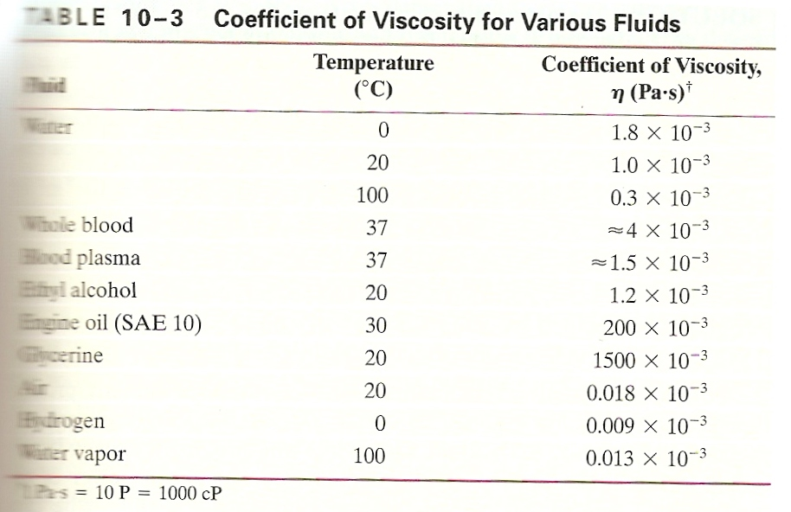
Coefficients of Viscosity
Temperatures are specified because it has a strong effect on viscosity
Viscosity for most fluids decreases rapidly with increase in temperature

Slide 76
Drag Force
For a small sphere, the drag force is
The net force on a sphere falling through a fluid is

Slide 77
Terminal Speed
Terminal speed occurs when the net force is equal to zero

Slide 78
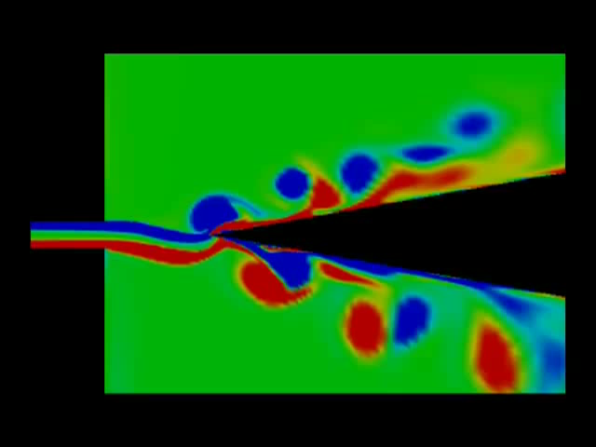

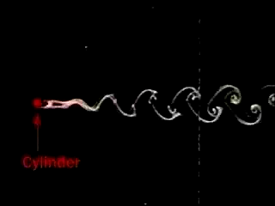
Turbulent Flow

Slide 79
Turbulent Flow
Non-Viscous Laminar Flow
Viscous Laminar Flow
Turbulent Flow

Slide 80
Reynolds Number
A dimensionless number usually associated with aerodynamics for calculating drag
Reynolds number for a pipe is,
Turbulence in pipes occurs at speeds when Reynolds number exceeds 1000

Slide 81
Understandings:
Density and pressure
Buoyancy and Archimedes’ principle
Pascal’s principle
Hydrostatic equilibrium
The ideal fluid
Streamlines

Slide 82
Understandings:
The continuity equation
The Bernoulli equation and the Bernoulli effect
Stokes’ law and viscosity
Laminar and turbulent flow and the Reynolds number

Slide 83
Data Booklet Reference:

Slide 84
Applications And Skills:
Determining buoyancy forces using Archimedes’ principle
Solving problems involving pressure, density and Pascal’s principle
Solving problems using the Bernoulli equation and the continuity equation

Slide 85
Applications And Skills:
Explaining situations involving the Bernoulli effect
Describing the frictional drag force exerted on small spherical objects in laminar fluid flow
Solving problems involving Stokes’ law
Determining the Reynolds number in simple situations

Slide 86
Guidance:
Ideal fluids will be taken to mean fluids that are incompressible and non-viscous and have steady flows
Applications of the Bernoulli equation will involve (but not be limited to) flow out of a container, determining the speed of a plane (pitot tubes), and venturi tubes

Slide 87
Guidance:
Proof of the Bernoulli equation will not be required for examination purposes
Laminar and turbulent flow will only be considered in simple situations
Values of R 103 <will be taken to represent conditions for laminar flow

Slide 88
Essential Idea:
Fluids cannot be modelled as point particles. Their distinguishable response to compression from solids creates a set of characteristics that require an in-depth study.

Slide 89
Questions?

Slide 90
Homework
#38-57

Slide 91
Stopped here 4/10/14

