Slide 1

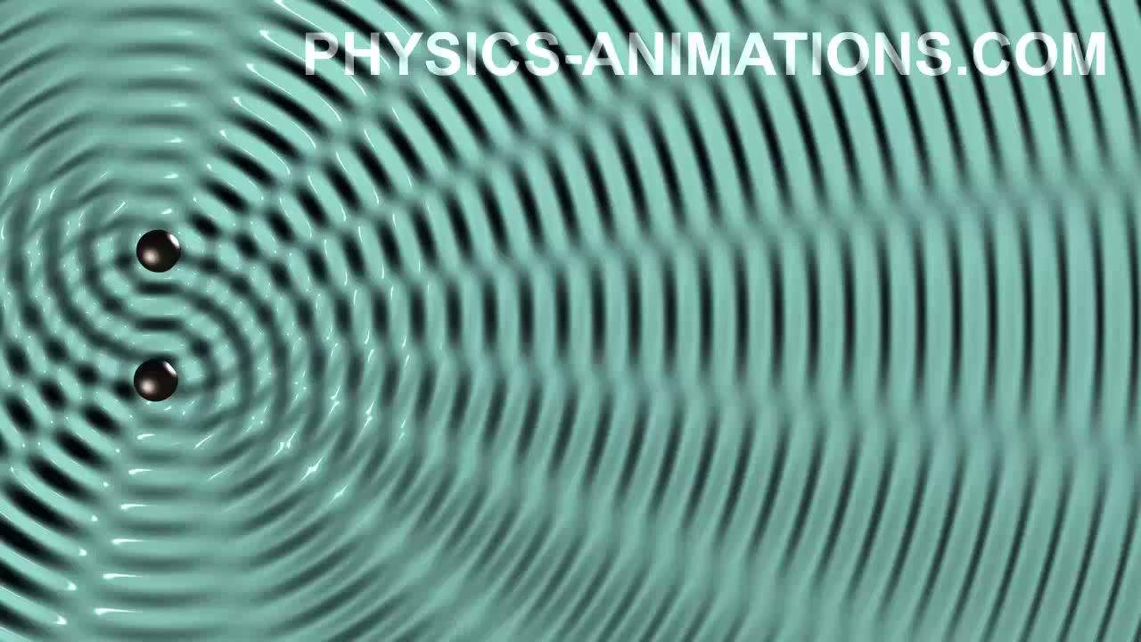
Devil physics
The baddest class on campus
IB Physics

Slide 2
Lsn 9-3: interference

Slide 3
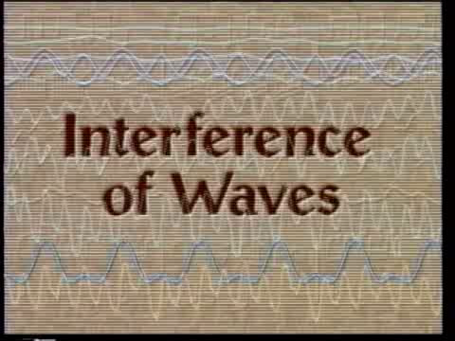
Intro Video: Interference of Waves

Slide 4
Questions From Reading Activity?

Slide 5
Essential Idea:
Interference patterns from multiple slits and thin films produce accurately repeatable patterns.

Slide 6
Nature Of Science:
Curiosity: Observed patterns of iridescence in animals, such as the shimmer of peacock feathers, led scientists to develop the theory of thin film interference.
Serendipity: The first laboratory production of thin films was accidental.

Slide 7
Theory Of Knowledge:
Most two-slit interference descriptions can be made without reference to the one-slit modulation effect.
To what level can scientists ignore parts of a model for simplicity and clarity?

Slide 8
Understandings:
Young’s double-slit experiment
Modulation of two-slit interference pattern by one-slit diffraction effect
Multiple slit and diffraction grating interference patterns
Thin film interference

Slide 9
Applications And Skills:
Qualitatively describing two-slit interference patterns, including modulation by one-slit diffraction effect
Investigating Young’s double-slit experimentally
Sketching and interpreting intensity graphs of double-slit interference patterns

Slide 10
Applications And Skills:
Solving problems involving the diffraction grating equation
Describing conditions necessary for constructive and destructive interference from thin films, including phase change at interface and effect of refractive index
Solving problems involving interference from thin films

Slide 11
Guidance:
Students should be introduced to interference patterns from a variety of coherent sources such as (but not limited to) electromagnetic waves, sound and simulated demonstrations
Diffraction grating patterns are restricted to those formed at normal incidence

Slide 12
Guidance:
The treatment of thin film interference is confined to parallel-sided films at normal incidence
The constructive interference and destructive interference formulae listed below and in the data booklet apply to specific cases of phase changes at interfaces and are not generally true

Slide 13
Data Booklet Reference:
Constructive Interference:
Destructive Interference:

Slide 14
Utilization:
Compact discs are a commercial example of the use of diffraction gratings
Thin films are used to produce anti-reflection coatings

Slide 15
Aims:
Aim 4: two scientific concepts (diffraction and interference) come together in this sub-topic, allowing students to analyze and synthesize a wider range of scientific information

Slide 16
Aims:
Aim 6: experiments could include (but are not limited to): observing the use of diffraction gratings in spectroscopes; analysis of thin soap films; sound wave and microwave interference pattern analysis

Slide 17
Aims:
Aim 9: the ray approach to the description of thin film interference is only an approximation. Students should recognize the limitations of such a visualization

Slide 18
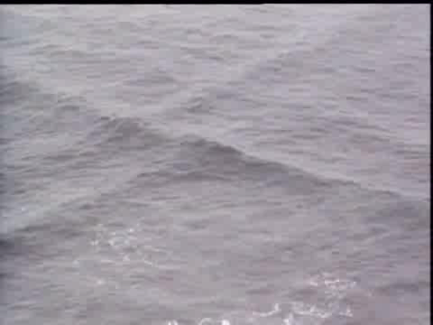
Video: Interference of Light

Slide 19
Young’s Double-Slit Experiment
We know that when waves pass through an opening that is comparable to or smaller than the wavelength, the wave will diffract

Slide 20
Young’s Double-Slit Experiment
If a single wave passes through two slits, it will form two diffracting wavefronts

Slide 21
Huygens Interlude
Every point on a wave front can be considered as a source of tiny wavelets that spread out in the forward direction at the speed of the wave itself. The new wave front is the envelope of all the wavelets.

Slide 22
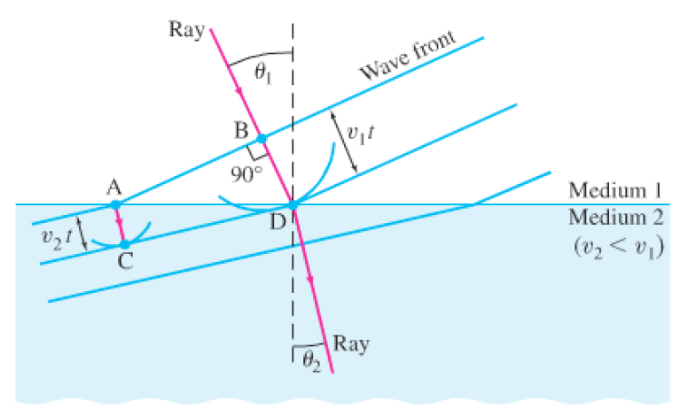
Huygens Interlude
This helps to explain why wavelength and speed decrease when changing mediums, but the wave stays intact

Slide 23
Young’s Double-Slit Experiment
The two diffracting waves will cross paths
At some points they will be in phase and constructive interference will occur
At others, destructive interference occurs

Slide 24
Young’s Double-Slit Experiment
What shows up on the screen, is a series of bright and dark spots
While that is pretty cool by itself, as physicists, we want to know how to predict where the bright and dark spots will occur

Slide 25
Young’s Double-Slit Experiment
In the middle of the screen, the two waves have travelled the same distance, so they are in phase when they meet so we get a bright spot

Slide 26
Young’s Double-Slit Experiment
In this instance, the bottom wave travels farther than the top wave
However, the path difference is equal to one wavelength, so they are also in phase and we get a bright spot

Slide 27
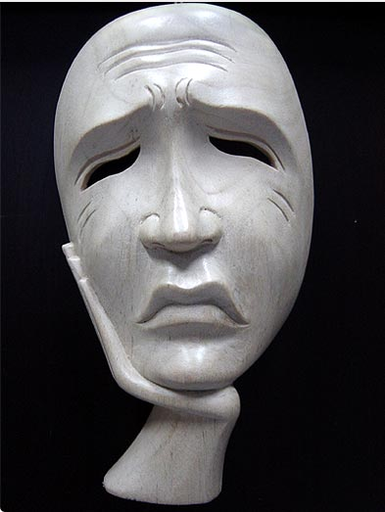
Young’s Double-Slit Experiment
In this instance, the path difference is ½ wavelength
The waves are out of phase, destructive interference occurs and we get a dark spot

Slide 28
Young’s Double-Slit Experiment
Constructive Interference occurs when the path difference equals multiples of λ
Destructive Interference occurs when the path difference equals multiples plus ½ of λ

Slide 29
Young’s Double-Slit Experiment
So how do we determine path difference?
1. Even though the two waves meet at some distant point, the angle between them is so small that we can consider them parallel.

Slide 30
Young’s Double-Slit Experiment
2. Draw a line perpendicular to the two ‘parallel’ waves to form a right triangle.
3. If you look at it long enough, you realize the diffraction angle θ, is the same angle as that at the apex of the right triangle.

Slide 31
Young’s Double-Slit Experiment
4. The distance between the two waves, d, is the same as the distance between the two slits. This distance forms the hypotenuse of the right triangle.
5. The path difference then becomes

Slide 32
Young’s Double-Slit Experiment
We can now redefine our Constructive Interference as
And our Destructive Interference as

Slide 33
Young’s Double-Slit Experiment
Now we need to know where on the screen the multiple maxima will fall.

Slide 34
Young’s Double-Slit Experiment
To do this, we need more variables
  Let s_{n} be the distance from the center to the n = 1st, 2nd, 3rd, etc maxima
  Let D be the distance from the slits to the screen

Slide 35
Young’s Double-Slit Experiment
We see then that

Slide 36
Young’s Double-Slit Experiment
We see then that

Slide 37
Young’s Double-Slit Experiment
This gives us the separation distance between two maxima
Section 4 of Data Guide

Slide 38
Young’s Double-Slit Experiment
What about Phase Difference?
Constructive Interference
Destructive Interference

Slide 39
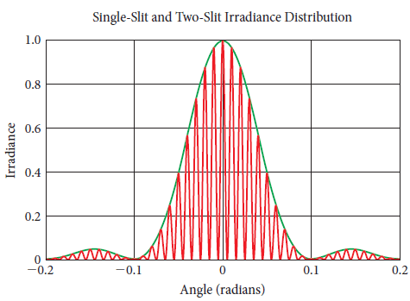
Effect of Slit Width
The intensity pattern of multi-slit diffraction is modulated or ‘enveloped’ by the pattern for single-slit

Slide 40
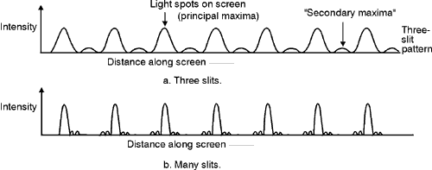
Multiple-Slit Diffraction
Secondary maxima appear between primary maxima
With N slits, there are N-2 secondary maxima

Slide 41
Multiple-Slit Diffraction
As the number of slits increase,
  Intensity for primary maxima remains the same but becomes narrower
  Secondary maxima diminish

Slide 42
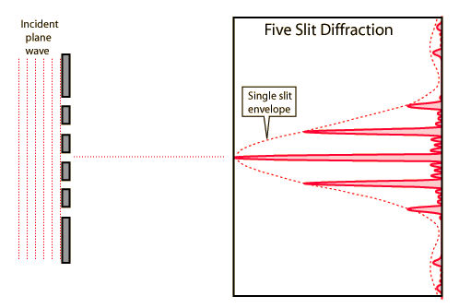
Multiple-Slit Diffraction

Slide 43
Diffraction Grating
Uses multi-slit diffraction to create very thin, highly defined maxima called ‘lines’
Used in spectroscopy – the analysis of light

Slide 44
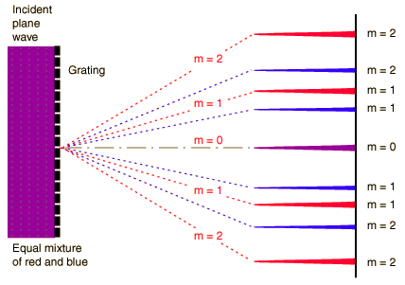
Diffraction Grating

Slide 45
Diffraction Grating

Slide 46
Diffraction Grating

Slide 47
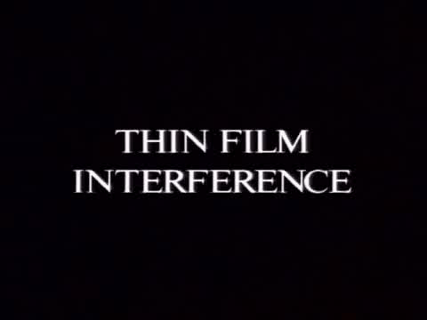
Thin Film Interference

Slide 48
Thin Film Interference
Colors seen in soap bubbles, a thin film of liquid, or oil floating on water

Slide 49
Thin Film Interference
Two key components:
  Reflected waves are inverted
  Path difference of refracted rays that are then reflected

Slide 50
Thin Film Interference
Reflected waves are inverted
  When a wave hits a surface with a higher refractive index part of its energy will be reflected off the surface
  Just like a rope tied to a wall, the reflected wave will be inverted, a phase change of π

Slide 51
Thin Film Interference
Path difference of refracted rays that are then reflected
  Part of the ray’s energy is refracted in the medium and then reflected off the bottom of the medium
  The path difference also puts this wave out of phase

Slide 52
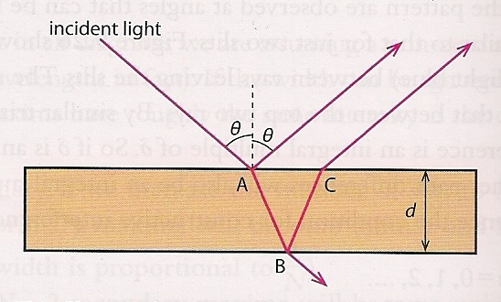
Thin Film Interference
d is the thickness of the film
If the angle of incidence, θ, is very small, we can take the path difference to be 2d (down and back up)

Slide 53
Thin Film Interference
But now, since there has been a phase change of π (a half wavelength) on the reflected wave, these two are reversed.
Remember:
Constructive Interference
Destructive Interference

Slide 54
Thin Film Interference
λ₀ is the wavelength of the wave in the medium.
We have also changed the variable for integers from n to m
Remember:
Constructive Interference
Destructive Interference

Slide 55
Thin Film Interference
λ₀ is the wavelength of the wave in the medium.
We have also changed the variable for integers from n to m – That’s why!
The wavelength in the medium is found by:
  λ is the wavelength in air
  n is now the refractive index of the medium

Slide 56
Thin Film Interference
We now have:
Constructive Interference
    One phase change
    Zero or two phase changes
Destructive Interference
  One phase change
  Zero or two phase changes

Slide 57
Nature of Science
Curiosity and Serendipity
Which do you have right now?

Slide 58
Essential Idea:
Interference patterns from multiple slits and thin films produce accurately repeatable patterns.

Slide 59
Nature Of Science:
Curiosity: Observed patterns of iridescence in animals, such as the shimmer of peacock feathers, led scientists to develop the theory of thin film interference.
Serendipity: The first laboratory production of thin films was accidental.

Slide 60
Theory Of Knowledge:
Most two-slit interference descriptions can be made without reference to the one-slit modulation effect.
To what level can scientists ignore parts of a model for simplicity and clarity?

Slide 61
Understandings:
Young’s double-slit experiment
Modulation of two-slit interference pattern by one-slit diffraction effect
Multiple slit and diffraction grating interference patterns
Thin film interference

Slide 62
Applications And Skills:
Qualitatively describing two-slit interference patterns, including modulation by one-slit diffraction effect
Investigating Young’s double-slit experimentally
Sketching and interpreting intensity graphs of double-slit interference patterns

Slide 63
Applications And Skills:
Solving problems involving the diffraction grating equation
Describing conditions necessary for constructive and destructive interference from thin films, including phase change at interface and effect of refractive index
Solving problems involving interference from thin films

Slide 64
Guidance:
Students should be introduced to interference patterns from a variety of coherent sources such as (but not limited to) electromagnetic waves, sound and simulated demonstrations
Diffraction grating patterns are restricted to those formed at normal incidence

Slide 65
Guidance:
The treatment of thin film interference is confined to parallel-sided films at normal incidence
The constructive interference and destructive interference formulae listed below and in the data booklet apply to specific cases of phase changes at interfaces and are not generally true

Slide 66
Data Booklet Reference:
Constructive Interference:
Destructive Interference:

Slide 67
Utilization:
Compact discs are a commercial example of the use of diffraction gratings
Thin films are used to produce anti-reflection coatings

Slide 68
Aims:
Aim 4: two scientific concepts (diffraction and interference) come together in this sub-topic, allowing students to analyse and synthesize a wider range of scientific information

Slide 69
Aims:
Aim 6: experiments could include (but are not limited to): observing the use of diffraction gratings in spectroscopes; analysis of thin soap films; sound wave and microwave interference pattern analysis

Slide 70
Aims:
Aim 9: the ray approach to the description of thin film interference is only an approximation. Students should recognize the limitations of such a visualization

Slide 71
Questions?

Slide 72
Homework
#17-26

