Slide 1
Devil physics The baddest class on campus AP Physics

Slide 2
Lsn 8-5: Rotational Dynamics; torque and rotational inertia Lsn 8-6: Solving problems in rotational dynamics

Slide 3
Questions From Reading Activity?

Slide 4
Big Idea(s):
Interactions between systems can result in changes in those systems.
Changes that occur as a result of interactions are constrained by conservation laws.

Slide 5
Enduring Understanding(s):
A net torque exerted on a system by other objects or systems will change the angular momentum of the system.
The angular momentum of a system is conserved.

Slide 6
Essential Knowledge(s):
The angular momentum of a system may change due to interactions with other objects or systems.
Alternatively, the angular momentum of a system can be found from the product of the system’s rotational inertia and its angular velocity.

Slide 7
Essential Knowledge(s):
The angular momentum of a system is determined by the locations and velocities of the objects that make up the system.
The rotational inertia of an object or system depends upon the distribution of mass within the object or system.

Slide 8
Essential Knowledge(s):
Changes in the radius of a system or in the distribution of mass within the system result in changes in the system’s rotational inertia, and hence in its angular velocity and linear speed for a given angular momentum.

Slide 9
Essential Knowledge(s):
Examples should include elliptical orbits in an Earth-satellite system. Mathematical expressions for the moments of inertia will be provided where needed. Students will not be expected to know the parallel axis theorem.

Slide 10
Learning Objective(s):
The student is able to plan a data collection and analysis strategy to determine the change in angular momentum of a system and relate it to interactions with other objects and systems.

Slide 11
Learning Objective(s):
The student is able to describe or calculate the angular momentum and rotational inertia of a system in terms of the locations and velocities of objects that make up the system. Students are expected to do qualitative reasoning with compound objects. Students are expected to do calculations with a fixed set of extended objects and point masses.

Slide 12
Introductory Video

Slide 13
Moment of Inertia
Angular acceleration is proportional to the net torque applied to it
Force along a moment arm is torque
More force means more acceleration
F
m

Slide 14
Moment of Inertia
Everything in life relates to Newton’s Second Law
F
m

Slide 15
Moment of Inertia
Moment of Inertia defined:
Note that the moment of inertia is much more affected by distance than by mass.
Determination of the axis of rotation (reference point) is critical!
F
m

Slide 16
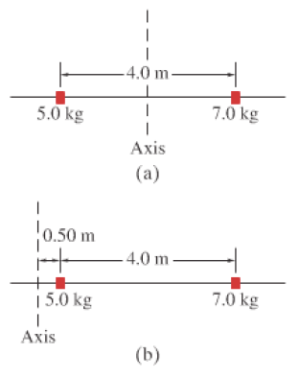
Moment of Inertia
Example 8-10: Find the moment of inertia for (a) and (b)

Slide 17
Moment of Inertia
Example 8-10: Find the moment of inertia for (a) and (b)

Slide 18
Moment of Inertia
Moment of Inertia defined:
This is Newton’s Second Law for rotation!
F
m

Slide 19
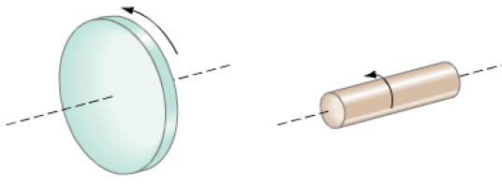
Moment of Inertia
Moment of Inertia defined:
So how do you find the moment of inertia and the torque on these objects?
F
m

Slide 20
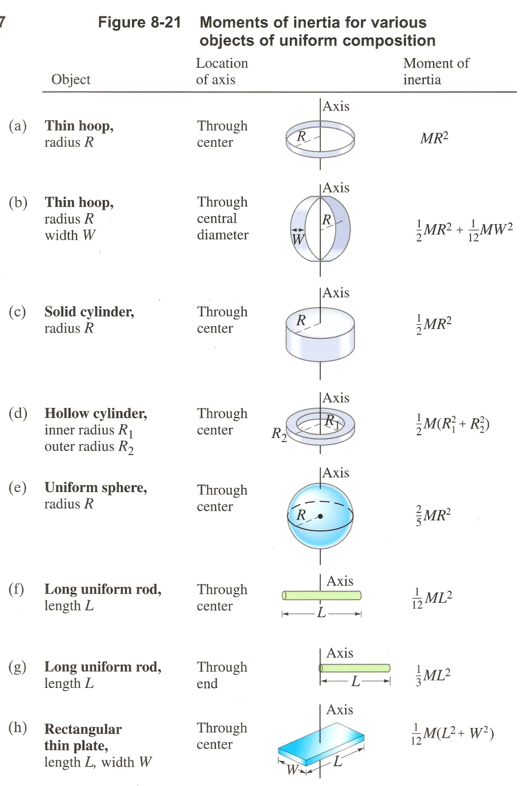
Moment of Inertia
Without calculus, finding the moment of inertia can be difficult as seen by this chart
It can be determined experimentally by finding the acceleration from a known torque

Slide 21
Problem Solving – Rotational Motion
Draw a diagram of the system.
Draw a free-body diagram for the object of interest.
Identify the axis of rotation (reference point) and determine the torques (remember directions!)
Apply Newton’s Second Law for rotation (Στ = Iα).
Apply Newton’s Second Law for translation as needed.
Solve and check for reasonability.

Slide 22
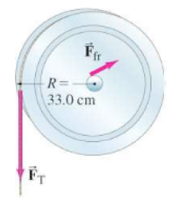
Example 8-11
Determine the moment of inertia of the pulley

Slide 23
Example 8-11
Determine the moment of inertia of the pulley

Slide 24
Example 8-11
Determine the moment of inertia of the pulley

Slide 25
Example 8-11
Determine the moment of inertia of the pulley

Slide 26
Example 8-11
Determine the moment of inertia of the pulley

Slide 27
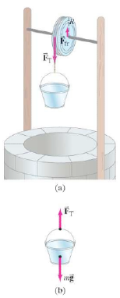
Example 8-12
Calculate the angular and linear acceleration of the pulley.

Slide 28
Example 8-12
Calculate the angular and linear acceleration of the pulley.

Slide 29
Example 8-12
Calculate the angular and linear acceleration of the pulley.

Slide 30
Example 8-12
Calculate the angular and linear acceleration of the pulley.

Slide 31
Example 8-12
Calculate the angular and linear acceleration of the pulley.

Slide 32
Example 8-12
Calculate the angular and linear acceleration of the pulley.

Slide 33
Review Video

Slide 34
Learning Objective(s):
The student is able to plan a data collection and analysis strategy to determine the change in angular momentum of a system and relate it to interactions with other objects and systems.

Slide 35
Learning Objective(s):
The student is able to describe or calculate the angular momentum and rotational inertia of a system in terms of the locations and velocities of objects that make up the system. Students are expected to do qualitative reasoning with compound objects. Students are expected to do calculations with a fixed set of extended objects and point masses.

Slide 36
Essential Knowledge(s):
The angular momentum of a system may change due to interactions with other objects or systems.
Alternatively, the angular momentum of a system can be found from the product of the system’s rotational inertia and its angular velocity.

Slide 37
Essential Knowledge(s):
The angular momentum of a system is determined by the locations and velocities of the objects that make up the system.
The rotational inertia of an object or system depends upon the distribution of mass within the object or system.

Slide 38
Essential Knowledge(s):
Changes in the radius of a system or in the distribution of mass within the system result in changes in the system’s rotational inertia, and hence in its angular velocity and linear speed for a given angular momentum.

Slide 39
Essential Knowledge(s):
Examples should include elliptical orbits in an Earth-satellite system. Mathematical expressions for the moments of inertia will be provided where needed. Students will not be expected to know the parallel axis theorem.

Slide 40
Enduring Understanding(s):
A net torque exerted on a system by other objects or systems will change the angular momentum of the system.
The angular momentum of a system is conserved.

Slide 41
Big Idea(s):
Interactions between systems can result in changes in those systems.
Changes that occur as a result of interactions are constrained by conservation laws.

Slide 42
Questions?

Slide 43
Homework
#27-40

