Slide 1
Devil physics The baddest class on campus IB Physics

Slide 2
Lsn 8-1: Energy Sources

Slide 3
Questions From Reading Activity?

Slide 4
Essential Idea:
The constant need for new energy sources implies decisions that may have a serious effect on the environment. The finite quantity of fossil fuels and their implication in global warming has led to the development of alternative sources of energy. This continues to be an area of rapidly changing technological innovation.

Slide 5
Nature Of Science:
Risks and problem-solving: Since early times mankind understood the vital role of harnessing energy and large-scale production of electricity has impacted all levels of society. Processes where energy is transformed require holistic approaches that involve many areas of knowledge. Research and development of alternative energy sources has lacked support in some countries for economic and political reasons. Scientists, however, have continued to collaborate and share new technologies that can reduce our dependence on non-renewable energy sources.

Slide 6
International-Mindedness:
The production of energy from fossil fuels has a clear impact on the world we live in and therefore involves global thinking. The geographic concentrations of fossil fuels have led to political conflict and economic inequalities. The production of energy through alternative energy resources demands new levels of international collaboration.

Slide 7
Theory Of Knowledge:
The use of nuclear energy inspires a range of emotional responses from scientists and society.
How can accurate scientific risk assessment be undertaken in emotionally charged areas?

Slide 8
Understandings:
Specific energy and energy density of fuel sources
Sankey diagrams
Primary energy sources
Electricity as a secondary and versatile form of energy
Renewable and non-renewable energy sources

Slide 9
Applications And Skills:
Solving specific energy and energy density problems
Sketching and interpreting Sankey diagrams
Describing the basic features of fossil fuel power stations, nuclear power stations, wind generators, pumped storage hydroelectric systems and solar power cells

Slide 10
Applications And Skills:
Solving problems relevant to energy transformations in the context of these generating systems
Discussing safety issues and risks associated with the production of nuclear power
Describing the differences between photovoltaic cells and solar heating panels

Slide 11
Guidance:
Specific energy has units of J kg–1; energy density has units of J m–3
The description of the basic features of nuclear power stations must include the use of control rods, moderators and heat exchangers

Slide 12
Guidance:
Derivation of the wind generator equation is not required but an awareness of relevant assumptions and limitations is required
Students are expected to be aware of new and developing technologies which may become important during the life of this guide

Slide 13
Data Booklet Reference:

Slide 14
Utilization:
Generators for electrical production and engines for motion have revolutionized the world (see Physics sub-topics 5.4 and 11.2)
The engineering behind alternative energy sources is influenced by different areas of physics (see Physics sub-topics 3.2, 5.4 and B.2)
Energy density (see Chemistry sub-topic C.1)
Carbon recycling (see Biology sub-topic 4.3)

Slide 15
Aims:
Aim 4: the production of power involves many different scientific disciplines and requires the evaluation and synthesis of scientific information
Aim 8: the production of energy has wide economic, environmental, moral and ethical dimensions

Slide 16
Definitions
Primary Energy
Energy found in nature that has not been subject to processing of any kind
Energy stored in fuels: oil, coal, natural gas, solar, wind, tidal, etc
Secondary Energy
Primarily electrical energy
Mechanical energy (transportation)

Slide 17
Primary to Secondary Energy Generation
Electricity Generation: Non Renewables. Learn360. Films Media Group, 2015. Web. 12 Feb. 2016.

Slide 18
Definitions
Specific Energy
Amount of energy extracted per unit mass of fuel
J/kg
Energy Density
Amount of energy extracted per unit volume
J/kg
Which is more important?

Slide 20
Definitions
Non-renewable source
Finite sources that are being depleted faster than they are being produced
Fossil fuels and nuclear fuels
Renewable sources
Sources essentially available as long as the sun, earth, and moon exist
Solar, wind, wave, tidal, geothermal

Slide 21
Considerations in Choice
Cost of transportation
Transportation safety considerations
Storage facilities
Environmental impact/risk

Slide 22
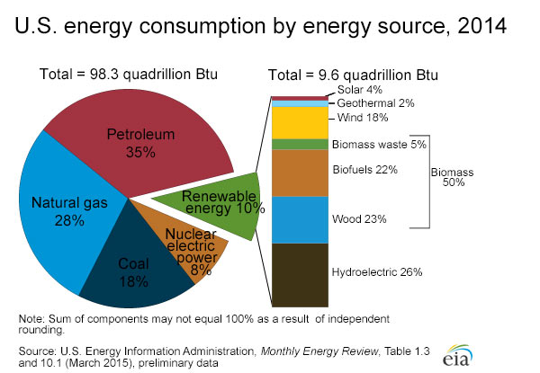

Slide 23
Non-Renewable Fossil Fuels
Electricity Generation: Non Renewables. Learn360. Films Media Group, 2015. Web. 12 Feb. 2016.

Slide 24
Fossil Fuels
Primary resource for transportation, electricity production, and industry

Slide 26
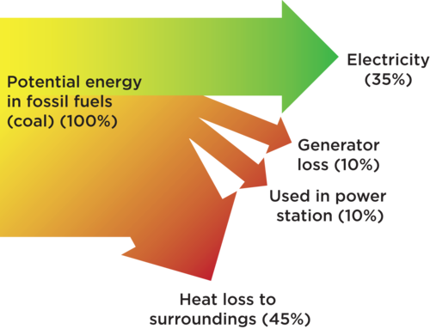

Slide 27
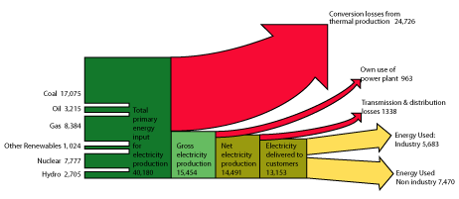

Slide 28
The Pros and Cons of Coal and Oil
Electricity Generation: Non Renewables. Learn360. Films Media Group, 2015. Web. 12 Feb. 2016.

Slide 29
The Pros and Cons of Gas
Electricity Generation: Non Renewables. Learn360. Films Media Group, 2015. Web. 12 Feb. 2016.

Slide 30
Fossil Fuels
Advantages
Disadvantages
Relatively cheap and currently abundant
High energy density
Variety of engines and devices use them directly and easily
Extensive distribution network in place
Will run out
Pollutes the environment
Contributes to greenhouse effect by releasing greenhouse gases in the atmosphere

Slide 31
The Pros and Cons of Nuclear
Electricity Generation: Non Renewables. Learn360. Films Media Group, 2015. Web. 12 Feb. 2016.

Slide 32
Introduction to Nuclear Power

Slide 33
Generating Nuclear Power

Slide 34
Nuclear Power
Induced fission reaction
Neutrons must be propelled into the material to start the reaction
Two released neutrons have enough energy to initiate reactions in other atoms

Slide 35
Nuclear Power
The number of reactions increases exponentially -- a chain reaction
Left unchecked, you have a nuclear meltdown and/or explosion
We try to avoid that

Slide 36
Nuclear Power
Control rods absorb neutrons to limit the number available to start reactions
Raised or lowered to change the amount of surface area available for absorption

Slide 37
Nuclear Power
Uranium will not react if the neutrons are going too fast
The neutrons in the above reaction are going too fast
Moderators (graphite or water) surround the control rods and slow the neutrons down by providing a collision surface

Slide 38
Nuclear Power
Uranium must have a minimum mass based on its container that will allow reactions to continue without the neutrons escaping
This mass value is call critical mass

Slide 39
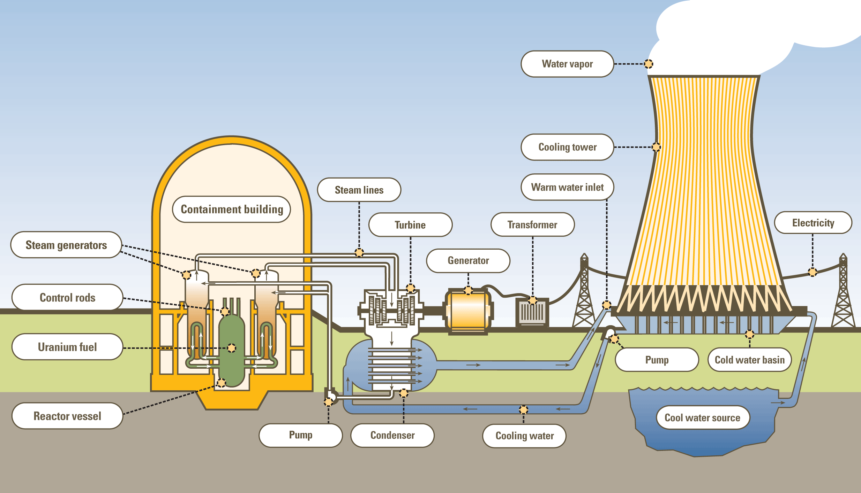

Slide 40
Energy from Nuclear Power
Nuclear (binding) energy
Kinetic energy (particles)
Thermal energy (steam)
Kinetic energy (turbine)
Electricalenergy

Slide 41
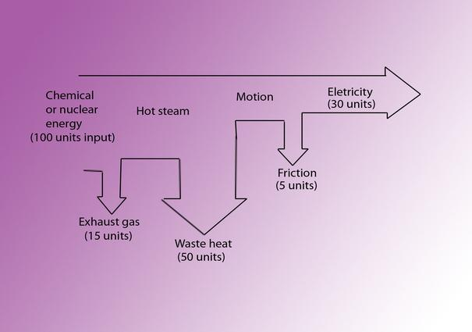

Slide 42
Other Uses of Nuclear Power

Slide 43
Other Uses of Nuclear Power
Neutrons from a fission reaction can produce plutonium-239 (does not occur naturally) from uranium-238

Slide 44
Other Uses of Nuclear Power
Process turns non-fissionable material (uranium-238) into fissionable material (plutonium-239) that can be used as reactor fuel or nuclear weapons

Slide 45
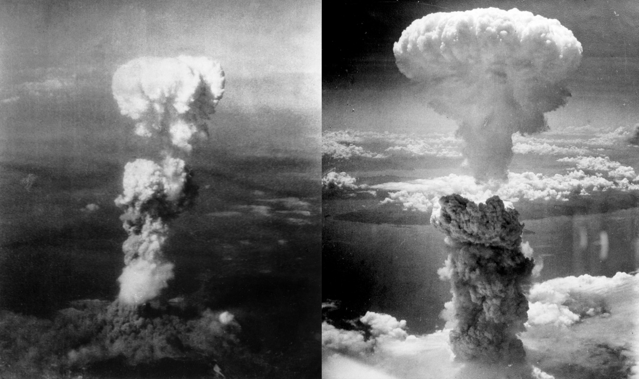
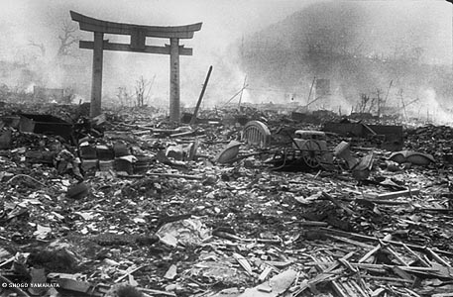

Slide 46
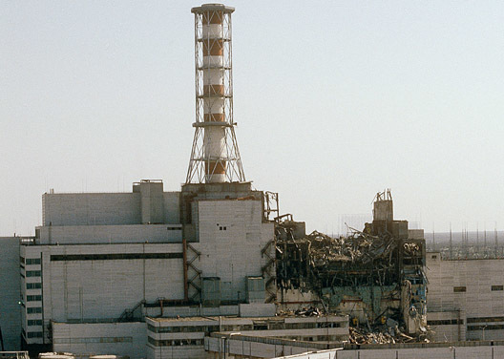

Slide 47
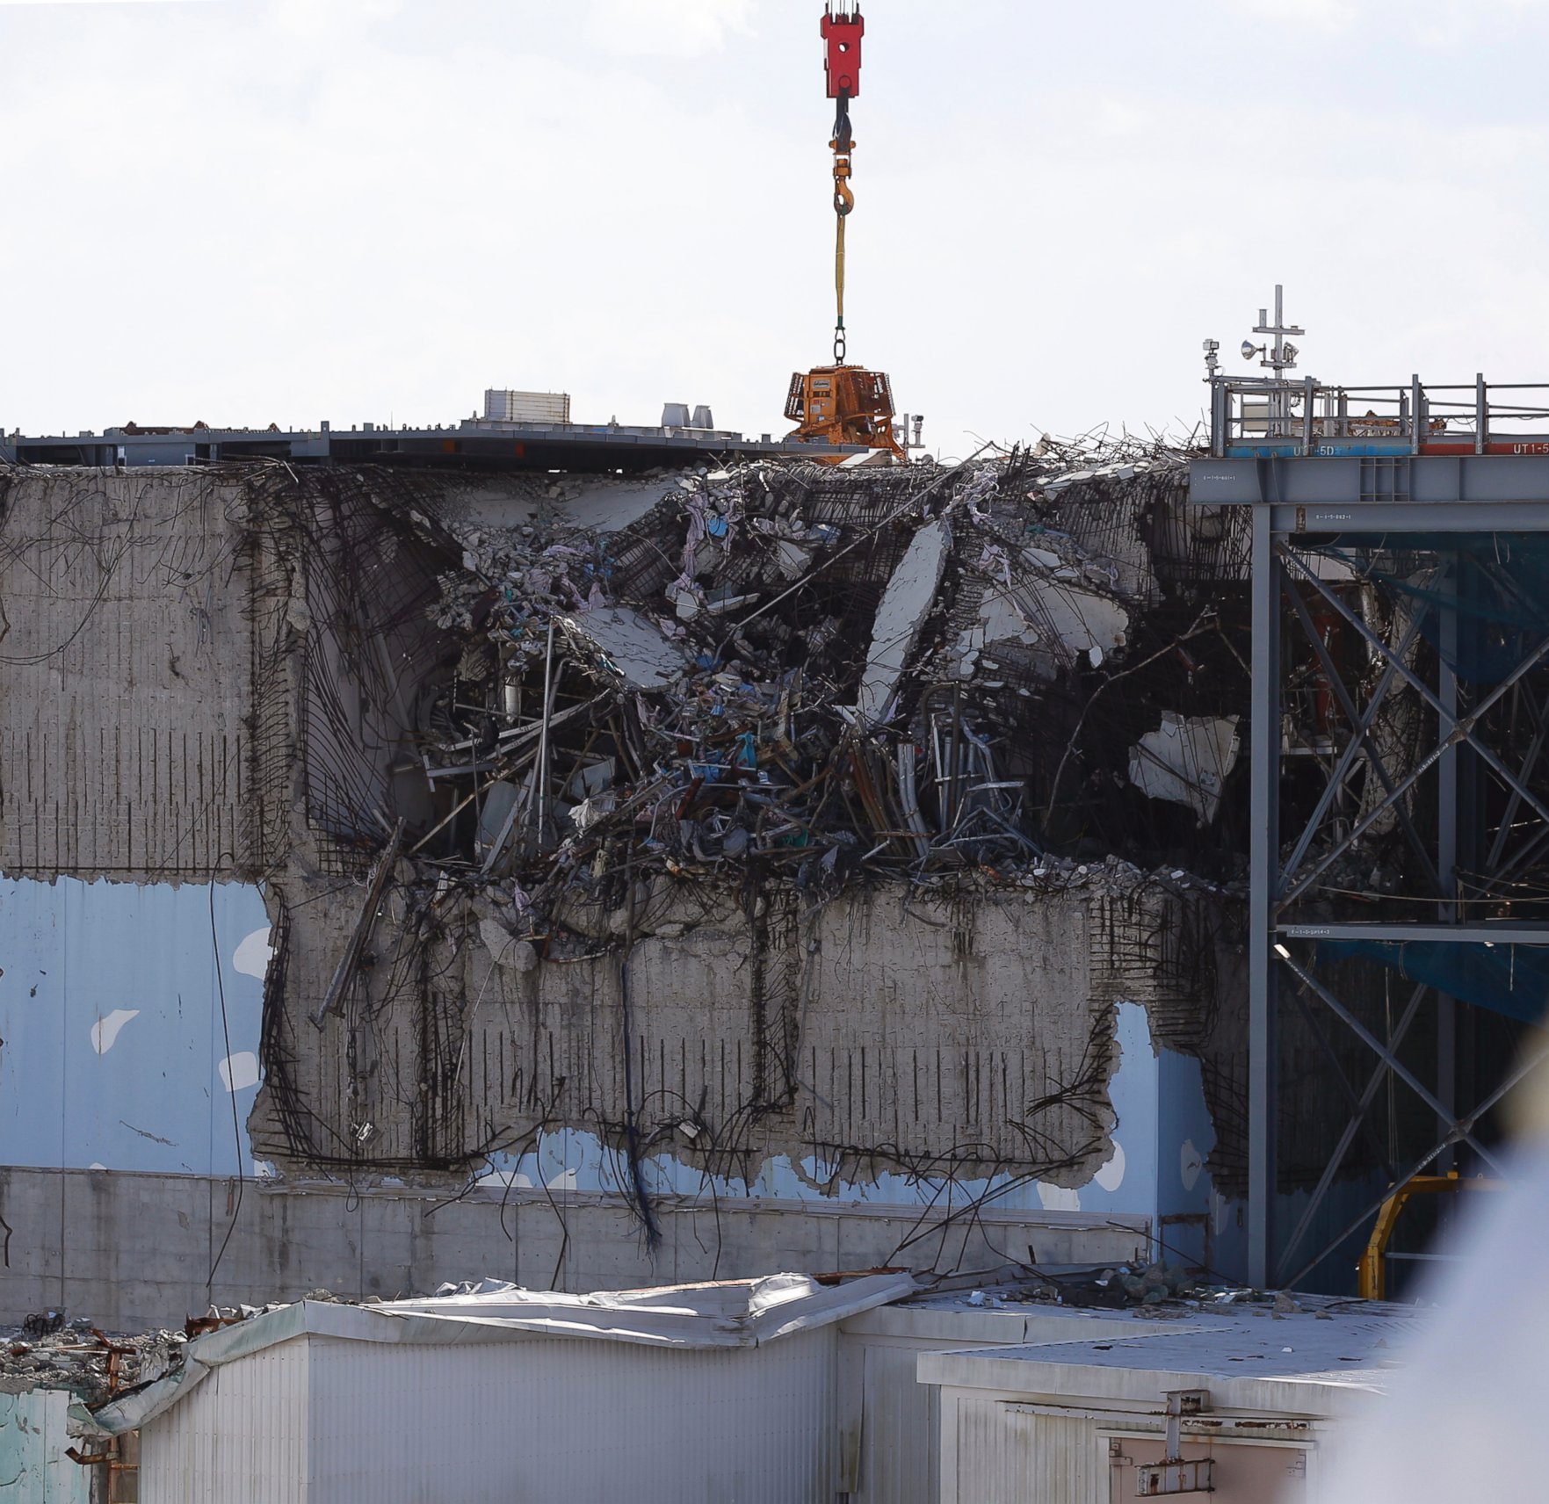

Slide 48
Nuclear Power
Advantages
Disadvantages
High power output
Large reserves of nuclear fuels
Nuclear power does not produce greenhouse gases
Radioactive waste products difficult to dispose of
Major public health hazard in accidents
Problems associated with uranium mining
Potential for producing materials for nuclear weapons

Slide 49
More Information
Podcast On The Environmentalist Debate Over Nuclear Power
http://www.kqed.org/a/forum/R201104010900
Radiation Exposure Chart
http://imgs.xkcd.com/blag/radiation.png

Slide 50
From Petroleum Age to Alternative Energy Sources
Energy and Resources. Learn360. Films Media Group, 2006. Web. 12 Feb. 2016.

Slide 51
The Pros and Cons of Solar
Electricity Generation: Renewables. Learn360. Films Media Group, 2015. Web. 12 Feb. 2016.

Slide 52
Solar Power
Active solar devices – used to directly heat water or air
Photovoltaic cells convert sunlight to electricity
Low power output
About 30-45% efficient

Slide 53
Solar Power
Advantages
Disadvantages
Free ‘fuel’
Inexhaustible
Clean
Daylight only operation
Affected by cloudy weather
Low power output
Requires large areas
Initial costs high

Slide 54
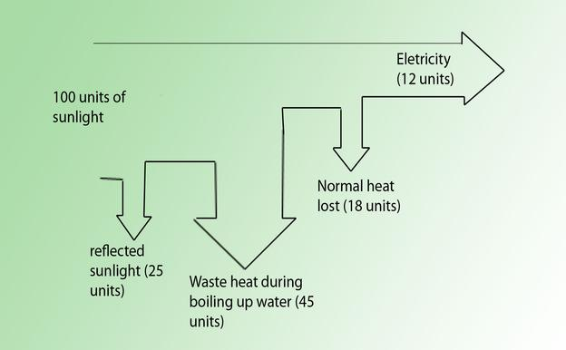

Slide 55
The Pros and Cons of Hydro-Electric Power
Electricity Generation: Renewables. Learn360. Films Media Group, 2015. Web. 12 Feb. 2016.

Slide 56
Hydroelectric Power
Requires a river with a large area that can be flooded
Uses the potential energy of stored water
ρ = density
Q = volume flow rate of the water
Pumped storage system

Slide 57
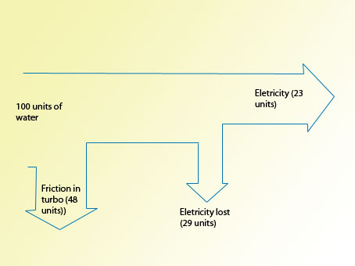

Slide 58
Hydroelectric Power
Pumped storage system
Water pumped to an upper reservoir
Allowed to drain through a turbine
Requires more energy to pump water to reservoir than can be effectively retrieved
Why would you want to do this?

Slide 59
Hydroelectric Power
Pumped storage system
Water pumped to an upper reservoir
Allowed to drain through a turbine
Requires more energy to pump water to reservoir than can be effectively retrieved
Why would you want to do this?
Pump the water using excess solar or wind power to ‘store’ energy for nighttime or adverse weather usage

Slide 60
Hydroelectric Power
Advantages
Disadvantages
Free ‘fuel’
Inexhaustible
Clean
Very dependent on location
Requires drastic changes to environment
Initial costs high

Slide 61
Hydroelectric Power Rocks!

Slide 62
The Pros and Cons of Wind
Electricity Generation: Renewables. Learn360. Films Media Group, 2015. Web. 12 Feb. 2016.

Slide 63
Wind Power
Dutch windmills
Modern wind turbine farms
Transfers kinetic energy of wind to turning electrical generators
Theoretical maximum assuming the wind velocity can be brought to zero

Slide 64
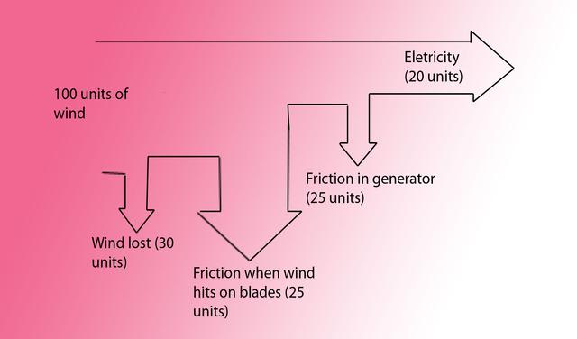

Slide 65
Wind Power
Advantages
Disadvantages
Free ‘fuel’
Inexhaustible
Clean
Dependent on local wind conditions
Aesthetic problems
Noise problems
Requires large open area

Slide 66
Just to be smarter than everyone else . . .

Slide 67
The Pros and Cons of Geothermal Power
Electricity Generation: Renewables. Learn360. Films Media Group, 2015. Web. 12 Feb. 2016.

Slide 68
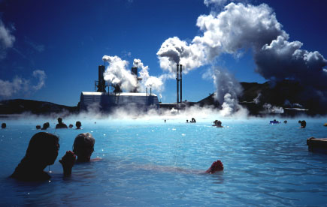

Slide 69
Tidal Energy Pros and Cons
The Greening of Energy. Learn360. Films Media Group, 2014. Web. 12 Feb. 2016.

Slide 70
Wave Energy
Waves, Tides and the Coastal Environment. Learn360. Films Media Group, 2009. Web. 12 Feb. 2016.

Slide 71
Hydrogen Power
Alternative Energy Sources. Learn360. Films Media Group, 2003. Web. 12 Feb. 2016.

Slide 72
Study the Following On Your Own
Know The Advantages and Disadvantages of Each Type of Power Source!!!!!

Slide 73
Understandings:
Specific energy and energy density of fuel sources
Sankey diagrams
Primary energy sources
Electricity as a secondary and versatile form of energy
Renewable and non-renewable energy sources

Slide 74
Applications And Skills:
Solving specific energy and energy density problems
Sketching and interpreting Sankey diagrams
Describing the basic features of fossil fuel power stations, nuclear power stations, wind generators, pumped storage hydroelectric systems and solar power cells

Slide 75
Applications And Skills:
Solving problems relevant to energy transformations in the context of these generating systems
Discussing safety issues and risks associated with the production of nuclear power
Describing the differences between photovoltaic cells and solar heating panels

Slide 76
Guidance:
Specific energy has units of J kg–1; energy density has units of J m–3
The description of the basic features of nuclear power stations must include the use of control rods, moderators and heat exchangers

Slide 77
Guidance:
Derivation of the wind generator equation is not required but an awareness of relevant assumptions and limitations is required
Students are expected to be aware of new and developing technologies which may become important during the life of this guide

Slide 78
Data Booklet Reference:

Slide 79
Essential Idea:
The constant need for new energy sources implies decisions that may have a serious effect on the environment. The finite quantity of fossil fuels and their implication in global warming has led to the development of alternative sources of energy. This continues to be an area of rapidly changing technological innovation.

Slide 80
Questions?

Slide 81
Homework
#1-25

Slide 82
The Rest of the Nuclear Power Video (32 min total)

