Slide 1

Devil physics
The baddest class on campus
IB Physics

Slide 2
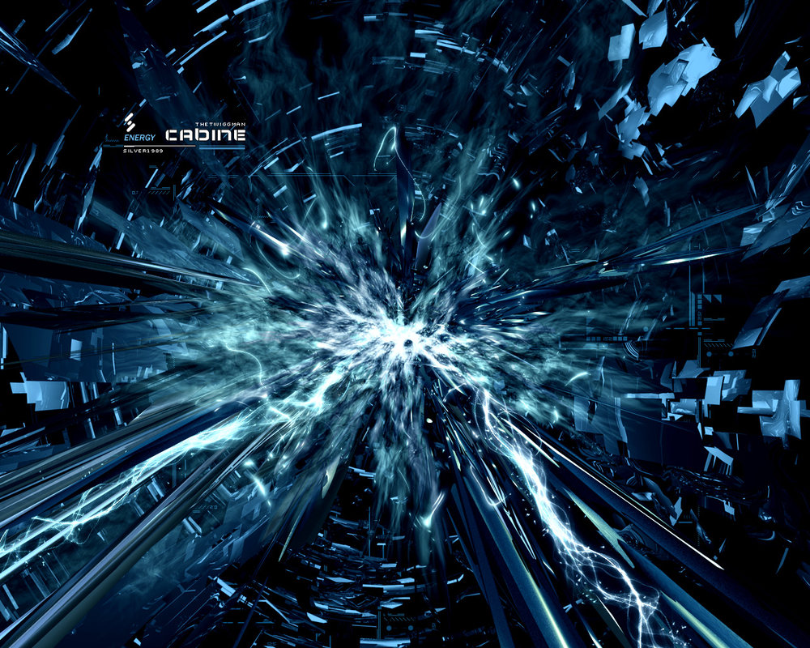
Lsn 7-3: The structure of matter

Slide 3
Questions From Reading Activity?

Slide 4
Essential Idea:
It is believed that all the matter around us is made up of fundamental particles called quarks and leptons. It is known that matter has a hierarchical structure with quarks making up nucleons, nucleons making up nuclei, nuclei and electrons making up atoms and atoms making up molecules. In this hierarchical structure, the smallest scale is seen for quarks and leptons (10^{–18}m).

Slide 5
Nature Of Science:
Predictions: Our present understanding of matter is called the Standard Model, consisting of six quarks and six leptons. Quarks were postulated on a completely mathematical basis in order to explain patterns in properties of particles.

Slide 6
Nature Of Science:
Collaboration: It was much later that large-scale collaborative experimentation led to the discovery of the predicted fundamental particles.

Slide 7
International-Mindedness:
Research into particle physics requires ever-increasing funding, leading to debates in governments and international research organizations on the fair allocation of precious financial resources.

Slide 8
Theory Of Knowledge:
Does the belief in the existence of fundamental particles mean that it is justifiable to see physics as being more important than other areas of knowledge?

Slide 9
Understandings:
Quarks, leptons and their antiparticles
Hadrons, baryons and mesons
The conservation laws of charge, baryon number, lepton number and strangeness
The nature and range of the strong nuclear force, weak nuclear force and electromagnetic force
Exchange particles
Feynman diagrams
Confinement
The Higgs boson

Slide 10
Applications And Skills:
Describing the Rutherford-Geiger-Marsden experiment that led to the discovery of the nucleus
Applying conservation laws in particle reactions
Describing protons and neutrons in terms of quarks
Comparing the interaction strengths of the fundamental forces, including gravity

Slide 11
Applications And Skills:
Describing the mediation of the fundamental forces through exchange particles
Sketching and interpreting simple Feynman diagrams
Describing why free quarks are not observed

Slide 12
Guidance:
A qualitative description of the standard model is required.

Slide 13
Data Booklet Reference:

Slide 14
Data Booklet Reference:

Slide 15
Utilization:
An understanding of particle physics is needed to determine the final fate of the universe (see Physics option sub-topics D.3 and D.4).

Slide 16
Aims:
Aim 1: the research that deals with the fundamental structure of matter is international in nature and is a challenging and stimulating adventure for those who take part
Aim 4: particle physics involves the analysis and evaluation of very large amounts of data

Slide 17
Aims:
Aim 6: students could investigate the scattering angle of alpha particles as a function of the aiming error, or the minimum distance of approach as a function of the initial kinetic energy of the alpha particle
Aim 8: scientific and government organizations are asked if the funding for particle physics research could be spent on other research or social needs

Slide 18

Review: Models of the Atom

Slide 19

Review: Strong Nuclear Force

Slide 20
Standard Model
Protons and neutrons in a concentrated nucleus
Electrons in a cloud of quantized energy levels
Photons released as electrons return from excited energy levels

Slide 21
History of Discovery
1897 – electron
1905 - photon
1911 – nucleus
1920 – proton
1932 – neutron
1938 – nuclear fission

Slide 22

History of Discovery
With particle accelerators and bubble chambers, hundreds of new particles were discovered in the 1950’s and 1960’s
  Previously, they could not be detected due to short lifespans (unstable, rapid decay)
  Making sense of it all was the biggest problem

Slide 23
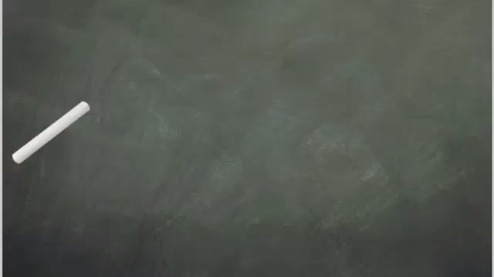
Large Hadron Collider (LHC)

Slide 24
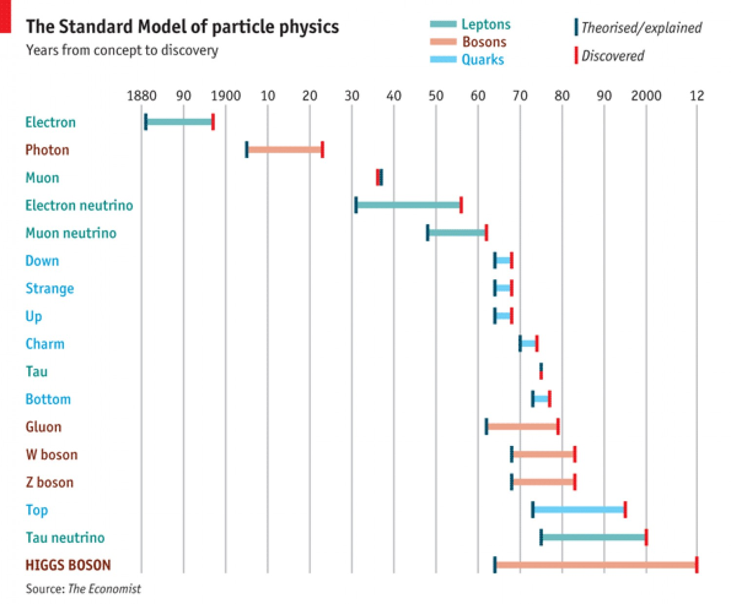
Age of Discovery

Slide 25
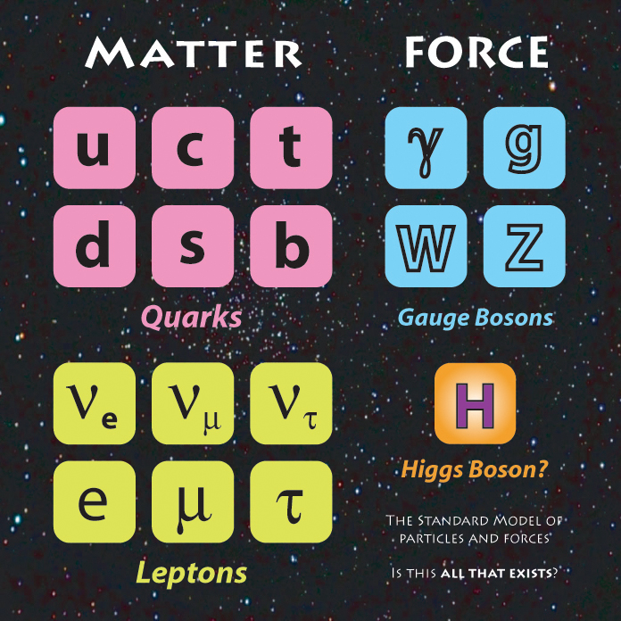
Elementary Particles

Slide 26

Introductory to Elementary Particle Physics

Slide 27
Quarks
Quarks come in six different flavours:
  Those with electric charge ⅔e:
    Up (u)
    Charm (c)
    Top (t) [also called Truth]
  Those with electric charge –⅓e:
    Down (d)
    Strange (s)
    Bottom (b) [also called Beauty]

Slide 28
Quarks
Anti-particles:
  For every particle, there is an anti-particle
    Neutrino, anti-neutrino
    Electron, positron
  Anti-particles are denoted by a bar over the symbol
    Up
    Top
    Charm

Slide 29
Quarks
Quarks combine in two ways to form hadrons:
  Three quarks combine to form baryons:
    Proton (uud)
    Neutron (udd)

Slide 30
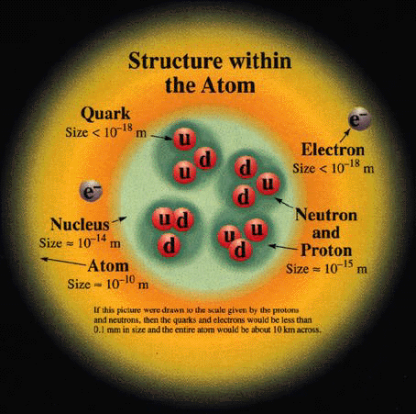
Atomic Structure

Slide 31
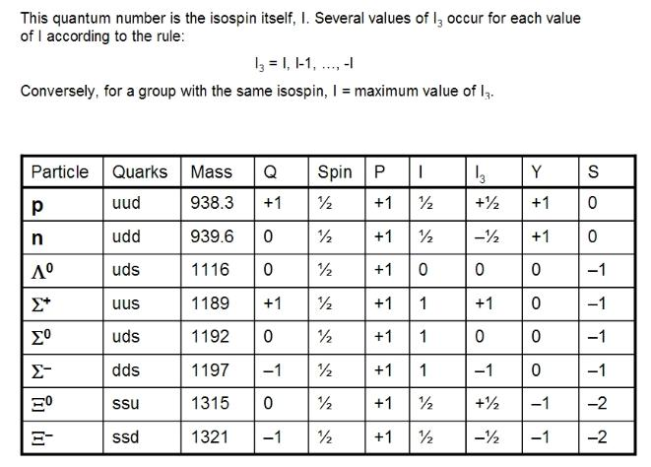
Quarks
Other baryons and their characteristics:

Slide 32
Quarks
Quarks combine in two ways to form hadrons:
  A quark and anti-quark combine to form mesons:
    Pion (π⁺ meson)
      Up + Down anti-quark

Slide 33
Quarks
Another characteristic of Quarks is baryon number (B):
  Quarks have a baryon number of +⅓
  Anti-quarks have a baryon number of –⅓
  To find the baryon number of a hadron, add the baryon numbers
    Baryon
    Meson

Slide 34
Quarks
Another characteristic of Quarks is baryon number:
  All baryons have a baryon number of +1
  All anti-baryons have a baryon number of -1
  All mesons have a baryon number of 0
  All other particles not made from quarks have a baryon number of 0

Slide 35
Quarks
Quarks interact with:
  Strong nuclear interaction
  Weak nuclear interaction
  Electromagnetic interaction

Slide 36
Quarks
Conservation:
  In all reactions, electric charge and baryon number are conserved
  The same values before and after the reaction

Slide 37
Quarks
Time factor:
  The two reactions look alike
  The first takes 10⁻²⁵ s
  The second takes 10⁻¹⁰ s
The shorter first decay involves a strong force interaction
The longer second decay involves a weak force interaction

Slide 38
Quarks
Strangeness (S):
  Strange quarks have a strangeness of -1
  Anti-strange quarks have a strangeness of +1
  All other particles have a strangeness of 0
  Strangeness is conserved in strong and electromagnetic interactions, but may be violated in weak interactions

Slide 39
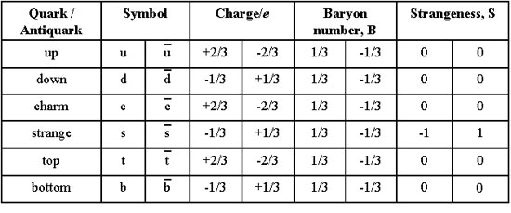
Quarks

Slide 40
Elementary Particles - Leptons

Slide 41
Leptons
Six types of leptons:
  Electron, e⁻
  Electron neutrino, υ_{e}
  Muon, μ⁻
  Muon neutrino, υ_{μ}
  Tau, τ⁻
  Tau neutrino, υ_{τ}
Each of these particles has its respective anti-particle

Slide 42
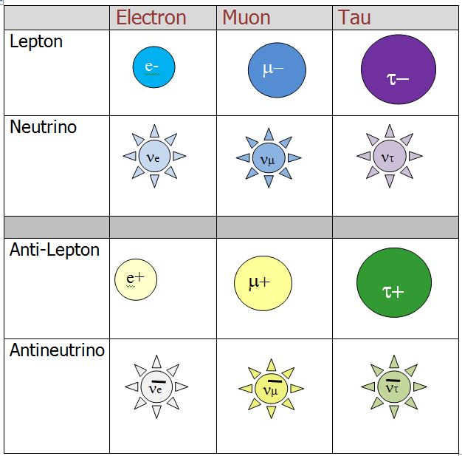
Leptons

Slide 43
Leptons
Chart is representative of size
Neutrinos have been shown to have a very small non-zero mass
Leptons interact with the weak nuclear force
Those that have a charge (e⁻, μ⁻, τ⁻) also interact with the electromagnetic force

Slide 44
Leptons
Family lepton number (L):
  There is a quantum number for each lepton (L_{e}, L_{μ}, L_{τ})
  Most of the time it is just referred to as lepton number (L)
  All leptons have L = +1
  All anti-leptons have L = -1

Slide 45
Leptons
Charge:
  Electron, e⁻ = -e
  Electron neutrino, υ_{e} = 0
  Muon, μ⁻ = -e
  Muon neutrino, υ_{μ} = 0
  Tau, τ⁻ = -e
  Tau neutrino, υ_{τ} = 0

Slide 46
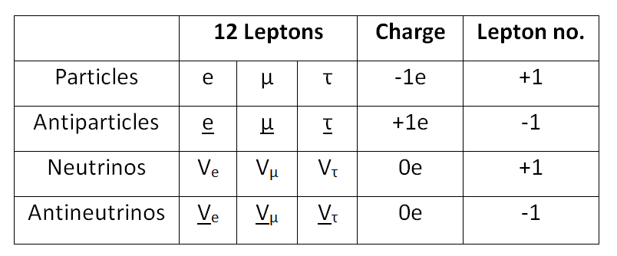
Leptons

Slide 47
Elementary Particles – Exchange Particles

Slide 48
Exchange Particles
Gravitational attraction and electrical attraction/repulsion classically explained by field strength
Particle physics explains this force as an exchange of a particle using Newton’s Laws

Slide 49
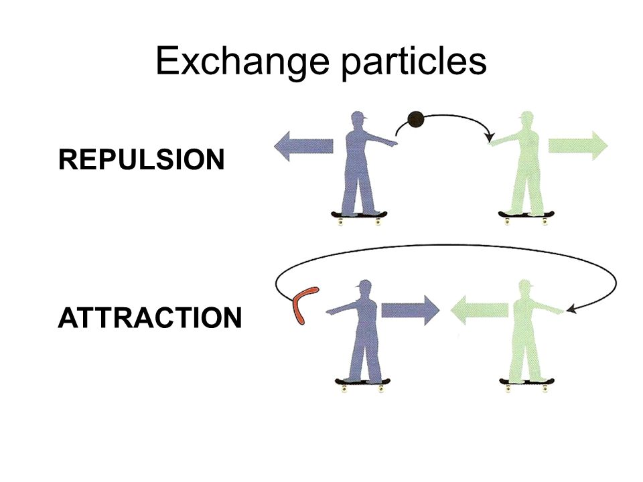
Exchange Particles

Slide 50
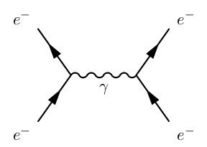
Exchange Particles
In the case of the electromagnetic interaction, one electron emits a photon and the other absorbs it
The photon carries momentum so the exchange exerts a force on each electron

Slide 51
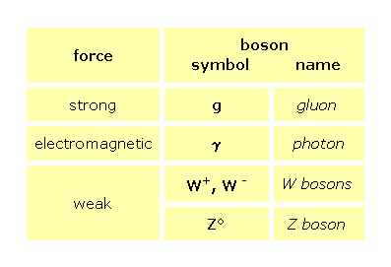
Exchange Particles

Slide 52
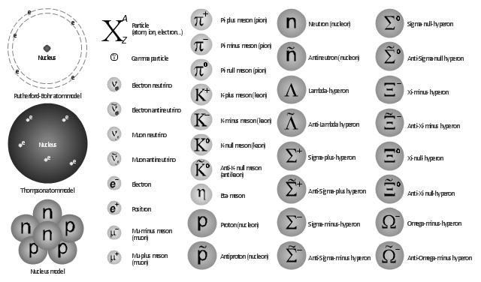
Particles Everywhere!

Slide 53
Halftime!
Lsn 7-3A
  Evolution of Standard and Particle Physics
  Elementary particles
    Quarks
    Leptons
    Exchange Particles
Lsn 7-3B
  Feynman Diagrams
  Confinement
  Higgs Boson

Slide 54
Halftime Homework
Lsn 7-3A
  #25-38
Lsn 7-3B
  #39-44

Slide 55
Halftime Homework
Lsn 7-3A
  #25-38
Lsn 7-3B
  #39-44

Slide 56
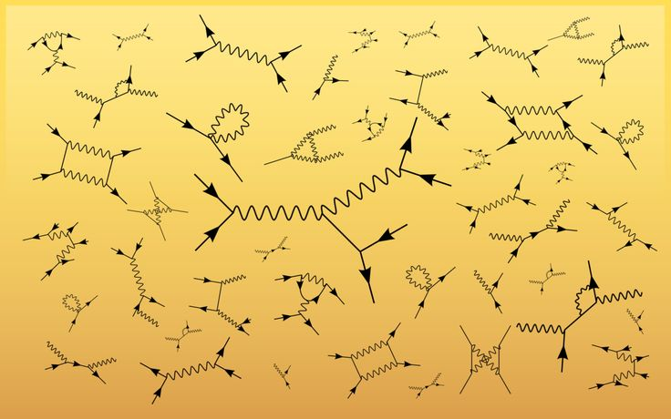
Feynman Diagrams

Slide 57
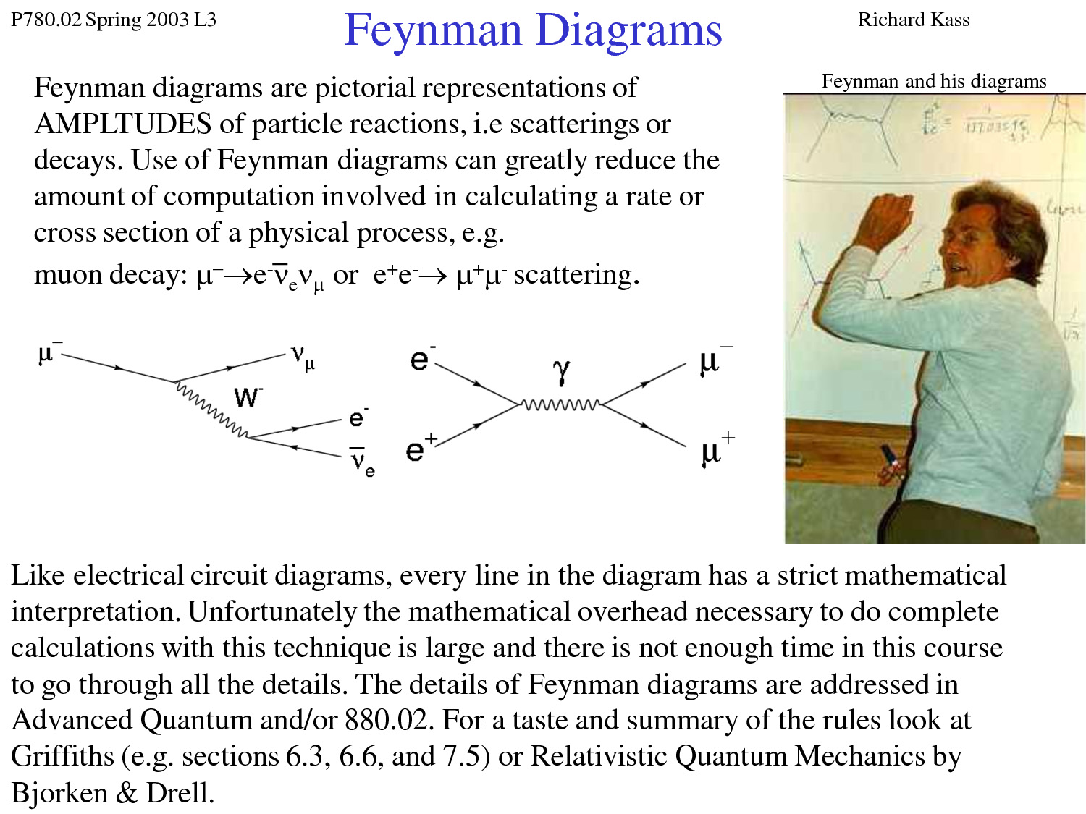
Feynman Diagrams

Slide 58
Feynman Diagrams
Interactions between particles involve the exchange of particles
Key is the interaction vertex
  Two arrows and one wavy line
  Time is along one axis, space on the other
  Particles will have arrows in the opposite direction of antiparticles

Slide 59
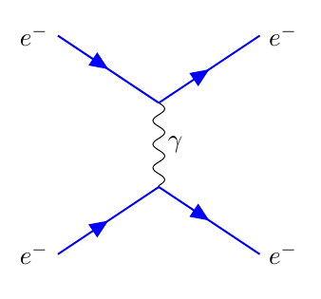
Feynman Diagrams

Slide 60
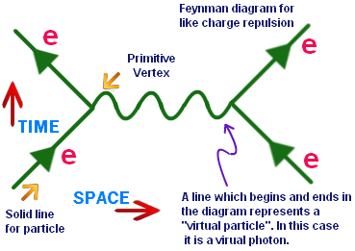
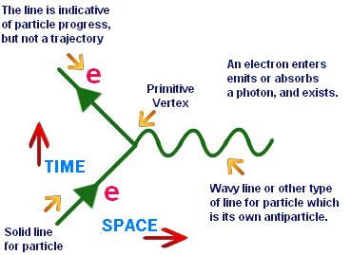
Feynman Diagrams

Slide 61
Feynman Diagrams
Each line on the diagram corresponds to a precise mathematical expression
Each expression contributes to the probability of the process occurring
Precise rules for calculating probability from the diagram

Slide 62
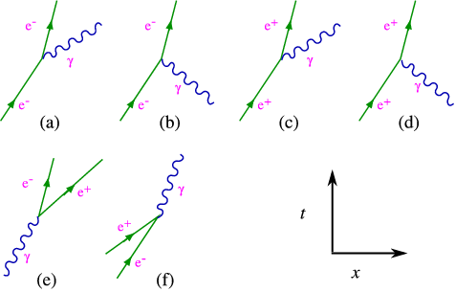
Feynman Diagrams

Slide 63
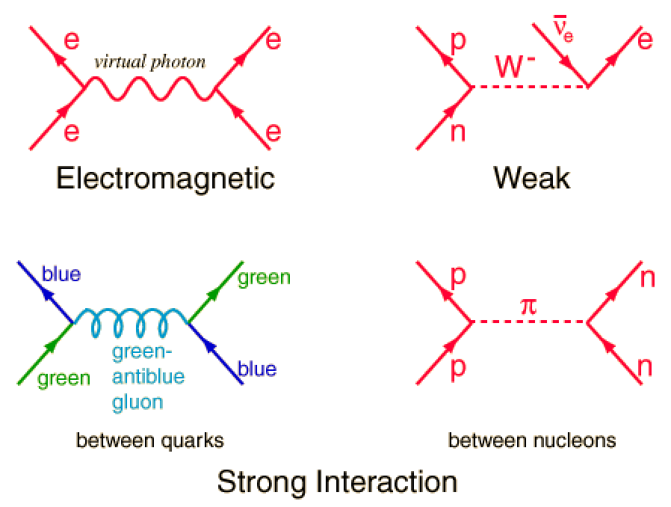
Feynman Diagrams

Slide 64
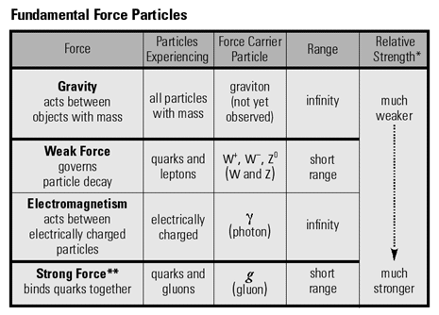
Feynman Diagrams

Slide 65
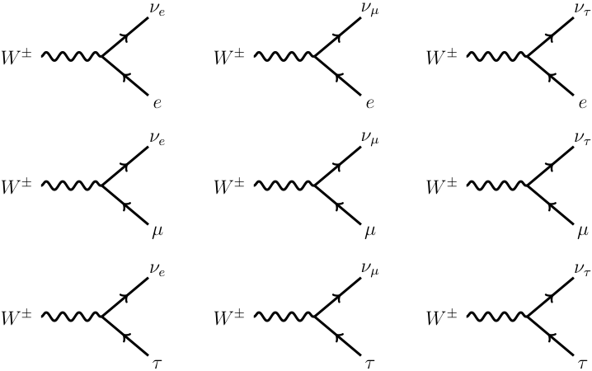
Feynman Diagrams – Weak Interaction

Slide 66
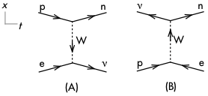
Feynman Diagrams – Weak Interaction

Slide 67
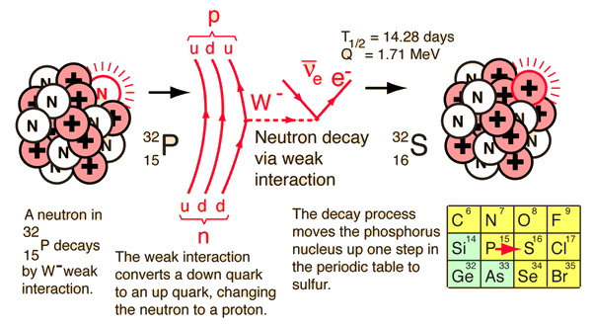
Feynman Diagrams – Weak Interaction
What type of decay is this?

Slide 68
Feynman Diagrams – Weak Interaction
Beta Decay!

Slide 69
Feynman Diagrams – Strong Interaction

Slide 70
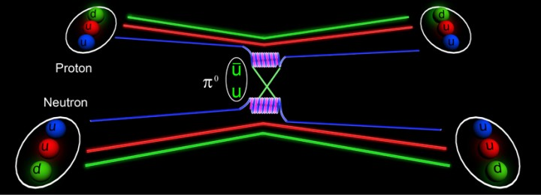
Feynman Diagrams – Strong Interaction
A Feynman diagram showing an example of the kind of interaction that binds neutrons and protons together inside the nucleus. The nuclear force, a residual effect of the strong force between quarks is transmitted by the exchange of a quark-antiquark pair, known as a meson (in this case a pi zero meson).

Slide 71
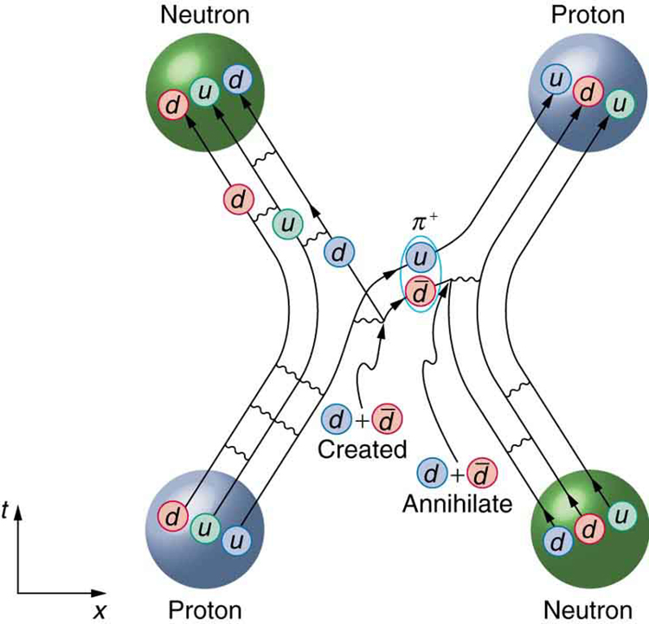
Feynman Diagrams – Strong Interaction

Slide 72
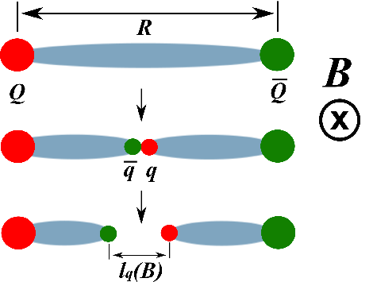
Quark Confinement
Different from CAS detention, but analogous
The force between a quark-anti-quark pair is the same regardless of the separation
It takes a continuous amount of energy to move them apart

Slide 73
Quark Confinement
If you were theoretically able to supply enough force to separate them, that energy would create a new pairing
It is not possible to observe isolated quarks

Slide 74
Higgs Particle
All aspects of the Standard Model have been proved experimentally – except one
The missing link has been the one that holds it all together – the Higgs Boson
How do elementary particles acquire mass and why do they have the mass that they do?
The Standard Model is based on mathematical symmetry and that symmetry did not allow for the existence of mass

Slide 75
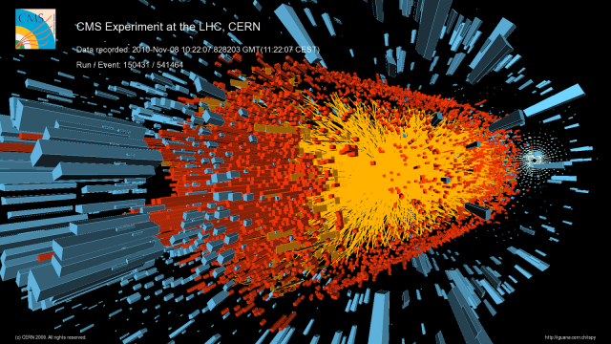
Higgs Particle
The Higgs particle was finally discovered in 2012
Higgs particle is the quantum (unit or packet) of the Higgs field

Slide 76
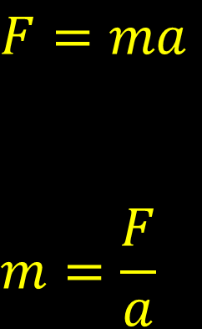
Higgs Particle
Illustration:
  If you apply a force to an object in space, it accelerates
  If you apply the same force to an object in water, the acceleration is less
  To get the same acceleration, you must apply more force
  This gives the appearance of greater mass, “The force produced less acceleration so the mass must be greater
$$F=ma$$
$$m=\frac{F}{a}$$

Slide 77
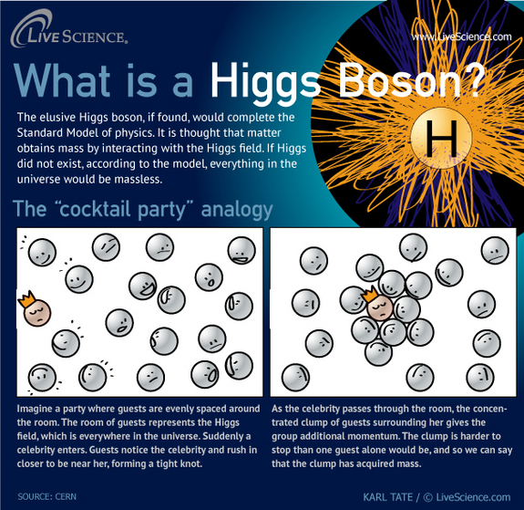

Slide 78
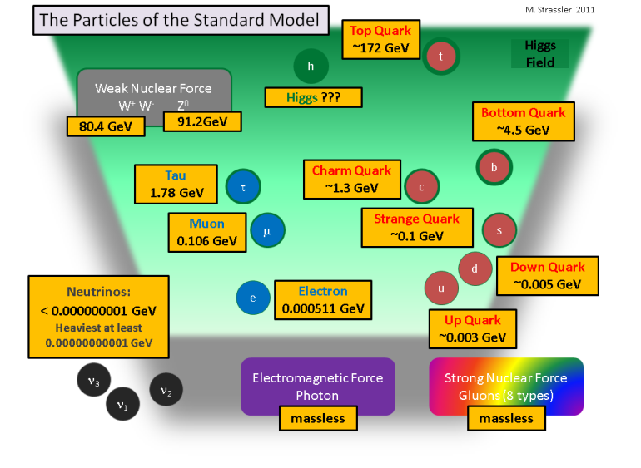
Standard Model and Higgs Field

Slide 79
And so, . . .

Slide 80
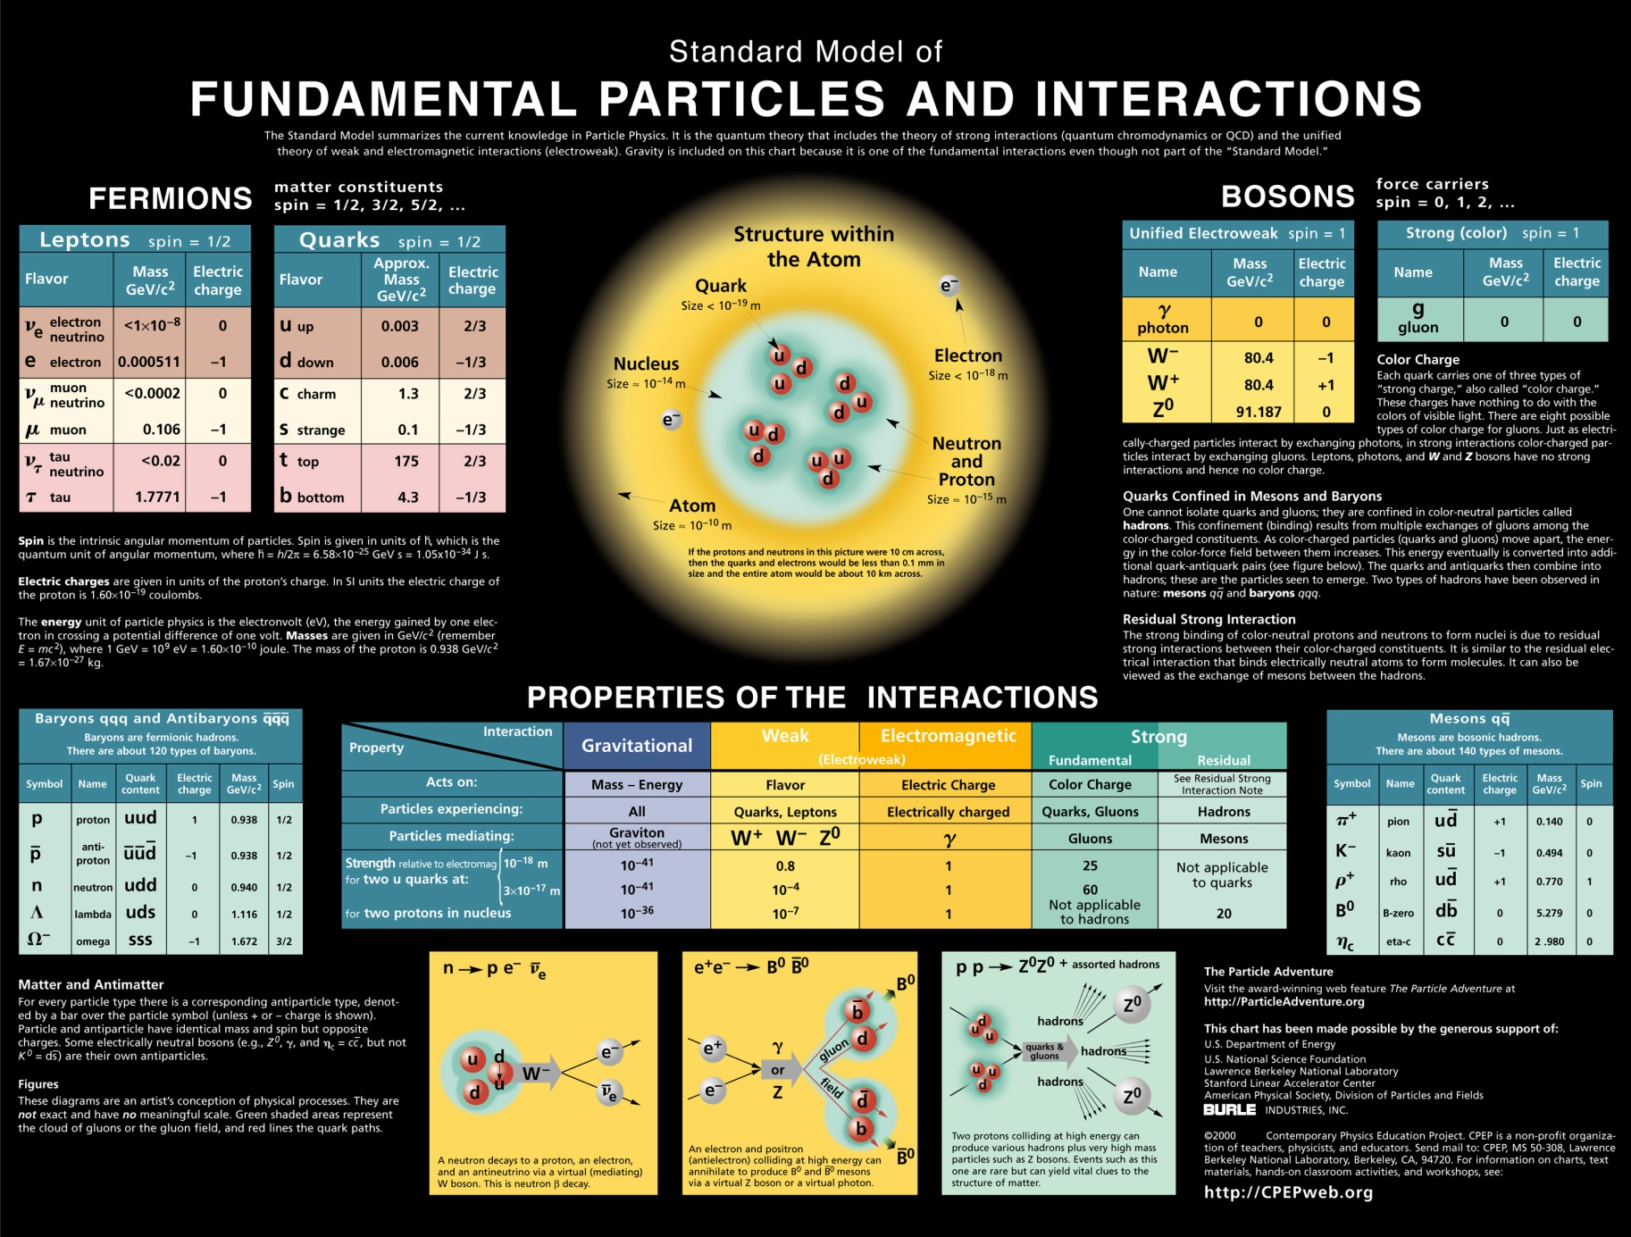
Summary

Slide 81
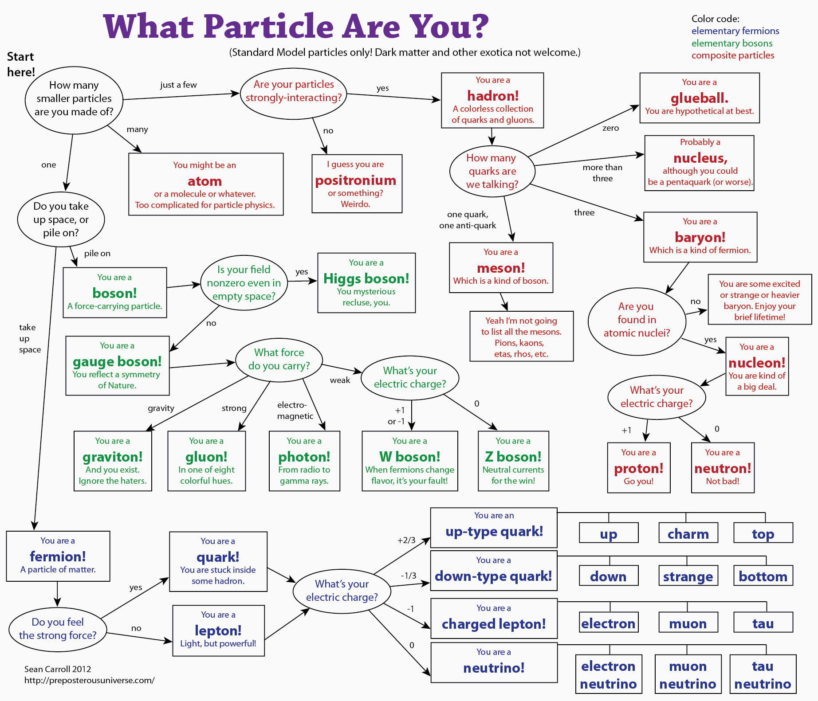

Slide 82
Understandings:
Quarks, leptons and their antiparticles
Hadrons, baryons and mesons
The conservation laws of charge, baryon number, lepton number and strangeness
The nature and range of the strong nuclear force, weak nuclear force and electromagnetic force
Exchange particles
Feynman diagrams
Confinement
The Higgs boson

Slide 83
Applications And Skills:
Describing the Rutherford-Geiger-Marsden experiment that led to the discovery of the nucleus
Applying conservation laws in particle reactions
Describing protons and neutrons in terms of quarks
Comparing the interaction strengths of the fundamental forces, including gravity

Slide 84
Applications And Skills:
Describing the mediation of the fundamental forces through exchange particles
Sketching and interpreting simple Feynman diagrams
Describing why free quarks are not observed

Slide 85
Data Booklet Reference:

Slide 86
Data Booklet Reference:

Slide 87
Utilization:
An understanding of particle physics is needed to determine the final fate of the universe (see Physics option sub-topics D.3 and D.4).

Slide 88
Essential Idea:
It is believed that all the matter around us is made up of fundamental particles called quarks and leptons. It is known that matter has a hierarchical structure with quarks making up nucleons, nucleons making up nuclei, nuclei and electrons making up atoms and atoms making up molecules. In this hierarchical structure, the smallest scale is seen for quarks and leptons (10^{–18}m).

Slide 89
Questions?

Slide 90
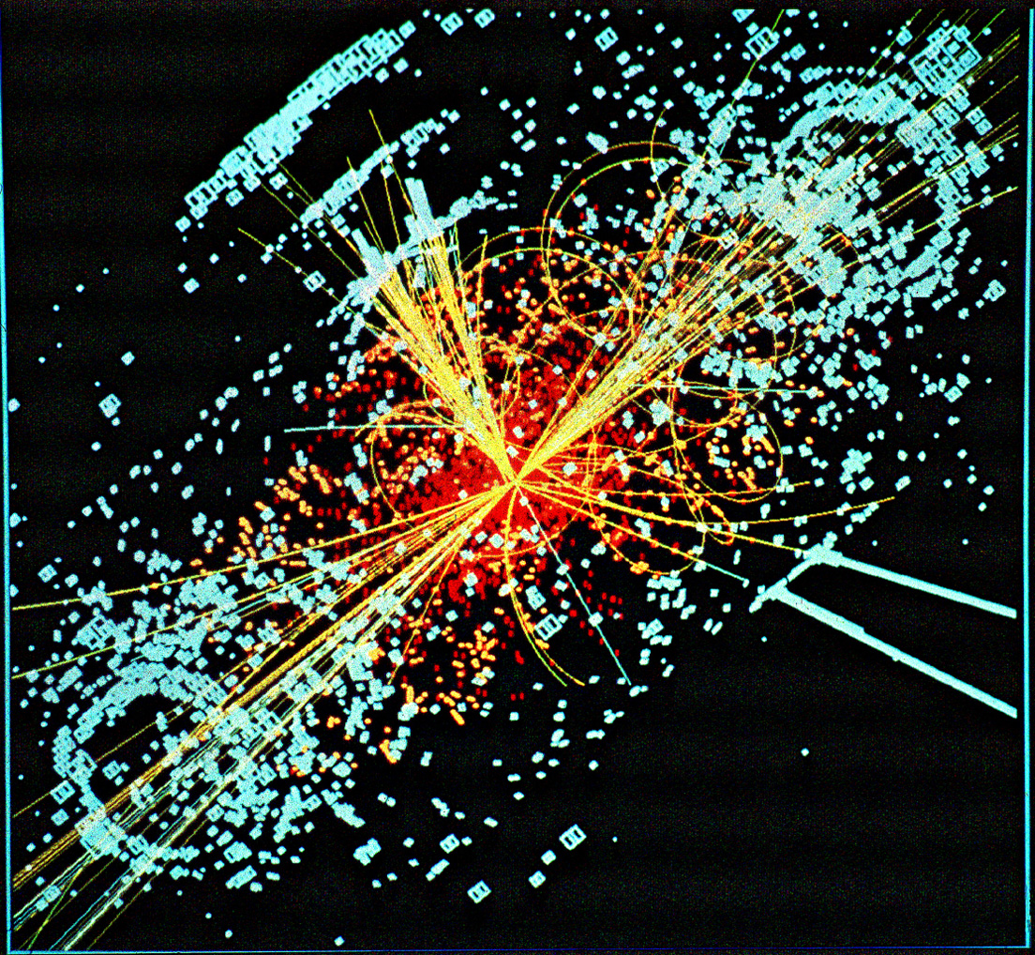
Homework
7-3A - #25-38
7-3B - #39-44

