Slide 1

Devil physics
The baddest class on campus
IB Physics

Slide 2
Tsokos Lsn 5-8 alternating current

Slide 3
IB Assessment Statements
Topic 12.2., Alternating Current:
  12.2.1. Describe the emf induced in a coil rotating within a uniform magnetic field.
  12.2.2. Explain the operation of a basic alternating current (ac) generator.
  12.2.3. Describe the effect on the induced emf of changing the generator frequency.
  12.2.4. Discuss what is meant by the root mean squared (rms) value of an alternating current or voltage.

Slide 4
IB Assessment Statements
Topic 12.2., Alternating Current:
  12.2.5. State the relation between peak and rms values for sinusoidal currents and voltages.
  12.2.6. Solve problems using peak and rms values.
  12.2.7. Solve ac circuit problems for ohmic resistors.
  12.2.8. Describe the operation of an ideal transformer.
  12.2.9. Solve problems on the operation of ideal transformers.

Slide 5
IB Assessment Statements
Topic 12.3., Transmission of Electrical Power:
  12.3.1. Outline the reasons for power losses in transmission lines and real transformers.
  12.3.2. Explain the use of high-voltage step-up and step-down transformers in the transmission of electrical power.
  12.3.3. Solve problems on the operation of real transformers and power transmission.

Slide 6
IB Assessment Statements
Topic 12.3., Transmission of Electrical Power:
  12.3.4. Suggest how extra-low-frequency electromagnetic fields, such as those created by electrical appliances and power lines, induce currents within a human body.
  12.3.5. Discuss some of the possible risks involved in living and working near high-voltage power lines.

Slide 7
Objectives
Appreciate that the induced emf in a uniformly rotating coil is sinusoidal;
Explain the operation and importance of the AC generator;
Understand the operation of the transformer;

Slide 8
Objectives
Apply the transformer equation,
and explain the use of transformers in power transmission;

Slide 9
Objectives
Understand the terms rms and peak current
and voltage
and calculate the average power in simple AC circuits

Slide 10
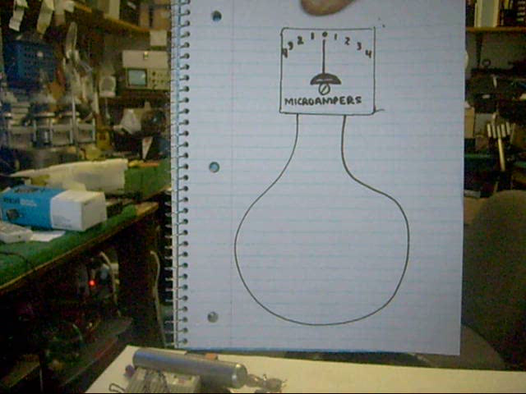
Introductory Video
Understanding AC and DC Generators

Slide 11
Alternating Current
Alternating Current (AC) is universally accepted for electrical power production and distribution
AC generator is an electrical motor in reverse
  Instead of an electrical current passed through a magnetic field to produce a force,
  A coil is made to move in relation to a magnetic field to produce a current

Slide 12
AC Generator
Lsn 5-7
  Electrical currents generated when a loop of wire moves in relation to a magnetic field
  Back and forth movement of a magnet through a loop of wire generated a current that alternated in the direction of its flow

Slide 13
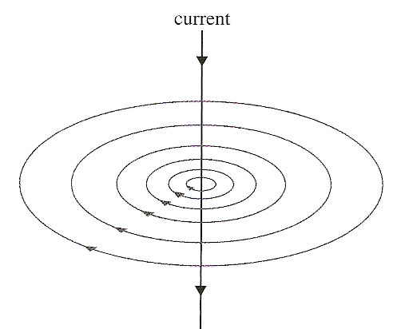
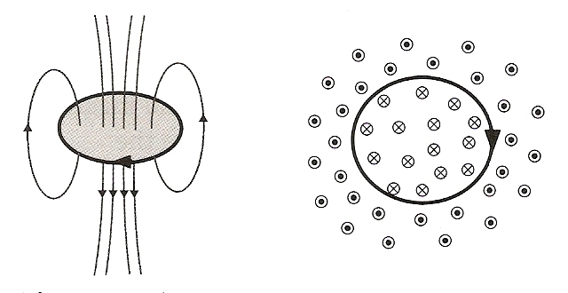
AC Generator
Lenz’s Law
A
B
Faraday’s Law

Slide 14
AC Generator
Current flow is from A to B
A
B
Current flow is from B to A
B
A

Slide 15
AC Generator
Lsn 5-7
  Equation for flux linkage is given as,
    where θ is the angle between the magnetic field and the normal to the coil
    and N is the number of turns in the coil

Slide 16
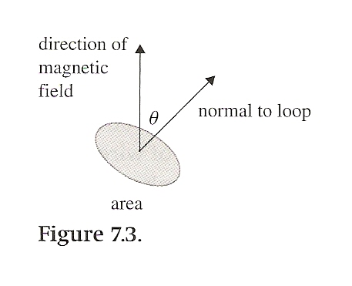
AC Generator

Slide 17
AC Generator

Slide 18
AC Generator

Slide 19
AC Generator

Slide 20
AC Generator

Slide 21
AC Generator
Emf is zero when flux is max
Emf is max when flux is zero
Emf based on rate of change of flux

Slide 22
AC Generator
Positive and negative voltage
Refers to current flow
Alternating current (AC)

Slide 23
AC Generator
DC current – electrons drift in one direction
AC current – electrons oscillate with same freq as voltage

Slide 24
AC Generator

Slide 25
AC Generator

Slide 26
Power in AC Circuits
Power is a function of current and voltage (emf)
Not constant in time
Peak power obtained at peak current and peak voltage

Slide 27
Power in AC Circuits

Slide 28
Power in AC Circuits
Power in terms of the parameters of the rotating coil

Slide 29
Root Mean Square (rms)
Since current and voltage alternate between positive and negative maximums, average current and voltage are always zero
How do you find a power rating?

Slide 30
Root Mean Square (rms)
Since current and voltage alternate between positive and negative maximums, average current and voltage are always zero
Root Mean Square
  Square the values (result always positive)
  Find the average of the squares
  Take the square root of the average
Root – Mean – Square
  Take square root of the mean of the squares

Slide 31
Root Mean Square (rms)
Review derivations on page 362

Slide 32
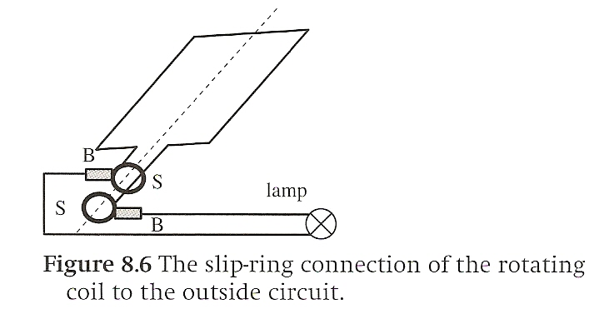
Slip-Ring Commutator
Wires of the loop are attached to separate rings that rotate with the loop
Separate brushes are pressed against each ring to pick up current

Slide 33
Back-emf in the DC Motor
Magnetic field generates a force on a current-carrying loop of wire
Since the current generates its own magnetic field, this field also creates an emf in the direction opposite to the current (Lenz’s Law)
The back-emf is at its peak when the motor initially starts to turn, but decreases as rotation increases
That’s why your lights dim when the refrigerator kicks on

Slide 34
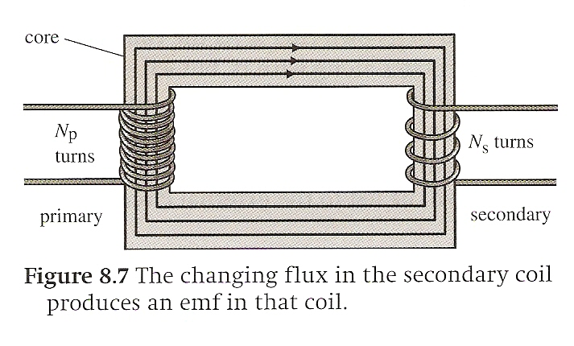
Transformers

Slide 35
Transformers

Slide 36
Transformers

Slide 37
Transformers and Power Transmission
Power Demand
Power Loss
To minimize loss, minimize current
To minimize current, maximize voltage

Slide 38
Objectives
Appreciate that the induced emf in a uniformly rotating coil is sinusoidal;
Explain the operation and importance of the AC generator;
Understand the operation of the transformer;

Slide 39
Objectives
Apply the transformer equation,
and explain the use of transformers in power transmission;

Slide 40
Objectives
Understand the terms rms and peak current
and voltage
and calculate the average power in simple AC circuits

Slide 41
IB Assessment Statements
Topic 12.2., Alternating Current:
  12.2.1. Describe the emf induced in a coil rotating within a uniform magnetic field.
  12.2.2. Explain the operation of a basic alternating current (ac) generator.
  12.2.3. Describe the effect on the induced emf of changing the generator frequency.
  12.2.4. Discuss what is meant by the root mean squared (rms) value of an alternating current or voltage.

Slide 42
IB Assessment Statements
Topic 12.2., Alternating Current:
  12.2.5. State the relation between peak and rms values for sinusoidal currents and voltages.
  12.2.6. Solve problems using peak and rms values.
  12.2.7. Solve ac circuit problems for ohmic resistors.
  12.2.8. Describe the operation of an ideal transformer.
  12.2.9. Solve problems on the operation of ideal transformers.

Slide 43
IB Assessment Statements
Topic 12.3., Transmission of Electrical Power:
  12.3.1. Outline the reasons for power losses in transmission lines and real transformers.
  12.3.2. Explain the use of high-voltage step-up and step-down transformers in the transmission of electrical power.
  12.3.3. Solve problems on the operation of real transformers and power transmission.

Slide 44
IB Assessment Statements
Topic 12.3., Transmission of Electrical Power:
  12.3.4. Suggest how extra-low-frequency electromagnetic fields, such as those created by electrical appliances and power lines, induce currents within a human body.
  12.3.5. Discuss some of the possible risks involved in living and working near high-voltage power lines.

Slide 45
Questions

Slide 46
Homework
#1-8

