Slide 1
Devil physics The baddest class on campus IB Physics

Slide 2
Lsn 4-4 Wave Behaviour

Slide 3
Questions From Reading Activity?

Slide 4
Essential Idea:
Waves interact with media and each other in a number of ways that can be unexpected and useful.

Slide 5
Nature Of Science:
Competing theories: The conflicting work of Huygens and Newton on their theories of light and the related debate between Fresnel, Arago and Poisson are demonstrations of two theories that were valid yet flawed and incomplete. This is an historical example of the progress of science that led to the acceptance of the duality of the nature of light.

Slide 6
International-Mindedness:
Characteristic wave behaviour has been used in many cultures throughout human history, often tying closely to myths and legends that formed the basis for early scientific studies.

Slide 7
Theory Of Knowledge:
Huygens and Newton proposed two competing theories of the behaviour of light.
How does the scientific community decide between competing theories?

Slide 8
Understandings:
Reflection and refraction
Snell’s law, critical angle and total internal reflection
Diffraction through a single-slit and around objects
Interference patterns
Double-slit interference
Path difference

Slide 9
Applications And Skills:
Sketching and interpreting incident, reflected and transmitted waves at boundaries between media
Solving problems involving reflection at a plane interface

Slide 10
Applications And Skills:
Solving problems involving Snell’s law, critical angle and total internal reflection
Determining refractive index experimentally

Slide 11
Applications And Skills:
Qualitatively describing the diffraction pattern formed when plane waves are incident normally on a single-slit
Quantitatively describing double-slit interference intensity patterns

Slide 12
Guidance:
Quantitative descriptions of refractive index are limited to light rays passing between two or more transparent media. If more than two media, only parallel interfaces will be considered
Students will not be expected to derive the double-slit equation
Students should have the opportunity to observe diffraction and interference patterns arising from more than one type of wave

Slide 13
Data Booklet Reference:

Slide 14
Data Booklet Reference:
Constructive Interference: path difference =
Destructive Interference: path difference =

Slide 15
Utilization:
A satellite footprint on Earth is governed by the diffraction at the dish on the satellite
Applications of the refraction and reflection of light range from the simple plane mirror through the medical endoscope and beyond. Many of these applications have enabled us to improve and extend our sense of vision

Slide 16
Utilization:
The simple idea of the cancellation of two coherent light rays reflecting from two surfaces leads to data storage in compact discs and their successors
The physical explanation of the rainbow involves refraction and total internal reflection. The bright and dark bands inside the rainbow, supernumeraries, can be explained only by the wave nature of light and diffraction

Slide 17
Aims:
Aim 1: the historical aspects of this topic are still relevant science and provide valuable insight into the work of earlier scientists
Aim 8: the increasing use of digital data and its storage density has implications on individual privacy through the permanence of a digital footprint

Slide 18
Aims:
Aim 6: experiments could include (but are not limited to): determination of refractive index and application of Snell’s law; determining conditions under which total internal reflection may occur; examination of diffraction patterns through apertures and around obstacles; investigation of the double-slit experiment

Slide 19
Law of Reflection
What happens to a pulse on a rope tied to a wall?

Slide 20
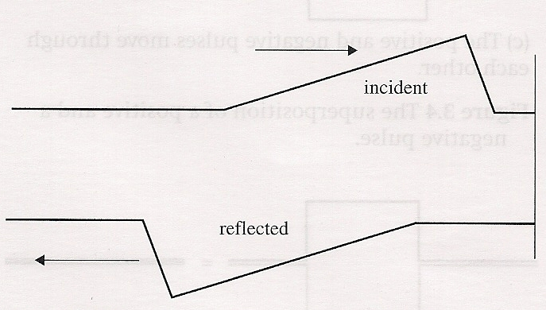
Law of Reflection
What happens to a pulse on a rope tied to a wall?
The pulse reflects inverted and traveling in the opposite direction:

Slide 21
Law of Reflection
Law of Reflection: The angle of incidence, i (angle between the ray and the normal to the reflecting surface at the point of incidence) is equal to the angle of reflection, r (angle between the normal and the reflected ray).

Slide 22
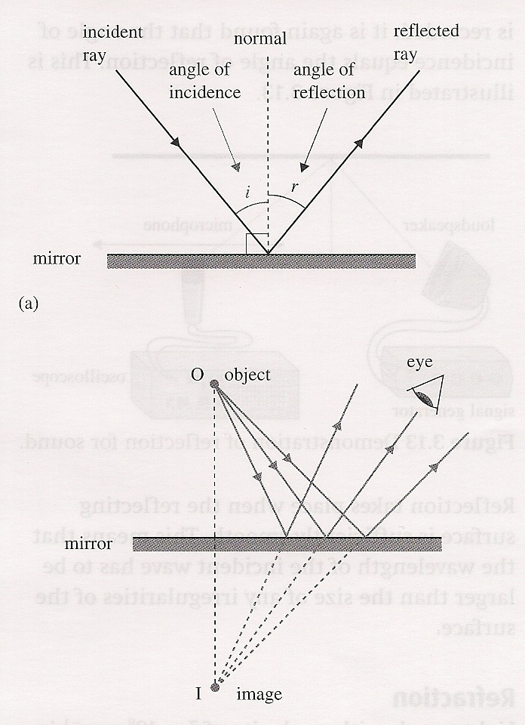
Law of Reflection
Law of Reflection: The angle of incidence, i (angle between the ray and the normal to the reflecting surface at the point of incidence) is equal to the angle of reflection, r (angle between the normal and the reflected ray).

Slide 23
Law of Reflection
The reflected and incident rays and the normal to the surface lie on the same plane, called the plane of incidence.

Slide 24
Law of Reflection
Reflection takes place when the reflecting surface is sufficiently smooth i.e., the wavelength of the incident wave is larger than any irregularities in the surface

Slide 25
Refraction

Slide 26
Refraction
Light travels fastest in vacuum (3x10⁸ m/s)
It is slower in all other media
The difference in speed is responsible for the phenomenon of refraction

Slide 27
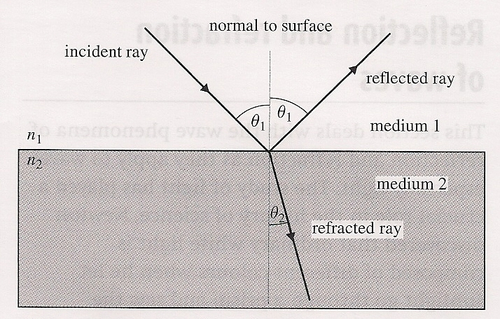
Refraction
When a ray of light strikes an interface between two media, there is both reflection and refraction

Slide 28
Refraction
When light travels from a medium of lower density to a medium of higher density, it slows down

Slide 29
Index of Refraction – Light Only
In the case of light only we define an index of refraction as:
n = index of refraction
c = speed of light in a vacuum
c_{m} = speed of light in the given medium
Since the speed of light is always greatest in a vacuum, the index will always be greater than 1

Slide 30
Index of Refraction – Light Only
By definition, the index of refraction for a vacuum is equal to 1
Index of refraction of water is 1.33
Snell’s Law then can be re-written specifically for light:

Slide 31
Snell’s Law:
θ₁ is the angle between the incident ray and the normal to the surface
c₁ is the speed of light in the first medium
θ₂ is the angle between the refracted ray and the normal to the surface
c₂ is the speed of light in the second medium

Slide 32
Snell’s Law:

Slide 33
Other Changes
Velocity changes with a change in media
But wavelength does change
Frequency DOES NOT change

Slide 34
An Example:
Light of wavelength 700 nm enters water at an angle of incidence of 45 degrees. Find (a) the angle of refraction and (b) the wavelength of the light in water.

Slide 35
An Example:
Light of wavelength 700 nm enters water at an angle of incidence of 45 degrees. Find (a) the angle of refraction and (b) the wavelength of the light in water.

Slide 36
An Example:
Light of wavelength 700 nm enters water at an angle of incidence of 45 degrees. Find (a) the angle of refraction and (b) the wavelength of the light in water.

Slide 37
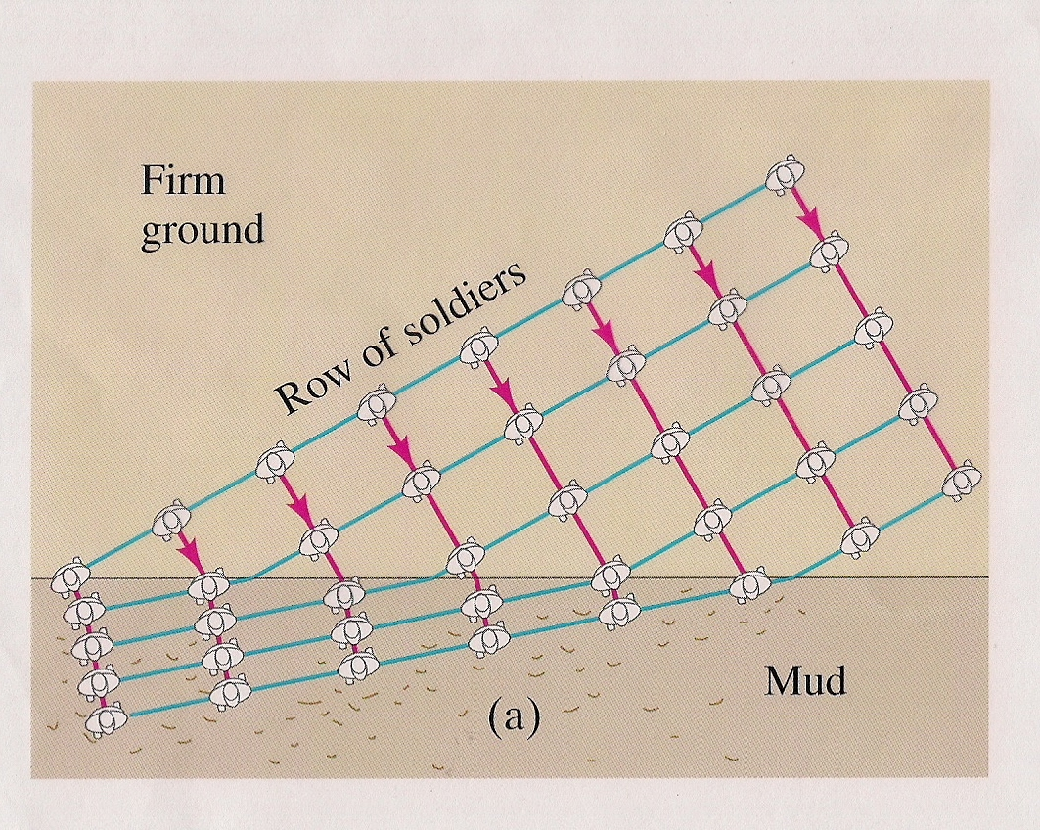
Refraction for Waves versus Rays

Slide 38
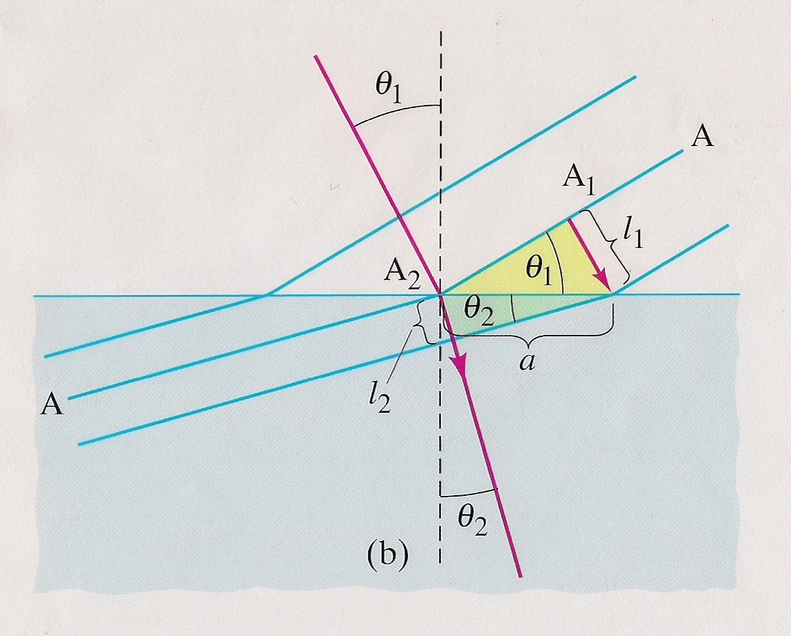
Refraction for Waves versus Rays

Slide 39
Refraction for other waves:
Refraction applies to all waves whenever the wave changes speed when going from one medium to another
Due to differences in density, sound waves are slowest in air, faster in a liquid, and fastest in a solid.

Slide 40
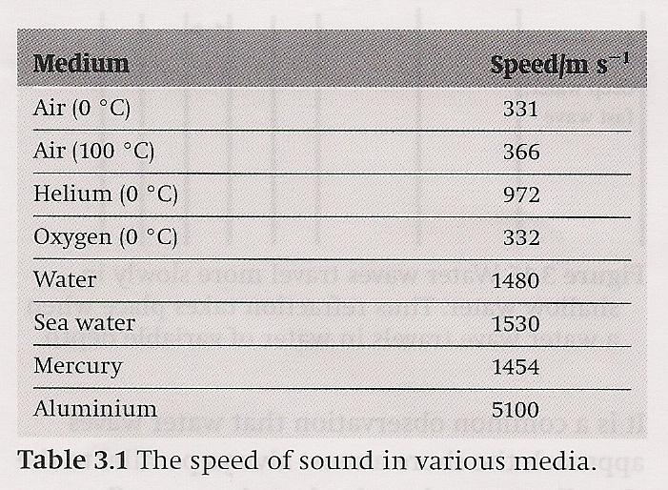
Refraction for other waves:

Slide 41
Total Internal Reflection
When moving from a less dense medium to a medium of higher density, the light refracts toward the normal line
When moving from a medium of higher density to a less dense medium, the light refracts away from the normal line
As you increase the angle of incidence, the refracted ray approaches being parallel to the surface boundary

Slide 42
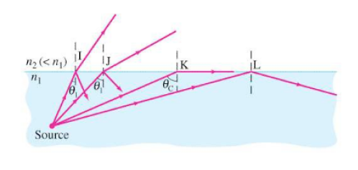
Total Internal Reflection
At the critical angle of incidence, the light is completely reflected and none is refracted

Slide 43
Total Internal Reflection
The critical angle can be found using Snell’s Law and using 90° for the refracted angle

Slide 44
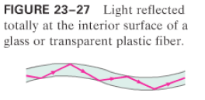
Total Internal Reflection
Total internal reflection is the principle used in fiber optic cables – allows for data speeds at the speed of light (in the given medium)

Slide 45
Diffraction

Slide 46
Diffraction of Light

Slide 47
Diffraction:
The spreading of a wave as it goes past an obstacle or through an aperture
Dependent on the value of the wavelength, λ, in relation to the size of the aperture, a

Slide 48
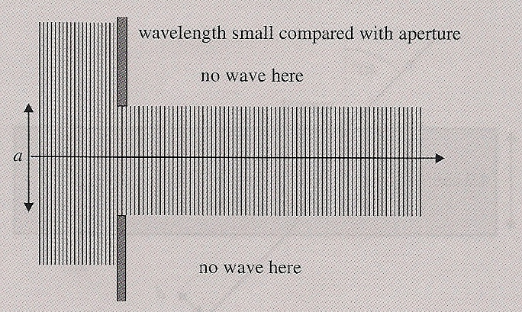
Diffraction:
When the wavelength is small compared to the aperture, little or no diffraction occurs

Slide 49
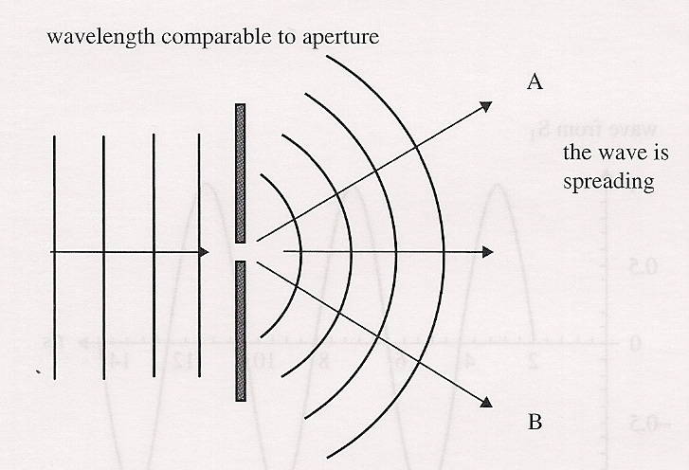
Diffraction:
If the wavelength, λ, is comparable to or larger than the aperture, a, the wavefronts on the other side of the aperture are curved and the wave spreads out around the edges of the opening

Slide 50
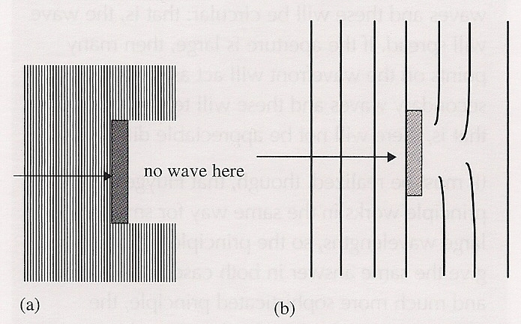
Diffraction:
If the wavelength is much smaller than the obstacle, no diffraction occurs and a shadow of the object is formed

Slide 51
Diffraction:
If the wavelength is comparable or larger than the object, diffraction takes place and the wave appears far from the object in the region where the shadow was expected

Slide 52
Interference
Video: Interference of Light

Slide 53
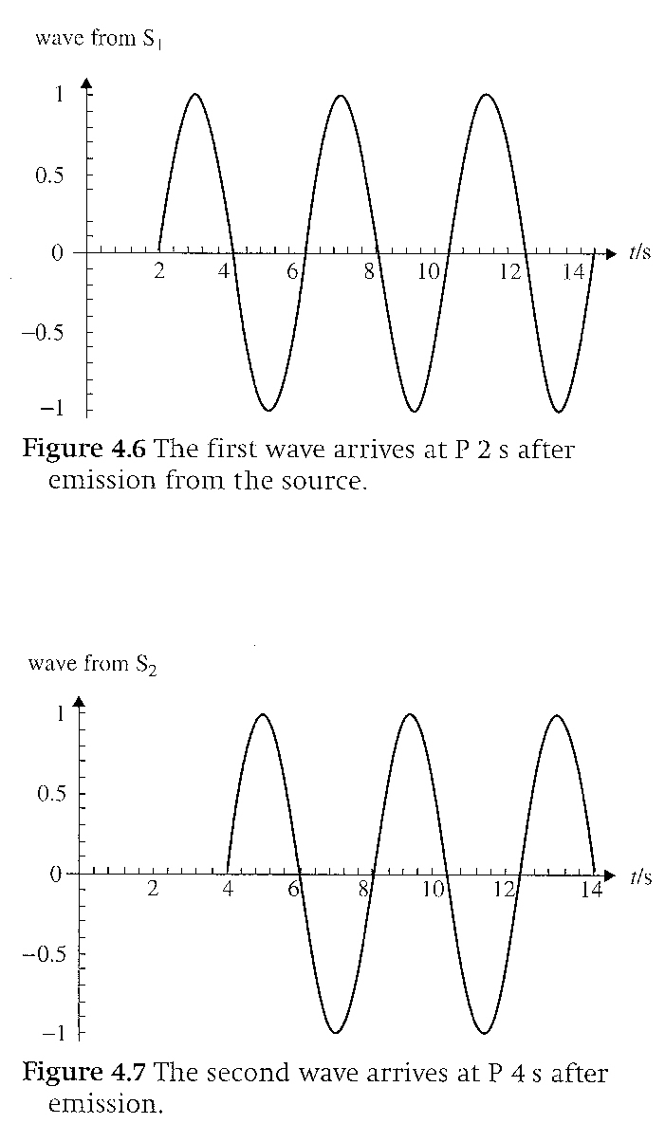
Interference
Interference is the result of the superposition of waves
Destructive Interference
Because these waves have the same amplitude and are 180° out of phase, they will completely cancel each other

Slide 54
Interference
We can also say that destructive interference occurs when two waves are out of phase by half a wavelength

Slide 55
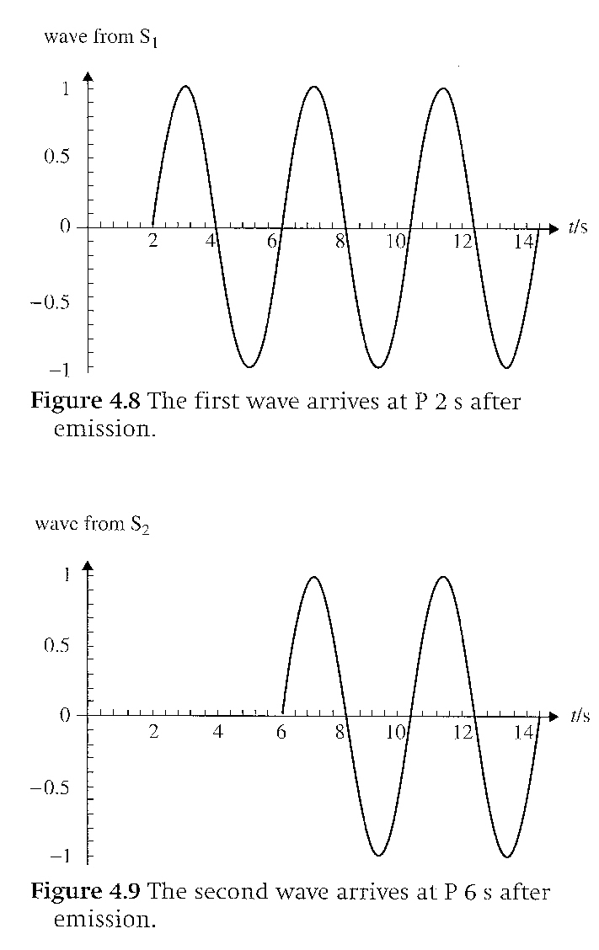
Interference
Constructive Interference
These waves have the same amplitude and are in phase with each other

Slide 56
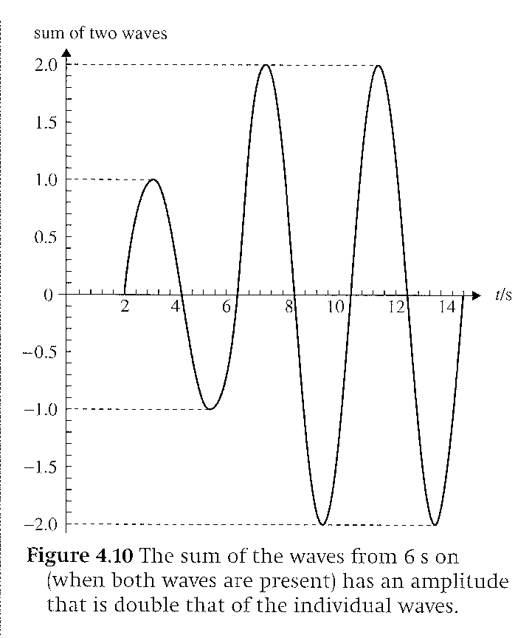
Interference
The result is the sum of their two amplitudes

Slide 57
Interference
Constructive Interference
We can also say that the waves can start at different times or travel different distances, as long as the difference is some multiple of the wavelength (nλ), the waves will be in phase and constructive interference occurs

Slide 58
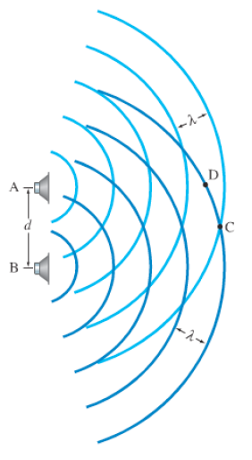
Two Source Interference
Two speakers are playing the same sound at the same frequency and wavelength
At point C, the observer is the same distance from each speaker
The observer experiences the crests of both waves which creates a loud sound (constructive interference)

Slide 59
Two Source Interference
At point D, the observer is at differences distance from each speaker
Because the waves have to travel different distances to get to the observer, they are out of phase
At point D, the waves are 180° out of phase, the observer gets the crest from A and the trough from B so complete destructive interference occurs

Slide 60
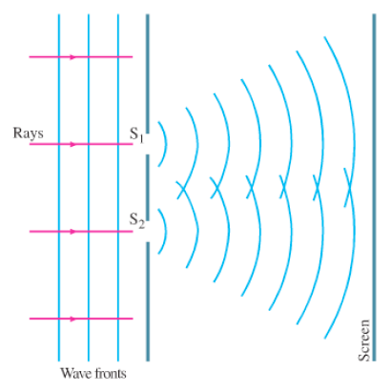
Two Source Interference
The same effect occurs when light diffracts from two separate slits

Slide 61
Two Source Interference
Example (a): At a point directly in between the two slits, the distance travelled by the light wave is the same, so they are in phase, constructive interference occurs and the light is bright

Slide 62
Two Source Interference
Example (c):
The light from the bottom source has further to travel. When they meet, the waves are 180° out of phase, the waves cancel each other out, and there is a dark spot on the screen.

Slide 63
Two Source Interference
Example (c):
Diagram (d) shows the differences between the distances travelled

Slide 64
Two Source Interference
Example (c):
θ is the diffraction angle
d is the distance between the two slits
If the path difference (d₂-d₁ or d sin θ) is equal to ½ wavelength [(n + 1/2)λ], you have destructive interference
If the path difference is equal to some multiple of the wavelength [nλ], you have constructive interference

Slide 65
Two Source Interference
Example (b):
The path difference is equal to 1 wavelength so constructive interference occurs
The same would happen with path differences of 2λ, 3λ, 4λ, . . .

Slide 66
Two Source Interference
Example (b):
The path difference is equal to 1 wavelength so constructive interference occurs
The same would happen with path differences of 2λ, 3λ, 4λ, . . .

Slide 67
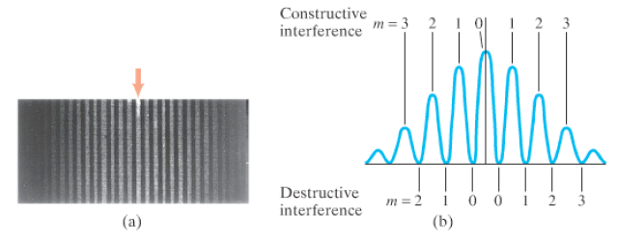
Two Source Interference
The resulting pattern looks something like the pictures below
(a) is what it would look like on a screen
(b) is a graph of the intensities versus distances from the central maximum
How can we determine the distances between the maxima?

Slide 68
Two Source Interference
s is the distance between peaks, or maxima
λ is the wavelength
D is the distance from the slits to the screen
d is the distance between the slits

Slide 69
Two Source Interference
You should be able to reproduce this graph with computed distances between maxima
The intensity and rate of decrease are arbitrary but should be representative

Slide 70
Piece a‘ Cake, Right?

Slide 71
Understandings:
Reflection and refraction
Snell’s law, critical angle and total internal reflection
Diffraction through a single-slit and around objects
Interference patterns
Double-slit interference
Path difference

Slide 72
Applications And Skills:
Sketching and interpreting incident, reflected and transmitted waves at boundaries between media
Solving problems involving reflection at a plane interface

Slide 73
Applications And Skills:
Solving problems involving Snell’s law, critical angle and total internal reflection
Determining refractive index experimentally

Slide 74
Applications And Skills:
Qualitatively describing the diffraction pattern formed when plane waves are incident normally on a single-slit
Quantitatively describing double-slit interference intensity patterns

Slide 75
Data Booklet Reference:

Slide 76
Data Booklet Reference:
Constructive Interference: path difference =
Destructive Interference: path difference =

Slide 77
Utilization:
A satellite footprint on Earth is governed by the diffraction at the dish on the satellite
Applications of the refraction and reflection of light range from the simple plane mirror through the medical endoscope and beyond. Many of these applications have enabled us to improve and extend our sense of vision

Slide 78
Utilization:
The simple idea of the cancellation of two coherent light rays reflecting from two surfaces leads to data storage in compact discs and their successors
The physical explanation of the rainbow involves refraction and total internal reflection. The bright and dark bands inside the rainbow, supernumeraries, can be explained only by the wave nature of light and diffraction

Slide 79
Essential Idea:
Waves interact with media and each other in a number of ways that can be unexpected and useful.

Slide 80
Questions?

Slide 81
Homework
#25-31

