Slide 1
Devil physics The baddest class on campus IB Physics

Slide 2
Lsn 4-2: Traveling Waves

Slide 3
Questions From Reading Activity?

Slide 4
Essential Idea:
There are many forms of waves available to be studied. A common characteristic of all travelling waves is that they carry energy, but generally the medium through which they travel will not be permanently disturbed.

Slide 5
Nature Of Science:
Patterns, trends and discrepancies: Scientists have discovered common features of wave motion through careful observations of the natural world, looking for patterns, trends and discrepancies and asking further questions based on these findings.

Slide 6
International-Mindedness:
Electromagnetic waves are used extensively for national and international communication

Slide 7
Theory Of Knowledge:
Scientists often transfer their perception of tangible and visible concepts to explain similar non-visible concepts, such as in wave theory.
How do scientists explain concepts that have no tangible or visible quality?

Slide 8
Understandings:
Travelling waves
Wavelength, frequency, period and wave speed
Transverse and longitudinal waves
The nature of electromagnetic waves
The nature of sound waves

Slide 9
Applications And Skills:
Explaining the motion of particles of a medium when a wave passes through it for both transverse and longitudinal cases
Sketching and interpreting displacement–distance graphs and displacement–time graphs for transverse and longitudinal waves
Solving problems involving wave speed, frequency and wavelength
Investigating the speed of sound experimentally

Slide 10
Guidance:
Students will be expected to derive c = fλ
Students should be aware of the order of magnitude of the wavelengths of radio, microwave, infra-red, visible, ultraviolet, X-ray and gamma rays

Slide 11
Data Booklet Reference:

Slide 12
Utilization:
Communication using both sound (locally) and electromagnetic waves (near and far) involve wave theory
Emission spectra are analyzed by comparison to the electromagnetic wave spectrum (see Chemistry topic 2 and Physics sub-topic 12.1)
Sight (see Biology sub-topic A.2)

Slide 13
Aims:
Aim 2: there is a common body of knowledge and techniques involved in wave theory that is applicable across many areas of physics
Aim 4: there are opportunities for the analysis of data to arrive at some of the models in this section from first principles

Slide 14
Aims:
Aim 6: experiments could include (but are not limited to): speed of waves in different media; detection of electromagnetic waves from various sources; use of echo methods (or similar) for determining wave speed, wavelength, distance, or medium elasticity and/or density

Slide 15
Transition Video: Physics of Waves

Slide 16
INTRODUCTORY VIDEOS
Cool Waves
Bad Waves
Properties of Waves

Slide 17
What is a wave?
A wave is a way of transferring energy and momentum from one place to another, but without the actual large-scale motion of a material body

Slide 18
What is a wave?
Examples:
Life is a beach
Light from the sun
Soprano breaking a glass
Light travels in a vacuum – no medium required – an electromagnetic wave
Sound and water require a medium – mechanical waves

Slide 19
What is a wave?
Waves occur because something is disturbed
A wave is a disturbance that travels, transferring energy and momentum from one place to another, but without the actual large-scale motion of a material body. The direction of energy transfer is the direction of propagation of the wave.

Slide 20
Transverse and Longitudinal Waves
Video: Longitudinal and Transverse Waves

Slide 21
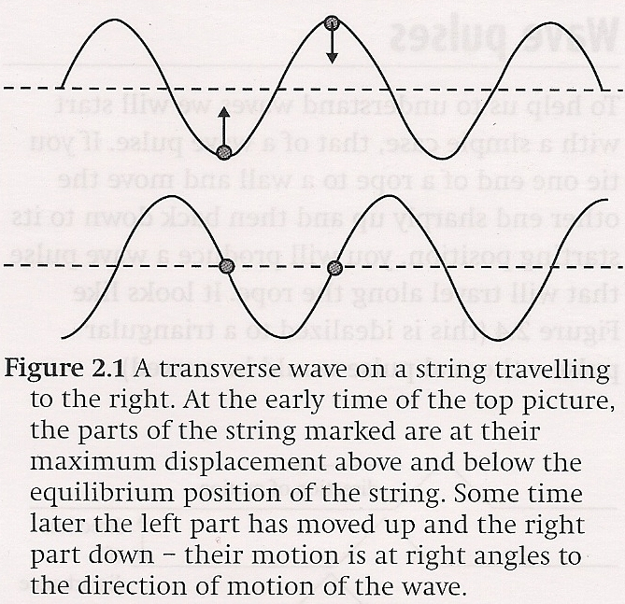
Transverse and Longitudinal Waves
Transverse – waves in which the disturbance is at right angles to the direction of energy transfer
rope tricks

Slide 22
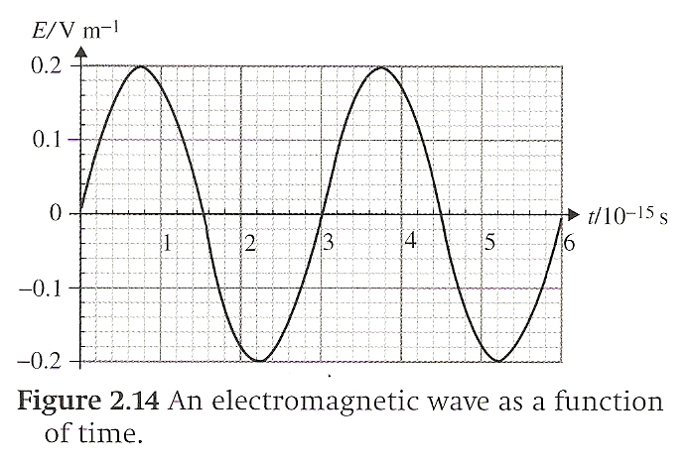
Transverse and Longitudinal Waves
Transverse – waves in which the disturbance is at right angles to the direction of energy transfer
rope tricks
electromagnetic waves

Slide 23
Transverse and Longitudinal Waves
Longitudinal -- waves in which the disturbance is along the direction of energy transfer
dominos
sound waves
energy propagated through a series of compressions (region of higher than normal density) and rarefactions (region of lower than normal density)

Slide 24
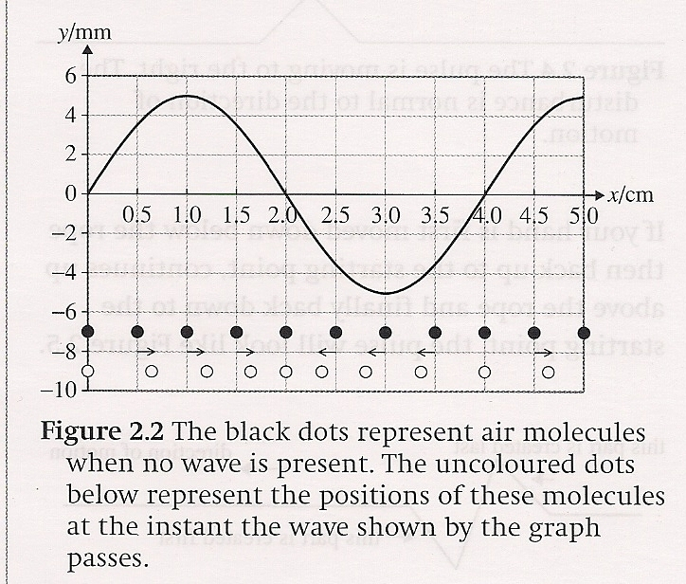
Transverse and Longitudinal Waves

Slide 25
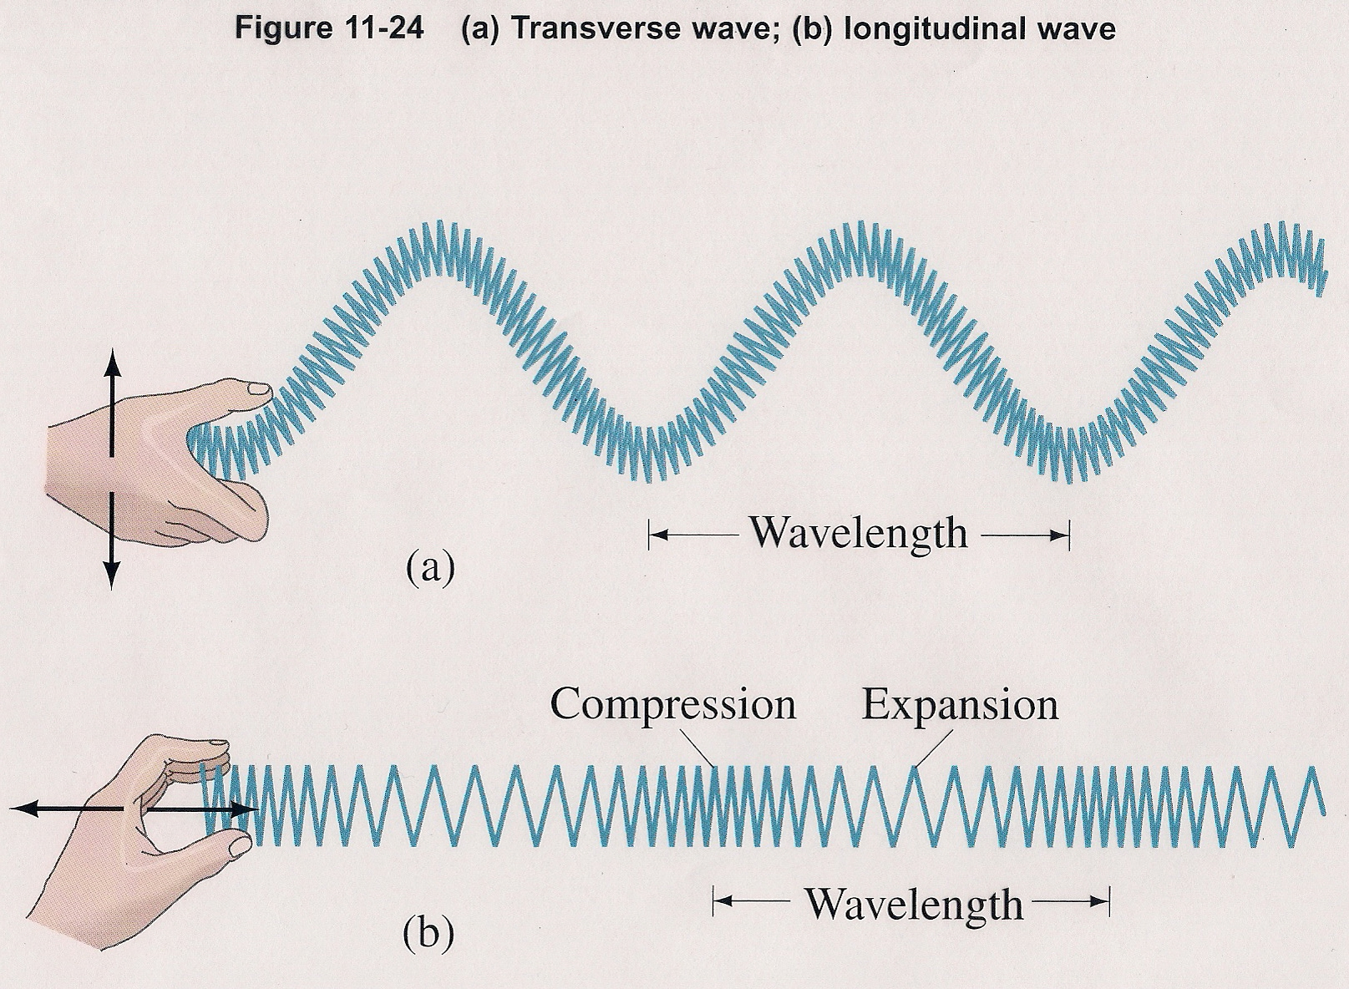
Transverse and Longitudinal Waves

Slide 26
Wave pulses
Video: Pulses and Waves

Slide 27
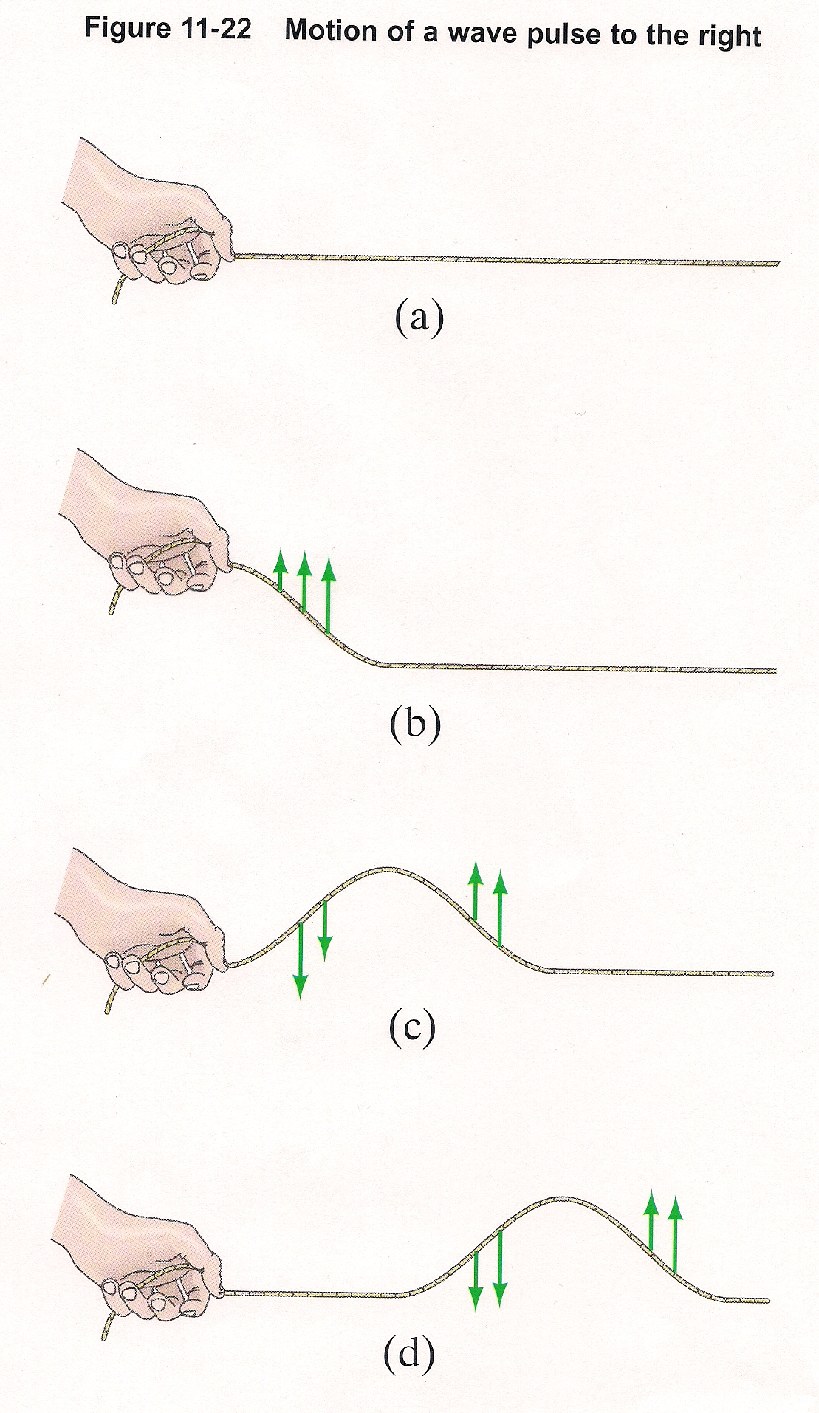
Wave pulses
Rope Tricks
half-pulse vs. full pulse

Slide 28
Wave pulses
Rope Tricks
wave pulses travel with a given speed determined by the tension in the rope and mass per unit length, μ = m/L

Slide 29
Wave Pulses
Rope Tricks
the speed of the wave is determined by the properties of the medium and not by how the wave is created,
i.e. independent of shape or how fast you produced it

Slide 30
Travelling Waves
those that take more than one step before dribbling (N/A NBA)
when pulses are repetitiously produced
if the wave driver demonstrates SHM, the wave produced will exhibit SHM and the wave will look like a sine wave (also called a harmonic wave)

Slide 31
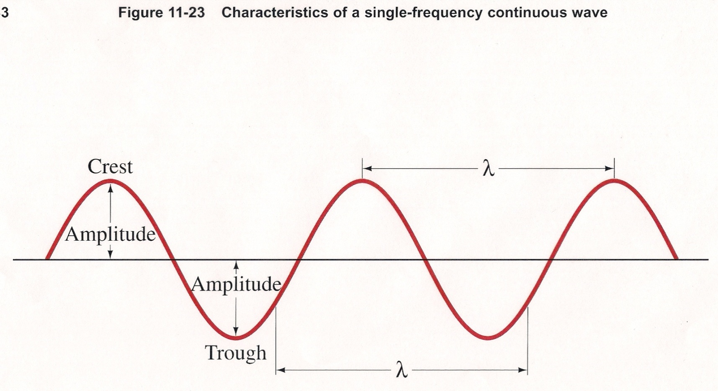
Harmonic waves
exhibit SHM

Slide 32
Harmonic waves
period (s) – time to complete one full wave, unit is s
wavelength () – length of a wave (surprise!)

Slide 33
Harmonic waves
velocity (v) – equal to one wavelength (m) per the period (s)
frequency (f) – number of waves per unit time, equal to 1/T, unit is s⁻¹ or Hz
The Marvels of Algebra!!!

Slide 34
Harmonic waves
displacement (y) – height obtained above or below the undisturbed point due to the disturbance, it is a function of the distance (x) and time (t)
When wave movement is dependent on the medium (like for sound [compression] waves), displacement is given in terms of density:

Slide 35
Harmonic waves
displacement (y) – height obtained above or below the undisturbed point due to the disturbance, it is a function of the distance (x) and time (t)
or in terms of pressure

Slide 36
Harmonic waves
displacement is a function of distance and time for any wave regardless of whether the displacement is vertical (transverse) or horizontal (longitudinal)

Slide 37
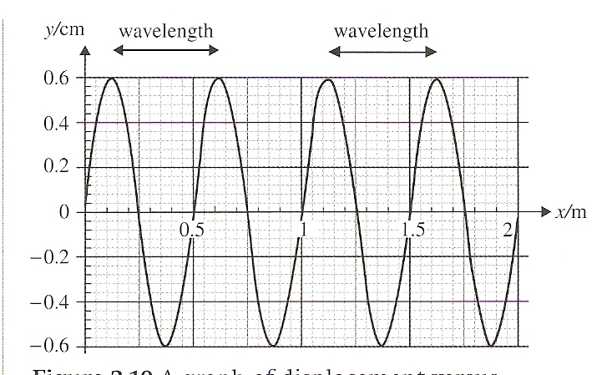
Displacement Versus Position Graph
determines wavelength

Slide 38
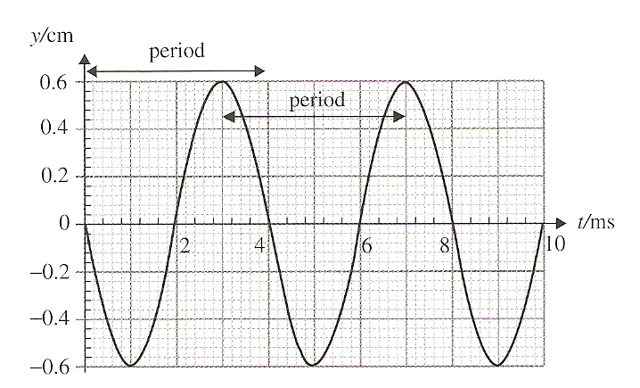
Displacement Versus Time Graph
determines period

Slide 39
Other Wave Stuff
Points on the wave with maximum displacement are call crests and those at the minimum displacement are called troughs

Slide 40
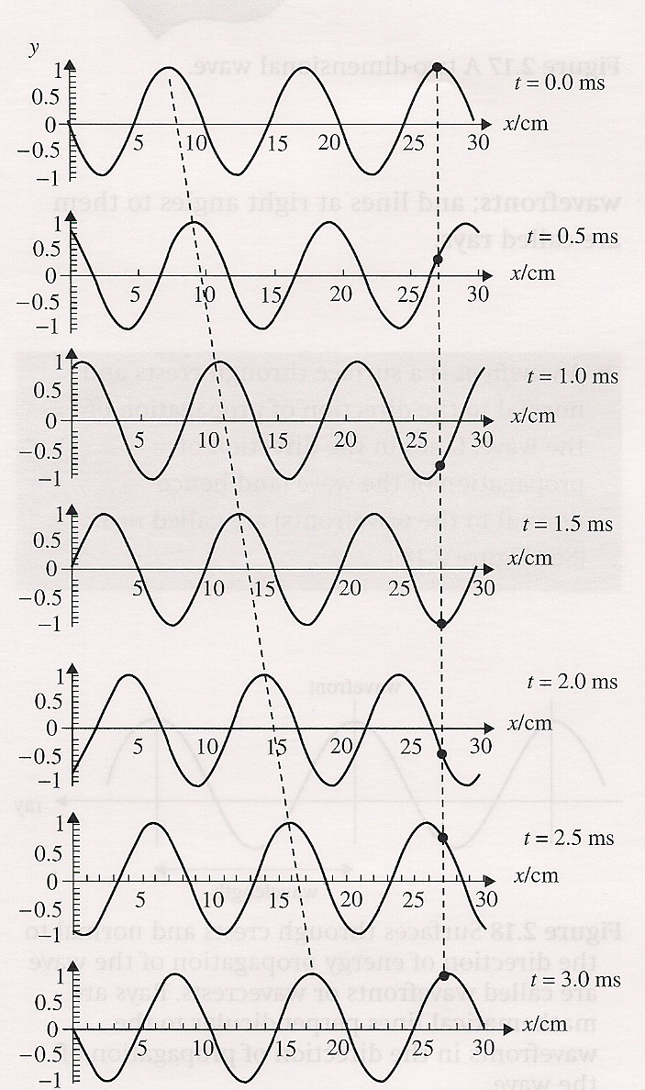
Other Wave Stuff
In a travelling wave, the crests will steadily move forward until the period is reached which is where the wave will look like it originally did when it was disturbed

Slide 41
Example Questions:
A radio station emits at a frequency of 90.8 MHz. What is the wavelength of the waves emitted?

Slide 42
Example Questions:
A radio station emits at a frequency of 90.8 MHz. What is the wavelength of the waves emitted?
Since they are electromagnetic waves, they travel at the speed of light, 3x10⁸ m/s
f = 90.8x10⁶ s⁻¹

Slide 43
Example Questions:
A sound wave of frequency 450Hz is emitted from A and travels towards B, a distance of 150m away. Take the speed of sound to be 341 m s⁻¹ . How many wavelengths fit in the distance from A to B?

Slide 44
Example Questions:
A sound wave of frequency 450Hz is emitted from A and travels towards B, a distance of 150m away. Take the speed of sound to be 341 m s⁻¹ . How many wavelengths fit in the distance from A to B?
f = 450 s⁻¹
v = 341 m s⁻¹

Slide 45
Example Questions:
The noise of thunder is heard 3 s after the flash of lightning. How far away is the place where the lightning struck? (Use 340 m s⁻¹ for the speed of sound)

Slide 46
Example Questions:
The noise of thunder is heard 3 s after the flash of lightning. How far away is the place where the lightning struck? (Use 340 m s⁻¹ for the speed of sound)
Since light travels so fast, you can assume you saw it instantaneously.
v x t = d
(340 m s⁻¹)(3 s) = 1020 m
1609 m = 1 mi

Slide 47
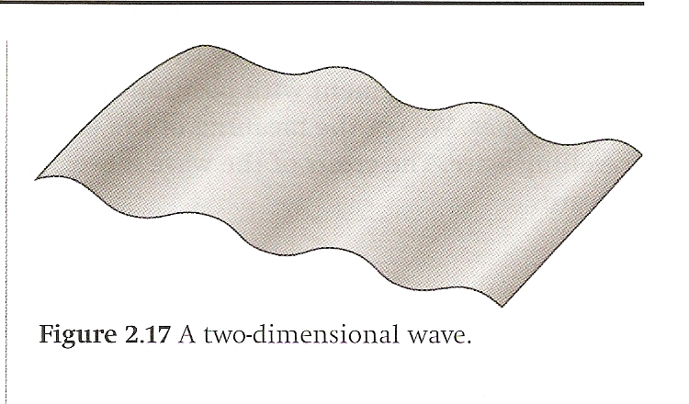
Wavefronts and Rays
If you consider a wave to be moving horizontally, a wavefront is a plane perpendicular to the wave and perpendicular to the direction the wave is travelling

Slide 48
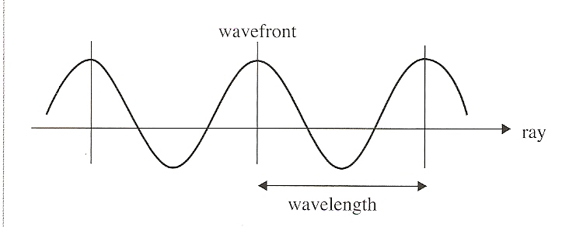
Wavefronts and Rays
Rays are a pretty good baseball team
They are also lines perpendicular to the wavefronts in the direction the wave is travelling

Slide 49
Wavefronts and Rays
Examples:
The waves on the beach would have a rectangular wavefront
If you drop a stone in the water, the wavefront would be cylindrical
Light waves from a point source would have spherical wavefronts

Slide 50
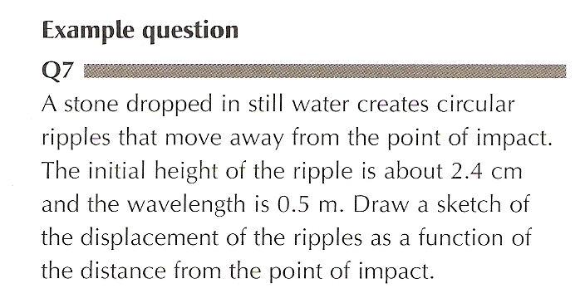
Wavefronts and Rays
Example Question: Why do waves from a rock thrown into a lake eventually die out?

Slide 51
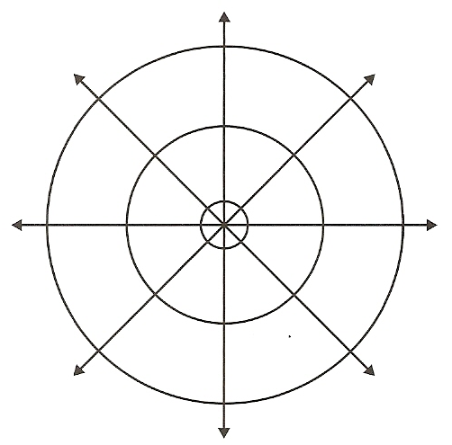
Wavefronts and Rays
Example Question: Why do waves from a rock thrown into a lake eventually die out?

Slide 52
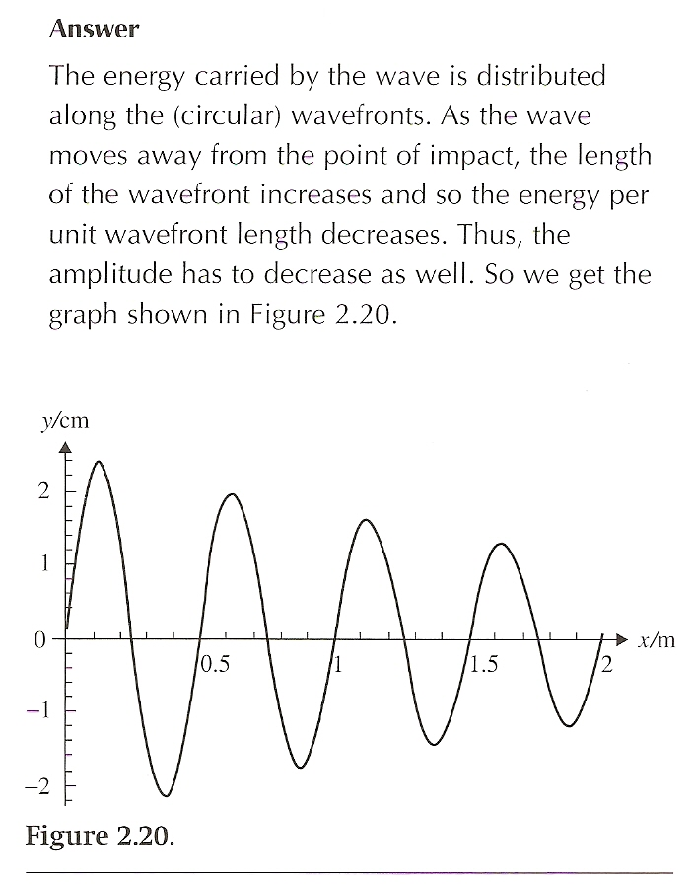
Wavefronts and Rays
Example Question: Why do waves from a rock thrown into a lake eventually die out?

Slide 53
Applications And Skills:
Explaining the motion of particles of a medium when a wave passes through it for both transverse and longitudinal cases
Sketching and interpreting displacement–distance graphs and displacement– time graphs for transverse and longitudinal waves
Solving problems involving wave speed, frequency and wavelength
Investigating the speed of sound experimentally

Slide 54
Understandings:
Travelling waves
Wavelength, frequency, period and wave speed
Transverse and longitudinal waves
The nature of electromagnetic waves
The nature of sound waves

Slide 55
Utilization:
Communication using both sound (locally) and electromagnetic waves (near and far) involve wave theory
Emission spectra are analysed by comparison to the electromagnetic wave spectrum (see Chemistry topic 2 and Physics sub-topic 12.1)
Sight (see Biology sub-topic A.2)

Slide 56
Aims:
Aim 2: there is a common body of knowledge and techniques involved in wave theory that is applicable across many areas of physics
Aim 4: there are opportunities for the analysis of data to arrive at some of the models in this section from first principles

Slide 57
Aims:
Aim 6: experiments could include (but are not limited to): speed of waves in different media; detection of electromagnetic waves from various sources; use of echo methods (or similar) for determining wave speed, wavelength, distance, or medium elasticity and/or density

Slide 58
Essential Idea:
There are many forms of waves available to be studied. A common characteristic of all travelling waves is that they carry energy, but generally the medium through which they travel will not be permanently disturbed.

Slide 59
Questions?

Slide 60
Homework
#6-14

