Slide 1
Devil physics The baddest class on campus AP Physics

Slide 2
Lsn 11-4: The Simple pendulum

Slide 3
Big Idea(s):
The interactions of an object with other objects can be described by forces.
Interactions between systems can result in changes in those systems.
Changes that occur as a result of interactions are constrained by conservation laws.

Slide 4
Enduring Understanding(s):
Classically, the acceleration of an object interacting with other objects can be predicted by using .
Interactions with other objects or systems can change the total energy of a system.
The energy of a system is conserved.

Slide 5
Enduring Understanding(s):
Certain quantities are conserved, in the sense that the changes of those quantities in a given system are always equal to the transfer of that quantity to or from the system by all possible interactions with other systems.

Slide 6
Essential Knowledge(s):
Restoring forces can result in oscillatory motion. When a linear restoring force is exerted on an object displaced from an equilibrium position, the object will undergo a special type of motion called simple harmonic motion. Examples should include gravitational force exerted by the Earth on a simple pendulum, massspring oscillator.
For a spring that exerts a linear restoring force the period of a mass-spring oscillator increases with mass and decreases with spring stiffness.
For a simple pendulum oscillating the period increases with the length of the pendulum.
Minima, maxima, and zeros of position, velocity, and acceleration are features of harmonic motion. Students should be able to calculate force and acceleration for any given displacement for an object oscillating on a spring.

Slide 7
Essential Knowledge(s):
The energy of a system includes its kinetic energy, potential energy, and microscopic internal energy. Examples should include gravitational potential energy, elastic potential energy, and kinetic energy.
For all systems under all circumstances, energy, charge, linear momentum, and angular momentum are conserved. For an isolated or a closed system, conserved quantities are constant. An open system is one that exchanges any conserved quantity with its surroundings.

Slide 8
Essential Knowledge(s):
Mechanical energy (the sum of kinetic and potential energy) is transferred into or out of a system when an external force is exerted on a system such that a component of the force is parallel to its displacement. The process through which the energy is transferred is called work.
If the force is constant during a given displacement, then the work done is the product of the displacement and the component of the force parallel or antiparallel to the displacement.
Work (change in energy) can be found from the area under a graph of the magnitude of the force component parallel to the displacement versus displacement.

Slide 9
Essential Knowledge(s):
A system with internal structure can have internal energy, and changes in a system’s internal structure can result in changes in internal energy. [Physics 1: includes mass-spring oscillators and simple pendulums. Physics 2: includes charged object in electric fields and examining changes in internal energy with changes in configuration.]

Slide 10
Essential Knowledge(s):
A system with internal structure can have potential energy. Potential energy exists within a system if the objects within that system interact with conservative forces.
The work done by a conservative force is independent of the path taken. The work description is used for forces external to the system. Potential energy is used when the forces are internal interactions between parts of the system.
Changes in the internal structure can result in changes in potential energy. Examples should include mass-spring oscillators, objects falling in a gravitational field.

Slide 11
Essential Knowledge(s):
The internal energy of a system includes the kinetic energy of the objects that make up the system and the potential energy of the configuration of the objects that make up the system.
Since energy is constant in a closed system, changes in a system’s potential energy can result in changes to the system’s kinetic energy.
The changes in potential and kinetic energies in a system may be further constrained by the construction of the system.

Slide 12
Learning Objective(s):
The student is able to predict which properties determine the motion of a simple harmonic oscillator and what the dependence of the motion is on those properties.
The student is able to design a plan and collect data in order to ascertain the characteristics of the motion of a system undergoing oscillatory motion caused by a restoring force.
The student can analyze data to identify qualitative or quantitative relationships between given values and variables (i.e., force, displacement, acceleration, velocity, period of motion, frequency, spring constant, string length, mass) associated with objects in oscillatory motion to use that data to determine the value of an unknown.

Slide 13
Learning Objective(s):
The student is able to construct a qualitative and/or a quantitative explanation of oscillatory behavior given evidence of a restoring force.
The student is able to calculate the total energy of a system and justify the mathematical routines used in the calculation of component types of energy within the system whose sum is the total energy.
The student is able to predict changes in the total energy of a system due to changes in position and speed of objects or frictional interactions within the system.

Slide 14
Learning Objective(s):
The student is able to make predictions about the changes in the mechanical energy of a system when a component of an external force acts parallel or antiparallel to the direction of the displacement of the center of mass.
The student is able to apply the concepts of Conservation of Energy and the Work-Energy theorem to determine qualitatively and/or quantitatively that work done on a two-object system in linear motion will change the kinetic energy of the center of mass of the system, the potential energy of the systems, and/or the internal energy of the system.
The student is able to define open and closed systems for everyday situations and apply conservation concepts for energy, charge, and linear momentum to those situations.

Slide 15
Learning Objective(s):
The student is able to define open and closed systems for everyday situations and apply conservation concepts for energy, charge, and linear momentum to those situations.
The student is able to describe and make qualitative and/or quantitative predictions about everyday examples of systems with internal potential energy.
The student is able to make quantitative calculations of the internal potential energy of a system from a description or diagram of that system.

Slide 16
Learning Objective(s):
The student is able to calculate the expected behavior of a system using the object model (i.e., by ignoring changes in internal structure) to analyze a situation. Then, when the model fails, the student can justify the use of conservation of energy principles to calculate the change in internal energy due to changes in internal structure because the object is actually a system.
The student is able to describe and make predictions about the internal energy of systems.

Slide 17
Learning Objective(s):
The student is able to apply mathematical reasoning to create a description of the internal potential energy of a system from a description or diagram of the objects and interactions in that system.
The student is able to calculate changes in kinetic energy and potential energy of a system, using information from representations of that system.

Slide 18
Review Video: Simple Harmonic Motion

Slide 19
Oscillation vs. Simple Harmonic Motion
An oscillation is any motion in which the displacement of a particle from a fixed point keeps changing direction and there is a periodicity in the motion i.e. the motion repeats in some way.
In simple harmonic motion, the displacement from an equilibrium position and the force/acceleration are proportional and opposite to each other.

Slide 20
Definitions
Understand the terms displacement, amplitude and period
displacement (x) – distance from the equilibrium or zero point at any time
amplitude (A) – maximum displacement from the equilibrium or zero point
period (T) – time it takes to complete one oscillation and return to starting point

Slide 21
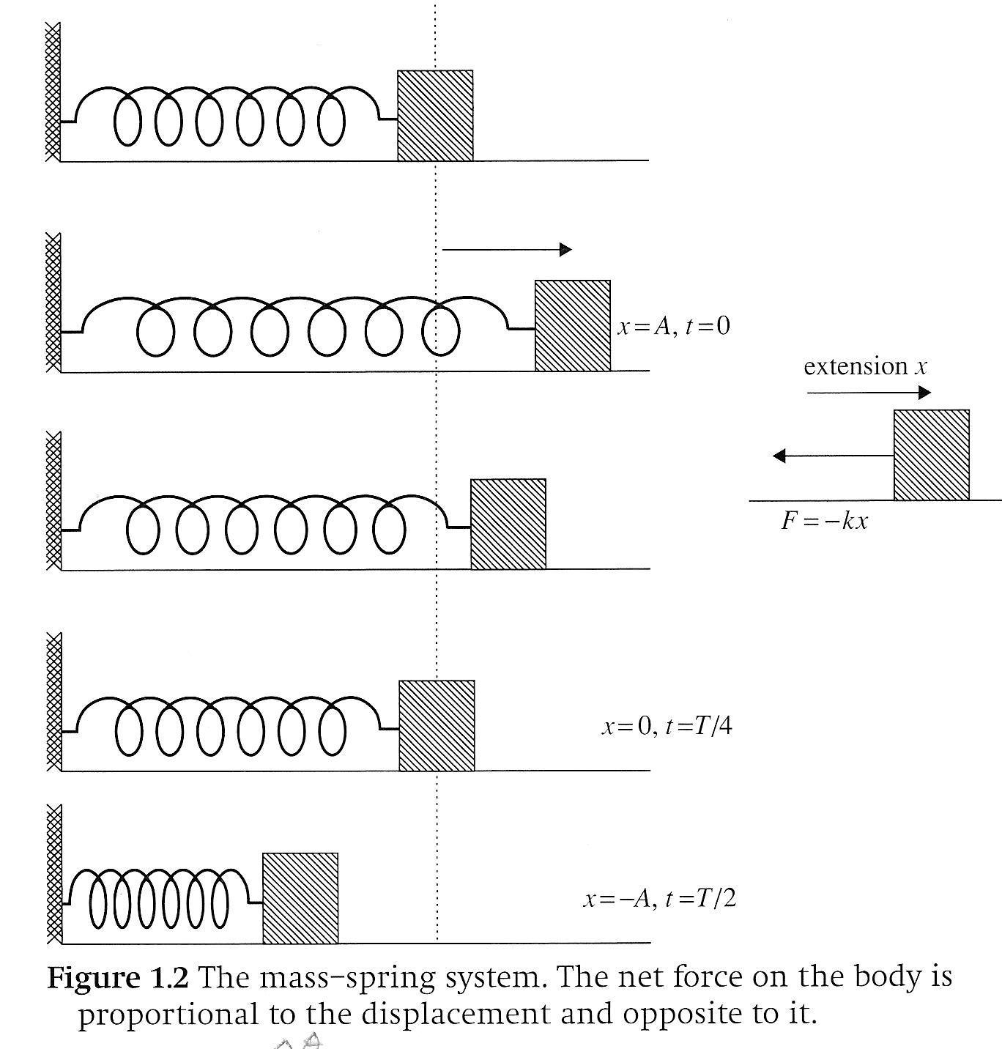
Definitions

Slide 22
Definitions
Understand the terms period and frequency
frequency (f) – How many oscillations are completed in one second, equal to the inverse of the period
period (T) – Time for one complete oscillation

Slide 23
Simple Harmonic Motion
In simple harmonic motion, the displacement from an equilibrium position and the restoring force / acceleration are proportional and opposite to each other.

Slide 24
Simple Harmonic Motion
Understand that in simple harmonic motion there is continuous transformation of energy from kinetic energy into elastic potential energy and vice versa

Slide 25
Simple Harmonic Motion: Spring
Elastic Potential Energy:
Kinetic Energy:

Slide 26
Simple Harmonic Motion: Spring
Conservation of Energy:
When a spring is stretched to its maximum length (amplitude) that represents the total energy of the system

Slide 27
Simple Harmonic Motion: Spring
no displ, no energy, no accl
max displ, max PE, max accl, zero KE
half max displ, half max PE, half max accl, half max KE
max displ, max PE, max accl, zero KE
zero displ, zero PE, zero accl, max KE

Slide 28
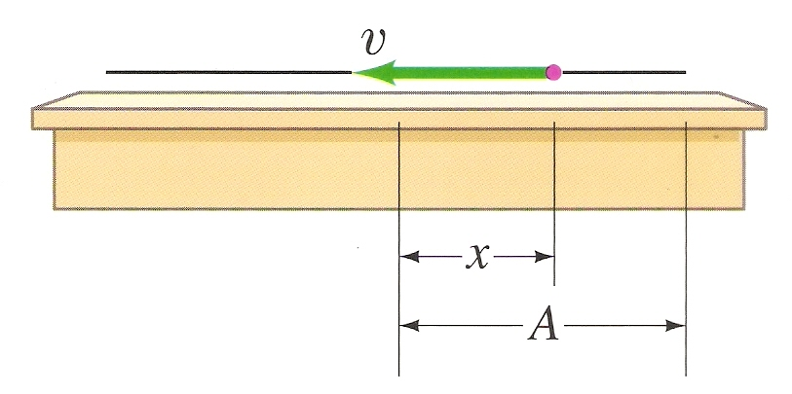
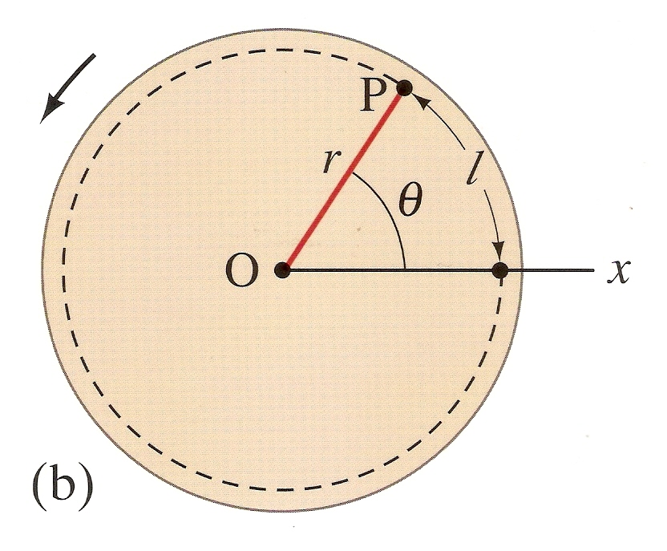
Velocity

Slide 29
Radians

Slide 30
Angular Velocity

Slide 31
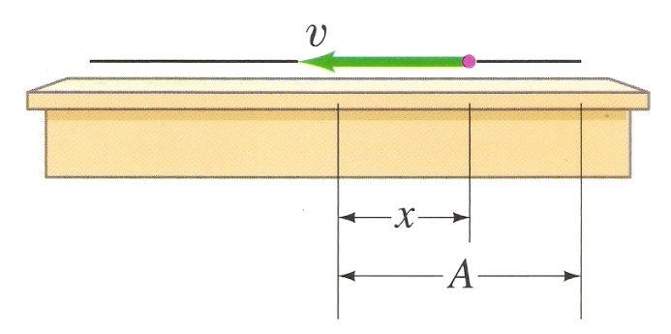
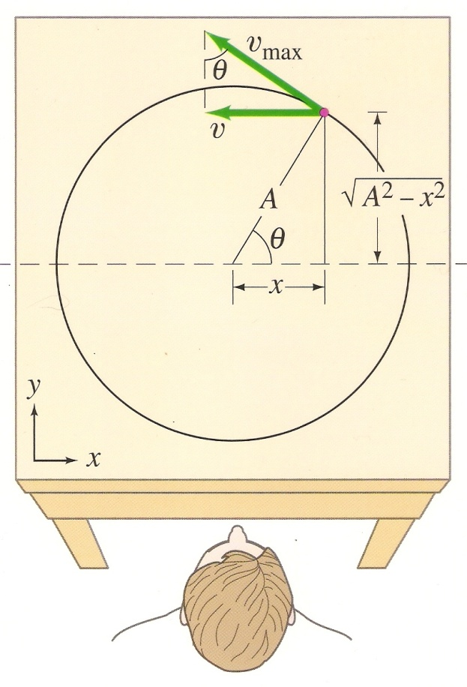
Position

Slide 32
Velocity

Slide 33
Acceleration

Slide 34
Relating SHM to Motion Around A Circle
These equations yield the following graphs

Slide 35
Relating SHM to Motion Around A Circle
These equations yield the following graphs

Slide 36
Relating SHM to Motion Around A Circle
These equations yield the following graphs

Slide 37
Relating SHM to Motion Around A Circle
These equations yield the following graphs

Slide 38
Relating cos to sin

Slide 39
Angular Speak

Slide 40
Simple Pendulum

Slide 41
Simple Pendulums
Small object (bob) suspended from a cord or shaft
Assumptions:
Cord/shaft doesn’t stretch
Mass of cord/shaft is negligible
Friction is negligible

Slide 42
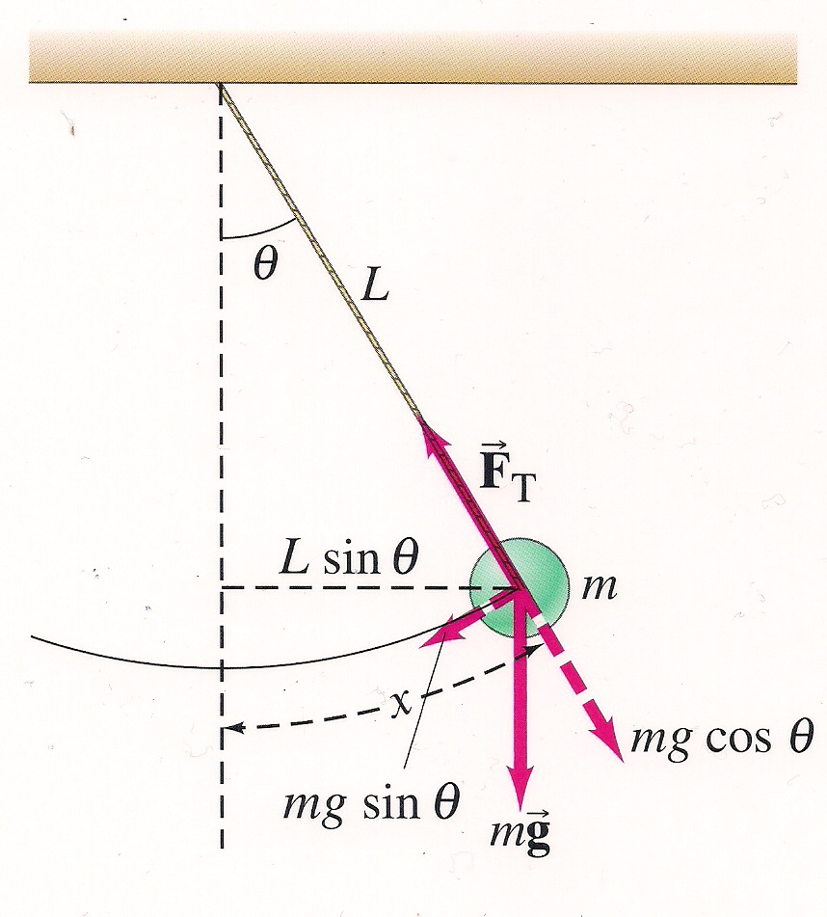
Simple Pendulums
Top of the arc, max displacement – max gravitational potential energy
Bottom of the arc – max kinetic energy

Slide 43
Simple Pendulums
Forces (static)
Tension
Gravity
Y-component = F_{T}
X-component in the direction of motion
Forces (dynamic)?

Slide 44
Simple Pendulums
Forces (static)
Tension
Gravity
Y-component = F_{T}
X-component in the direction of motion
Forces (dynamic)?
F = m (v²/r), y-direction only

Slide 45
Simple Pendulums – Complicated Math
Displacement
Restoring Force
Is it Simple Harmonic Motion?

Slide 46
Simple Pendulums – Complicated Math
Displacement
Restoring Force
Is it Simple Harmonic Motion?
No, because the restoring force is not in the same direction as the acceleration!!!

Slide 47
Is It SHM?
Note that for pendulums, since the acceleration / force is proportional to sinθ and not θ, it is not SHM
We will have oscillations, but they will not be simple harmonic motion
However, we consider it to be SHM for small amplitudes – eh, it’s close enough

Slide 48
Simple Pendulums – Complicated Math
Displacement
Restoring Force
For small angles / amplitudes

Slide 49
Simple Pendulums – Complicated Math
Satisfies the require-ments of Hooke’s Law, F = -kx

Slide 50
Simple Pendulums – Complicated Math

Slide 51
Simple Pendulums – Complicated Math
How does the mass of the bob affect period?

Slide 52
Simple Pendulums – Complicated Math
How does the mass of the bob affect period?
Nada

Slide 53
Simple Pendulums – Complicated Math
How does the amplitude of the pendulum affect period?

Slide 54
Simple Pendulums – Complicated Math
How does the amplitude of the pendulum affect period?
Nada ----------- Sorta

Slide 55
Simple Pendulums – Complicated Math
How does the length of the pendulum affect period?

Slide 56
Simple Pendulums – Complicated Math
How does the length of the pendulum affect period?
Proportional to the square of the length

Slide 57
Learning Objective(s):
The student is able to predict which properties determine the motion of a simple harmonic oscillator and what the dependence of the motion is on those properties.
The student is able to design a plan and collect data in order to ascertain the characteristics of the motion of a system undergoing oscillatory motion caused by a restoring force.
The student can analyze data to identify qualitative or quantitative relationships between given values and variables (i.e., force, displacement, acceleration, velocity, period of motion, frequency, spring constant, string length, mass) associated with objects in oscillatory motion to use that data to determine the value of an unknown.

Slide 58
Learning Objective(s):
The student is able to construct a qualitative and/or a quantitative explanation of oscillatory behavior given evidence of a restoring force.
The student is able to calculate the total energy of a system and justify the mathematical routines used in the calculation of component types of energy within the system whose sum is the total energy.
The student is able to predict changes in the total energy of a system due to changes in position and speed of objects or frictional interactions within the system.

Slide 59
Learning Objective(s):
The student is able to make predictions about the changes in the mechanical energy of a system when a component of an external force acts parallel or antiparallel to the direction of the displacement of the center of mass.
The student is able to apply the concepts of Conservation of Energy and the Work-Energy theorem to determine qualitatively and/or quantitatively that work done on a two-object system in linear motion will change the kinetic energy of the center of mass of the system, the potential energy of the systems, and/or the internal energy of the system.
The student is able to define open and closed systems for everyday situations and apply conservation concepts for energy, charge, and linear momentum to those situations.

Slide 60
Learning Objective(s):
The student is able to define open and closed systems for everyday situations and apply conservation concepts for energy, charge, and linear momentum to those situations.
The student is able to describe and make qualitative and/or quantitative predictions about everyday examples of systems with internal potential energy.
The student is able to make quantitative calculations of the internal potential energy of a system from a description or diagram of that system.

Slide 61
Learning Objective(s):
The student is able to calculate the expected behavior of a system using the object model (i.e., by ignoring changes in internal structure) to analyze a situation. Then, when the model fails, the student can justify the use of conservation of energy principles to calculate the change in internal energy due to changes in internal structure because the object is actually a system.
The student is able to describe and make predictions about the internal energy of systems.

Slide 62
Learning Objective(s):
The student is able to apply mathematical reasoning to create a description of the internal potential energy of a system from a description or diagram of the objects and interactions in that system.
The student is able to calculate changes in kinetic energy and potential energy of a system, using information from representations of that system.

Slide 63
Essential Knowledge(s):
Restoring forces can result in oscillatory motion. When a linear restoring force is exerted on an object displaced from an equilibrium position, the object will undergo a special type of motion called simple harmonic motion. Examples should include gravitational force exerted by the Earth on a simple pendulum, massspring oscillator.
For a spring that exerts a linear restoring force the period of a mass-spring oscillator increases with mass and decreases with spring stiffness.
For a simple pendulum oscillating the period increases with the length of the pendulum.
Minima, maxima, and zeros of position, velocity, and acceleration are features of harmonic motion. Students should be able to calculate force and acceleration for any given displacement for an object oscillating on a spring.

Slide 64
Essential Knowledge(s):
The energy of a system includes its kinetic energy, potential energy, and microscopic internal energy. Examples should include gravitational potential energy, elastic potential energy, and kinetic energy.
For all systems under all circumstances, energy, charge, linear momentum, and angular momentum are conserved. For an isolated or a closed system, conserved quantities are constant. An open system is one that exchanges any conserved quantity with its surroundings.

Slide 65
Essential Knowledge(s):
Mechanical energy (the sum of kinetic and potential energy) is transferred into or out of a system when an external force is exerted on a system such that a component of the force is parallel to its displacement. The process through which the energy is transferred is called work.
If the force is constant during a given displacement, then the work done is the product of the displacement and the component of the force parallel or antiparallel to the displacement.
Work (change in energy) can be found from the area under a graph of the magnitude of the force component parallel to the displacement versus displacement.

Slide 66
Essential Knowledge(s):
A system with internal structure can have internal energy, and changes in a system’s internal structure can result in changes in internal energy. [Physics 1: includes mass-spring oscillators and simple pendulums. Physics 2: includes charged object in electric fields and examining changes in internal energy with changes in configuration.]

Slide 67
Essential Knowledge(s):
A system with internal structure can have potential energy. Potential energy exists within a system if the objects within that system interact with conservative forces.
The work done by a conservative force is independent of the path taken. The work description is used for forces external to the system. Potential energy is used when the forces are internal interactions between parts of the system.
Changes in the internal structure can result in changes in potential energy. Examples should include mass-spring oscillators, objects falling in a gravitational field.

Slide 68
Essential Knowledge(s):
The internal energy of a system includes the kinetic energy of the objects that make up the system and the potential energy of the configuration of the objects that make up the system.
Since energy is constant in a closed system, changes in a system’s potential energy can result in changes to the system’s kinetic energy.
The changes in potential and kinetic energies in a system may be further constrained by the construction of the system.

Slide 69
Enduring Understanding(s):
Classically, the acceleration of an object interacting with other objects can be predicted by using .
Interactions with other objects or systems can change the total energy of a system.
The energy of a system is conserved.

Slide 70
Enduring Understanding(s):
Certain quantities are conserved, in the sense that the changes of those quantities in a given system are always equal to the transfer of that quantity to or from the system by all possible interactions with other systems.

Slide 71
Big Idea(s):
The interactions of an object with other objects can be described by forces.
Interactions between systems can result in changes in those systems.
Changes that occur as a result of interactions are constrained by conservation laws.

Slide 72
Questions?

Slide 73
Homework
#28-34

