Slide 1
Devil physics The baddest class on campus IB Physics

Slide 2
Lsn 11-3: Capacitance

Slide 3
Questions From Reading Activity?

Slide 4
Essential Idea:
Capacitors can be used to store electrical energy for later use.

Slide 5
Nature Of Science:
Relationships: Examples of exponential growth and decay pervade the whole of science. It is a clear example of the way that scientists use mathematics to model reality.
This topic can be used to create links between physics topics but also to uses in chemistry, biology, medicine and economics.

Slide 6
International-Mindedness:
Lightning is a phenomenon that has fascinated physicists from Pliny through Newton to Franklin. The charged clouds form one plate of a capacitor with other clouds or Earth forming the second plate. The frequency of lightning strikes varies globally, being particularly prevalent in equatorial regions. The impact of lightning strikes is significant, with many humans and animals being killed annually and huge financial costs to industry from damage to buildings, communication and power transmission systems, and delays or the need to reroute air transport.

Slide 7
Understandings:
Capacitance
Dielectric materials
Capacitors in series and parallel
Resistor-capacitor (RC) series circuits
Time constant

Slide 8
Applications And Skills:
Describing the effect of different dielectric materials on capacitance
Solving problems involving parallel-plate capacitors
Investigating combinations of capacitors in series or parallel circuits
Determining the energy stored in a charged capacitor

Slide 9
Applications And Skills:
Describing the nature of the exponential discharge of a capacitor
Solving problems involving the discharge of a capacitor through a fixed resistor
Solving problems involving the time constant of an RC circuit for charge, voltage and current

Slide 10
Guidance:
Only single parallel-plate capacitors providing a uniform electric field, in series with a load, need to be considered (edge effect will be neglected)
Problems involving the discharge of capacitors through fixed resistors need to be treated both graphically and algebraically
Problems involving the charging of a capacitor will only be treated graphically
Derivation of the charge, voltage and current equations as a function of time is not required

Slide 11
Data Booklet Reference:
$C=\frac{q}{V}$
$C_{parallel}=C_{1}+C_{2}+…$
$\frac{1}{C_{series}}=\frac{1}{C_{1}}+\frac{1}{C_{2}}+…$
$C=ε\frac{A}{d}$
$E=\frac{1}{2}CV^{2}$
$τ=RC$
$q=q_{0}e^{−\frac{t}{τ}}$
$I=I_{0}e^{−\frac{t}{τ}}$
$V=V_{0}e^{−\frac{t}{τ}}$

Slide 12
Utilization:
The charge and discharge of capacitors obeys rules that have parallels in other branches of physics including radioactivity.

Slide 13
Aims:
Aim 3: the treatment of exponential growth and decay by graphical and algebraic methods offers both the visual and rigorous approach so often characteristic of science and technology.
Aim 6: experiments could include (but are not limited to): investigating basic RC circuits; using a capacitor in a bridge circuit; examining other types of capacitors; verifying time constant.

Slide 14
Introductory Video

Slide 15
Capacitor
Two conductors separated by a vacuum or by insulating material
The reason why
When a camera stops whining, it is ready to release a really bright flash
Reason why a light stays on for a while then fades out after a device is turned off

Slide 16
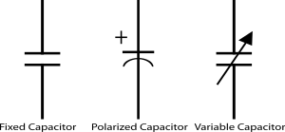
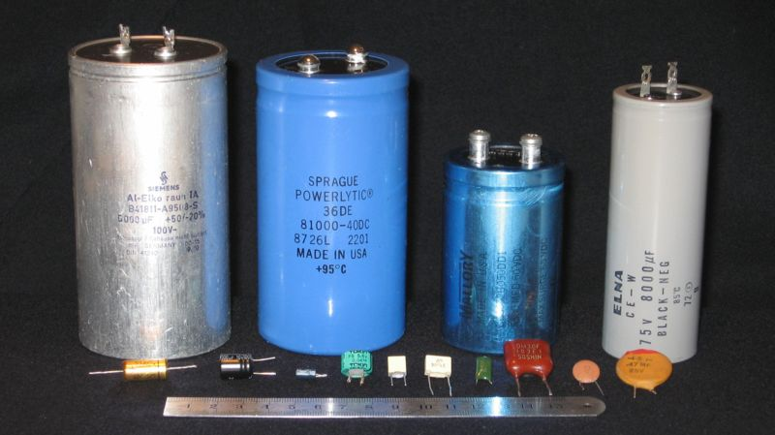
Capacitor
Symbols and Forms

Slide 17
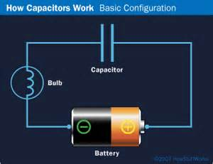
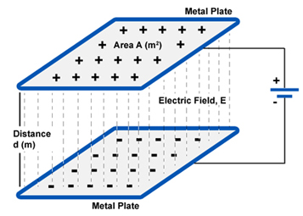
Capacitor
Parallel Plate Capacitor

Slide 18
Capacitor
Parallel Plate Capacitor
We assume the electric field between the plates is uniform with no edge effects.

Slide 19
Capacitor
TOK Question: If we connect the capacitor to a 12-V battery, how much charge accumulates?
Parallel Plate Capacitor

Slide 20
Capacitor
TOK Question: If we connect the capacitor to a 12-V battery, how much charge accumulates?
TOK Answer: It depends
Parallel Plate Capacitor

Slide 21
Capacitor
TOK Question: If we connect the capacitor to a 12-V battery, how much charge accumulates?
TOK Answer: It depends
Physics Question: On what?
Parallel Plate Capacitor

Slide 22
Capacitor
TOK Question: If we connect the capacitor to a 12-V battery, how much charge accumulates?
TOK Answer: It depends
Physics Question: On what?
Physics Answer: Capacitance
Parallel Plate Capacitor

Slide 23
Capacitance
Charge per unit voltage that can be stored on a capacitor
q = charge
V = potential difference between the plates
Unit is the farad, 1F = 1C/V
$$C=\frac{q}{V}$$

Slide 24
Capacitance
Charge per unit voltage that can be stored on a capacitor
q = charge
V = potential difference between the plates
Unit is the farad, 1F = 1C/V
$$C=\frac{q}{V}$$

Slide 25
Capacitance
Capacitance depends on the geometry of the capacitor
ε = permittivity of the medium between the plates (for a vacuum, ε₀ = 8.85 x 10⁻¹² F/m)
A = area of one of the plates
d = separation of the plates
$$C=ε\frac{A}{d}$$

Slide 26
Capacitance
Capacitance depends on the geometry of the capacitor
ε = permittivity of the medium between the plates (for a vacuum, ε₀ = 8.85 x 10⁻¹² F/m)
A = area of one of the plates
d = separation of the plates
$$C=ε\frac{A}{d}$$

Slide 27
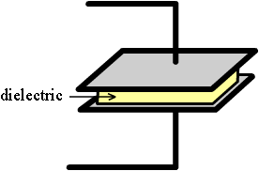
Effect of Dielectric
Dielectric is an insulating material placed between the two plates
Since the permittivity of an insulator is greater than that of a vacuum (ε > ε₀) the capacitance with a dielectric is greater than one with a vacuum
$$C=ε\frac{A}{d}$$

Slide 28
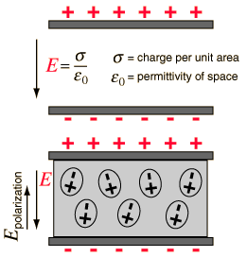
Effect of Dielectric
The electric field will cause charge polarization of the dielectric material
Unlike charges attract
This creates a small electric field within the dielectric material that reduces the net field strength of the capacitor in comparison to the vacuum capacitor

Slide 29
Effect of Dielectric
Work done to move a charge q from one plate to another is,
Since E is reduced with a dielectric, work done is also reduced
Work is also,
This implies that potential, V, also decreases with a dielectric

Slide 30
Effect of Dielectric
Since potential, V, decreases with a dielectric and
Then capacitance increases

Slide 31
Effect of Dielectric
Now consider a situation where the capacitors are connected to a power supply (like a battery) where the potential is constant
Since
Work is constant
Since
The net electric fields must be equal

Slide 32
Effect of Dielectric
Now consider a situation where the capacitors are connected to a power supply (like a battery) where the potential is constant
Since the dielectric capacitor has an increased charge q, it follows that its capacitance is also increased

Slide 33
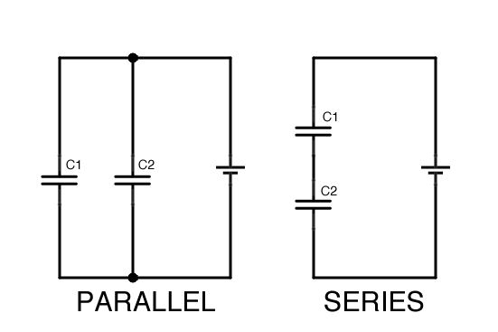
Capacitors in Parallel
If two of the same capacitors are wired in parallel and connected to a voltage source, V, then the voltage drop across each capacitor is the same

Slide 34
Capacitors in Parallel
If two of the same capacitors are wired in parallel and connected to a voltage source, V, then the voltage drop across each capacitor is the same
Just the opposite of resistors!

Slide 35
Capacitors in Series
In a series circuit, the sum of the voltage drops across each component is equal to the voltage source

Slide 36
Capacitors in Series
In a series circuit, the sum of the voltage drops across each component is equal to the voltage source
Just the opposite of resistors!

Slide 37
Energy Stored in a Capacitor
Think of the energy stored in a capacitor as being equal to the work required to move a charge from one plate to the other
Through calculus, this becomes

Slide 38
Energy Stored in a Capacitor
Think of the energy stored in a capacitor as being equal to the work required to move a charge from one plate to the other
Through calculus, this becomes

Slide 39
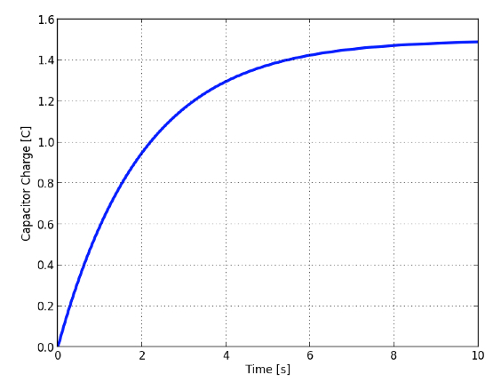
Charging a Capacitor

Slide 40
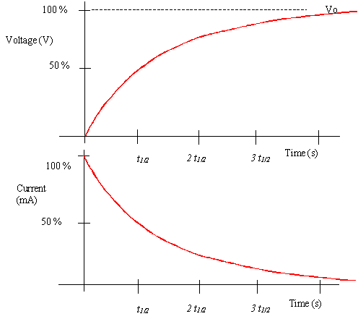
Charging a Capacitor

Slide 41
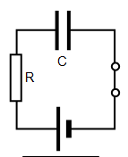
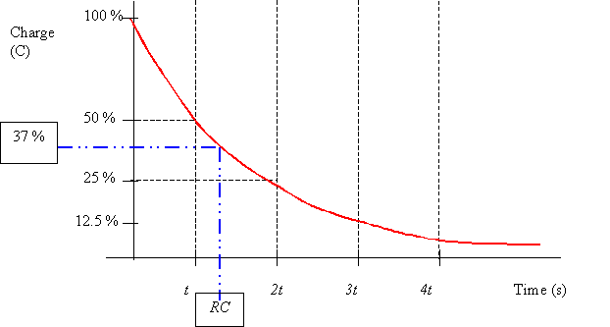
Discharging a Capacitor through a Resistor (RC circuit)
As seen by the graph, the discharge rate is an exponential decay function represented by
R = resistance
C = capacitance

Slide 42
Discharging a Capacitor through a Resistor (RC circuit)
The quantity RC is called the time constant and is given the variable τ
Time constant determines time scale for discharge
Large = long time
Small = short time

Slide 43
Discharging a Capacitor through a Resistor (RC circuit)
It is called the time constant because when t = τ, the value of the charge will be 37% of its original charge

Slide 44
Discharging a Capacitor through a Resistor (RC circuit)
Since current is proportional to voltage (V = IR), the same equation applies to current

Slide 45
Discharging a Capacitor through a Resistor (RC circuit)
Since current is proportional to voltage (V = IR), the same equation applies to current

Slide 46
Discharging a Capacitor through a Resistor (RC circuit)
When will the charge on the capacitor be half of its original charge (q = ½ q₀)?

Slide 47
Discharging a Capacitor through a Resistor (RC circuit)
When will the charge on the capacitor be half of its original charge (q = ½ q₀)?

Slide 48
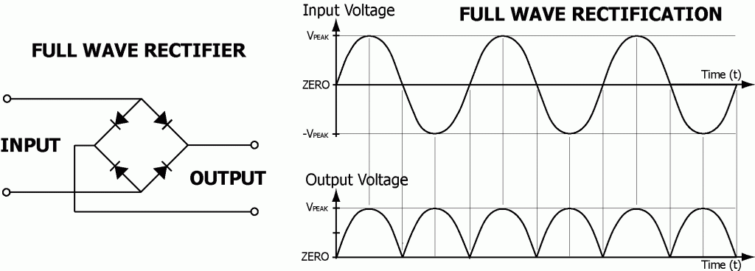
Capacitors in Rectification
The output of a diode bridge is a direct current, but one that is not very ‘smooth’

Slide 49
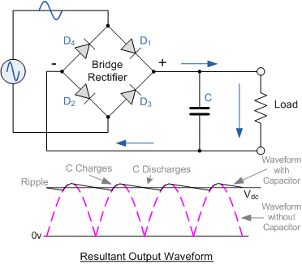
Capacitors in Rectification
By adding a capacitor in parallel to the output load, the output is ‘smoothed out’

Slide 50
Capacitors in Rectification
In the circuit, current flows clockwise thru the capacitor and resistor (load)
The first quarter-cycle charges the capacitor and the potential on the top plate reaches a maximum

Slide 51
Capacitors in Rectification
In the circuit, current flows clockwise thru the capacitor and resistor (load)
In the second quarter-cycle, as the potential decreases, the capacitor discharges because of its higher top-plate potential

Slide 52
Capacitors in Rectification
In the circuit, current flows clockwise thru the capacitor and resistor (load)
In the third quarter-cycle, as the potential increases, the capacitor discharge rate decreases and then starts charging

Slide 53
Capacitors in Rectification
The ‘ripple effect’ is thus reduced

Slide 54
Understandings:
Capacitance
Dielectric materials
Capacitors in series and parallel
Resistor-capacitor (RC) series circuits
Time constant

Slide 55
Applications And Skills:
Describing the effect of different dielectric materials on capacitance
Solving problems involving parallel-plate capacitors
Investigating combinations of capacitors in series or parallel circuits
Determining the energy stored in a charged capacitor

Slide 56
Applications And Skills:
Describing the nature of the exponential discharge of a capacitor
Solving problems involving the discharge of a capacitor through a fixed resistor
Solving problems involving the time constant of an RC circuit for charge, voltage and current

Slide 57
Data Booklet Reference:
$C=\frac{q}{V}$
$C_{parallel}=C_{1}+C_{2}+…$
$\frac{1}{C_{series}}=\frac{1}{C_{1}}+\frac{1}{C_{2}}+…$
$C=ε\frac{A}{d}$
$E=\frac{1}{2}CV^{2}$
$τ=RC$
$q=q_{0}e^{−\frac{t}{τ}}$
$I=I_{0}e^{−\frac{t}{τ}}$
$V=V_{0}e^{−\frac{t}{τ}}$

Slide 58
Essential Idea:
Capacitors can be used to store electrical energy for later use.

Slide 59
Questions?

Slide 60
Homework
#22-35

