Slide 1
Devil physics The baddest class on campus IB Physics

Slide 2
Lsn 10-2: Motion in a gravitational field

Slide 3
Questions From Reading Activity?

Slide 4
Gravity Waves?

Slide 5
Essential Idea:
Similar approaches can be taken in analyzing electrical and gravitational potential problems.

Slide 6
Nature Of Science:
Communication of scientific explanations:
The ability to apply field theory to the unobservable (charges) and the massively scaled (motion of satellites) required scientists to develop new ways to investigate, analyze and report findings to a general public used to scientific discoveries based on tangible and discernible evidence.

Slide 7
Understandings:
Potential and potential energy
Potential gradient
Potential difference
Escape speed
Orbital motion, orbital speed and orbital energy
Forces and inverse-square law behavior

Slide 8
Applications And Skills:
Determining the potential energy of a point mass and the potential energy of a point charge
Solving problems involving potential energy
Solving problems involving the speed required for an object to go into orbit around a planet and for an object to escape the gravitational field of a planet

Slide 9
Applications And Skills:
Solving problems involving orbital energy of charged particles in circular orbital motion and masses in circular orbital motion
Determining the potential inside a charged sphere
Solving problems involving forces on charges and masses in radial and uniform fields

Slide 10
Guidance:
Orbital motion of a satellite around a planet is restricted to a consideration of circular orbits (links to 6.1 and 6.2)
Students should recognize that lines of force can be two-dimensional representations of three-dimensional fields

Slide 11
Guidance:
Both uniform and radial fields need to be considered
Students should assume that the electric field everywhere between parallel plates is uniform with edge effects occurring beyond the limits of the plates.

Slide 12
Data Booklet Reference:
$$V_{g}=−\frac{GM}{r}$$ | $$V_{e}=−\frac{kq}{r}$$
$$g=−\frac{V_{g}}{Δr}$$ | $$E=−\frac{V_{e}}{Δr}$$
$$E_{p}=mV_{g}=−\frac{GMm}{r}$$ | $$E_{p}=qV_{e}=−\frac{kq_{1}q_{2}}{r}$$
$$F_{G}=G\frac{m_{1}m_{2}}{r^{2}}$$ | $$F_{E}=k\frac{q_{1}q_{2}}{r^{2}}$$
$V_{esc}=\sqrt{\frac{2GM}{r}}$
$V_{orbit}=\sqrt{\frac{GM}{r}}$

Slide 13
Utilization:
The global positioning system depends on complete understanding of satellite motion
Geostationary/polar satellites
The acceleration of charged particles in particle accelerators and in many medical imaging devices depends on the presence of electric fields (see Physics option sub-topic

Slide 14
Aims:
Aim 2: Newton’s law of gravitation and Coulomb’s law form part of the structure known as “classical physics”. This body of knowledge has provided the methods and tools of analysis up to the advent of the theory of relativity and the quantum theory

Slide 15
Aims:
Aim 4: the theories of gravitation and electrostatic interactions allows for a great synthesis in the description of a large number of phenomena

Slide 16
Newton’s Law of Universal Gravitation
Last year we learned,
This year we look at it from an energy standpoint

Slide 17
Gravitational Potential Energy
The gravitational force is an attractive force
Work must be done to separate two bodies in space a certain distance R
This work is converted to potential energy called the gravitational potential energy

Slide 18
Gravitational Potential Energy
For a satellite orbiting a body, its total energy is the sum of its kinetic and potential energy

Slide 19
Gravitational Potential Energy
If the satellite is in a stable, continuous orbit, the kinetic energy is equal to its potential energy

Slide 20
Gravitational Potential Energy
Newton’s Second Law tells us that the gravitational force will be balanced by the centripetal acceleration

Slide 21
Gravitational Potential Energy
Substituting into the traditional value for kinetic energy gives us

Slide 22
Gravitational Potential Energy
And total energy for an orbiting body becomes

Slide 23
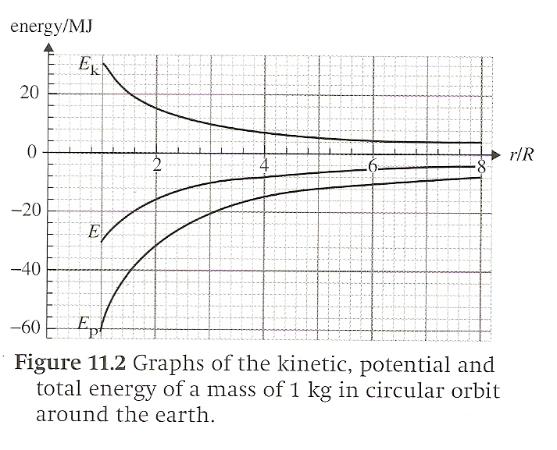
Gravitational Potential Energy
Graph of kinetic, potential, and total energy as a function of distance for a circular orbit

Slide 24
Gravitational Potential Energy
As you get further away from the earth’s surface, the less potential energy there is, so less kinetic energy is required

Slide 25
Gravitational Potential Energy
Because r is squared, it is an exponential and not a linear relationship

Slide 26
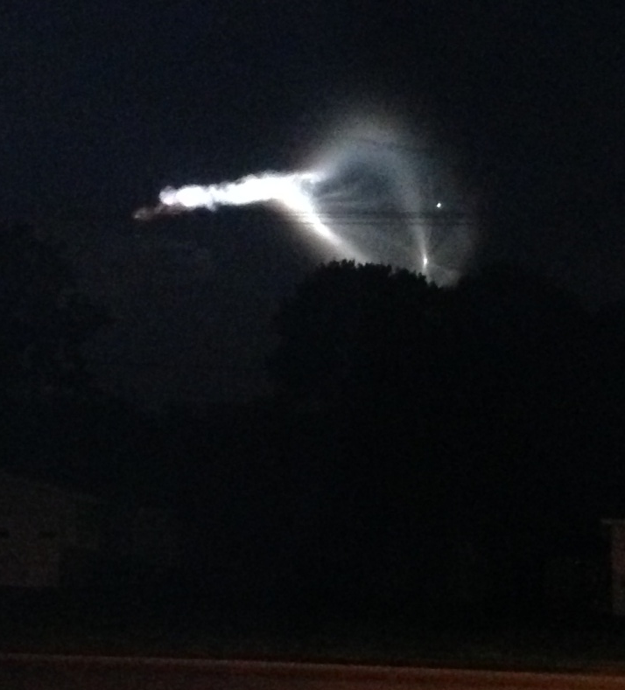
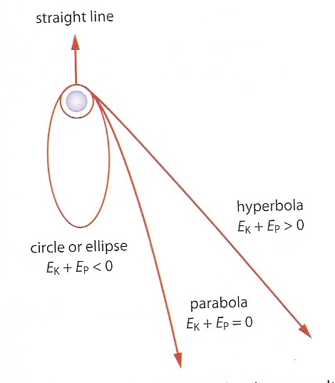
What will happen?
Suppose you launch a rocket with a given velocity. There are three options:
If total energy is positive (E_{K} > E_{P}), the rocket will follow a hyperbolic orbit and never return
If total energy is zero (E_{K} = E_{P}), the rocket will follow a parabolic orbit to infinity and never return
If total energy is negative (E_{K} < E_{P}), the rocket will enter a circular or elliptical orbit (or crash and burn)

Slide 27
Escape Velocity
Total energy of a mass m moving near a large mass M is given by
We assume the only force acting on m is the gravitational force created by M

Slide 28
Escape Velocity
We want to know if a mass m is launched from the surface of M, will it escape M’s gravitational field?

Slide 29
Escape Velocity
If total energy is greater than zero, m escapes
If total energy is less than zero, m will eventually return to the surface of M

Slide 30
Escape Velocity
The separation point is when V∞ is equal to zero

Slide 31
Escape Velocity
This is the minimum velocity needed to exceed the gravitational attraction of M and is called the escape velocity
What happens if we double the value of m?

Slide 32
Escape Velocity
This is the minimum velocity needed to exceed the gravitational attraction of M and is called the escape velocity
What happens if we double the value of m?
Nothing changes

Slide 33
Escape from Planet Earth
In reality there are other things to consider when launching a rocket from earth:
Atmospheric friction
Gravitational pull of the Sun, Moon, and other planets
Considers only ballistic motion and not that of a rocket with a continuous force applied

Slide 34
Orbital Motion
The law of gravitational attraction combined with Newton’s second law show that the orbit of any body due to gravitational attraction will follow the path of an ellipse or a circle (circles are ellipses with both foci at the same point).

Slide 35
Orbital Speed

Slide 36
Black Holes
What if the required escape velocity exceeds the speed of light?
This means that nothing, even light, can escape the star and it is a black hole
The radius at which this occurs is called the Schwarzschild radius

Slide 37
Weightlessness
“Relative weightlessness” occurs when the centripetal acceleration is equal to the acceleration due to gravity
Motorcycle jump
Ski jumper

Slide 38
Weightlessness
Weightlessness in Space

Slide 39
Weightlessness
Weightlessness in Space
When the object is at orbit speed, the normal force is zero, i.e. “weightless”

Slide 40
Inverse Square Law Behavior
The gravitational and electrical forces are inversely proportional to the square of the distance from the source

Slide 41
Inverse Square Law Behavior
The gravitational and electrical forces are inversely proportional to the square of the distance from the source

Slide 42
Inverse Square Law Behavior
The gravitational and electrical forces are inversely proportional to the square of the distance from the source

Slide 43
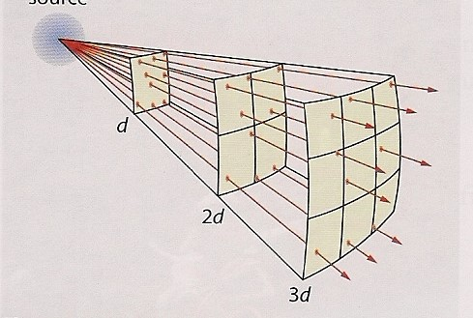
Inverse Square Law Behavior
Since these forces radiate from the source, their spherical “area of influence” quadruples as distance doubles

Slide 44
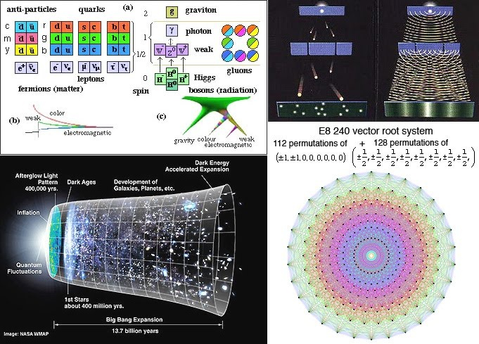
Inverse Square Law Behavior
It is also related to the fact that photons and gravitons have zero mass (Chapter 7)

Slide 45
One Final Question
What if we could fall through the center of the earth?

Slide 46
Understandings:
Potential and potential energy
Potential gradient
Potential difference
Escape speed
Orbital motion, orbital speed and orbital energy
Forces and inverse-square law behavior

Slide 47
Guidance:
Orbital motion of a satellite around a planet is restricted to a consideration of circular orbits (links to 6.1 and 6.2)
Students should recognize that lines of force can be two-dimensional representations of three-dimensional fields

Slide 48
Guidance:
Both uniform and radial fields need to be considered
Students should assume that the electric field everywhere between parallel plates is uniform with edge effects occurring beyond the limits of the plates.

Slide 49
Data Booklet Reference:
$$V_{g}=−\frac{GM}{r}$$ | $$V_{e}=−\frac{kq}{r}$$
$$g=−\frac{V_{g}}{Δr}$$ | $$E=−\frac{V_{e}}{Δr}$$
$$E_{p}=mV_{g}=−\frac{GMm}{r}$$ | $$E_{p}=qV_{e}=−\frac{kq_{1}q_{2}}{r}$$
$$F_{G}=G\frac{m_{1}m_{2}}{r^{2}}$$ | $$F_{E}=k\frac{q_{1}q_{2}}{r^{2}}$$
$V_{esc}=\sqrt{\frac{2GM}{r}}$
$V_{orbit}=\sqrt{\frac{GM}{r}}$

Slide 50
Utilization:
The global positioning system depends on complete understanding of satellite motion
Geostationary/polar satellites
The acceleration of charged particles in particle accelerators and in many medical imaging devices depends on the presence of electric fields (see Physics option sub-topic

Slide 51
Aims:
Aim 2: Newton’s law of gravitation and Coulomb’s law form part of the structure known as “classical physics”. This body of knowledge has provided the methods and tools of analysis up to the advent of the theory of relativity and the quantum theory

Slide 52
Aims:
Aim 4: the theories of gravitation and electrostatic interactions allows for a great synthesis in the description of a large number of phenomena

Slide 53
Essential Idea:
Similar approaches can be taken in analyzing electrical and gravitational potential problems.

Slide 54
Questions?

Slide 55
Homework
#22-38

