Slide 1
Devil physics The baddest class on campus AP Physics

Slide 2
Lsn 6-4: Potential energy Lsn 6-5: Conservative and nonconservative forces

Slide 3
Questions From Reading Activity?
Can’t help you with recipes or how to twerk.

Slide 4
Big Idea(s):
The interactions of an object with other objects can be described by forces.
Interactions between systems can result in changes in those systems.
Changes that occur as a result of interactions are constrained by conservation laws.

Slide 5
Enduring Understanding(s):
All forces share certain common characteristics when considered by observers in inertial reference frames.
Classically, the acceleration of an object interacting with other objects can be predicted by using .

Slide 6
Enduring Understanding(s):
Interactions with other objects or systems can change the total energy of a system.
The energy of a system is conserved.

Slide 7
Essential Knowledge(s):
An observer in a particular reference frame can describe the motion of an object using such quantities as position, displacement, distance, velocity, speed, and acceleration.
A choice of reference frame determines the direction and the magnitude of each of these quantities.

Slide 8
Essential Knowledge(s):
Free-body diagrams are useful tools for visualizing forces being exerted on a single object and writing the equations that represent a physical situation.
An object can be drawn as if it was extracted from its environment and the interactions with the environment identified.
A force exerted on an object can be represented as an arrow whose length represents the magnitude of the force and whose direction shows the direction of the force.
A coordinate system with one axis parallel to the direction of the acceleration simplifies the translation from the free-body diagram to the algebraic representation.

Slide 9
Essential Knowledge(s):
The energy of a system includes its kinetic energy, potential energy, and microscopic internal energy. Examples should include gravitational potential energy, elastic potential energy, and kinetic energy.
Classically, an object can only have kinetic energy since potential energy requires an interaction between two or more objects.

Slide 10
Essential Knowledge(s):
A system with internal structure can have potential energy. Potential energy exists within a system if the objects within that system interact with conservative forces.
The work done by a conservative force is independent of the path taken. The work description is used for forces external to the system. Potential energy is used when the forces are internal interactions between parts of the system.
Changes in the internal structure can result in changes in potential energy. Examples should include mass-spring oscillators, objects falling in a gravitational field.

Slide 11
Learning Objective(s):
The student is able to create and use free-body diagrams to analyze physical situations to solve problems with motion qualitatively and quantitatively.
The student is able to calculate the total energy of a system and justify the mathematical routines used in the calculation of component types of energy within the system whose sum is the total energy.

Slide 12
Learning Objective(s):
The student is able to predict changes in the total energy of a system due to changes in position and speed of objects or frictional interactions within the system.
The student is able to set up a representation or model showing that a single object can only have kinetic energy and use information about that object to calculate its kinetic energy.

Slide 13
Learning Objective(s):
The student is able to translate between a representation of a single object, which can only have kinetic energy, and a system that includes the object, which may have both kinetic and potential energies.
The student is able to describe and make qualitative and/or quantitative predictions about everyday examples of systems with internal potential energy.

Slide 14
Learning Objective(s):
The student is able to make quantitative calculations of the internal potential energy of a system from a description or diagram of that system.
The student is able to apply mathematical reasoning to create a description of the internal potential energy of a system from a description or diagram of the objects and interactions in that system.

Slide 15
Introductory Video: Potential and Kinetic Energy

Slide 16
Potential Energy
“ . . . energy associated with forces that depend on the position or configuration of a body (or bodies) and the surroundings.”
Two main types:
Gravitational potential energy
Elastic potential energy
(Electrical potential energy)
(Chemical potential energy)

Slide 17
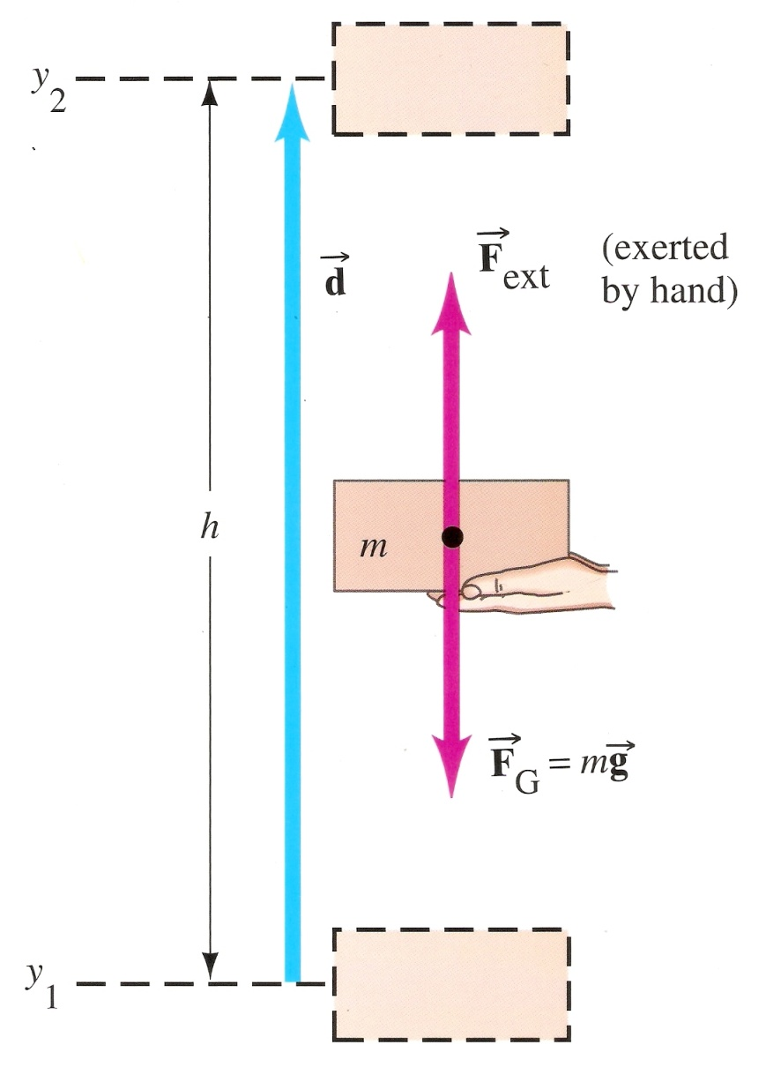
Gravitational Potential Energy
The energy of position
If we hold a brick at some height above an object, the brick has energy because it has the ability to do work
That ability to do work is because of gravity which exerts a force on the brick

Slide 18
Gravitational Potential Energy
In order to raise the brick (at constant velocity to height y₂, we had to do work

Slide 19
Gravitational Potential Energy
This work is stored as gravitational potential energy

Slide 20
Gravitational Potential Energy
Potential Energy is dependent on the reference level
y₂ with respect to y₁
y₁ with respect to y₂
y₂ with respect to present
y₁ with respect to present

Slide 21
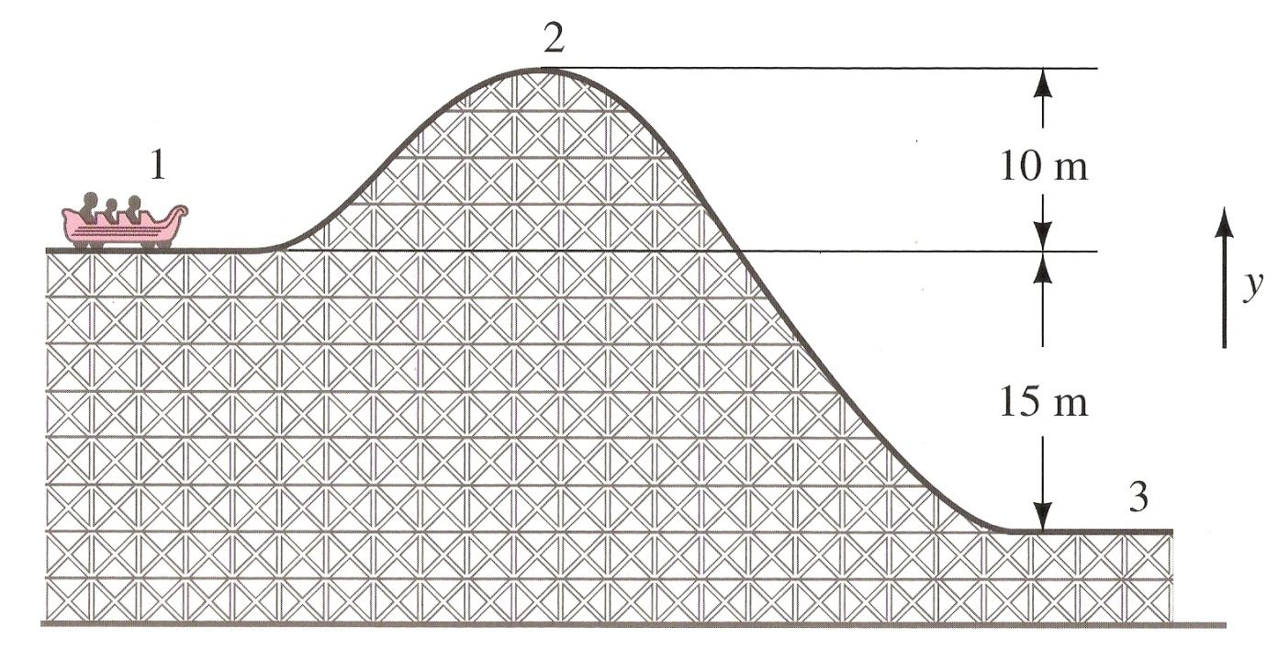
Gravitational Potential Energy
Potential Energy is dependent on the reference level
Think in terms of work equal to the change in potential energy

Slide 22
Gravitational Potential Energy
If the weight of the cart is 1000 N, what is its potential energy at 1, 2 and 3?

Slide 23
Gravitational Potential Energy
If the weight of the cart is 1000 N, what is its potential energy at 1, 2 and 3?
1. 15,000 J
2. 25,000 J
3. 0 J
If we use y = 0 at point #3

Slide 24
Potential Energy
“ . . . change in potential energy associated with a particular force, is equal to the negative of the work done by that force if the object is moved from one point to a second point.”
“ . . . change in potential energy is the work required of an external force to move the object without acceleration between the two points.”

Slide 25
Elastic Potential Energy
It takes work to compress a spring
A compressed spring has the ability to do work so,
The work done in compressing a spring is saved as potential energy

Slide 26
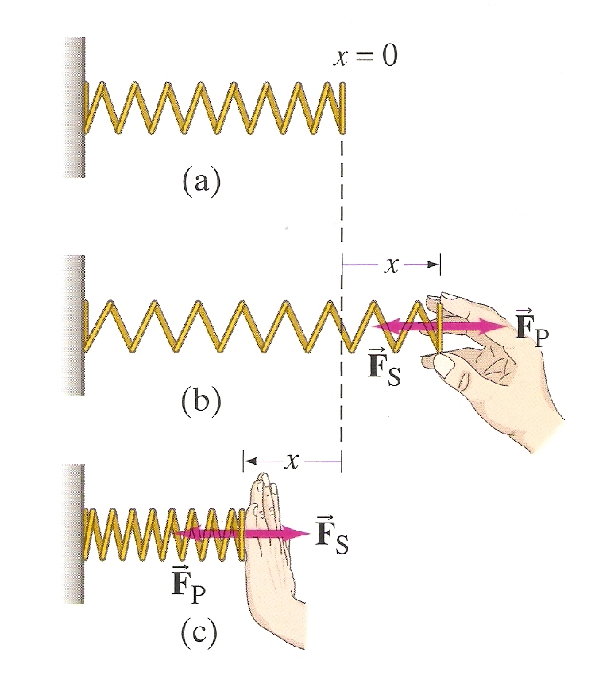
Elastic Potential Energy
A bi-directional spring works in both stretching and pushing
We find that it takes the same amount of work (Fd) to stretch a spring a given distance as it does to push the spring the same distance

Slide 27
Elastic Potential Energy
We also find that the further we stretch or compress a spring, the more force it takes
In fact, the force required is directly proportional to the distance x the spring is displaced
k is called the spring constant (N/m)

Slide 28
Elastic Potential Energy
In order to find the potential energy of a stretched or compressed spring, we need to find the work needed to stretch or compress it

Slide 29
Elastic Potential Energy
You might think that
But this is not the case

Slide 30
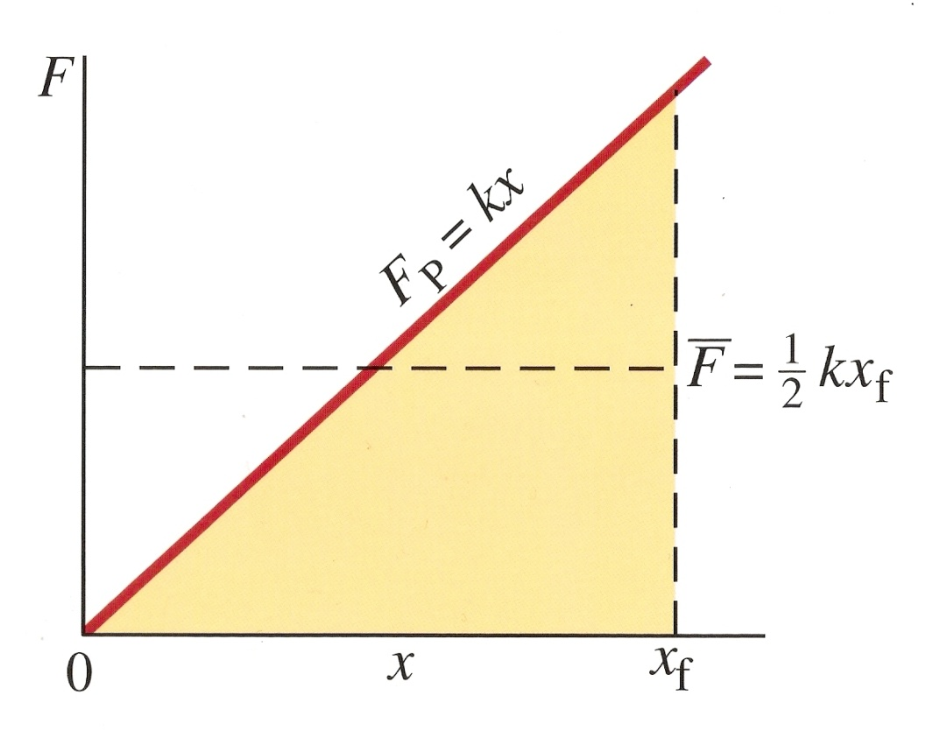
Elastic Potential Energy
The force required constantly changes as the distance increases
So, we have to use the average force,

Slide 31
Elastic Potential Energy
Now we can find the elastic potential energy

Slide 32
Elastic Potential Energy
This is called Hooke’s Law or the spring equation
k is known as the spring constant

Slide 33
Conservative and Nonconservative Forces
What are the characteristics of conservative forces?
What are the characteristics of nonconservative forces?

Slide 34
Conservative and Nonconservative Forces
What are the characteristics of conservative forces?
Does work
Allows progress, i.e. movement forward
Generally produces positive energy
What are the characteristics of nonconservative forces?

Slide 35
Conservative and Nonconservative Forces
What are the characteristics of conservative forces?
Does work
Allows progress, i.e. movement forward
Generally produces positive energy
What are the characteristics of nonconservative forces?
Opposes work
Inhibits progress
Generally produces negative or wasteful energy

Slide 36
Conservative and Nonconservative Forces
Conservative Forces
The work done does not depend on the path taken, but only on the initial and final positions (displacement)
It doesn’t matter what route you take to get up a hill, the work depends on the change in height (PE)
Nonconservative Forces
The work done does depend on the path taken
Friction constantly opposes motion throughout the path taken

Slide 37
Conservative and Nonconservative Forces

Slide 38
Conservative and Nonconservative Forces
Potential Energy
Since potential energy is dependent on a difference of positions, potential energy can only be defined for a conservative force

Slide 39
Work-Energy Principle
Net Work is equal to the sum of the work done by conservative and nonconservative forces
Work done by nonconservative forces is equal to the sum of the changes in PE and KE

Slide 40
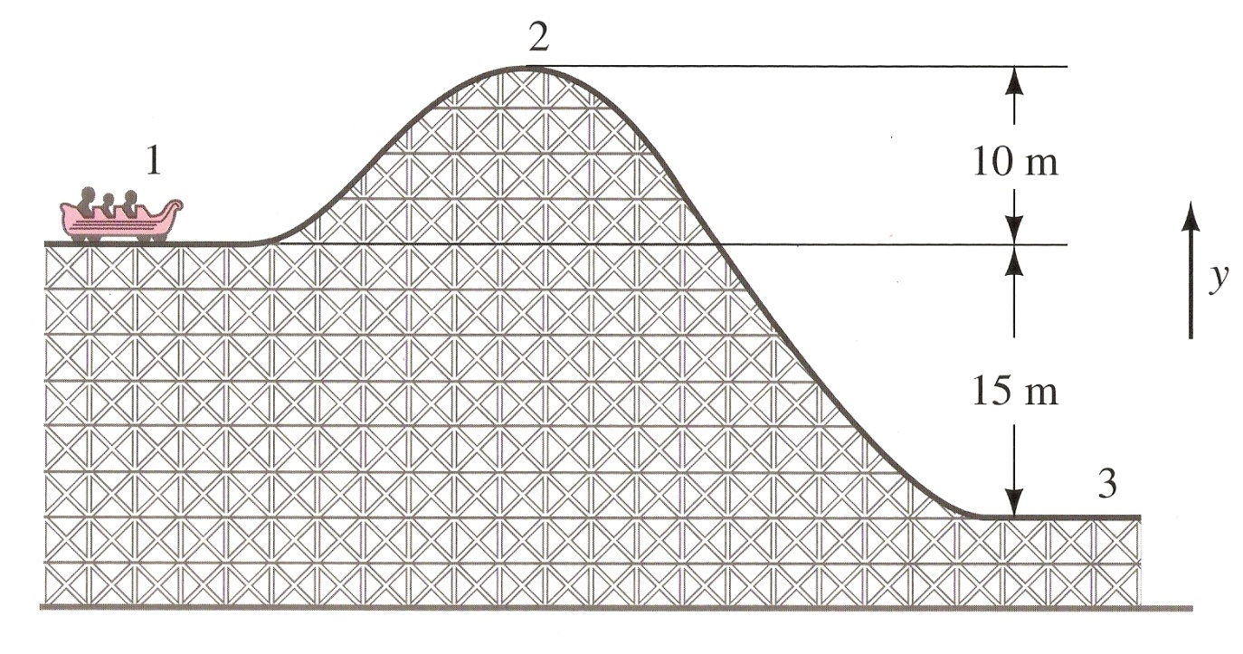
Work-Energy Principle
Work done by nonconservative forces is equal to the sum of the changes in PE and KE
If energy is lost, it is due to work done by nonconservative forces

Slide 41
Summary: Wiley Coyote Demonstrates Potential, Gravitational and Elastic Energy

Slide 42
Learning Objective(s):
The student is able to create and use free-body diagrams to analyze physical situations to solve problems with motion qualitatively and quantitatively.
The student is able to calculate the total energy of a system and justify the mathematical routines used in the calculation of component types of energy within the system whose sum is the total energy.

Slide 43
Learning Objective(s):
The student is able to predict changes in the total energy of a system due to changes in position and speed of objects or frictional interactions within the system.
The student is able to set up a representation or model showing that a single object can only have kinetic energy and use information about that object to calculate its kinetic energy.

Slide 44
Learning Objective(s):
The student is able to translate between a representation of a single object, which can only have kinetic energy, and a system that includes the object, which may have both kinetic and potential energies.
The student is able to describe and make qualitative and/or quantitative predictions about everyday examples of systems with internal potential energy.

Slide 45
Learning Objective(s):
The student is able to make quantitative calculations of the internal potential energy of a system from a description or diagram of that system.
The student is able to apply mathematical reasoning to create a description of the internal potential energy of a system from a description or diagram of the objects and interactions in that system.

Slide 46
Essential Knowledge(s):
An observer in a particular reference frame can describe the motion of an object using such quantities as position, displacement, distance, velocity, speed, and acceleration.
A choice of reference frame determines the direction and the magnitude of each of these quantities.

Slide 47
Essential Knowledge(s):
Free-body diagrams are useful tools for visualizing forces being exerted on a single object and writing the equations that represent a physical situation.
An object can be drawn as if it was extracted from its environment and the interactions with the environment identified.
A force exerted on an object can be represented as an arrow whose length represents the magnitude of the force and whose direction shows the direction of the force.
A coordinate system with one axis parallel to the direction of the acceleration simplifies the translation from the free-body diagram to the algebraic representation.

Slide 48
Essential Knowledge(s):
The energy of a system includes its kinetic energy, potential energy, and microscopic internal energy. Examples should include gravitational potential energy, elastic potential energy, and kinetic energy.
Classically, an object can only have kinetic energy since potential energy requires an interaction between two or more objects.

Slide 49
Essential Knowledge(s):
A system with internal structure can have potential energy. Potential energy exists within a system if the objects within that system interact with conservative forces.
The work done by a conservative force is independent of the path taken. The work description is used for forces external to the system. Potential energy is used when the forces are internal interactions between parts of the system.
Changes in the internal structure can result in changes in potential energy. Examples should include mass-spring oscillators, objects falling in a gravitational field.

Slide 50
Enduring Understanding(s):
All forces share certain common characteristics when considered by observers in inertial reference frames.
Classically, the acceleration of an object interacting with other objects can be predicted by using .

Slide 51
Enduring Understanding(s):
Interactions with other objects or systems can change the total energy of a system.
The energy of a system is conserved.

Slide 52
Big Idea(s):
The interactions of an object with other objects can be described by forces.
Interactions between systems can result in changes in those systems.
Changes that occur as a result of interactions are constrained by conservation laws.

Slide 53
Questions?

Slide 54
Homework
#26-32

