Slide 1
Devil physics The baddest class on campus IB Physics

Slide 2
Faraday Cage Experiment

Slide 3
Lsn 16-1: Static electricity; Electric charge and its conservation Lsn 16-2: Electric charge in the atom Lsn 16-3: insulators and conductors Lsn 16-4: Induced charge; the electroscope

Slide 4
Introductory Video Electrical Charge and Potential

Slide 5
Big Idea(s):
Objects and systems have properties such as mass and charge. Systems may have internal structure.
The interactions of an object with other objects can be described by forces.
Changes that occur as a result of interactions are constrained by conservation laws.

Slide 6
Enduring Understanding(s):
Electric charge is a property of an object or system that affects its interactions with other objects or systems containing charge.
Materials have many macroscopic properties that result from the arrangement and interactions of the atoms and molecules that make up the material.

Slide 7
Enduring Understanding(s):
At the macroscopic level, forces can be categorized as either long-range (action-at-a-distance) forces or contact forces.
The energy of a system is conserved.
The electric charge of a system is conserved.

Slide 8
Essential Knowledge(s):
There are only two kinds of electric charge. Neutral objects or systems contain equal quantities of positive and negative charge, with the exception of some fundamental particles that have no electric charge.
Like-charged objects and systems repel, and unlikecharged objects and systems attract.
Charged objects or systems may attract neutral systems by changing the distribution of charge in the neutral system.

Slide 9
Essential Knowledge(s):
The smallest observed unit of charge that can be isolated is the electron charge, also known as the elementary charge.
The magnitude of the elementary charge is equal to 1.6 ×10−19 coulombs.
Electrons have a negative elementary charge; protons have a positive elementary charge of equal magnitude, although the mass of a proton is much larger than the mass of an electron.

Slide 10
Essential Knowledge(s):
Matter has a property called electric permittivity.
Free space has a constant value of the permittivity that appears in physical relationships.
The permittivity of matter has a value different from that of free space.

Slide 11
Essential Knowledge(s):
Electric force results from the interaction of one object that has an electric charge with another object that has an electric charge.
Electric forces dominate the properties of the objects in our everyday experiences. However, the large number of particle interactions that occur make it more convenient to treat everyday forces in terms of nonfundamental forces called contact forces, such as normal force, friction, and tension.
Electric forces may be attractive or repulsive, depending upon the charges on the objects involved.

Slide 12
Essential Knowledge(s):
A system with internal structure can have potential energy. Potential energy exists within a system if the objects within that system interact with conservative forces.
The change in electric potential in a circuit is the change in potential energy per unit charge. [Physics 1: only in the context of circuits.]

Slide 13
Essential Knowledge(s):
The exchange of electric charges among a set of objects in a system conserves electric charge.
Charging by conduction between objects in a system conserves the electric charge of the entire system.
Charge separation in a neutral system can be induced by an external charged object placed close to the neutral system.
Grounding involves the transfer of excess charge to another larger system (e.g., the earth).

Slide 14
Learning Objective(s):
The student is able to construct an explanation of the two-charge model of electric charge based on evidence produced through scientific practices.
The student is able to make a qualitative prediction about the distribution of positive and negative electric charges within neutral systems as they undergo various processes.
The student is able to challenge claims that polarization of electric charge or separation of charge must result in a net charge on the object.

Slide 15
Learning Objective(s):
The student is able to challenge the claim that an electric charge smaller than the elementary charge has been isolated.
The student is able to use Coulomb’s law qualitatively and quantitatively to make predictions about the interaction between two electric point charges (interactions between collections of electric point charges are not covered in Physics 1 and instead are restricted to Physics 2).
The student is able to describe and make qualitative and/or quantitative predictions about everyday examples of systems with internal potential energy.

Slide 16
Learning Objective(s):
The student is able to connect the concepts of gravitational force and electric force to compare similarities and differences between the forces.
The student is able to make quantitative calculations of the internal potential energy of a system from a description or diagram of that system.
The student is able to apply mathematical reasoning to create a description of the internal potential energy of a system from a description or diagram of the objects and interactions in that system.

Slide 17
Learning Objective(s):
The student is able to predict electric charges on objects within a system by application of the principle of charge conservation within a system.
The student is able to design a plan to collect data on the electrical charging of objects and electric charge induction on neutral objects and qualitatively analyze that data.
The student is able to justify the selection of data relevant to an investigation of the electrical charging of objects and electric charge induction on neutral objects.

Slide 18
Electric Charge
Electricity is the study of electric charge
Two kinds of charges: positive and negative
Positive charge resides on protons
Negative charge resides on electrons

Slide 19
Electric Charge
Electrons
Electrons are lighter, move easier and reside on the outer shell of the atom
Electrons can be stripped from an atom leaving a positively charged ion
Thus the flow of electricity in solid bodies is due to the motion of electrons
In liquids and gases, positive ions can also transport charge
Electrons carry the smallest unit of charge of any free particle

Slide 20
Electric Charge
All materials are classified as either conductors or insulators (unless it is a semi-conductor)
Conductors have many free electrons so electricity flows freely through them
Insulators, well, don’t
Semiconductors have properties of both
Tend to have greater conductive properties under certain circumstances

Slide 21
Electric Charge
Electric charge is conserved like total energy – cannot be created or destroyed
Electrons are not destroyed
Charge is merely balanced
The total charge of an isolated system cannot change

Slide 22
Electric Charge
If two identical conductors have charges of 7µC and -12µC respectively. If the two are allowed to touch and then separated, what will be the charge on each?

Slide 23
Electric Charge
If two identical conductors have charges of 7µC and -12µC respectively. If the two are allowed to touch and then separated, what will be the charge on each?
When the two spheres touch, the net charge will be -5µC. When they separate, each conductor will take half the charge, so each one will have a charge of -2.5µC.

Slide 24
Electric Force
Observation shows that there is a force between electric charges
Like charges repel each other
Opposite charges attract each other
Magnitude of the force is directly proportional to the size of the charge, AND inversely proportional to the square of the distance between them

Slide 25
Charging by Friction
If two different materials are rubbed together, one will pass electrons to the other
Based on respective triboelectric properties
One material is more apt to give up electrons, the other is more apt to capture electrons
When materials come in contact, they ‘adhere’ to each other chemically and electrons are passed
When they are separated, each has a net charge
Referred to as static electricity which is really just stored charge

Slide 26
Charging by Induction

Slide 27
Charging by Induction

Slide 28
Charging by Induction

Slide 29
Charging by Induction Electroscope

Slide 30
Charging by Induction Electroscope

Slide 31
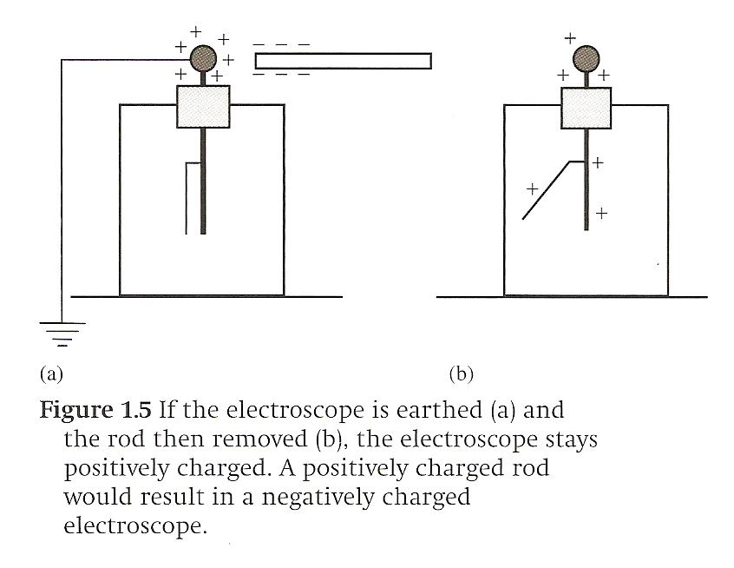
Charging by Induction Electroscope
Why did the electrons move to ground?

Slide 32
Charging by Induction Electroscope
Why did the electrons move to ground?
Electrons will always move to higher potential
When the negatively charged rod was brought near, positive moved to the ball while negative charge moved to the leaves giving them a negative charge
Ground, by definition, has a charge of zero
When grounded, charge will flow from negative potential to the higher zero potential

Slide 33
Electrostatic Experiments
In static electricity, i.e. a material is holding a charge, the charge on the conductor resides on the outside of the conductor
The net charge in the center remains zero

Slide 34
Electrostatic Experiments

Slide 35
Lsn 16-5: Coulomb’s Law Lsn 16-2: Solving Problems involving Coulomb’s law and vectors

Slide 36
Coulomb’s Law
Magnitude of the force between charges is directly proportional to the size of the charge, AND inversely proportional to the square of the distance between them

Slide 37
Coulomb’s Law
ε₀ is the electric permittivity of a vacuum
ε₀ = 8.85x10⁻¹² C² N⁻¹ m⁻²
k = 8.99x10⁹ N m² C⁻²
Notice the similarity
to Newton’s Law of
Universal Gravitation?

Slide 38
Coulomb’s Law
Sample Problem

Slide 39
Coulomb’s Law
How about with 4 particles arranged in a square 8 nm to a side, each with a +2 μC charge? What is the net force on A?
D
A
C
B

Slide 40
Coulomb’s Law
How about with 4 particles arranged in a square 8 nm to a side, each with a +2 μC charge? What is the net force on A?
F_{BA}
F_{CA}
D
A
F_{DA}
C
B

Slide 41
Learning Objective(s):
The student is able to construct an explanation of the two-charge model of electric charge based on evidence produced through scientific practices.
The student is able to make a qualitative prediction about the distribution of positive and negative electric charges within neutral systems as they undergo various processes.
The student is able to challenge claims that polarization of electric charge or separation of charge must result in a net charge on the object.

Slide 42
Learning Objective(s):
The student is able to challenge the claim that an electric charge smaller than the elementary charge has been isolated.
The student is able to use Coulomb’s law qualitatively and quantitatively to make predictions about the interaction between two electric point charges (interactions between collections of electric point charges are not covered in Physics 1 and instead are restricted to Physics 2).
The student is able to describe and make qualitative and/or quantitative predictions about everyday examples of systems with internal potential energy.

Slide 43
Learning Objective(s):
The student is able to connect the concepts of gravitational force and electric force to compare similarities and differences between the forces.
The student is able to make quantitative calculations of the internal potential energy of a system from a description or diagram of that system.
The student is able to apply mathematical reasoning to create a description of the internal potential energy of a system from a description or diagram of the objects and interactions in that system.

Slide 44
Learning Objective(s):
The student is able to predict electric charges on objects within a system by application of the principle of charge conservation within a system.
The student is able to design a plan to collect data on the electrical charging of objects and electric charge induction on neutral objects and qualitatively analyze that data.
The student is able to justify the selection of data relevant to an investigation of the electrical charging of objects and electric charge induction on neutral objects.

Slide 45
Enduring Understanding(s):
Electric charge is a property of an object or system that affects its interactions with other objects or systems containing charge.
Materials have many macroscopic properties that result from the arrangement and interactions of the atoms and molecules that make up the material.

Slide 46
Enduring Understanding(s):
At the macroscopic level, forces can be categorized as either long-range (action-at-a-distance) forces or contact forces.
The energy of a system is conserved.
The electric charge of a system is conserved.

Slide 47
Essential Knowledge(s):
There are only two kinds of electric charge. Neutral objects or systems contain equal quantities of positive and negative charge, with the exception of some fundamental particles that have no electric charge.
Like-charged objects and systems repel, and unlikecharged objects and systems attract.
Charged objects or systems may attract neutral systems by changing the distribution of charge in the neutral system.

Slide 48
Essential Knowledge(s):
The smallest observed unit of charge that can be isolated is the electron charge, also known as the elementary charge.
The magnitude of the elementary charge is equal to 1.6 ×10−19 coulombs.
Electrons have a negative elementary charge; protons have a positive elementary charge of equal magnitude, although the mass of a proton is much larger than the mass of an electron.

Slide 49
Essential Knowledge(s):
Matter has a property called electric permittivity.
Free space has a constant value of the permittivity that appears in physical relationships.
The permittivity of matter has a value different from that of free space.

Slide 50
Essential Knowledge(s):
Electric force results from the interaction of one object that has an electric charge with another object that has an electric charge.
Electric forces dominate the properties of the objects in our everyday experiences. However, the large number of particle interactions that occur make it more convenient to treat everyday forces in terms of nonfundamental forces called contact forces, such as normal force, friction, and tension.
Electric forces may be attractive or repulsive, depending upon the charges on the objects involved.

Slide 51
Essential Knowledge(s):
A system with internal structure can have potential energy. Potential energy exists within a system if the objects within that system interact with conservative forces.
The change in electric potential in a circuit is the change in potential energy per unit charge. [Physics 1: only in the context of circuits.]

Slide 52
Essential Knowledge(s):
The exchange of electric charges among a set of objects in a system conserves electric charge.
Charging by conduction between objects in a system conserves the electric charge of the entire system.
Charge separation in a neutral system can be induced by an external charged object placed close to the neutral system.
Grounding involves the transfer of excess charge to another larger system (e.g., the earth).

Slide 53
Big Idea(s):
Objects and systems have properties such as mass and charge. Systems may have internal structure.
The interactions of an object with other objects can be described by forces.
Changes that occur as a result of interactions are constrained by conservation laws.

Slide 54
Questions?

Slide 55
Homework
None!!! . . . but, there’s 17 problems in the next section

Slide 56
Stopped here on 8/27/14

