Slide 1
Devil Physics Baddest Class on Campus AP Physics

Slide 2
Lsn 3-5: Projectile Motion Lsn 3-6: solving Projectile Motion problems

Slide 3
VĬdÉÒs IntrÕdŰctÎÖnĀlĘ
Two-Dimensional Projectile Motion
Useful Applications of Projectile Motion

Slide 4
Big Idea(s):
Big Idea 3: The interactions of an object with other objects can be described by forces.
Big Idea 4: Interactions between systems can result in changes in those systems.

Slide 5
Enduring Understanding(s):
All forces share certain common characteristics when considered by observers in inertial reference frames.
The acceleration of the center of mass of a system is related to the net force exerted on the system, where

Slide 6
Essential Knowledge(s):
An observer in a particular reference frame can describe the motion of an object using such quantities as position, displacement, distance, velocity, speed, and acceleration.
Displacement, velocity, and acceleration are all vector quantities.
Displacement is change in position. Velocity is the rate of change of position with time. Acceleration is the rate of change of velocity with time. Changes in each property are expressed by subtracting initial values from final values.
A choice of reference frame determines the direction and the magnitude of each of these quantities.

Slide 7
Essential Knowledge(s):
Forces are described by vectors.
Forces are detected by their influence on the motion of an object.
Forces have magnitude and direction.
The linear motion of a system can be described by the displacement, velocity, and acceleration of its center of mass.

Slide 8
Essential Knowledge(s):
The acceleration is equal to the rate of change of velocity with time, and velocity is equal to the rate of change of position with time.
The acceleration of the center of mass of a system is directly proportional to the net force exerted on it by all objects interacting with the system and inversely proportional to the mass of the system.
Force and acceleration are both vectors, with acceleration in the same direction as the net force.

Slide 9
Learning Objective(s):
The student is able to express the motion of an object using narrative, mathematical, and graphical representations.
The student is able to design an experimental investigation of the motion of an object.

Slide 10
Learning Objective(s):
The student is able to analyze experimental data describing the motion of an object and is able to express the results of the analysis using narrative, mathematical, and graphical representations.
The student is able to represent forces in diagrams or mathematically using appropriately labeled vectors with magnitude, direction, and units during the analysis of a situation.

Slide 11
Learning Objective(s):
The student is able to make predictions about the motion of a system based on the fact that acceleration is equal to the change in velocity per unit time, and velocity is equal to the change in position per unit time.

Slide 12
Learning Objective(s):
The student is able to create mathematical models and analyze graphical relationships for acceleration, velocity, and position of the center of mass of a system and use them to calculate properties of the motion of the center of mass of a system.

Slide 13
Where We’ve Been
Chapter 2 – One Dimensional Motion

Slide 14
Horizontal Motion

Slide 15
Kinematic Equations for Horizontal Motion

Slide 16
Vertical Motion – Drop Problem

Slide 17
Vertical Motion with Vertical Velocity

Slide 18
Kinematic Equations
Horizontal
Vertical

Slide 19
Where We’ve Been
Chapter 3 – Vectors

Slide 20
Vectors and Scalars

Slide 21
Vector Addition - Graphically

Slide 22
Vector Subtraction - Graphically

Slide 23
Breaking Vectors Down Into Components

Slide 24
Adding Vectors Using Components

Slide 25
Putting It All Together

Slide 26
Two Dimensional Projectile Motion

Slide 27
Two Dimensional Projectile Motion

Slide 28
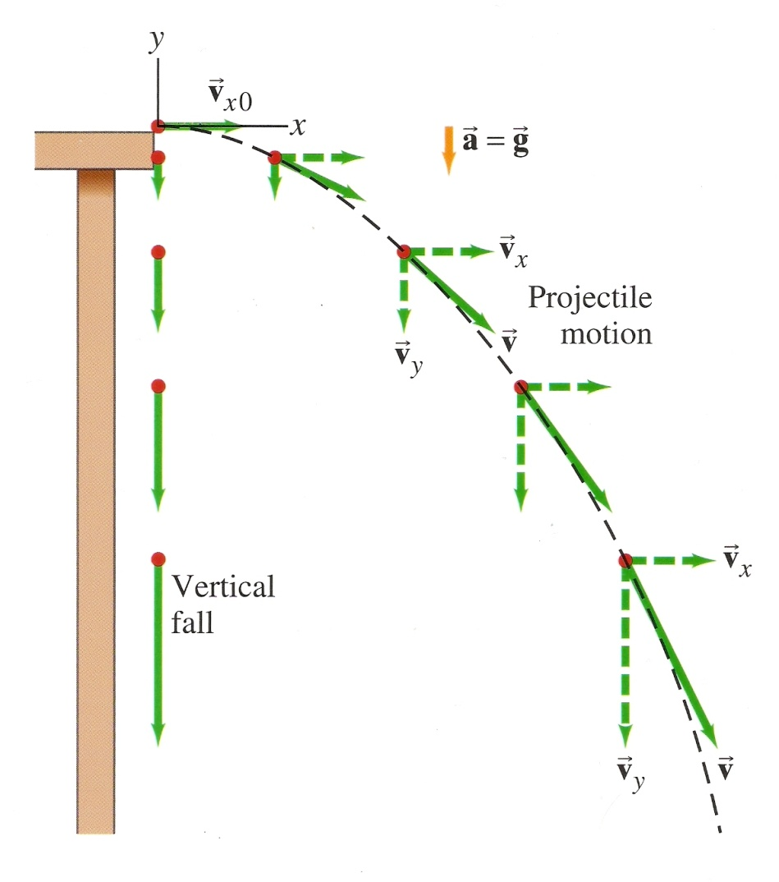
Thanks, Galileo

Slide 29
One Key Finding
How long it takes to fall down
Time to Fall

Slide 30
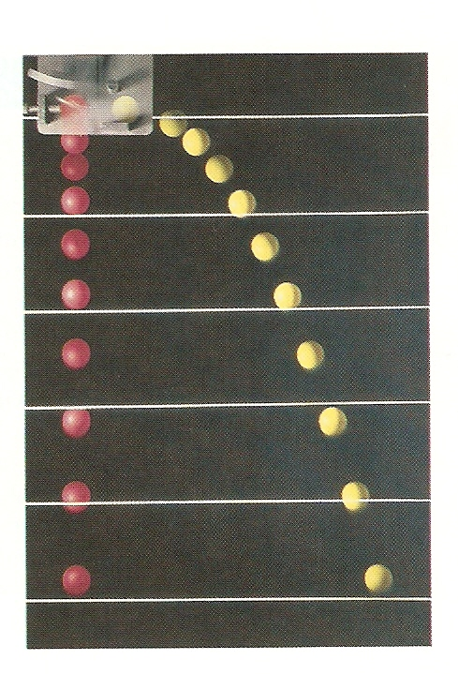
One Key Finding
The time it takes for an object to fall from a given height is the same whether it is simply dropped or if it begins with a horizontal velocity.

Slide 31
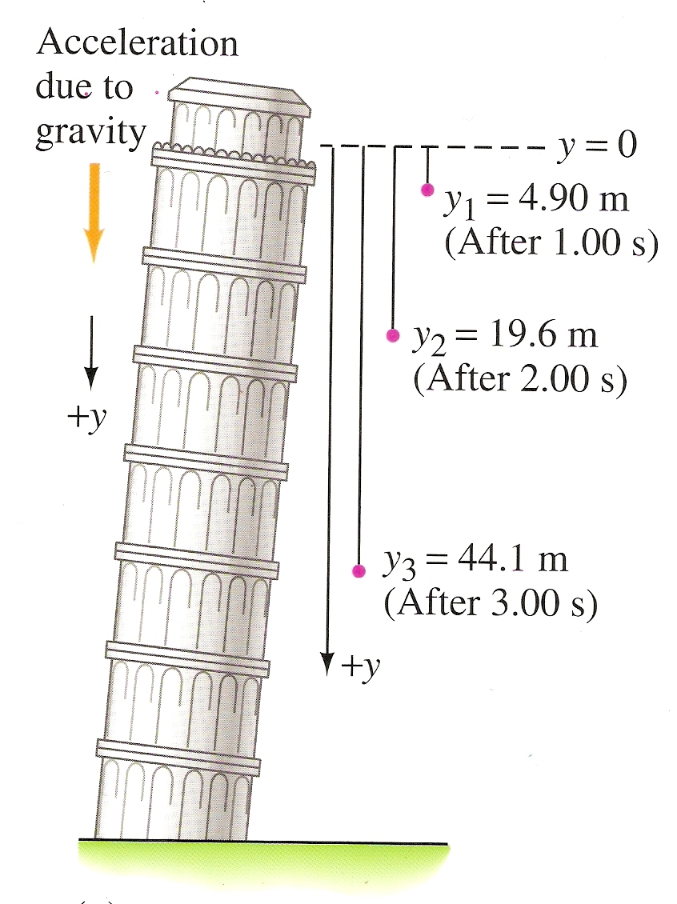
One Key Finding
The time it takes for an object to fall from a given height is the same whether it is simply dropped or if it begins with a horizontal velocity.

Slide 32
Kinematic Equations
Horizontal
Vertical

Slide 33
Assumptions
We consider its motion only after it has been projected and is moving freely through the air
We don’t consider the acceleration it took to reach that velocity
We consider air resistance to be negligible
When the object is moving through the air, both horizontally and vertically, it doesn’t slow down due to air resistance

Slide 34
Make the Math Easier
No horizontal acceleration, horizontal velocity remains constant
Vectors in Parabolic Motion
Y-axis positive up, gravity negative down

Slide 35
Kinematic Equations for Projectile Motion

Slide 36
Problem Solving Process – Extra Steps
Read the problem carefully and draw a picture
Choose origin and x-y coordinate system
If given an initial velocity, resolve it into x- and y-components. RIGHT NOW!!!
Analyze horizontal (x) and vertical (y) motion separately
Continue with problem solving process for kinematic equations

Slide 37
Helpful Hint
The time is always determined by the height, so do a vertical problem to determine time if you need to.

Slide 38
Manipulation of Variables
Projectile Motion Simulator

Slide 39
Sample Problems
Rolling Off A Cliff
Shooting A Canon

Slide 40
Learning Objective(s):
The student is able to express the motion of an object using narrative, mathematical, and graphical representations.
The student is able to design an experimental investigation of the motion of an object.

Slide 41
Learning Objective(s):
The student is able to analyze experimental data describing the motion of an object and is able to express the results of the analysis using narrative, mathematical, and graphical representations.
The student is able to represent forces in diagrams or mathematically using appropriately labeled vectors with magnitude, direction, and units during the analysis of a situation.

Slide 42
Learning Objective(s):
The student is able to make predictions about the motion of a system based on the fact that acceleration is equal to the change in velocity per unit time, and velocity is equal to the change in position per unit time.

Slide 43
Learning Objective(s):
The student is able to create mathematical models and analyze graphical relationships for acceleration, velocity, and position of the center of mass of a system and use them to calculate properties of the motion of the center of mass of a system.

Slide 44
Summary Video
Projectile Motion Concepts

Slide 45
Homework
#17-33

