Slide 1
AP physics

Slide 2
Giancoli Lesson 6-1, Work Done by a constant force Lesson 6-2, Work Done by a Varying force

Slide 3
Big Idea(s):
The interactions of an object with other objects can be described by forces.
Interactions between systems can result in changes in those systems.
Changes that occur as a result of interactions are constrained by conservation laws.

Slide 4
Enduring Understanding(s):
Interactions with other objects or systems can change the total energy of a system.
The energy of a system is conserved.

Slide 5
Essential Knowledge(s):
Mechanical energy (the sum of kinetic and potential energy) is transferred into or out of a system when an external force is exerted on a system such that a component of the force is parallel to its displacement. The process through which the energy is transferred is called work.
If the force is constant during a given displacement, then the work done is the product of the displacement and the component of the force parallel or antiparallel to the displacement.
Work (change in energy) can be found from the area under a graph of the magnitude of the force component parallel to the displacement versus displacement.

Slide 6
Essential Knowledge(s):
A system with internal structure can have potential energy. Potential energy exists within a system if the objects within that system interact with conservative forces.
The work done by a conservative force is independent of the path taken. The work description is used for forces external to the system. Potential energy is used when the forces are internal interactions between parts of the system.

Slide 7
Essential Knowledge(s):
Energy can be transferred by an external force exerted on an object or system that moves the object or system through a distance; this energy transfer is called work. Energy transfer in mechanical or electrical systems may occur at different rates. Power is defined as the rate of energy transfer into, out of, or within a system. [A piston filled with gas getting compressed or expanded is treated in Physics 2 as a part of thermodynamics.]

Slide 8
Learning Objective(s):
The student is able to make predictions about the changes in the mechanical energy of a system when a component of an external force acts parallel or antiparallel to the direction of the displacement of the center of mass.
The student is able to design an experiment and analyze data to examine how a force exerted on an object or system does work on the object or system as it moves through a distance.

Slide 9
Learning Objective(s):
The student is able to design an experiment and analyze graphical data in which interpretations of the area under a force-distance curve are needed to determine the work done on or by the object or system.
The student is able to predict and calculate from graphical data the energy transfer to or work done on an object or system from information about a force exerted on the object or system through a distance.

Slide 10
Learning Objective(s):
The student is able to make claims about the interaction between a system and its environment in which the environment exerts a force on the system, thus doing work on the system and changing the energy of the system (kinetic energy plus potential energy).
The student is able to predict and calculate the energy transfer to (i.e., the work done on) an object or system from information about a force exerted on the object or system through a distance.

Slide 11
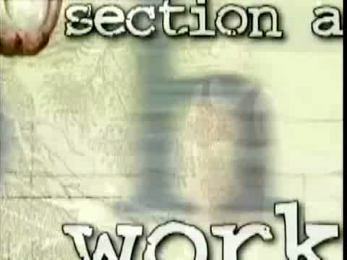
Introductory Video: Work

Slide 12
Work
General meanings for the term in everyday life
Very specific meaning in physics

Slide 13
Work
The work done on an object by a constant force (constant in magnitude and direction) is defined to be the product of the magnitude of the displacement and the component of the force parallel to the displacement
F_{P} = 40 N

Slide 14
Work
The work done on an object by a constant force (constant in magnitude and direction) is defined to be the product of the magnitude of the displacement and the component of the force parallel to the displacement
F_{P} = 60 N
θ=40º

Slide 15
Work
The work done on an object by a constant force (constant in magnitude and direction) is defined to be the product of the magnitude of the displacement and the component of the force parallel to the displacement
F_{P} = 60 N
θ=40º
F_{Px} = 46 N

Slide 16
Work
Work is a scalar quantity, only magnitude
Unit of measure for work is the joule (J)
1J = 1N·m = 1 kg m²/s²
W = Fd = (m x a) x d
(kg) (m/s²) (m) = kg m²/s²

Slide 17
Work
Can you exert a force without doing work?

Slide 18
Work
Can you exert a force without doing work?
A book sitting on a table: force of gravity and normal force, but no displacement

Slide 19
Work
Can you exert a force without doing work?
A book sitting on a table: force of gravity and normal force, but no displacement
Carrying a stack of books across the room?

Slide 20
Work
Can you exert a force without doing work?
A book sitting on a table: force of gravity and normal force, but no displacement
Carrying a stack of books across the room
No work done on the books by your arms because the applied force is normal to the displacement
However, your feet do work on the floor and friction does work on your feet

Slide 21
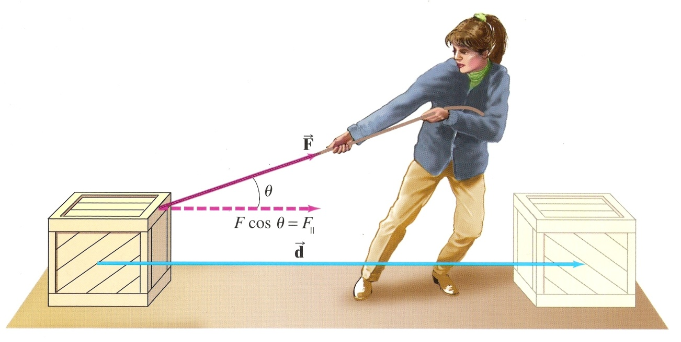
Work
What forces are applied here and what work is being done?

Slide 22
Work
What forces are applied here and what work is being done?
F_{g} = mg

Slide 23
Work
What forces are applied here and what work is being done?
F_{g} = mg

Slide 24
Work
What forces are applied here and what work is being done?
F_{N} = mg?
F_{g} = mg

Slide 25
Work
What forces are applied here and what work is being done?
F_{N} = mg?
F_{g} = mg

Slide 26
Work
What forces are applied here and what work is being done?
F_{P-Y} = F_{P} sinθ
F_{N} = mg?
F_{P-Y}
F_{P-Y}
F_{g} = mg

Slide 27
Work
What forces are applied here and what work is being done?
F_{N} = mg - F_{P} sinθ
F_{P-Y}
F_{g} = mg

Slide 28
Work
What forces are applied here and what work is being done?
F_{N} = mg - F_{P} sinθ
F_{P-Y}
F_{f}
F_{g} = mg

Slide 29
Work
What forces are applied here and what work is being done?
F_{N} = mg - F_{P} sinθ
F_{P-Y}
F_{f}
F_{p-x} = F_{P} cos θ
F_{g} = mg

Slide 30
Work
What forces are applied here and what work is being done?
F_{N} = mg - F_{P} sinθ
F_{P-Y}
F_{f}
F_{p-x} = F_{P} cos θ
F_{g} = mg

Slide 31
Work
What forces are applied here and what work is being done?
F_{N} = mg - F_{P} sinθ
F_{P-Y}
F_{f}
Work is only done in the x-direction. No work done in y-direction
F_{p-x} = F_{P} cos θ
F_{g} = mg

Slide 32
Work
What forces are applied here and what work is being done?

Slide 33
Work
What forces are applied here and what work is being done?
Hiker

Slide 34
Work
What forces are applied here and what work is being done?
Hiker

Slide 35
Work
What forces are applied here and what work is being done?
Gravity

Slide 36
Work
What forces are applied here and what work is being done? Note: W_{net} = W_{Hiker} – W_{gravity} = 0

Slide 37
Work Done By A Varying Force
Examples:
Rocket overcoming steadily decreasing gravity force as it moves away from earth
Force of a spring increases as its length increases
Force used to pull a cart up an uneven hill

Slide 38
Work Done By A Varying Force
Work can be determined graphically
The area under a force-distance graph is equal to work

Slide 39
Learning Objective(s):
The student is able to make predictions about the changes in the mechanical energy of a system when a component of an external force acts parallel or antiparallel to the direction of the displacement of the center of mass.
The student is able to design an experiment and analyze data to examine how a force exerted on an object or system does work on the object or system as it moves through a distance.

Slide 40
Learning Objective(s):
The student is able to design an experiment and analyze graphical data in which interpretations of the area under a force-distance curve are needed to determine the work done on or by the object or system.
The student is able to predict and calculate from graphical data the energy transfer to or work done on an object or system from information about a force exerted on the object or system through a distance.

Slide 41
Learning Objective(s):
The student is able to make claims about the interaction between a system and its environment in which the environment exerts a force on the system, thus doing work on the system and changing the energy of the system (kinetic energy plus potential energy).
The student is able to predict and calculate the energy transfer to (i.e., the work done on) an object or system from information about a force exerted on the object or system through a distance.

Slide 42
Essential Knowledge(s):
Mechanical energy (the sum of kinetic and potential energy) is transferred into or out of a system when an external force is exerted on a system such that a component of the force is parallel to its displacement. The process through which the energy is transferred is called work.
If the force is constant during a given displacement, then the work done is the product of the displacement and the component of the force parallel or antiparallel to the displacement.
Work (change in energy) can be found from the area under a graph of the magnitude of the force component parallel to the displacement versus displacement.

Slide 43
Essential Knowledge(s):
A system with internal structure can have potential energy. Potential energy exists within a system if the objects within that system interact with conservative forces.
The work done by a conservative force is independent of the path taken. The work description is used for forces external to the system. Potential energy is used when the forces are internal interactions between parts of the system.

Slide 44
Essential Knowledge(s):
Energy can be transferred by an external force exerted on an object or system that moves the object or system through a distance; this energy transfer is called work. Energy transfer in mechanical or electrical systems may occur at different rates. Power is defined as the rate of energy transfer into, out of, or within a system. [A piston filled with gas getting compressed or expanded is treated in Physics 2 as a part of thermodynamics.]

Slide 45
Enduring Understanding(s):
Interactions with other objects or systems can change the total energy of a system.
The energy of a system is conserved.

Slide 46
Big Idea(s):
The interactions of an object with other objects can be described by forces.
Interactions between systems can result in changes in those systems.
Changes that occur as a result of interactions are constrained by conservation laws.

Slide 47
Questions?

Slide 48
Homework
#1-14

