Slide 1
Devil physics The baddest class on campus AP Physics

Slide 2
Giancoli Lesson 3-1 to 3-3 Vectors and scalars Addition of Vectors – Graphical Method Subtraction of Vectors and Multiplication of a Vector by a Scalar

Slide 3
Big Idea(s):
Big Idea 3: The interactions of an object with other objects can be described by forces.

Slide 4
Enduring Understanding(s):
Enduring Understanding 3.A: All forces share certain common characteristics when considered by observers in inertial reference frames.
Enduring Understanding 3.B: Classically, the acceleration of an object interacting with other objects can be predicted by using

Slide 5
Essential Knowledge(s):
Forces are described by vectors.
Forces are detected by their influence on the motion of an object.
Forces have magnitude and direction.
If an object of interest interacts with several other objects, the net force is the vector sum of the individual forces.

Slide 6
Learning Objective(s):
The student is able to represent forces in diagrams or mathematically using appropriately labeled vectors with magnitude, direction, and units during the analysis of a situation.

Slide 7
Learning Objective(s):
The student is able to design a plan to collect and analyze data for motion (static, constant, or accelerating) from force measurements and carry out an analysis to determine the relationship between the net force and the vector sum of the individual forces.

Slide 8
Scalars and Vectors

Slide 9
Scalars
Require only a number to represent them
No direction involved
Just a number
Represents magnitude

Slide 10
Vectors
Cannot be fully specified without both a number (magnitude) and direction
Represented by an arrow from left to right over the variable
Two vectors are equal only if both their magnitude and direction are the same

Slide 11
Examples of Vectors and Scalars

Slide 12
Multiplying a Vector by a Scalar
Multiplication of a vector by a scalar only affects the magnitude and not the direction

Slide 13
Adding vectors

Slide 14
Adding Vectors

Slide 15
Subtracting Vectors

Slide 16
Adding Vectors

Slide 17
Adding Vectors Parallelogram Method

Slide 18
Adding Vectors Parallelogram Method

Slide 19
Adding Vectors Parallelogram Method

Slide 20
Adding Vectors Parallelogram Method

Slide 21
Adding Vectors Parallelogram Method

Slide 22
Adding Vectors Parallelogram Method

Slide 23
Adding Vectors Parallelogram Method

Slide 24
Adding Vectors Head-To-Tail Method

Slide 25
Adding Vectors Head-To-Tail Method

Slide 26
Adding Vectors Head-To-Tail Method

Slide 27
Adding Vectors Head-To-Tail Method

Slide 28
Adding Vectors Head-To-Tail Method

Slide 29
Adding Vectors Head-To-Tail Method

Slide 30
Adding Vectors Head-To-Tail Method

Slide 31
Adding Vectors Head-To-Tail Method

Slide 32
Adding Vectors Head-To-Tail Method

Slide 33
Adding Vectors Head-To-Tail Method

Slide 34
Adding Vectors Head-To-Tail Method

Slide 35
Adding Vectors Head-To-Tail Method

Slide 36
Adding Vectors Head-To-Tail Method

Slide 37
Adding Vectors Head-To-Tail Method

Slide 38
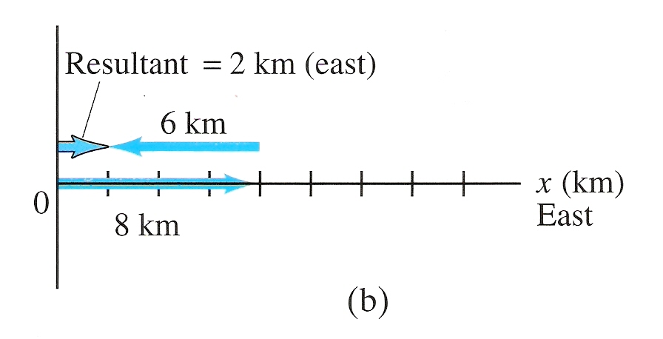
Subtracting Vectors

Slide 39
Subtracting Vectors Head-To-Tail Method

Slide 40
Subtracting Vectors Head-To-Tail Method

Slide 41
Adding Vectors Head-To-Tail by Components

Slide 42
Adding Vectors Head-To-Tail by Components

Slide 43
Adding Vectors Head-To-Tail by Components

Slide 44
Adding Vectors Head-To-Tail by Components

Slide 45
Adding Vectors Head-To-Tail by Components

Slide 46
Adding Vectors Head-To-Tail by Components

Slide 47
Adding Vectors Head-To-Tail by Components

Slide 48
Adding Vectors Head-To-Tail by Components

Slide 49
Adding Vectors Head-To-Tail by Components

Slide 50
Adding Vectors Head-To-Tail by Components

Slide 51
Adding Vectors Head-To-Tail by Components

Slide 52
Adding Vectors Head-To-Tail by Components

Slide 55
Simple, Right?

Slide 56
Solve for x = 3

Slide 57
This gives magnitude. What about direction?

Slide 58
Trigonometry Revisited

Slide 59
Learning Objective(s):
The student is able to represent forces in diagrams or mathematically using appropriately labeled vectors with magnitude, direction, and units during the analysis of a situation.

Slide 60
Learning Objective(s):
The student is able to design a plan to collect and analyze data for motion (static, constant, or accelerating) from force measurements and carry out an analysis to determine the relationship between the net force and the vector sum of the individual forces.

Slide 61
Enduring Understanding(s):
Enduring Understanding 3.A: All forces share certain common characteristics when considered by observers in inertial reference frames.
Enduring Understanding 3.B: Classically, the acceleration of an object interacting with other objects can be predicted by using

Slide 62
Essential Knowledge(s):
Forces are described by vectors.
Forces are detected by their influence on the motion of an object.
Forces have magnitude and direction.
If an object of interest interacts with several other objects, the net force is the vector sum of the individual forces.

Slide 63
Big Idea(s):
Big Idea 3: The interactions of an object with other objects can be described by forces.

Slide 64
Questions?

Slide 65
Homework
No Homework
At least not yet
Trigonometry for Vectors Worksheet
Reading Activity Lsn 3-4
After 3-4, HW Lsn 3-2 to 3-4, # 1-16

