Slide 1

Devil physics
The baddest class on campus
AP Physics

Slide 2
2-1: Reference Frames and displacement
2-2: Average Velocity
2-3: Instantaneous velocity

Slide 3
Big Idea
Big Idea 3: The interactions of an object with other objects can be described by forces.

Slide 4
Enduring Understanding
Enduring Understanding 3.A: All forces share certain common characteristics when considered by observers in inertial reference frames.

Slide 5
Essential Knowledge
Essential Knowledge 3.A.1: An observer in a particular reference frame can describe the motion of an object using such quantities as position, displacement, distance, velocity, speed, and acceleration.

Slide 6
Essential Knowledge
  Displacement, velocity, and acceleration are all vector quantities.
  Displacement is change in position. Velocity is the rate of change of position with time. Acceleration is the rate of change of velocity with time. Changes in each property are expressed by subtracting initial values from final values.
  A choice of reference frame determines the direction and the magnitude of each of these quantities.

Slide 7
Learning Objectives
(3.A.1.1): The student is able to express the motion of an object using narrative, mathematical, and graphical representations.
(3.A.1.2): The student is able to design an experimental investigation of the motion of an object.

Slide 8
Learning Objectives
(3.A.1.3): The student is able to analyze experimental data describing the motion of an object and is able to express the results of the analysis using narrative, mathematical, and graphical representations.

Slide 9
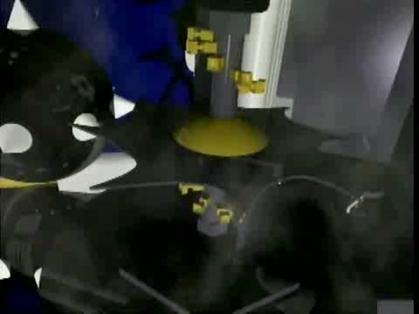
Introductory Video: Displacement, Velocity and Acceleration

Slide 10
Mechanics
The study of the motion of objects and the related concepts of force and energy.
Galileo Galilee (1564-1642)
Sir Isaac Newton (1642-1727)
Building blocks of all areas of modern physics

Slide 11
Mechanics
Two major divisions:
  Kinematics: description of how things move
  Dynamics: force and why things move the way they do
Chapters 2 and 3 deal with kinematics

Slide 12
Translational Motion
Objects that move without rotating
Moves along a straight-line path
One-dimensional motion

Slide 13
Translational Motion

Slide 14
Translational Motion

Slide 15
Frame of Reference
The point from which you are viewing something
The point from which you are measuring something
We normally place a set of coordinate axes (a coordinate plane) with the origin resting on the reference point

Slide 16
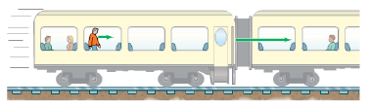
Frame of Reference
A train is moving from left to right at 20 m/s. A man walks toward the front of the train at 3 m/s.
  To an observer outside the train, how fast and in what direction is the seated woman moving?

Slide 17
Frame of Reference
A train is moving from left to right at 20 m/s. A man walks toward the front of the train at 3 m/s.
  To an observer outside the train, how fast and in what direction is the seated woman moving?
    20 m/s from left to right

Slide 18
Frame of Reference
A train is moving from left to right at 20 m/s. A man walks toward the front of the train at 3 m/s.
  To an observer outside the train, how fast and in what direction is the walking man moving?

Slide 19
Frame of Reference
A train is moving from left to right at 20 m/s. A man walks toward the front of the train at 3 m/s.
  To an observer outside the train, how fast and in what direction is the walking man moving?
    23 m/s from left to right

Slide 20
Frame of Reference
A train is moving from left to right at 20 m/s. A man walks toward the front of the train at 3 m/s.
  To the seated observer on the right, how fast and in what direction is the walking man moving?

Slide 21
Frame of Reference
A train is moving from left to right at 20 m/s. A man walks toward the front of the train at 3 m/s.
  To the seated observer on the right, how fast and in what direction is the walking man moving?
    3 m/s toward him

Slide 22
Frame of Reference
A train is moving from left to right at 20 m/s. A man walks toward the front of the train at 3 m/s.
  To the walking man , how fast and in what direction is the seated observer moving?

Slide 23
Frame of Reference
A train is moving from left to right at 20 m/s. A man walks toward the front of the train at 3 m/s.
  To the walking man , how fast and in what direction is the seated observer moving?
    3 m/s toward him

Slide 24
Frame of Reference
A train is moving from left to right at 20 m/s. A man walks toward the front of the train at 3 m/s.
  To the walking man, how fast and in what direction is an observer outside the train moving?

Slide 25
Frame of Reference
A train is moving from left to right at 20 m/s. A man walks toward the front of the train at 3 m/s.
  To the walking man, how fast and in what direction is an observer outside the train moving?
    23 m/s from the walking man’s left to his right

Slide 26
Distance vs. Displacement
Distance: measurement of the entire length travelled without respect to direction
  Includes magnitude only, a scalar
Displacement: change in position of an object, or, how far the object is from its original position and in what direction
  Includes both magnitude and direction, a vector

Slide 27
Distance vs. Displacement
Pike’s Peak Marathon
Pikes Peak
14,110 ft
7,610 ft
1.44 mi
Manitou Springs
6,500 ft

Slide 28
Distance vs. Displacement
Pike’s Peak Marathon
Distance: 14.1 mi
Pikes Peak
14,110 ft
7,610 ft
1.44 mi
Manitou Springs
6,500 ft

Slide 29
Distance vs. Displacement
Pike’s Peak Marathon
Distance: 14.1 mi
Displacement
Pikes Peak
14,110 ft
7,610 ft
1.44 mi
Manitou Springs
6,500 ft
θ

Slide 30
Scalar vs. Vector
Distance: 14.1 mi
Displacement
Pikes Peak
14,110 ft
7,610 ft
1.44 mi
Manitou Springs
6,500 ft
θ

Slide 31
Displacement
“The change in position is equal to the second position minus the first position”
Example 1: You are standing on a number line at 23 and suffer a blow to the head. When you wake up, you are laying at -17. What was your displacement?

Slide 32
Displacement
“The change in position is equal to the second position minus the first position”
Example 1: You are standing on a number line at 23 and suffer a blow to the head. When you wake up, you are laying at -17. What was your displacement?

Slide 33
Displacement
Example 1: You are standing on a number line at 23 and suffer a blow to the head. When you wake up, you are laying at -17. What was your displacement?
Your displacement is 40 to the left

Slide 34
Displacement
Example 2: Having nothing better to do, you walk 3 miles east and 4 miles north.
  What distance did you travel?
  What was your displacement?
  Why couldn’t you find anything better to do?
4 mi
3 mi

Slide 35
Displacement
Example 2: Having nothing better to do, you walk 3 miles east and 4 miles north.
  What distance did you travel?
    7 mi
  What was your displacement?
4 mi
3 mi

Slide 36
Displacement
Example 2: Having nothing better to do, you walk 3 miles east and 4 miles north.
  What was your displacement?
    Pythagorize 5 mi
  Why couldn’t you find anything better to do?
4 mi
3 mi

Slide 37
Displacement
Example 2: Having nothing better to do, you walk 3 miles east and 4 miles north.
  Why couldn’t you find anything better to do?
    You had already finished all your physics homework!
4 mi
3 mi

Slide 38
Speed
Distance traveled in a given time interval
Distance per unit time
60 mph, 35 m/s
Vector or scalar?

Slide 39
Average Speed
Distance travelled divided by time elapsed
Avg. speed = distance travelled/time elapsed

Slide 40
Velocity
Displacement traveled in a given time interval
Displacement per unit time
60 mph, 35 m/s
Vector or scalar?

Slide 41
Average Velocity
Displacement divided by time elapsed
Avg. velocity = displacement/time elapsed

Slide 42
Speed vs. Velocity
Distance: 14.1 mi
Displacement
Pikes Peak
14,110 ft
7,610 ft
1.44 mi
Manitou Springs
6,500 ft
θ

Slide 43
Speed vs. Velocity
Can the magnitude of the velocity ever be more than speed for any given timed movement of a body?

Slide 44
Speed vs. Velocity
Can the magnitude of the velocity ever be more than speed for any given timed movement of a body?
Distance equals displacement
Distance is greater than or equal to displacement but never less than displacement

Slide 45
Speed vs. Velocity
Can the magnitude of the velocity ever be more than speed for any given timed movement of a body?
Since distance is always greater than or equal to displacement
And since speed is distance/time
And since velocity is displacement/time
Speed will always be greater than or equal to velocity

Slide 46
Avg. Velocity: The Equation

Slide 47
Avg. Velocity: The Equation

Slide 48
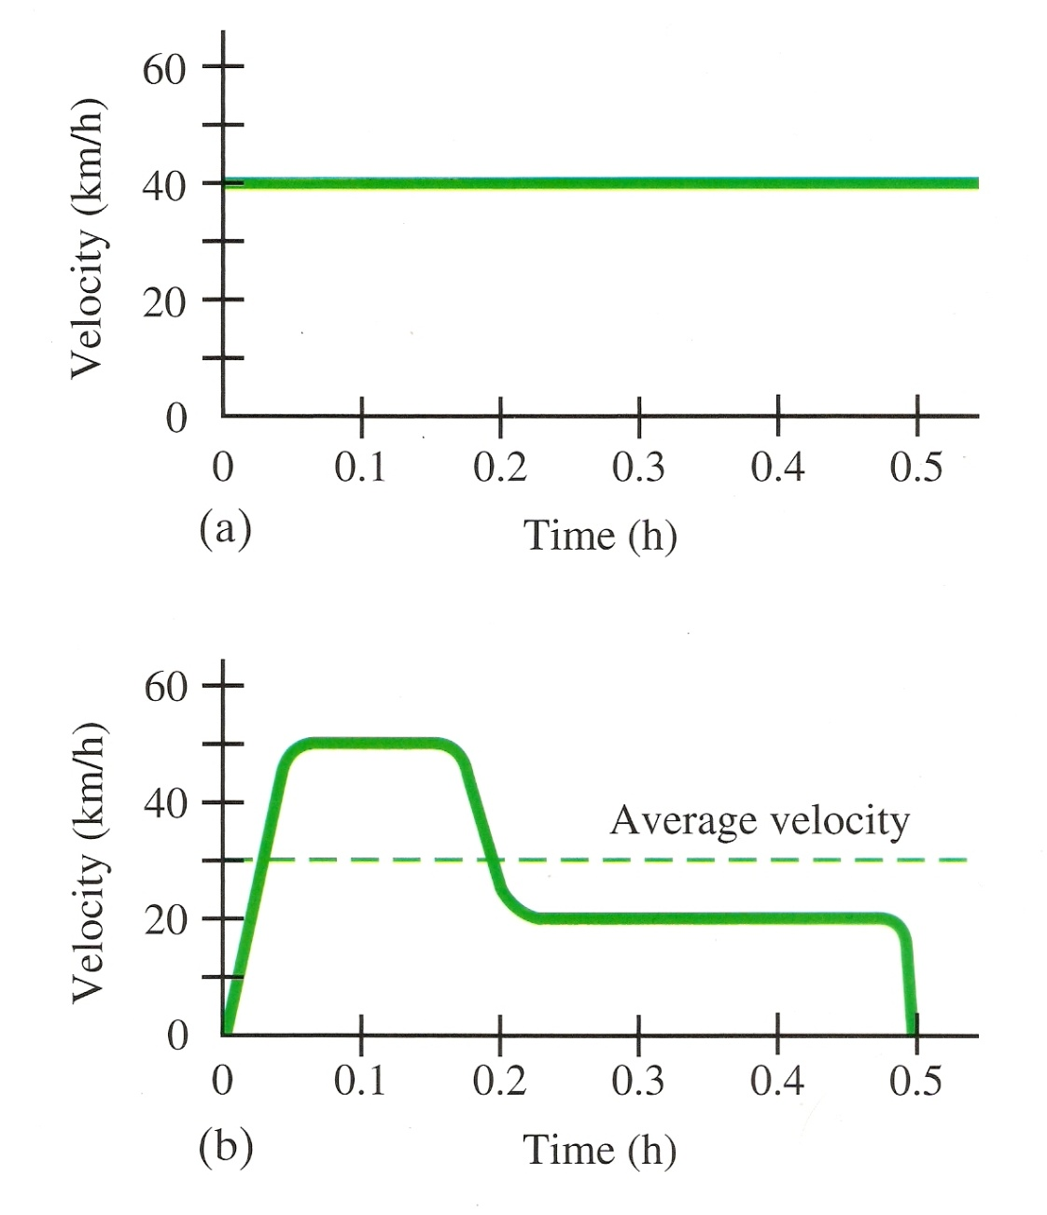
Average Velocity of a Car

Slide 49
Average Velocity – Air Track
Steven Le has my photogates!

Slide 50
Instantaneous Velocity
Velocity at a split second of time
The average velocity of an infinitesimally short time interval

Slide 51
Instantaneous Velocity: The Equation

Slide 52
Instantaneous Velocity – Air Track
Steven Le has my photogates!

Slide 53
Instantaneous Velocity
Instantaneous speed will always equal the magnitude of the instantaneous velocity. Why?

Slide 54
Instantaneous Velocity
Instantaneous speed will always equal the magnitude of the instantaneous velocity. Why?
When distance/displacement become infinitesimally small, their difference also becomes infinitesimally small, approaching zero

Slide 55
Learning Objectives
(3.A.1.1): The student is able to express the motion of an object using narrative, mathematical, and graphical representations.
(3.A.1.2): The student is able to design an experimental investigation of the motion of an object.

Slide 56
Learning Objectives
(3.A.1.3): The student is able to analyze experimental data describing the motion of an object and is able to express the results of the analysis using narrative, mathematical, and graphical representations.

Slide 57
Essential Knowledge
Essential Knowledge 3.A.1: An observer in a particular reference frame can describe the motion of an object using such quantities as position, displacement, distance, velocity, speed, and acceleration.

Slide 58
Essential Knowledge
  Displacement, velocity, and acceleration are all vector quantities.
  Displacement is change in position. Velocity is the rate of change of position with time. Acceleration is the rate of change of velocity with time. Changes in each property are expressed by subtracting initial values from final values.
  A choice of reference frame determines the direction and the magnitude of each of these quantities.

Slide 59
Enduring Understanding
Enduring Understanding 3.A: All forces share certain common characteristics when considered by observers in inertial reference frames.

Slide 60
Big Idea
Big Idea 3: The interactions of an object with other objects can be described by forces.

Slide 61
Questions?

Slide 62
Homework
#1-14

