Slide 1
Devil physics The baddest class on campus IB Physics

Slide 2
Lsn 6-6: Mechanical energy and its conservation Lsn 6-7: Problem Solving Using Conservation of Mechanical energy

Slide 3
Questions From Reading Activity?

Slide 4
Big Idea(s):
Interactions between systems can result in changes in those systems.
Changes that occur as a result of interactions are constrained by conservation laws.

Slide 5
Enduring Understanding(s):
Interactions with other objects or systems can change the total energy of a system.
The energy of a system is conserved.

Slide 6
Enduring Understanding(s):
Certain quantities are conserved, in the sense that the changes of those quantities in a given system are always equal to the transfer of that quantity to or from the system by all possible interactions with other systems.

Slide 7
Essential Knowledge(s):
The energy of a system includes its kinetic energy, potential energy, and microscopic internal energy. Examples should include gravitational potential energy, elastic potential energy, and kinetic energy.

Slide 8
Essential Knowledge(s):
The internal energy of a system includes the kinetic energy of the objects that make up the system and the potential energy of the configuration of the objects that make up the system.
Since energy is constant in a closed system, changes in a system’s potential energy can result in changes to the system’s kinetic energy.
The changes in potential and kinetic energies in a system may be further constrained by the construction of the system.

Slide 9
Learning Objective(s):
The student is able to calculate the total energy of a system and justify the mathematical routines used in the calculation of component types of energy within the system whose sum is the total energy.
The student is able to predict changes in the total energy of a system due to changes in position and speed of objects or frictional interactions within the system.

Slide 10
Learning Objective(s):
The student is able to describe and make predictions about the internal energy of systems.
The student is able to calculate changes in kinetic energy and potential energy of a system, using information from representations of that system.

Slide 11
Introductory Video Conservation of Energy Song

Slide 12
Conservation of Energy
Energy cannot be created or destroyed.
Instead, it is transformed into other forms of energy or even matter.
Energy is said to be conserved.

Slide 13
Conservation of Energy
When we say energy is “lost” due to friction or other resistance forces, we really mean it has been transformed into a form that is not usable.

Slide 14
Conservation of Mechanical Energy
Mechanical energy consists of kinetic and potential energy.
Mechanical energy is a product of conservative forces.
Mechanical energy is conserved if only conservative forces are involved.

Slide 15
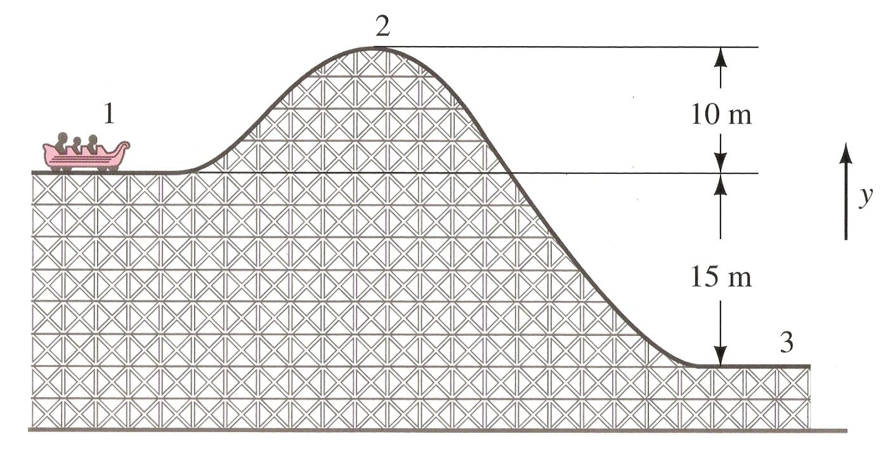
Conservation of Mechanical Energy
For a given system, the total mechanical energy will be the same at all points.
Sometimes kinetic energy will be high and potential energy will be low.
Other times potential energy will be high and kinetic energy will be low
Their sum, however will always be the same

Slide 16
Conservation of Mechanical Energy

Slide 17
Sample Problem 1: You drop a 3-kg rock off a 30-m building. How fast is it going when it hits Jeremy’s Dad’s new car?
Kinematics
Conservation of Energy

Slide 18
Sample Problem 1: You drop a 3-kg rock off a 30-m building. How fast is it going when it hits Jeremy’s Dad’s new car?
Kinematics
Conservation of Energy

Slide 19
Sample Problem 2: A pole vaulter accelerates to 9.3 m/s on the run-up. What is the maximum height we can expect her to clear?
Kinematics
Conservation of Energy

Slide 20
Sample Problem 2: A pole vaulter accelerates to 9.3 m/s on the run-up. What is the maximum height we can expect her to clear?
Kinematics
Conservation of Energy

Slide 21
Sample Problem 2: A pole vaulter accelerates to 9.3 m/s on the run-up. What is the maximum height we can expect her to clear?
Is our answer valid since we failed to take into consideration the elasticity or “springyness” of the pole?

Slide 22
Sample Problem 2: A pole vaulter accelerates to 9.3 m/s on the run-up. What is the maximum height we can expect her to clear?
Is our answer valid since we failed to take into consideration the elasticity or “springyness” of the pole?
Sure it is!
All of the kinetic energy of the run was translated into elastic potential energy in bending the pole.
The elastic potential energy of the pole was then translated into kinetic energy going upward.
The kinetic energy upward was then translated into height gain to clear the bar.
Since mechanical energy is conserved, the final energy equals the initial energy no matter what happens in between.

Slide 23
Sample Problem 3: The spring has a spring constant of 1250N/m. If the spring is compressed 2.5m, how fast will the 2000kg elephant be going when the spring is released and how high up the ramp will he travel?
Conservation of Energy

Slide 24
Sample Problem 3: The spring has a spring constant of 1250N/m. If the spring is compressed 2.5m, how fast will the 2000kg elephant be going when the spring is released and how high up the ramp will he travel?
Conservation of Energy

Slide 25
Sample Problem 3: The spring has a spring constant of 1250N/m. If the spring is compressed 2.5m, how fast will the 2000kg elephant be going when the spring is released and how high up the ramp will he travel??
Conservation of Energy

Slide 26
Sample Problem 4: Angela is standing on top of a building with a 5kg rock. She throws it up into the air at 5m/s. It goes up, then comes down and lands on a spring with a 350N/m spring constant that is 50m below Anna. The spring compresses and then extends sending the rock back at Angela at what velocity?
Your turn!!!

Slide 27
Sample Problem 4: Angela is standing on top of a building with a 5kg rock. She throws it up into the air at 5m/s. It goes up, then comes down and lands on a spring with a 350N/m spring constant that is 50m below Anna. The spring compresses and then extends sending the rock back at Angela at what velocity?
Think before you act!
Does the spring really matter

Slide 28
Sample Problem 4: Angela is standing on top of a building with a 5kg rock. She throws it up into the air at 5m/s. It goes up, then comes down and lands on a spring with a 350N/m spring constant that is 50m below Anna. The spring compresses and then extends sending the rock back at Angela at what velocity?
Think before you act!
Does the spring really matter?
No! If energy is conserved, the kinetic and potential energy at Angela’s height will equal the kinetic energy at the top of the spring.

Slide 29
Sample Problem 4: Angela is standing on top of a building with a 5kg rock. She throws it up into the air at 5m/s. It goes up, then comes down and lands on a spring with a 350N/m spring constant that is 50m below Anna. The spring compresses and then extends sending the rock back at Angela at what velocity?
Think before you act!
Do you need to use kinematic equations to find the rock’s speed as it passes Angela on the way down?

Slide 30
Sample Problem 4: Angela is standing on top of a building with a 5kg rock. She throws it up into the air at 5m/s. It goes up, then comes down and lands on a spring with a 350N/m spring constant that is 50m below Anna. The spring compresses and then extends sending the rock back at Angela at what velocity?
Think before you act!
Do you need to use kinematic equations to find the rock’s speed as it passes Angela on the way down?
No! It will be the same as it was going up only in the opposite direction!

Slide 31
Sample Problem 4: Anna is standing on top of a building with a 5kg rock. She throws it up into the air at 5m/s. It goes up, then comes down and lands on a spring with a 350N/m spring constant that is 50m below Anna. The spring compresses and then extends sending the rock back at Anna at what velocity?

Slide 32
Learning Objective(s):
The student is able to calculate the total energy of a system and justify the mathematical routines used in the calculation of component types of energy within the system whose sum is the total energy.
The student is able to predict changes in the total energy of a system due to changes in position and speed of objects or frictional interactions within the system.

Slide 33
Learning Objective(s):
The student is able to describe and make predictions about the internal energy of systems.
The student is able to calculate changes in kinetic energy and potential energy of a system, using information from representations of that system.

Slide 34
Essential Knowledge(s):
The energy of a system includes its kinetic energy, potential energy, and microscopic internal energy. Examples should include gravitational potential energy, elastic potential energy, and kinetic energy.

Slide 35
Essential Knowledge(s):
The internal energy of a system includes the kinetic energy of the objects that make up the system and the potential energy of the configuration of the objects that make up the system.
Since energy is constant in a closed system, changes in a system’s potential energy can result in changes to the system’s kinetic energy.
The changes in potential and kinetic energies in a system may be further constrained by the construction of the system.

Slide 36
Enduring Understanding(s):
Interactions with other objects or systems can change the total energy of a system.
The energy of a system is conserved.

Slide 37
Enduring Understanding(s):
Certain quantities are conserved, in the sense that the changes of those quantities in a given system are always equal to the transfer of that quantity to or from the system by all possible interactions with other systems.

Slide 38
Big Idea(s):
Interactions between systems can result in changes in those systems.
Changes that occur as a result of interactions are constrained by conservation laws.

Slide 39
Questions?

Slide 40
Homework
#33-44

