Slide 1

Devil physics
The baddest class on campus
AP Physics

Slide 2

Giancoli Lesson 10-3 to 10-6
 Pressure in Fluids
 Atmospheric pressure and gauge Pressure
 Pascal’s principle
 Measurement of pressure: Gauges and Barometer

Slide 3
Objectives
Know the relationship between pressure, force and area.
Know the relationship between fluid pressure, density and height (or depth) of the fluid.
Understand that fluid exerts a pressure in all directions.
Understand that fluid pressure at equal depths within a uniform liquid is the same.

Slide 4
Objectives
Understand that pressure exerts a pressure perpendicular to the surface it is in contact with.
Know the difference between gauge pressure and total pressure and solve problems involving both of them.
Apply Pascal’s principle to solve problems involving ‘mechanical advantage’.

Slide 5
Objectives
Name three different pressure gauges and how they work.
Convert different units of pressure.

Slide 6
Reading Activity Questions?

Slide 7
Pressure
Pressure, P, is defined as force per unit area where the force is understood to be acting perpendicular to the surface area, A

Slide 8
Volunteer from Audience
School puts a lot of pressure on students, but how much pressure does the student exert on the school?
  Mass = ______________
  F = mg = _____________
  A_{foot} = l x w x 2 = _______
  P = F/A = _____________

Slide 9
Volunteer from Audience
School puts a lot of pressure on students, but how much pressure does the student exert on the school?
  Mass = _____70kg_____
  F = mg = _____________
  A_{foot} = l x w x 2 = _______
  P = F/A = _____________

Slide 10
Volunteer from Audience
School puts a lot of pressure on students, but how much pressure does the student exert on the school?
  Mass = _____70kg_____
  F = mg = ___700N_____
  A_{foot} = l x w x 2 = _______
  P = F/A = _____________

Slide 11
Volunteer from Audience
School puts a lot of pressure on students, but how much pressure does the student exert on the school?
  Mass = _____70kg_____
  F = mg = ___700N_____
  A_{foot} = l x w x 2 = _.3x.1x2_
  P = F/A = _____________

Slide 12
Volunteer from Audience
School puts a lot of pressure on students, but how much pressure does the student exert on the school?
  Mass = _____70kg_____
  F = mg = ___700N_____
  A_{foot} = l x w x 2 = _.3x.1x2_
  P = F/A = _11,667 Pa____________

Slide 13
Volunteer #2 from Audience
What type of fluid pressure are students under and how does it impact students?
  Avg Cranial Diameter = ______________
  Radius = _____________
  A_{head} = πr² = __________
  P_{atm} = _______________
  F = PA = _____________

Slide 14
Volunteer #2 from Audience
What type of fluid pressure are students under and how does it impact students?
  Avg Cranial Diameter = ___0.13m___________
  Radius = _____________
  A_{head} = πr² = __ ________
  P_{atm} = _______________
  F = PA = _____________

Slide 15
Volunteer #2 from Audience
What type of fluid pressure are students under and how does it impact students?
  Avg Cranial Diameter = ___0.13m___________
  Radius = ____0.065m _______
  A_{head} = πr² = _______________
  P_{atm} = ____________________
  F = PA = __________________

Slide 16
Volunteer #2 from Audience
What type of fluid pressure are students under and how does it impact students?
  Avg Cranial Diameter = ___0.13m___________
  Radius = ____0.065m _______
  A_{head} = πr² = __0.0133m² _____
  P_{atm} = ____________________
  F = PA = _____________

Slide 17
Volunteer #2 from Audience
What type of fluid pressure are students under and how does it impact students?
  Avg Cranial Diameter = ___0.13m___________
  Radius = ____0.065m_________
  A_{head} = πr² = __0.0133m² ________
  P_{atm} = _1.013x10⁵ N/m² ______________
  F = PA = _____________

Slide 18
Volunteer #2 from Audience
What type of fluid pressure are students under and how does it impact students?
  Avg Cranial Diameter = ___0.13m___________
  Radius = ____0.065m _______
  A_{head} = πr² = __0.0133m² _____
  P_{atm} = ___1.013x10⁵ N/m² ____
  F = PA = _7,631,903 N _______

Slide 19
Pressure in Fluids
Fluid exerts a pressure in all directions
Fluid pressure is exerted perpendicular to whatever surface it is in contact with
Fluid pressure increases with depth

Slide 20
Pressure in Fluids
Think of a disk 5 cm (0.05 m) in diameter (A = πr² = 1.96 cm² = 0.00196 m² )
You place it in water 30 cm (0.30 m) below the surface
The pressure on that disk is equal to the weight of a column of water that has a 5 cm diameter and is 30 cm high (h = height of water)

Slide 21
Pressure in Fluids
Like a graduated cylinder
  A_{disk} = 0.00196 m²
  The volume of the cylinder is A x h (πr²h) = 589 cm³ = 5.89 x 10⁻⁴ m³

Slide 22
Pressure in Fluids
Like a graduated cylinder
  A_{disk} = 0.00196 m²
  V = 5.89 x 10⁻⁴ m³
  m = 0.589 kg

Slide 23
Pressure in Fluids
Like a graduated cylinder
  A_{disk} = 0.00196 m²
  V = 5.89 x 10⁻⁴ m³
  m = 0.589 kg
  F = 5.78 N
That’s way too much work!
How about a formula?

Slide 24
Pressure in Fluids
Like a graduated cylinder
  P = 2.9 x 10³ N/m²
That’s way too much work!
How about a formula?

Slide 25
Pressure in Fluids
Like a graduated cylinder
  P = 2.9 x 10³ N/m²

Slide 26
Pressure in Fluids
Pressure at equal depths within a uniform liquid is the same
IMPORTANT: The pressure the water exerts on an object at a certain depth is the same on all parts of a body.
In other words, if you hold a cube 30cm under water, each side of that cube will feel the same pressure exerted on it – not just the top, but the bottom and all four sides!!!

Slide 27
Pressure in Fluids
It follows from this that a change in depth is directly proportional to a change in pressure
Note: An important assumption here is that the fluid is incompressible, because if it were compressible, the density would change with depth!

Slide 28
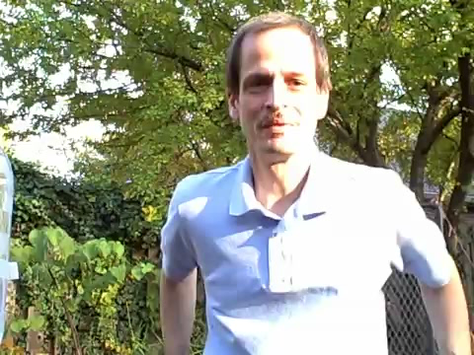
Pressure in Fluids

Slide 29
Pressure in Fluids
Let’s say you had a water tank 15m in diameter and was 20m tall. What would be the pressure at the bottom of the tank?

Slide 30
Pressure in Fluids
Let’s say you had a water tank 15m in diameter and was 20m tall. What would be the pressure at the bottom of the tank?

Slide 31
Pressure in Fluids
Let’s say you had two pipes attached to the tank, one 18 cm in diameter and the other 12 cm in diameter. What would be the difference in pressure between the two pipes?

Slide 32
Pressure in Fluids
Let’s say you had two pipes attached to the tank, one 18 cm in diameter and the other 12 cm in diameter. What would be the difference in pressure between the two pipes?
No difference

Slide 33
Pressure in Fluids
Let’s say you had a second tank that could hold twice as much water but was the same height. What would be the difference in pressure between the two tanks?

Slide 34
Pressure in Fluids
Let’s say you had a second tank that could hold twice as much water but was the same height. What would be the difference in pressure between the two tanks?
No difference

Slide 35
Atmospheric Pressure and Gauge Pressure
Atmospheric pressure is a function of elevation and weather conditions
  Elevation
    Higher elevation smaller column of air above
    Lower elevation larger column of air above
  Weather
    High temp = less dense
    High humidity = more dense

Slide 36
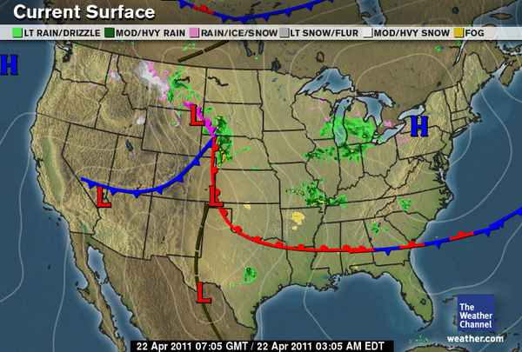
Atmospheric Pressure and Gauge Pressure
Atmospheric pressure is a function of elevation and weather conditions

Slide 37
Atmospheric Pressure and Gauge Pressure
Average atmospheric pressure is, well, 1 atmosphere, hence the name

Slide 38
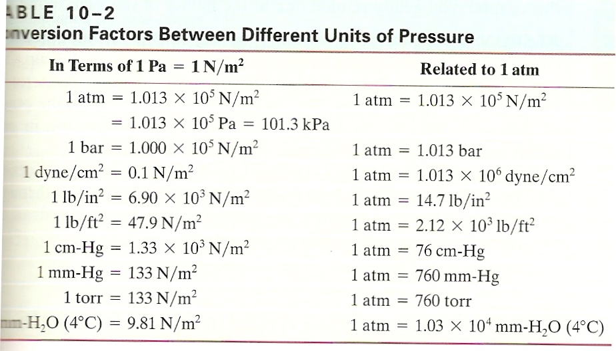
Atmospheric Pressure and Gauge Pressure
Units for pressure

Slide 39
Atmospheric Pressure and Gauge Pressure
Most pressure gauges read pressure over and above the atmospheric pressure
Total pressure is then equal to gauge pressure plus atmospheric pressure
Pressure limits correspond to the gauge readings

Slide 40
Atmospheric Pressure and Gauge Pressure
You put a tire gauge to your car tire and it reads 35 psi. What is the total pressure in your tire?

Slide 41
Atmospheric Pressure and Gauge Pressure
You put a tire gauge to your car tire and it reads 35 psi. What is the total pressure in your tire?

Slide 42
Atmospheric Pressure and Gauge Pressure
While we’re on tires, why does it say “Max Cold Inflation 35 psi” on the side?

Slide 43
Atmospheric Pressure and Gauge Pressure
While we’re on tires, why does it say “Max Cold Inflation 35 psi” on the side?
Because if it were written on the bottom, you couldn’t read it AND it would eventually wear off.

Slide 44
Atmospheric Pressure and Gauge Pressure
While we’re on tires, why does it say “Max Cold Inflation 35 psi” on the side?
Another reason is that as the tire heats up the pressure will increase and filling a cold tire to more than 35 psi, then getting the tire hotter could cause it to either explode or at least blow a bead.

Slide 45
Atmospheric Pressure and Gauge Pressure
One last tire question: The average car tire is inflated to 35-45 psi. What is the air pressure in a NASCAR vehicle or drag racer?

Slide 46
Atmospheric Pressure and Gauge Pressure
One last tire question: The average car tire is inflated to 35-45 psi. What is the air pressure in a NASCAR vehicle or drag racer?
They both use about 12 psi cold for two reasons:
  The tires heat up a lot and raise the pressure
  Keeping them somewhat flat to increase the amount of tire in contact with the track to give them more grip and avoid spinning the tires

Slide 47
Pascal’s Principle
The pressure applied to a confined fluid increases the pressure throughout the fluid by the same amount.
Examples
  A cube at the bottom of a bucket of water. It has the pressure of the water acting on it, but also the atmospheric pressure pushing on the water.
  The brake system in a car. You apply pressure via the brake pedal and that pressure gets transmitted via a fluid to the brake pads on the wheel

Slide 48
Pascal’s Principle
Demo Time

Slide 49
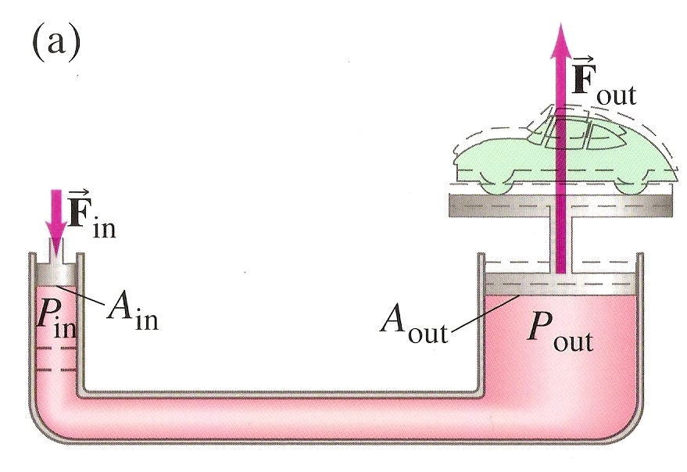
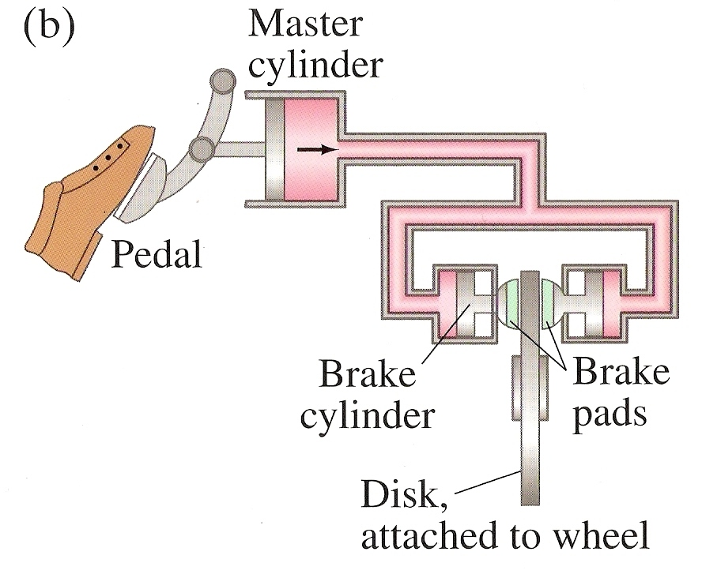
Pascal’s Principle
Examples

Slide 50
Pascal’s Principle
The pressure applied to a confined fluid increases the pressure throughout the fluid by the same amount.

Slide 51
Pascal’s Principle
If I want the force applied to my brakes to be 10 times the force I apply to the pedal, by what factor would the diameter of the piston at the brakes exceed that of the piston at the brake pedal?

Slide 52
Pascal’s Principle
If I want the force applied to my brakes to be 10 times the force I apply to the pedal, by what factor would the diameter of the piston at the brakes exceed that of the piston at the brake pedal?

Slide 53
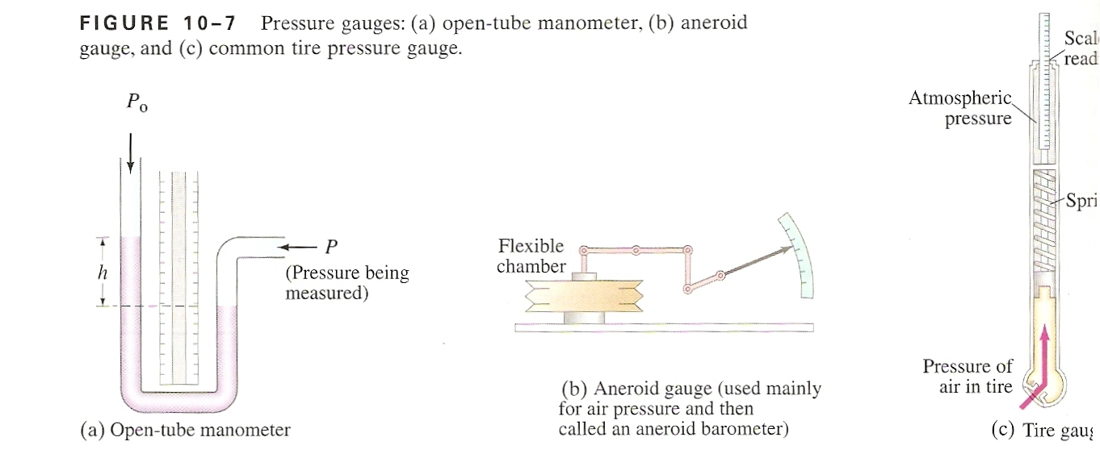
Pressure Gauges
Manometer
  U-shaped tube partially filled with liquid
  Difference in fluid height represents pressure measurement by

Slide 54
Pressure Gauges
Aneroid Gauge
  Pointer attached to a flexible chamber
  Changes in outside pressure will compress or expand the chamber which moves the pointer

Slide 55
Pressure Gauges
Tire Gauge
  When pressed against the tire valve stem, air pressure compresses the calibrated spring moving the scale bar (F = kx)
  Scale bar remains in place after pressure removed until manually reset

Slide 56
Barometers
Closed-End Mercury Manometer
  Standard atmospheric pressure will support a column of 76cm of mercury
  Changes in pressure calculated as deviations from this height

Slide 57
Summary Review
Do you know the relationship between pressure, force and area?
Do you know the relationship between fluid pressure, density and height (or depth) of the fluid?
Do you understand that fluid exerts a pressure in all directions?
Do you understand that fluid pressure at equal depths within a uniform liquid is the same?

Slide 58
Summary Review
Do you understand that pressure exerts a pressure perpendicular to the surface it is in contact with?
Do you know the difference between gauge pressure and total pressure and solve problems involving both of them?
Can you apply Pascal’s principle to solve problems involving ‘mechanical advantage’?

Slide 59
Summary Review
Can you name three different pressure gauges and how they work?
Can you convert different units of pressure?

Slide 60
Questions?

Slide 61
Homework
#7-17

Slide 62
Stopped here 4/10/14

