Slide 1

Devil physics
The baddest class on campus
AP Physics

Slide 2
18-1: The electric battery
18-2: Electric current
18-3: Ohm’s Law:Resistance and Resistors
18-4: Resistivity

Slide 3
Reading Activity Questions?

Slide 4
Big Idea(s):
Objects and systems have properties such as mass and charge. Systems may have internal structure.
Interactions between systems can result in changes in those systems.
Changes that occur as a result of interactions are constrained by conservation laws.

Slide 5
Enduring Understanding(s):
Electric charge is a property of an object or system that affects its interactions with other objects or systems containing charge.
The electric and magnetic properties of a system can change in response to the presence of, or changes in, other objects or systems.

Slide 6
Enduring Understanding(s):
The energy of a system is conserved.
Materials have many macroscopic properties that result from the arrangement and interactions of the atoms and molecules that make up the material.

Slide 7
Essential Knowledge(s):
Electric charge is conserved. The net charge of a system is equal to the sum of the charges of all the objects in the system.
  An electrical current is a movement of charge through a conductor.
  A circuit is a closed loop of electrical current.

Slide 8
Essential Knowledge(s):
The resistance of a resistor, and the capacitance of a capacitor, can be understood from the basic properties of electric fields and forces, as well as the properties of materials and their geometry.
  The current through a resistor is equal to the potential difference across the resistor divided by its resistance.

Slide 9
Essential Knowledge(s):
Matter has a property called resistivity.
  The resistivity of a material depends on its molecular and atomic structure.
  The resistivity depends on the temperature of the material.

Slide 10
Learning Objective(s):
The student is able to make claims about natural phenomena based on conservation of electric charge.
The student is able to choose and justify the selection of data needed to determine resistivity for a given material.

Slide 11
Learning Objective(s):
The student is able to make predictions, using the conservation of electric charge, about the sign and relative quantity of net charge of objects or systems after various charging processes, including conservation of charge in simple circuits.

Slide 12


Data Guide Equations
In Data Guide
  $\left|\vec{F_{E}}\right|=k\frac{\left|q_{1}q_{2}\right|}{r^{2}}$
  $I=\frac{∆q}{∆t}$
  $R=\frac{ρl}{A}$
  $I=\frac{∆V}{R}$
  $P=I∆V$
  ${R }_{s}=\sum_{i}{{R }_{i}}$
  $\frac{1}{{R }_{p}}=\sum_{i}{\frac{1}{{R }_{i}}}$
NOT in Data Guide
  $V=IR$

Slide 14
Batteries
Sources of Electricity
  battery - converts stored chemical energy into electrical energy
  generator – converts mechanical energy into electrical energy
  thermocouple – converts thermal energy into electrical energy
  photoelectric material – converts solar energy into electrical energy

Slide 15

Batteries: Practical Source of Electric Current

Slide 16
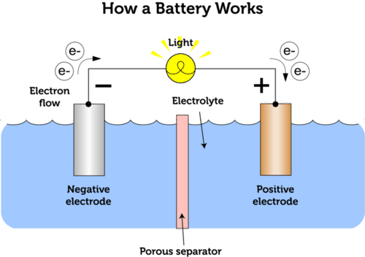
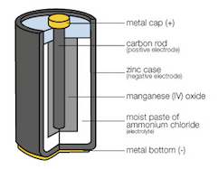
Batteries
Battery Parts
  Electrodes: one positive (anode), one negative (cathode)
  Electrolyte: breaks down the negative electrode
  Terminals: outlets for electricity

Slide 17
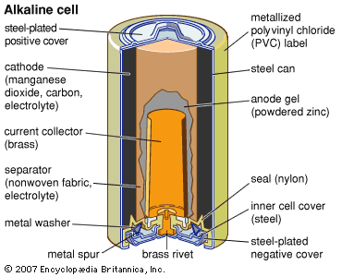
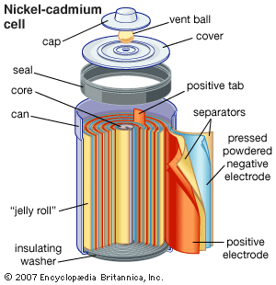
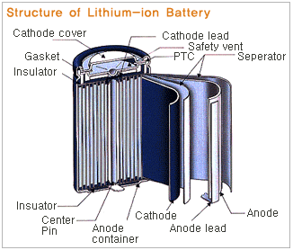
Batteries
Battery Types

Slide 18
Secondary Cells
Primary cells are those that can only be used once
Secondary cells can be recharged

Slide 19

Secondary Cells

Slide 20
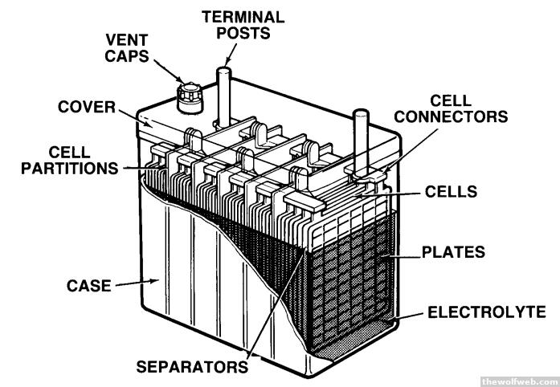
Batteries
These devices are electric cells, even though we call them batteries
A “battery” is a group of cells like in a car battery
  Any military buffs know why it is called a “battery”?

Slide 21

Video: Electric Current

Slide 22
Electric Current
Electric current is the amount of charge that moves through the cross-sectional area of a wire per unit time
The unit for current is the ampere (A) and is equal to 1C/s

Slide 23
Electric Current
EXAMPLE: Light falling on a metallic surface causes the surface to emit 2.2x10¹⁵ electrons per second. What is the current leaving the surface?

Slide 24
Electric Current
EXAMPLE: Light falling on a metallic surface causes the surface to emit 2.2x10¹⁵ electrons per second. What is the current leaving the surface?
ANSWER:

Slide 25
Electric Current
In an uncharged conductor, the electrons move randomly at speeds on the order of 10⁵ m/s
The presence of an electric field in a conductor causes the electrons to accelerate in a direction opposite to the electric field.
This ordering of the electron motion is what causes current.

Slide 26
Electric Current
As the electrons move, they collide with atoms of the material and impart some of their energy to those atoms
  This causes the atoms to increase the amplitude of their vibrations about their equilibrium position
  These increased vibrations show up as heat
  This is how we get toast

Slide 27
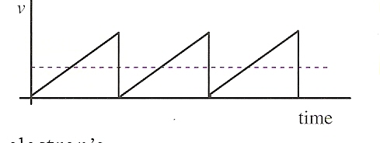
Electric Current
After the collision, the electrons are again accelerated by the electric field
The graph below represents this pattern. The dotted line represents the average, or drift velocity of the electron

Slide 28
Electric Current
For a typical metal, the drift velocity is on the order of 6x10⁻⁴ m/s
With this velocity, how long should it take for the lights to come on when you flip the switch?

Slide 29
Electric Current
For a typical metal, the drift velocity is on the order of 6x10⁻⁴ m/s
With this velocity, how long should it take for the lights to come on when you flip the switch?
So why do the lights come on instantaneously?

Slide 30
Electric Current
When an electric field is applied, every free electron in the conductor is energized – like the difference between opening a valve at the end of a pipe that is full of water versus opening a valve at the beginning of a pipe that is empty.

Slide 31
Electric Current
Special Cases:
  When a conductor is heated, it emits electrons through a process called thermionic emission which creates a current, or increases conductivity
  When light hits a metallic surface, electrons are emitted which creates a current – photoelectric effect

Slide 32
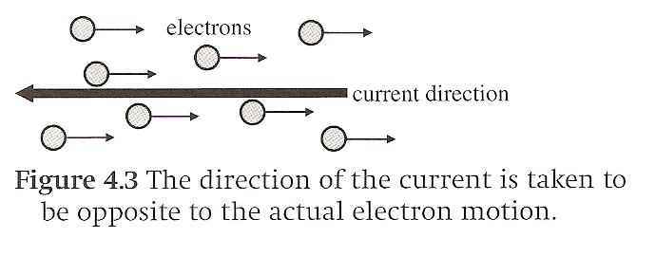
Electric Current
By convention, the direction of current is the opposite direction of the flow of electrons
  Current flows from positive to negative
  Electrons move from negative to positive

Slide 33
Electric Current
For current to flow, there must be a path from the positive electrode of a source to the negative electrode
This is called a complete or closed circuit
If there is a break in this path, current will not flow and this is called an open circuit

Slide 34

Developing Ohm’s Law

Slide 35
Electric Resistance and Ohm’s Law
When the temperature of a conductor is kept constant, current is proportional to the potential difference across it
Ohm’s Law
  This implies resistance is constant

Slide 36
Electric Resistance and Ohm’s Law
Electric resistance of a conductor is defined as the potential difference across its ends, divided by the current flowing through it:
The unit for resistance is the Ohm (𝛀) and is equal to 1 V/A

Slide 37
Electric Resistance and Ohm’s Law
A conductor with zero electric resistance is known as a perfect conductor
  Current can flow without a potential difference
  Superconductors can achieve zero resistance at very low temperatures (critical temperature) and are thus perfect conductors

Slide 38
Electric Resistance and Ohm’s Law
For metals, increase in temperature results in increased resistance
Assuming the conductor is kept at constant temperature, three factors affect resistance:
  properties of the material
  length
  cross-sectional area.

Slide 39
Electric Resistance and Ohm’s Law
Electric resistance of a wire (at constant temperature) is proportional to its length (L) and inversely proportional to the cross-sectional area
  Resistance increases with length
  Resistance decreases with cross-sectional area

Slide 40
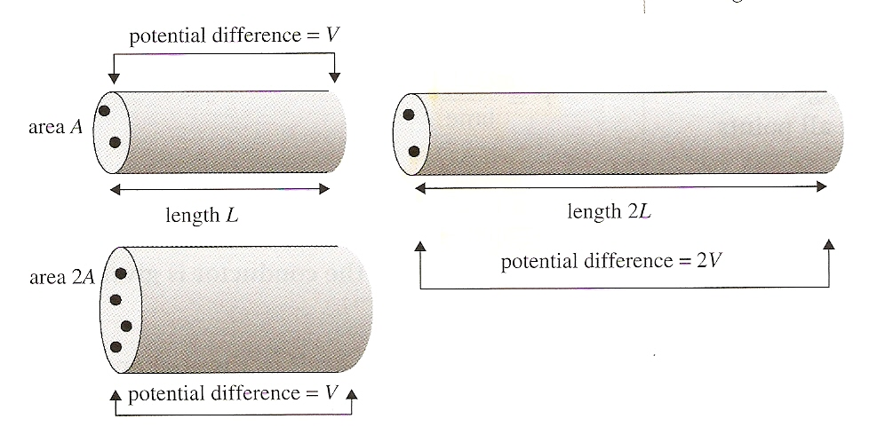
Electric Resistance and Ohm’s Law
Electric resistance of a wire (at constant temperature) is proportional to its length (L) and inversely proportional to the cross-sectional area

Slide 41
Electric Resistance and Ohm’s Law
Powerlines are long and thin which means more resistance and more power lost. How else might they lower resistance?

Slide 42
Electric Resistance and Ohm’s Law
Powerlines are long and thin which means more resistance and more power lost. How else might they lower resistance?
Transformers!!!

Slide 43
Resistivity

Slide 44

Resistivity (ρ)
$$R=ρ\frac{L}{A}$$
A physical property of a material
Units are Ω•m
Conductors should have low resistivity
  Silver is the best, but expensive
  Copper is most frequently used
  Aluminum has higher resistivity, but is lighter (resistance per pound is less than copper) and cheaper

Slide 45
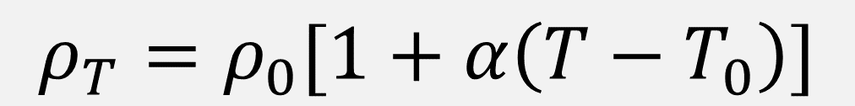
Resistivity (ρ)
$$R=ρ\frac{L}{A}$$
Resistivity is dependent on temperature
In general, resistance increases with temperature because of the greater disorder of the atoms
α is the temperature coefficient of resistivity
Physical Science
$$ρ_{T}=ρ_{0}[1+α\left(T−T_{0}\right)]$$

Slide 46
Resistivity

Slide 47

Data Guide Equations
In Data Guide
  $\left|\vec{F_{E}}\right|=k\frac{\left|q_{1}q_{2}\right|}{r^{2}}$
  $I=\frac{∆q}{∆t}$
  $R=\frac{ρl}{A}$
  $I=\frac{∆V}{R}$
  $P=I∆V$
  ${R }_{s}=\sum_{i}{{R }_{i}}$
  $\frac{1}{{R }_{p}}=\sum_{i}{\frac{1}{{R }_{i}}}$
NOT in Data Guide
  $V=IR$
  $ρ_{T}=ρ_{0}[1+α\left(T−T_{0}\right)$
  not in curriculum

Slide 48
Essential Knowledge(s):
Electric charge is conserved. The net charge of a system is equal to the sum of the charges of all the objects in the system.
  An electrical current is a movement of charge through a conductor.
  A circuit is a closed loop of electrical current.

Slide 49
Essential Knowledge(s):
The resistance of a resistor, and the capacitance of a capacitor, can be understood from the basic properties of electric fields and forces, as well as the properties of materials and their geometry.
  The current through a resistor is equal to the potential difference across the resistor divided by its resistance.

Slide 50
Essential Knowledge(s):
Matter has a property called resistivity.
  The resistivity of a material depends on its molecular and atomic structure.
  The resistivity depends on the temperature of the material.

Slide 51
Learning Objective(s):
The student is able to make claims about natural phenomena based on conservation of electric charge.
The student is able to choose and justify the selection of data needed to determine resistivity for a given material.

Slide 52
Learning Objective(s):
The student is able to make predictions, using the conservation of electric charge, about the sign and relative quantity of net charge of objects or systems after various charging processes, including conservation of charge in simple circuits.

Slide 53
Enduring Understanding(s):
Electric charge is a property of an object or system that affects its interactions with other objects or systems containing charge.
The electric and magnetic properties of a system can change in response to the presence of, or changes in, other objects or systems.

Slide 54
Enduring Understanding(s):
The energy of a system is conserved.
Materials have many macroscopic properties that result from the arrangement and interactions of the atoms and molecules that make up the material.

Slide 55
Big Idea(s):
Objects and systems have properties such as mass and charge. Systems may have internal structure.
Interactions between systems can result in changes in those systems.
Changes that occur as a result of interactions are constrained by conservation laws.

Slide 56
Questions?

Slide 57
Homework
#1-16, 20-22

Slide 58
Stopped here 9/8/14

