Slide 1
Devil physics The baddest class on campus AP Physics

Slide 2
Lsn 7-1: momentum and its relation to force Lsn 7-2: conservation of momentum Lsn 7-3: Collisions and impulse

Slide 3
Big Idea(s):
The interactions of an object with other objects can be described by forces.
Interactions between systems can result in changes in those systems.
Changes that occur as a result of interactions are constrained by conservation laws.

Slide 4
Enduring Understanding(s):
All forces share certain common characteristics when considered by observers in inertial reference frames.
A force exerted on an object can change the momentum of the object.

Slide 5
Enduring Understanding(s):
Interactions with other objects or systems can change the total linear momentum of a system.
Certain quantities are conserved, in the sense that the changes of those quantities in a given system are always equal to the transfer of that quantity to or from the system by all possible interactions with other systems.

Slide 6
Essential Knowledge(s):
A force exerted on an object is always due to the interaction of that object with another object.
The acceleration of an object, but not necessarily its velocity, is always in the direction of the net force exerted on the object by other objects.
If one object exerts a force on a second object, the second object always exerts a force of equal magnitude on the first object in the opposite direction.
The change in momentum of an object is a vector in the direction of the net force exerted on the object.

Slide 7
Essential Knowledge(s):
The change in momentum of an object occurs over a time interval.
The force that one object exerts on a second object changes the momentum of the second object (in the absence of other forces on the second object).
The change in momentum of that object depends on the impulse, which is the product of the average force and the time interval during which the interaction occurred.

Slide 8
Essential Knowledge(s):
The change in linear momentum for a constant-mass system is the product of the mass of the system and the change in velocity of the center of mass.
An interaction can be either a force exerted by objects outside the system or the transfer of some quantity with objects outside the system.

Slide 9
Essential Knowledge(s):
The change in linear momentum of the system is given by the product of the average force on that system and the time interval during which the force is exerted.
The units for momentum are the same as the units of the area under the curve of a force versus time graph.
The changes in linear momentum and force are both vectors in the same direction.

Slide 10
Essential Knowledge(s):
For all systems under all circumstances, energy, charge, linear momentum, and angular momentum are conserved. For an isolated or a closed system, conserved quantities are constant. An open system is one that exchanges any conserved quantity with its surroundings.

Slide 11
Essential Knowledge(s):
The boundary between a system and its environment is a decision made by the person considering the situation in order to simplify or otherwise assist in analysis.

Slide 12
Learning Objective(s):
The student is able to analyze a scenario and make claims (develop arguments, justify assertions) about the forces exerted on an object by other objects for different types of forces or components of forces.
The student is able to describe a force as an interaction between two objects and identify both objects for any force.
The student is able to construct explanations of physical situations involving the interaction of bodies using Newton’s third law and the representation of action-reaction pairs of forces.

Slide 13
Learning Objective(s):
The student is able to use Newton’s third law to make claims and predictions about the action-reaction pairs of forces when two objects interact.
The student is able to justify the selection of data needed to determine the relationship between the direction of the force acting on an object and the change in momentum caused by that force.
The student is able to justify the selection of routines for the calculation of the relationships between changes in momentum of an object, average force, impulse, and time of interaction.

Slide 14
Learning Objective(s):
The student is able to predict the change in momentum of an object from the average force exerted on the object and the interval of time during which the force is exerted.
The student is able to analyze data to characterize the change in momentum of an object from the average force exerted on the object and the interval of time during which the force is exerted.
The student is able to design a plan for collecting data to investigate the relationship between changes in momentum and the average force exerted on an object over time.

Slide 15
Learning Objective(s):
The student is able to calculate the change in linear momentum of a two-object system with constant mass in linear motion from a representation of the system (data, graphs, etc.).
The student is able to analyze data to find the change in linear momentum for a constant-mass system using the product of the mass and the change in velocity of the center of mass.

Slide 16
Learning Objective(s):
The student is able to apply mathematical routines to calculate the change in momentum of a system by analyzing the average force exerted over a certain time on the system.
The student is able to perform analysis on data presented as a force-time graph and predict the change in momentum of a system.
The student is able to define open and closed systems for everyday situations and apply conservation concepts for energy, charge, and linear momentum to those situations.

Slide 17
Introductory Video I: Linear Momentum

Slide 18
Linear Momentum
Linear momentum of a body is defined as mass times velocity
What are the units for momentum?
What is the SI unit for momentum?

Slide 19
Linear Momentum
What are the units for momentum?
kg-m/s
What is the SI unit for momentum?
There is no SI unit for momentum

Slide 20
Linear Momentum
Homework Problem #1
What is the magnitude of the momentum of a 22-g sparrow flying with a speed of 8.1 m/s?
How does that compare to a 2.2kg pelican flying at the same speed?

Slide 21
Linear Momentum
Homework Problem #1, Expanded
How does that compare to a 2.2kg pelican flying at the same speed?
Momentum is one hundred times greater.
How fast would the sparrow have to fly to equal the momentum of the pelican?

Slide 22
Linear Momentum
Homework Problem #1, Expanded, Again
How fast would the sparrow have to fly to equal the momentum of the pelican?
The required speed is one hundred times greater (and since it is 2.5 times the speed of sound it is also not very likely).

Slide 23
Linear Momentum
Newton’s Second Law Revisited

Slide 24
Linear Momentum
Newton’s Second Law Revisited
The rate of change of momentum of a body is equal to the net force applied to it.

Slide 25
Linear Momentum
Example 7-1
Washing a car: Momentum change and force
Water leaves a hose at a rate of 1.5 kg/s with a speed of 20 m/s and is aimed at the side of a car, which stops it (ignore splashback). What is the force exerted by the water on the car?

Slide 26
Linear Momentum
Example 7-1, Conceptual Question
Washing a car: Momentum change and force
We ignored the splashback. If we considered the momentum of the splashback, would the force be more or less?
What would the force be if momentum were conserved like energy?

Slide 27
Linear Momentum
Example 7-1
Washing a car: Momentum change and force
Water leaves a hose at a rate of 1.5 kg/s with a speed of 20 m/s and is aimed at the side of a car, which stops it (considering splashback). What is the force exerted by the water on the car?

Slide 28
Linear Momentum
Newton’s Second Law Revisited
The rate of change of momentum of a body is equal to the net force applied to it.

Slide 29
Linear Momentum
If momentum is conserved,

Slide 30
Conservation of Linear Momentum

Slide 31
CONSERVATION OF MOMENTUM
The vector sum of the momenta of two bodies colliding remains constant
Think of two billiard balls colliding head on

Slide 32
CONSERVATION OF MOMENTUM
LAW OF CONSERVATION OF LINEAR MOMENTUM
The total momentum of an isolated system of bodies remains constant.

Slide 33
Momentum Experiments

Slide 34
CONSERVATION OF MOMENTUM
Example 7-3, Railroad Cars Collide
A 10,000-kg railroad car travelling at 24.0 m/s strikes an identical car at rest. If the cars lock together as a result of the collision, what is their common speed afterward?

Slide 35
CONSERVATION OF MOMENTUM
Example 7-4, Rifle Recoil
Calculate the recoil velocity of a 5.0-kg rifle that shoots a 0.050-kg bullet at a speed of 120 m/s.

Slide 36
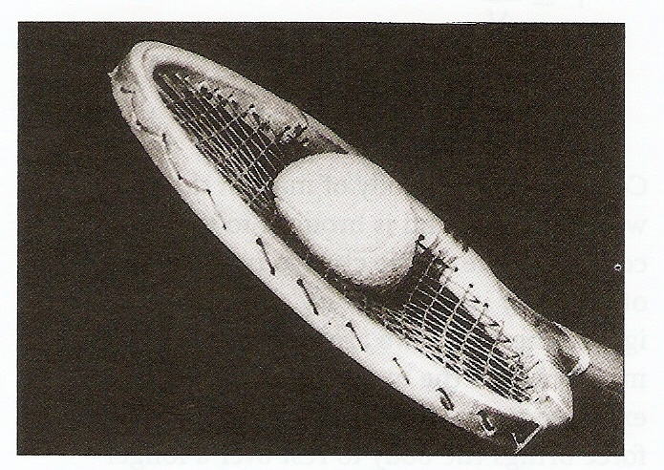
Conservation of Momentum in Collisions
Collisions represent a definitive change in momentum
Most collisions involve a deformation of the two colliding bodies due to the large forces required to change momentum

Slide 37
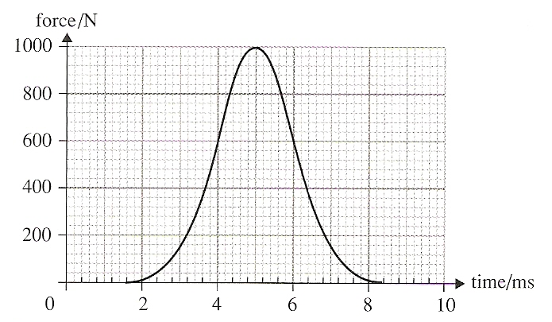
Conservation of Momentum in Collisions
The large force is rapidly applied over a short period of time, then falls just as abruptly to zero
This is what we call Impulse

Slide 38
Impulse
From Newton’s Second Law, we derived the equation relating force to the change in momentum per unit time

Slide 39
Impulse
From a car manufacturer’s standpoint, how can we use this equation to make crashes more survivable?

Slide 40
Impulse
From a car manufacturer’s standpoint, how can we use this equation to make crashes more survivable?
Crumple zones
Air bags (not to be confused with Hillary Clinton)

Slide 41
Impulse
We define impulse as the change in momentum or as the product of force and the time over which it is applied.

Slide 42
Impulse
Impulse is most applicable when the force is applied over a very short period of time, i.e. milliseconds

Slide 43
Impulse
However, you can have the same impulse with a smaller force over a longer period of time as with a larger force over a shorter period of time

Slide 44
Impulse
We saw that impulse is not applied in a linear fashion (see force-time graph) so how can we compute it?

Slide 45
Impulse
We saw that impulse is not applied in a linear fashion (see force-time graph) so how can we compute it?
Area under the curve

Slide 46
Impulse
We saw that impulse is not applied in a linear fashion (see force-time graph) so how can we compute it?
Area under the curve
OR?

Slide 47
Impulse
We saw that impulse is not applied in a linear fashion (see force-time graph) so how can we compute it?
Area under the curve
OR?
Average Force x time
F_{avg}
Δt

Slide 48
Learning Objective(s):
The student is able to analyze a scenario and make claims (develop arguments, justify assertions) about the forces exerted on an object by other objects for different types of forces or components of forces.
The student is able to describe a force as an interaction between two objects and identify both objects for any force.
The student is able to construct explanations of physical situations involving the interaction of bodies using Newton’s third law and the representation of action-reaction pairs of forces.

Slide 49
Learning Objective(s):
The student is able to use Newton’s third law to make claims and predictions about the action-reaction pairs of forces when two objects interact.
The student is able to justify the selection of data needed to determine the relationship between the direction of the force acting on an object and the change in momentum caused by that force.
The student is able to justify the selection of routines for the calculation of the relationships between changes in momentum of an object, average force, impulse, and time of interaction.

Slide 50
Learning Objective(s):
The student is able to predict the change in momentum of an object from the average force exerted on the object and the interval of time during which the force is exerted.
The student is able to analyze data to characterize the change in momentum of an object from the average force exerted on the object and the interval of time during which the force is exerted.
The student is able to design a plan for collecting data to investigate the relationship between changes in momentum and the average force exerted on an object over time.

Slide 51
Learning Objective(s):
The student is able to calculate the change in linear momentum of a two-object system with constant mass in linear motion from a representation of the system (data, graphs, etc.).
The student is able to analyze data to find the change in linear momentum for a constant-mass system using the product of the mass and the change in velocity of the center of mass.

Slide 52
Learning Objective(s):
The student is able to apply mathematical routines to calculate the change in momentum of a system by analyzing the average force exerted over a certain time on the system.
The student is able to perform analysis on data presented as a force-time graph and predict the change in momentum of a system.
The student is able to define open and closed systems for everyday situations and apply conservation concepts for energy, charge, and linear momentum to those situations.

Slide 53
Essential Knowledge(s):
A force exerted on an object is always due to the interaction of that object with another object.
The acceleration of an object, but not necessarily its velocity, is always in the direction of the net force exerted on the object by other objects.
If one object exerts a force on a second object, the second object always exerts a force of equal magnitude on the first object in the opposite direction.
The change in momentum of an object is a vector in the direction of the net force exerted on the object.

Slide 54
Essential Knowledge(s):
The change in momentum of an object occurs over a time interval.
The force that one object exerts on a second object changes the momentum of the second object (in the absence of other forces on the second object).
The change in momentum of that object depends on the impulse, which is the product of the average force and the time interval during which the interaction occurred.

Slide 55
Essential Knowledge(s):
The change in linear momentum for a constant-mass system is the product of the mass of the system and the change in velocity of the center of mass.
An interaction can be either a force exerted by objects outside the system or the transfer of some quantity with objects outside the system.

Slide 56
Essential Knowledge(s):
The change in linear momentum of the system is given by the product of the average force on that system and the time interval during which the force is exerted.
The units for momentum are the same as the units of the area under the curve of a force versus time graph.
The changes in linear momentum and force are both vectors in the same direction.

Slide 57
Essential Knowledge(s):
For all systems under all circumstances, energy, charge, linear momentum, and angular momentum are conserved. For an isolated or a closed system, conserved quantities are constant. An open system is one that exchanges any conserved quantity with its surroundings.

Slide 58
Essential Knowledge(s):
The boundary between a system and its environment is a decision made by the person considering the situation in order to simplify or otherwise assist in analysis.

Slide 59
Enduring Understanding(s):
All forces share certain common characteristics when considered by observers in inertial reference frames.
A force exerted on an object can change the momentum of the object.

Slide 60
Enduring Understanding(s):
Interactions with other objects or systems can change the total linear momentum of a system.
Certain quantities are conserved, in the sense that the changes of those quantities in a given system are always equal to the transfer of that quantity to or from the system by all possible interactions with other systems.

Slide 61
Big Idea(s):
The interactions of an object with other objects can be described by forces.
Interactions between systems can result in changes in those systems.
Changes that occur as a result of interactions are constrained by conservation laws.

Slide 62
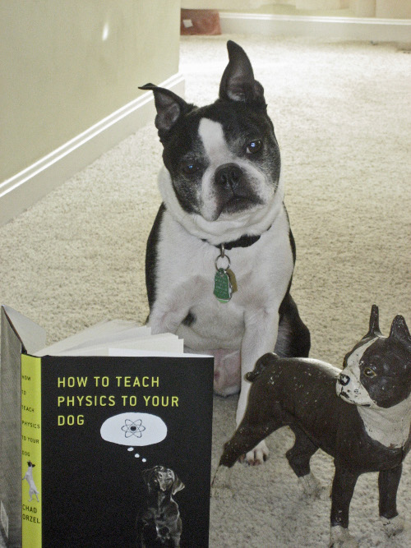
Questions?

Slide 63
HOMEWORK TIME!!!!!!!!!!!!
# 1-12 AND 15-20

