Slide 1
Devil physics The baddest class on campus AP Physics

Slide 2
Introductory Video

Slide 3
Giancoli Lesson 1-5 to 1-6 Units, Standards and the SI System Converting Units

Slide 4
Reading Activity Questions?
Reading Activity 1-5 to 1-6
Cornell Notes
unit
length/meter
time/second
mass/kilogram
Système International (SI)
cgs system
British engineering system
conversion factor

Slide 5
Objectives
MA.912.S.1.2: Determine appropriate and consistent standards of measurement for the data to be collected in a survey or experiment.
State the meaning of “unit” and “standard” and the difference between the two.

Slide 6
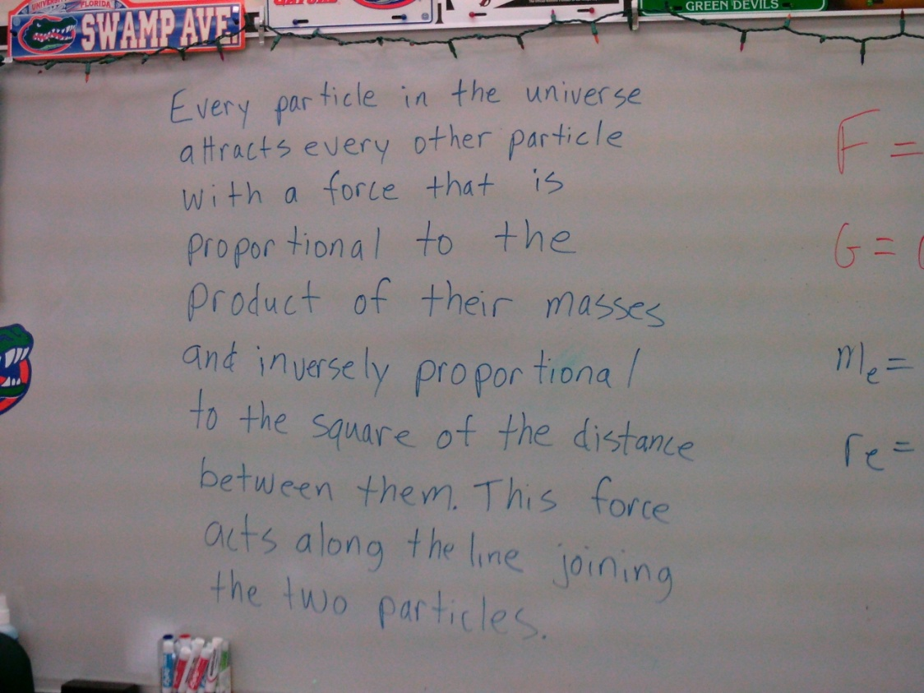
Objectives
State the primary SI units.
Use conversion factors to convert units.

Slide 7
Units and Standards
Units. Units are specifications for a measurement based on a standard.
Standard. A standard is a defined value for a unit based upon some measurement.

Slide 8
Units and Standards
Examples: “Meter” is a unit of length. The standard for a meter has, at various times, been:
Distance from the tip of your nose to the tip of your longest finger when arm is extended horizontally. Problem?
One ten-millionth of the distance from the earth’s equator to either pole. Problem?
Distance between two finely engraved marks on a particular bar of a platinum-iridium alloy. Problem?

Slide 9
Units and Standards
Examples: “Meter” is a unit of length. The standard for a meter has, at various times, been:
For greater precision and reproducibility, changed in 1960 to 1,650,763.73 wavelengths of an orange light emitted by krypton 86 gas. Problem?
Current: length of path traveled by light in 1/299,792,458th’s of a second. Problem?
How precise does it have to be?

Slide 10
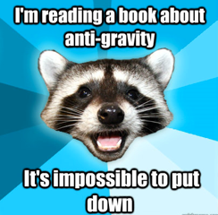
Units and Standards
Examples:
The standard for one inch is 2.54 cm.
For the standard for cm, see meter above and divide by 100

Slide 11
Système International (SI)
System of units and standards most commonly used in science
Commonly known as the metric system
Base units:
Length – meter (m)
Mass – kilogram (kg)
Time – second (s)
Old name was MKS system (meter, kilogram, second)

Slide 12
Système International (SI)
Secondary metric system: CGS System
Base units:
Length – centimeter (cm)
Mass – gram (g)
Time – second (s)
More useful for small stuff

Slide 13
British Engineering System
Base units:
Length – foot (ft)
Force – pound (lb)
Time – second (s)
Most engineering drawings are still in inches with tolerances measured in 1000ths of an inch

Slide 14
Units of Units
Force ⇒ Newton (N) ⇒ 1kg⋅m/s²
Energy and Work ⇒ Joule (J) ⇒ 1kg⋅m²/s²
Pressure ⇒ Pascal (Pa) ⇒ 1kg/m·s²

Slide 15
Using Units
Units are mucho importante to problem solving¡!
FIRST – ensure the units for your inputs are compatible for any constants you are given
SECOND – ensure all units are the same for the same type of measurement
THIRD – make sure your units cancel into the correct units for your answer (see below)

Slide 16
Unit Conversions
How do you add fractions?

Slide 17
Unit Conversions
How do you add fractions?
Multiply by a conversion factor to get a common denominator
Conversion factors always equal to 1
Identity Property
Unit conversion is the same – multiplying by 1 to change the form of a number

Slide 18
Unit Conversions
How do you multiply fractions?

Slide 19
Unit Conversions
How do you multiply fractions?
Common factors cancel out
Then multiply
Units cancel out in the same way fractions do

Slide 20
Unit Conversions

Slide 21
Unit Conversions
How do you convert 10 inches per second to meters per minute?
Multiply by conversion factors
Conversion factors equal to 1 (Identity Property)
Cancel out common units
Then multiply

Slide 22
Unit Conversions
Conversion factors do not count as significant figures if it is a defined conversion
1 in = 2.54 cm (not significant figure)
1 mi = 1.61 km (significant figure because 1.61 is not an exact or defined amount [1.609344 is exact)
Look at the conversion factors on the inside front cover of your book

Slide 23
Unit Conversions
Sample problem: If I drive 60 mph, how fast is that in mm/sec?

Slide 24
Unit Conversions
Sample problem: If I drive 60 mph, how fast is that in mm/sec?
(60 mi/hr) x (1hr/60min) x (1min/60sec) x (5280ft/1mi) x (12in/1ft) x (2.54cm/1in) x (10mm/cm) = ________

Slide 25
Unit Conversions
Sample problem: If I drive 60 mph, how fast is that in mm/sec?
(60 mi/hr) x (1hr/60min) x (1min/60sec) x (5280ft/1mi) x (12in/1ft) x (2.54cm/1in) x (10mm/cm) = ________

Slide 26
Unit Conversions
Sample problem: If I drive 60 mph, how fast is that in mm/sec?
(60) x (1/60) x (1/60sec) x (885280/1) x (12/1) x (2.54/1) x (10mm/1) = 26822.4 = 2.6x10⁴ mm/sec

Slide 27
Sig Figs and Scientific Notation

Slide 28
Sig Figs and Scientific Notation
In order to write really large numbers and really small numbers and still comply with the rules for significant figures , you have to use scientific notation
As a general rule for my class, you should never have an answer longer than three digits (but four isn’t too bad)
In problem solving, round your final answer only to significant figures

Slide 29
Review - Scientific Notation
Move decimal so there is only one number to the left of the decimal
Number of decimal place moves equals the power of ten
6200000 = 6.2x10⁶
0.00725 = 7.25x10⁻³
9.85x10⁵ = 985000
1.20x10⁻³ = 0.00120

Slide 30
Review - Scientific Notation
Multiplying numbers in scientific notation
Multiply the base numbers
Add the powers of ten
Move the decimal as required (and increase the power of ten) so you only have one digit to the left of the decimal
2x10³ x 4x10⁴ = 8x10⁷
4x10⁵ x 3x10⁻³ = 12x10² = 1.2x10³
6x10⁻⁷ x 3x10⁻² = 18x10⁻⁹ = 1.8x10⁻⁸

Slide 31
Review - Scientific Notation
Multiplying numbers in scientific notation
Multiply the base numbers
Add the powers of ten
Move the decimal as required (and increase the power of ten) so you only have one digit to the left of the decimal
2x10³ x 4x10⁴ = 8x10⁷
4x10⁵ x 3x10⁻³ = 12x10² = 1.2x10³
6x10⁻⁷ x 3x10⁻² = 18x10⁻⁹ = 1.8x10⁻⁸
Check Using Scientific Notation on Calculators

Slide 32
Review - Scientific Notation
Dividing numbers in scientific notation
Divide the base numbers
Subtract the powers of ten
Move the decimal (and decrease the power of ten) so you only have one digit to the left of the decimal
8x10⁶ ÷ 2x10⁴ = 4x10²
1x10⁻⁸ ÷ 9x10⁴ = 0.111x10⁻¹² = 1.11x10⁻¹³
4x10⁵ ÷ 3x10⁻³ = 0.75x10⁸ = 7.5x10⁷
6x10⁻⁷ ÷ 5x10⁻² = 1.2x10⁻⁵

Slide 33
Review - Scientific Notation
Adding and subtracting numbers in scientific notation
Convert numbers to decimal numbers
Add or subtract
Convert back to scientific notation
Or just use a calculator
8x10⁶ + 2x10⁴ = 8000000 + 20000 = 8020000
= 8.02x10⁶
6x10⁻³ - 5x10⁻² = 0.006 – 0.05 = -0.044
= -4.4x10⁻²

Slide 34
Review - Scientific Notation
Speaking of calculators . . .
Everyone take out their calculators
Make sure you can switch your display from decimal to scientific notation and back again
Perform the following operation using the scientific notation functions of your calculator:
6.39x10⁷ ÷ 8.72x10⁻⁵ = 7.33x10¹¹
GET YOUR CALCULATOR ENGRAVED!!!

Slide 35
General Operating Procedure
Perform all operations on your calculator without rounding if possible
Round your final answer to the correct number of significant figures using scientific notation if needed
If using intermittent rounding, never round to less than the correct number of sig figs
On tests, I use ±5% tolerance for intermittent rounding differences

Slide 36
Metrics With Prefixes
Prefixes are added to units to stand for a power of ten
1cm is a centimeter and centi is a prefix for 10⁻² thus 1cm = 1x10⁻² m or 0.01m
Note the chart on the inside front cover of your books

Slide 37
Metrics With Prefixes
I want to sell you a memory stick with a 3,000 hB capacity for $3. Is that a good deal?

Slide 38
Metrics With Prefixes
I want to sell you a memory stick with a 3,000 hB capacity for $3. Is that a good deal?
Not hardly. 3,000 hB is equal to 300,000 B which is 300 kB.

Slide 39
Summary Review
MA.912.S.1.2: Can you determine appropriate and consistent standards of measurement for the data to be collected in a survey or experiment?
Can you state the meaning of “unit” and “standard” and the difference between the two?

Slide 40
Summary Review
Can you state the primary SI units?
Can you use conversion factors to convert units?

Slide 41
Questions?

Slide 42
Homework
#12-22

Slide 43
Stopped here on 9/4

