Slide 1
Devil physics The baddest class on campus aP Physics

Slide 2
Giancoli Chapter 5: Circular motion; gravitation
Lsn 5-1: kinematics of uniform circular motion
Lsn 5-2: Dynamics of uniform circular motion
Lsn 5-3: highway curves, banked and unbanked

Slide 3
Big Idea(s):
Objects and systems have properties such as mass and charge. Systems may have internal structure.
The interactions of an object with other objects can be described by forces.
Interactions between systems can result in changes in those systems.

Slide 4
Enduring Understanding(s):
1.A: The internal structure of a system determines many properties of the system.
1.C: Objects and systems have properties of inertial mass and gravitational mass that are experimentally verified to be the same and that satisfy conservation principles.

Slide 5
Enduring Understanding(s):
3.A: All forces share certain common characteristics when considered by observers in inertial reference frames.
3.B: Classically, the acceleration of an object interacting with other objects can be predicted by using
4.A: The acceleration of the center of mass of a system is related to the net force exerted on the system, where

Slide 6
Essential Knowledge(s):
1.A.1: A system is an object or a collection of objects. Objects are treated as having no internal structure.
A collection of particles in which internal interactions change little or not at all, or in which changes in these interactions are irrelevant to the question addressed, can be treated as an object.
1.C.1: Inertial mass is the property of an object or a system that determines how its motion changes when it interacts with other objects or systems.

Slide 7
Essential Knowledge(s):
1.C.2: Gravitational mass is the property of an object or a system that determines the strength of the gravitational interaction with other objects, systems, or gravitational fields.
The gravitational mass of an object determines the amount of force exerted on the object by a gravitational field.

Slide 8
Essential Knowledge(s):
3.A.1: An observer in a particular reference frame can describe the motion of an object using such quantities as position, displacement, distance, velocity, speed, and acceleration.
Displacement, velocity, and acceleration are all vector quantities.
Displacement is change in position. Velocity is the rate of change of position with time. Acceleration is the rate of change of velocity with time. Changes in each property are expressed by subtracting initial values from final values.
A choice of reference frame determines the direction and the magnitude of each of these quantities.

Slide 9
Essential Knowledge(s):
3.A.2: Forces are described by vectors.
Forces are detected by their influence on the motion of an object.
Forces have magnitude and direction.
3.A.3: A force exerted on an object is always due to the interaction of that object with another object.
The acceleration of an object, but not necessarily its velocity, is always in the direction of the net force exerted on the object by other objects.

Slide 10
Essential Knowledge(s):
3.B.1: If an object of interest interacts with several other objects, the net force is the vector sum of the individual forces.
4.A.1: The linear motion of a system can be described by the displacement, velocity, and acceleration of its center of mass.

Slide 11
Essential Knowledge(s):
The acceleration is equal to the rate of change of velocity with time, and velocity is equal to the rate of change of position with time.
The acceleration of the center of mass of a system is directly proportional to the net force exerted on it by all objects interacting with the system and inversely proportional to the mass of the system.
Force and acceleration are both vectors, with acceleration in the same direction as the net force.

Slide 12
Learning Objective(s):
(1.C.1.1): The student is able to design an experiment for collecting data to determine the relationship between the net force exerted on an object, its inertial mass, and its acceleration.
(3.A.1.1): The student is able to express the motion of an object using narrative, mathematical, and graphical representations.
(3.A.1.2): The student is able to design an experimental investigation of the motion of an object.

Slide 13
Learning Objective(s):
(3.A.1.3): The student is able to analyze experimental data describing the motion of an object and is able to express the results of the analysis using narrative, mathematical, and graphical representations.
(3.A.2.1): The student is able to represent forces in diagrams or mathematically using appropriately labeled vectors with magnitude, direction, and units during the analysis of a situation.
(3.A.3.1): The student is able to analyze a scenario and make claims (develop arguments, justify assertions) about the forces exerted on an object by other objects for different types of forces or components of forces.

Slide 14
Learning Objective(s):
(3.A.3.3): The student is able to describe a force as an interaction between two objects and identify both objects for any force.
(3.B.1.1): The student is able to predict the motion of an object subject to forces exerted by several objects using an application of Newton’s second law in a variety of physical situations with acceleration in one dimension.
(3.B.1.2): The student is able to design a plan to collect and analyze data for motion (static, constant, or accelerating) from force measurements and carry out an analysis to determine the relationship between the net force and the vector sum of the individual forces.

Slide 15
Learning Objective(s):
(3.B.1.3): The student is able to reexpress a free-body diagram representation into a mathematical representation and solve the mathematical representation for the acceleration of the object.
(3.B.1.4): The student is able to predict the motion of an object subject to forces exerted by several objects using an application of Newton’s second law in a variety of physical situations.
(4.A.1.1): The student is able to use representations of the center of mass of an isolated two-object system to analyze the motion of the system qualitatively and semi-quantitatively.

Slide 16
Learning Objective(s):
(4.A.2.1): The student is able to make predictions about the motion of a system based on the fact that acceleration is equal to the change in velocity per unit time, and velocity is equal to the change in position per unit time.
(4.A.2.2): The student is able to evaluate using given data whether all the forces on a system or whether all the parts of a system have been identified.
(4.A.2.3): The student is able to create mathematical models and analyze graphical relationships for acceleration, velocity, and position of the center of mass of a system and use them to calculate properties of the motion of the center of mass of a system.

Slide 17
Introductory Video

Slide 18
So far we have learned:
The SI unit for force is the Newton (N) and it is derived from the units kg∙m/s²
To use vector addition to find the net force on an object and relate it to the resultant acceleration.
To draw free-body/force diagrams of an object or collection of objects.
Use free-body/force diagrams to analyze forces on an object.

Slide 19
So far we have learned:
Applied Newton’s Three Laws of Motion to solve problems involving forces and acceleration.
Inertia
∑F = ma
Action - Reaction
Learned and applied the force of friction in motion problems.

Slide 20
Now we do the same thing for circular motion instead of straight-line motion

Slide 21
Uniform Circular Motion
Uniform circular motion – when a body moves in a circular path at constant speed
Magnitude of velocity is constant (uniform)
Direction of velocity is constantly changing
Velocity is a vector so when the direction changes, acceleration occurs even though the speed remains constant

Slide 22
Newton’s First Law
A body at rest tends to remain at rest.
A body in motion tends to remain in motion at a constant velocity and in a straight line unless acted on by an outside force.
What does this mean to a ball on a string?

Slide 23
Newton’s First Law

Slide 24
Newton’s First Law

Slide 25
Newton’s First Law

Slide 26
Newton’s Second Law
∑F = ma
A force is required to change the direction of the velocity
If an unbalanced force is applied, there must be an acceleration

Slide 27
Newton’s Second Law

Slide 28
Newton’s Second Law
∑F = ma
Acceleration is change in velocity divided by change in time
But if the ball is travelling at constant speed, how can there be acceleration?

Slide 29
Newton’s Second Law
But if the ball is travelling at constant speed, how can there be acceleration?
Acceleration and Velocity are vectors
Vectors have magnitude and direction

Slide 30
Newton’s Second Law
But if the ball is travelling at constant speed, how can there be acceleration?
Since speed is constant, the magnitude of the velocity is constant, BUT . . .

Slide 31
Newton’s Second Law
But if the ball is travelling at constant speed, how can there be acceleration?
. . . because the direction of the velocity is constantly changing, there is acceleration and that acceleration is directed toward the center of the circle

Slide 32
Uniform Circular Motion

Slide 33
Uniform Circular Motion

Slide 34
Uniform Circular Motion

Slide 35
Uniform Circular Motion
The resulting acceleration is called centripetal acceleration (a_{c}) or radial acceleration (a_{R})

Slide 36
Uniform Circular Motion
Period (T) – time it takes for one revolution
Velocity is distance divided by time (Δx/Δt)
Distance around a circle is circumference which is equal to 2πr
Therefore,

Slide 37
Uniform Circular Motion
Period (T) – time per revolution
Frequency (f) – number of revolutions per unit time
Therefore,

Slide 38
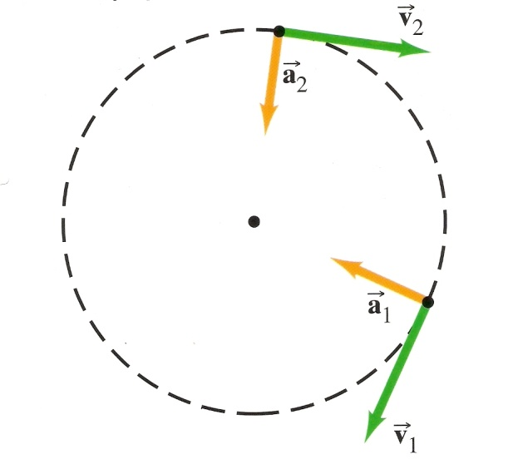
Dynamics of Uniform Circular Motion

Slide 39
Dynamics of Uniform Circular Motion
A 0.2kg ball on a 0.5m string is going in a circle at 5 m/s. What is the tension in the string? What is the ball’s period and frequency?

Slide 40
Dynamics of Uniform Circular Motion
A 0.2kg ball on a 0.5m string is going in a circle at 5 m/s. What is the tension in the string? What is the ball’s period and frequency?

Slide 41
Dynamics of Uniform Circular Motion
A 0.2kg ball on a 0.5m string is going in a circle at 5 m/s. What is the tension in the string? What is the ball’s period and frequency?

Slide 42
Dynamics of Uniform Circular Motion
A 0.2kg ball on a 0.5m string is going in a circle at 5 m/s. What is the tension in the string? What is the ball’s period and frequency?

Slide 43
Dynamics of Uniform Circular Motion
How fast must a ball on a string spin in a circle so that the string is perfectly horizontal?

Slide 44
Dynamics of Uniform Circular Motion
Can a ball on a string spin in a circle so that the string is perfectly horizontal?
Can’t happen. What is going to support the weight of the ball?
mg

Slide 45
Dynamics of Uniform Circular Motion
Can a ball on a string spin in a circle so that the string is perfectly horizontal?
No. What is going to support the weight of the ball?
F_{Tx}
F_{Ty}
F_{T}
mg

Slide 46
Dynamics of Uniform Circular Motion
We just looked at how gravity impacts horizontal circular motion.
How does gravity impact vertical circular motion?

Slide 47
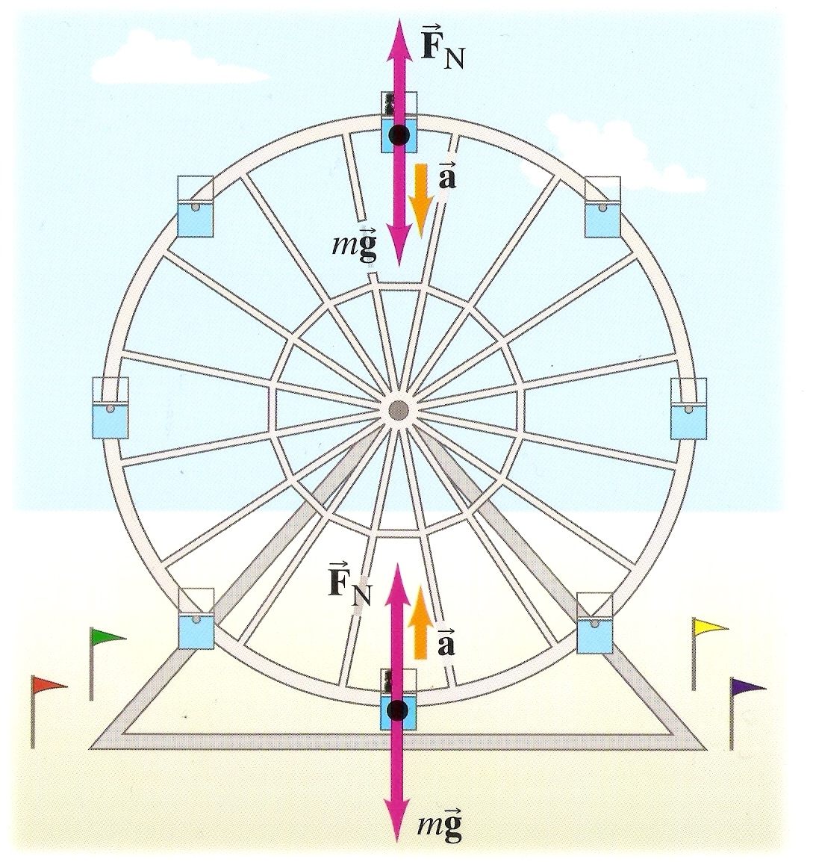
Dynamics of Uniform Circular Motion
How does gravity impact vertical circular motion?
Top of the wheel:

Slide 48
Dynamics of Uniform Circular Motion
How does gravity impact vertical circular motion?
Bottom of the wheel:

Slide 49
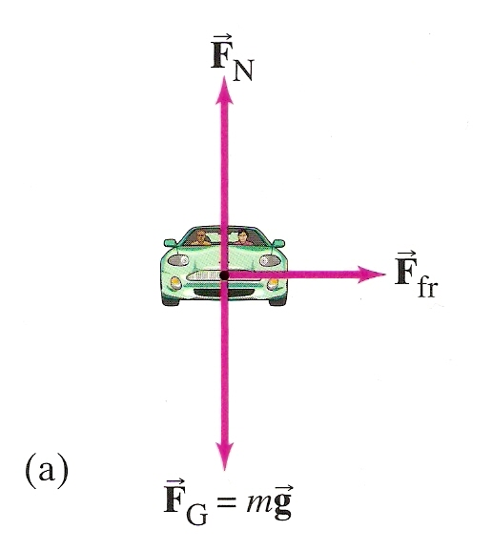
Car Rounding A Curve
The only force acting in the horizontal direction is friction
Friction pushes to the right causing an acceleration

Slide 50
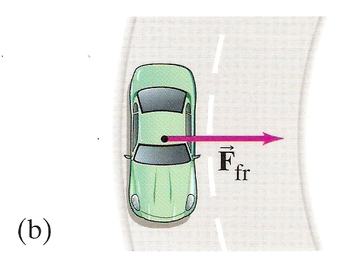
Car Rounding A Curve
That acceleration is the change in the direction of the car’s velocity, i.e. the car turns

Slide 51
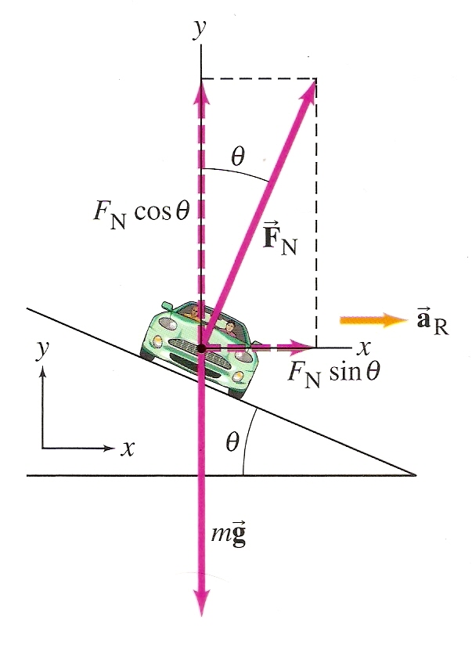
Car Rounding A Curve
On a flat curve, friction is the only force used to turn the car
On a banked turn, a component of the normal force also acts to turn the car

Slide 52
Car Rounding A Curve
When making a turn on a wet road, we are concerned about sliding sideways. Would we have more friction to make the turn if the wheels are rolling or with the brakes locked up?

Slide 53
Car Rounding A Curve
When making a turn on a wet road, we are concerned about sliding sideways. Would we have more friction to make the turn if the wheels are rolling or with the brakes locked up?
Wheels rolling. When the wheels are rolling, there is no movement between the point of contact of the tires and the road so static coefficient of friction applies. If the brakes are locked up, the tire is sliding in relation to the road so dynamic coefficient of friction applies and it is less so less force to turn.

Slide 54
Car Rounding A Curve
Sample Problem

Slide 55
Summary Video

Slide 56
Learning Objective(s):
(1.C.1.1): The student is able to design an experiment for collecting data to determine the relationship between the net force exerted on an object, its inertial mass, and its acceleration.
(3.A.1.1): The student is able to express the motion of an object using narrative, mathematical, and graphical representations.
(3.A.1.2): The student is able to design an experimental investigation of the motion of an object.

Slide 57
Learning Objective(s):
(3.A.1.3): The student is able to analyze experimental data describing the motion of an object and is able to express the results of the analysis using narrative, mathematical, and graphical representations.
(3.A.2.1): The student is able to represent forces in diagrams or mathematically using appropriately labeled vectors with magnitude, direction, and units during the analysis of a situation.
(3.A.3.1): The student is able to analyze a scenario and make claims (develop arguments, justify assertions) about the forces exerted on an object by other objects for different types of forces or components of forces.

Slide 58
Learning Objective(s):
(3.A.3.3): The student is able to describe a force as an interaction between two objects and identify both objects for any force.
(3.B.1.1): The student is able to predict the motion of an object subject to forces exerted by several objects using an application of Newton’s second law in a variety of physical situations with acceleration in one dimension.
(3.B.1.2): The student is able to design a plan to collect and analyze data for motion (static, constant, or accelerating) from force measurements and carry out an analysis to determine the relationship between the net force and the vector sum of the individual forces.

Slide 59
Learning Objective(s):
(3.B.1.3): The student is able to reexpress a free-body diagram representation into a mathematical representation and solve the mathematical representation for the acceleration of the object.
(3.B.1.4): The student is able to predict the motion of an object subject to forces exerted by several objects using an application of Newton’s second law in a variety of physical situations.
(4.A.1.1): The student is able to use representations of the center of mass of an isolated two-object system to analyze the motion of the system qualitatively and semi-quantitatively.

Slide 60
Learning Objective(s):
(4.A.2.1): The student is able to make predictions about the motion of a system based on the fact that acceleration is equal to the change in velocity per unit time, and velocity is equal to the change in position per unit time.
(4.A.2.2): The student is able to evaluate using given data whether all the forces on a system or whether all the parts of a system have been identified.
(4.A.2.3): The student is able to create mathematical models and analyze graphical relationships for acceleration, velocity, and position of the center of mass of a system and use them to calculate properties of the motion of the center of mass of a system.

Slide 61
Essential Knowledge(s):
1.A.1: A system is an object or a collection of objects. Objects are treated as having no internal structure.
A collection of particles in which internal interactions change little or not at all, or in which changes in these interactions are irrelevant to the question addressed, can be treated as an object.
1.C.1: Inertial mass is the property of an object or a system that determines how its motion changes when it interacts with other objects or systems.

Slide 62
Essential Knowledge(s):
1.C.2: Gravitational mass is the property of an object or a system that determines the strength of the gravitational interaction with other objects, systems, or gravitational fields.
The gravitational mass of an object determines the amount of force exerted on the object by a gravitational field.

Slide 63
Essential Knowledge(s):
3.A.1: An observer in a particular reference frame can describe the motion of an object using such quantities as position, displacement, distance, velocity, speed, and acceleration.
Displacement, velocity, and acceleration are all vector quantities.
Displacement is change in position. Velocity is the rate of change of position with time. Acceleration is the rate of change of velocity with time. Changes in each property are expressed by subtracting initial values from final values.
A choice of reference frame determines the direction and the magnitude of each of these quantities.

Slide 64
Essential Knowledge(s):
3.A.2: Forces are described by vectors.
Forces are detected by their influence on the motion of an object.
Forces have magnitude and direction.
3.A.3: A force exerted on an object is always due to the interaction of that object with another object.
The acceleration of an object, but not necessarily its velocity, is always in the direction of the net force exerted on the object by other objects.

Slide 65
Essential Knowledge(s):
3.B.1: If an object of interest interacts with several other objects, the net force is the vector sum of the individual forces.
4.A.1: The linear motion of a system can be described by the displacement, velocity, and acceleration of its center of mass.

Slide 66
Essential Knowledge(s):
The acceleration is equal to the rate of change of velocity with time, and velocity is equal to the rate of change of position with time.
The acceleration of the center of mass of a system is directly proportional to the net force exerted on it by all objects interacting with the system and inversely proportional to the mass of the system.
Force and acceleration are both vectors, with acceleration in the same direction as the net force.

Slide 67
Big Idea(s):
Objects and systems have properties such as mass and charge. Systems may have internal structure.
The interactions of an object with other objects can be described by forces.
Interactions between systems can result in changes in those systems.

Slide 68
Questions?

Slide 69
Homework
#1-20

