Slide 1
Devil physics The baddest class on campus Ap Physics
Student of the Week

Slide 2
Lsn 11-11: Reflection and Transmission of waves Lsn 11-12: Interference: principles of superposition Lsn 11-13: Standing waves; resonance

Slide 3
Questions from Reading Activity?

Slide 4
Big Idea(s):
Waves can transfer energy and momentum from one location to another without the permanent transfer of mass and serve as a mathematical model for the description of other phenomena.

Slide 5
Enduring Understanding(s):
Only waves exhibit interference and diffraction.
Interference and superposition lead to standing waves and beats.

Slide 6
Essential Knowledge(s):
When two waves cross, they travel through each other; they do not bounce off each other. Where the waves overlap, the resulting displacement can be determined by adding the displacements of the two waves. This is called superposition.
Two or more wave pulses can interact in such a way as to produce amplitude variations in the resultant wave. When two pulses cross, they travel through each other; they do not bounce off each other. Where the pulses overlap, the resulting displacement can be determined by adding the displacements of the two pulses. This is called superposition.

Slide 7
Essential Knowledge(s):
Two or more traveling waves can interact in such a way as to produce amplitude variations in the resultant wave.
Standing waves are the result of the addition of incident and reflected waves that are confined to a region and have nodes and antinodes. Examples should include waves on a fixed length of string, and sound waves in both closed and open tubes.

Slide 8
Essential Knowledge(s):
The possible wavelengths of a standing wave are determined by the size of the region to which it is confined.
A standing wave with zero amplitude at both ends can only have certain wavelengths. Examples should include fundamental frequencies and harmonics.
Other boundary conditions or other region sizes will result in different sets of possible wavelengths.

Slide 9
Essential Knowledge(s):
Essential Knowledge 6.D.5: Beats arise from the addition of waves of slightly different frequency.
Because of the different frequencies, the two waves are sometimes in phase and sometimes out of phase. The resulting regularly spaced amplitude changes are called beats. Examples should include the tuning of an instrument.
The beat frequency is the difference in frequency between the two waves.

Slide 10
Learning Objective(s):
The student is able to make claims and predictions about the net disturbance that occurs when two waves overlap. Examples should include standing waves.
The student is able to construct representations to graphically analyze situations in which two waves overlap over time using the principle of superposition.

Slide 11
Learning Objective(s):
The student is able to use representations of individual pulses and construct representations to model the interaction of two wave pulses to analyze the superposition of two pulses.
The student is able to design a suitable experiment and analyze data illustrating the superposition of mechanical waves (only for wave pulses or standing waves).

Slide 12
Learning Objective(s):
The student is able to design a plan for collecting data to quantify the amplitude variations when two or more traveling waves or wave pulses interact in a given medium.
The student is able to analyze data or observations or evaluate evidence of the interaction of two or more traveling waves in one or two dimensions (i.e., circular wave fronts) to evaluate the variations in resultant amplitudes.

Slide 13
Learning Objective(s):
The student is able to refine a scientific question related to standing waves and design a detailed plan for the experiment that can be conducted to examine the phenomenon qualitatively or quantitatively.
The student is able to predict properties of standing waves that result from the addition of incident and reflected waves that are confined to a region and have nodes and antinodes.

Slide 14
Learning Objective(s):
The student is able to plan data collection strategies, predict the outcome based on the relationship under test, perform data analysis, evaluate evidence compared to the prediction, explain any discrepancy and, if necessary, revise the relationship among variables responsible for establishing standing waves on a string or in a column of air.
The student is able to describe representations and models of situations in which standing waves result from the addition of incident and reflected waves confined to a region.

Slide 15
Learning Objective(s):
The student is able to challenge with evidence the claim that the wavelengths of standing waves are determined by the frequency of the source regardless of the size of the region.
The student is able to use a visual representation to explain how waves of slightly different frequency give rise to the phenomenon of beats.

Slide 16
Learning Objective(s):
The student is able to calculate wavelengths and frequencies (if given wave speed) of standing waves based on boundary conditions and length of region within which the wave is confined, and calculate numerical values of wavelengths and frequencies. Examples should include musical instruments.

Slide 17
Light Reflection and Refraction

Slide 18
Law of Reflection
What happens to a pulse on a rope tied to a wall?

Slide 19
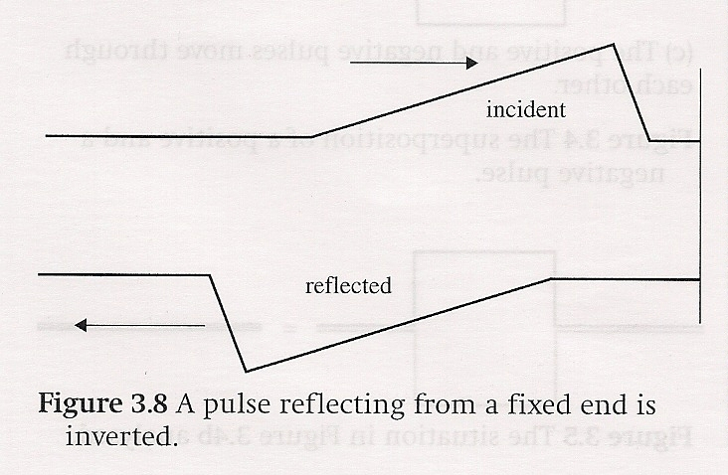
Law of Reflection
What happens to a pulse on a rope tied to a wall?
The pulse reflects inverted and traveling in the opposite direction

Slide 20
Law of Reflection
What happens to a pulse on a rope with the end free?

Slide 21
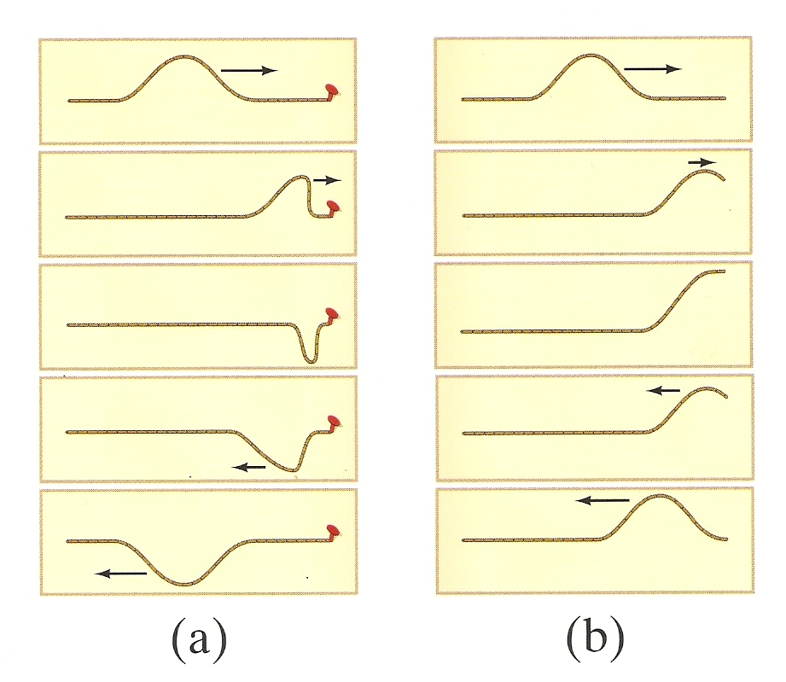
Law of Reflection
What happens to a pulse on a rope with the end free?
The pulse reflects upright and traveling in the opposite direction

Slide 22
Law of Reflection
What happens to a pulse on a rope that goes from a small to a larger diameter?

Slide 23
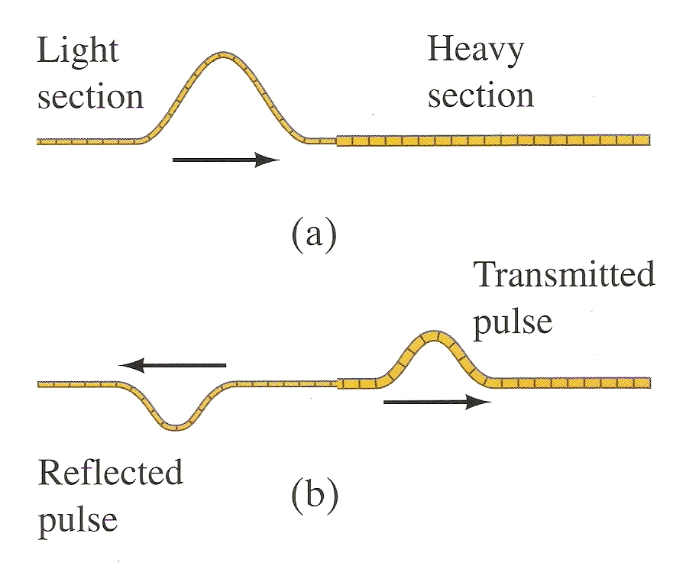
Law of Reflection
What happens to a pulse on a rope that goes from a small to a larger diameter?
A portion of the pulse is reflected inverted and another portion is transmitted to the larger diameter rope
Elastic collision????

Slide 24
Law of Reflection
Law of Reflection: The angle of incidence (i, angle between the ray and the normal to the reflecting surface at the point of incidence) is equal to the angle of reflection, (r, angle between the normal and the reflected ray).
Note that the angles are measured from the normal (perpendicular) to the reflecting surface.

Slide 25
Law of Reflection
The reflected and incident rays and the normal to the surface lie on the same plane, called the plane of incidence.

Slide 26
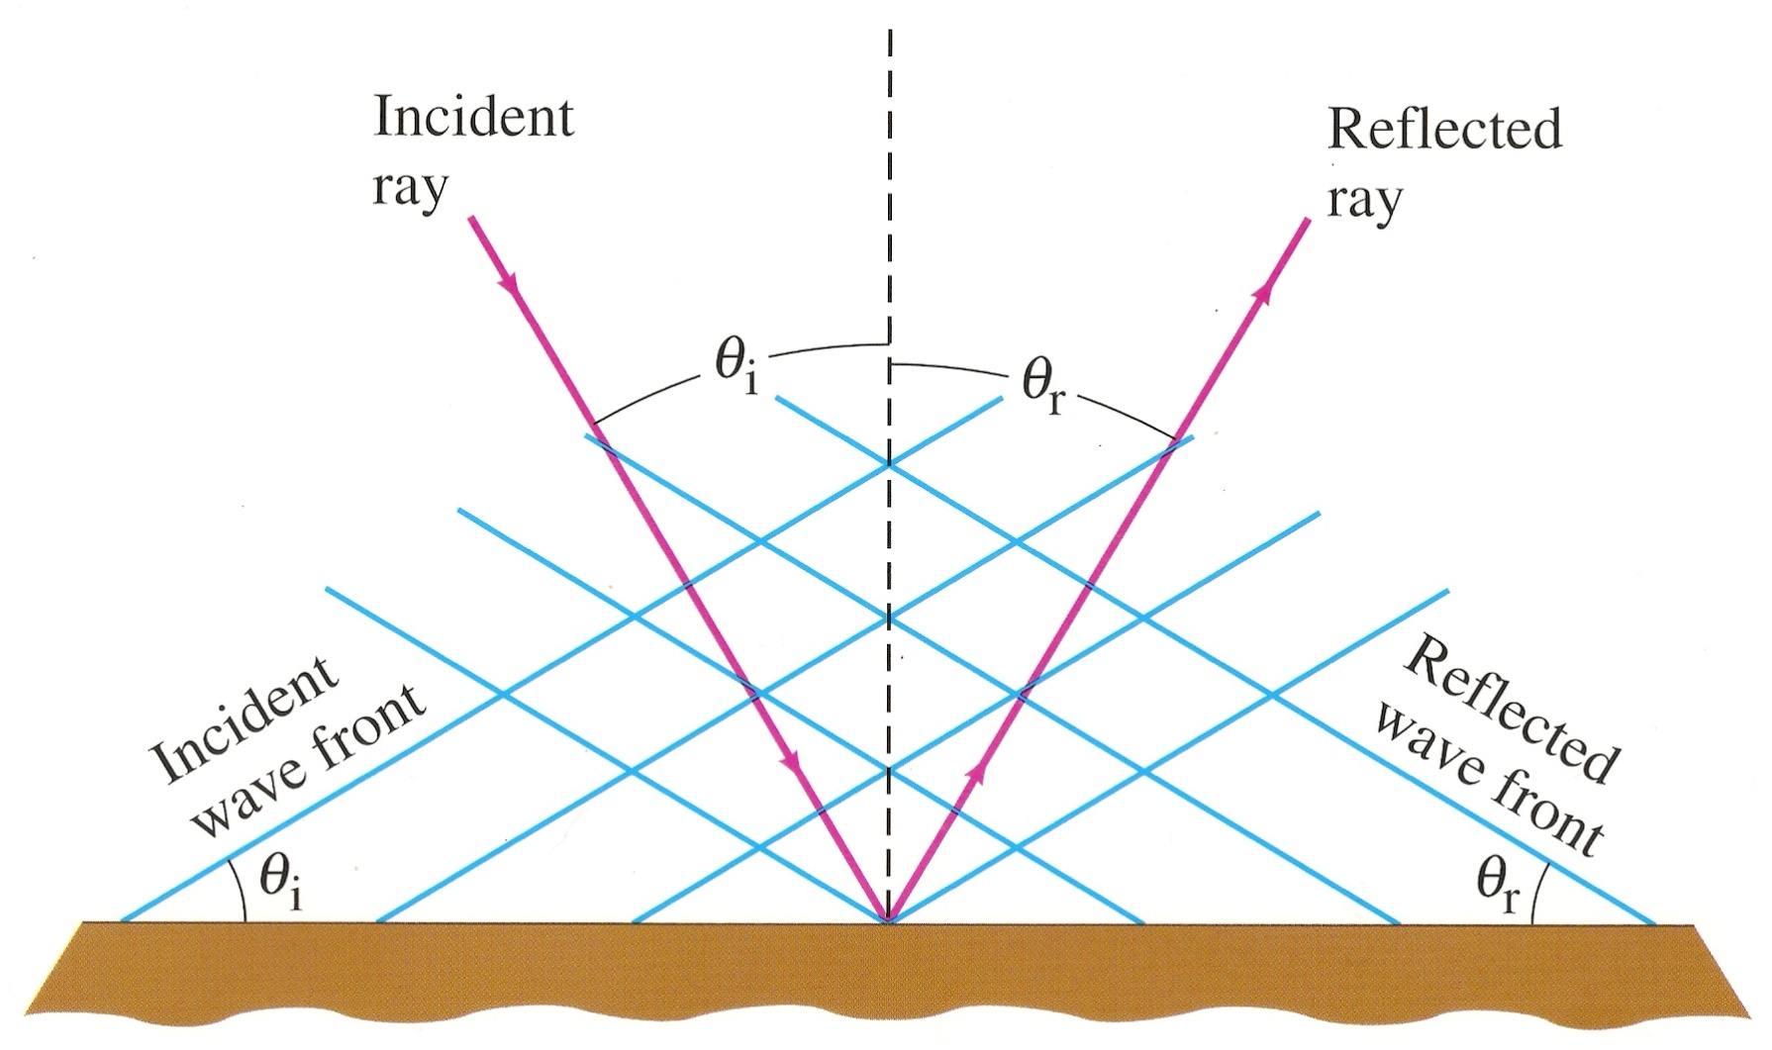
Law of Reflection
Remember that we are talking about incident rays and reflected rays, not wavefronts.

Slide 27
Law of Reflection
What happens when a reflected wave runs into an incident wave?

Slide 28
Interference and . . .
. . . SUPERPOSITION

Slide 29
Interference and Superposition

Slide 30
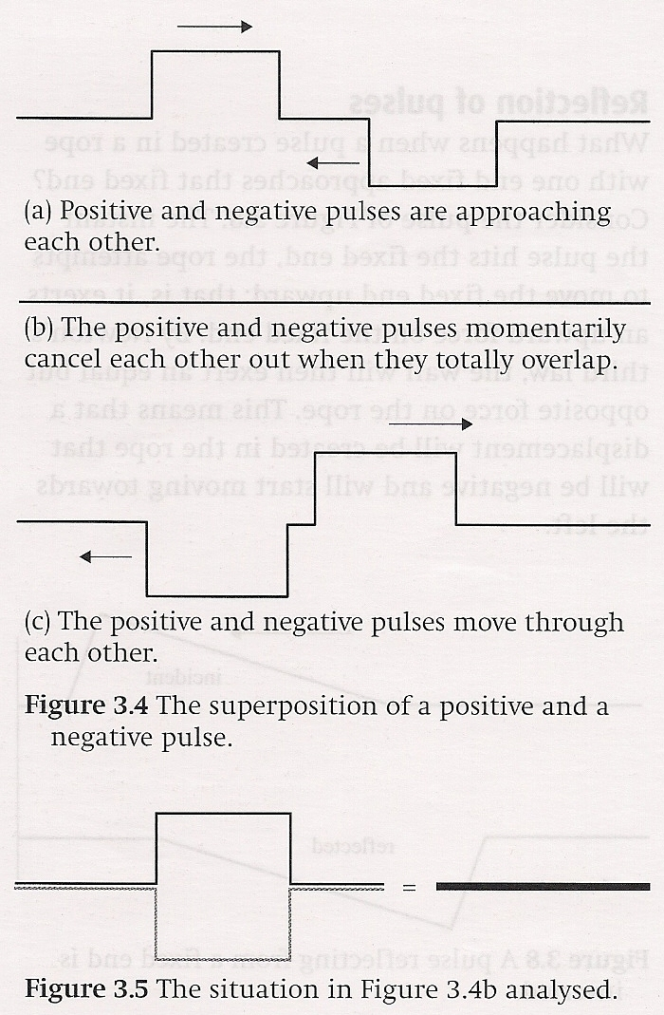
The Principle of Superposition
When two or more pulses meet, the displacement at that point is the algebraic sum of the individual displacements
Superposition of two opposite, but equal pulses

Slide 31
The Principle of Superposition
Superposition of two positive and unequal pulses

Slide 32
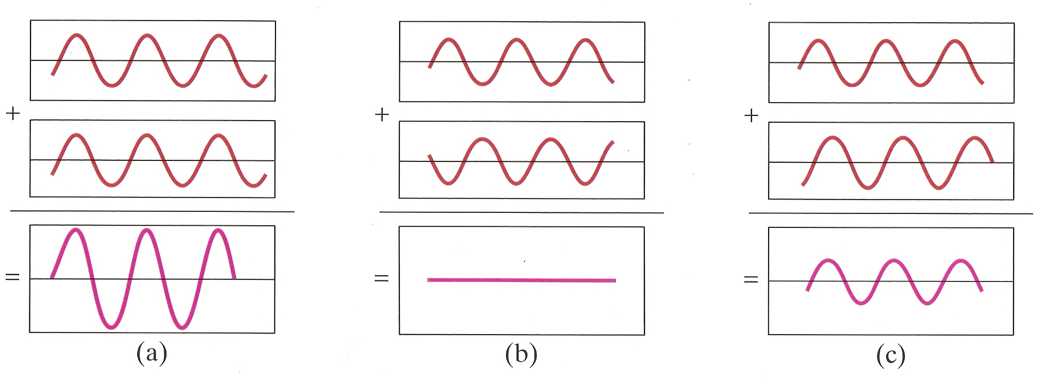
The Principle of Superposition
Superposition of two identical waves, 3 cases

Slide 33
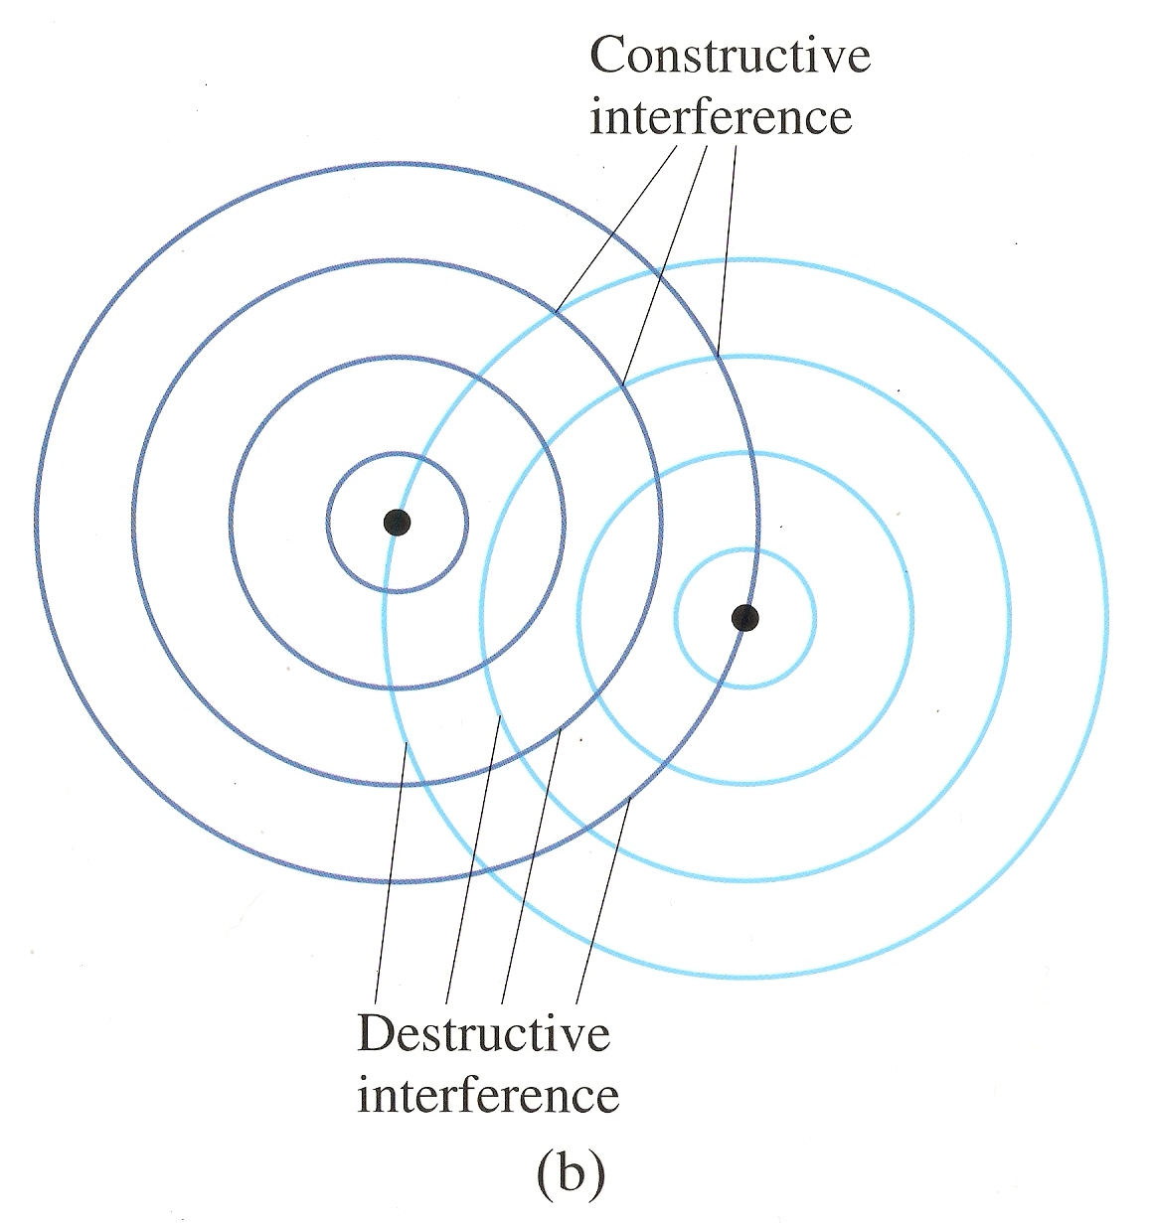
The Principle of Superposition
Trough
Crest
Superposition of two identical spherical / cylindrical waves from two different sources

Slide 34
Standing Waves
When the Law of Reflection is combined with the Principle of Superposition, we get . . . . .

Slide 35
Standing Waves
When the Law of Reflection is combined with the Principle of Superposition, we get . . . . .
STANDING WAVES

Slide 36
World Record Standing Wave

Slide 37
Standing Waves

Slide 38
Making Standing Waves

Slide 39
Standing Waves on Strings
“When two waves of the same speed and wavelength and equal, or almost equal, amplitudes travelling in opposite directions meet, a standing wave is formed.”
“This wave is the result of the superposition of the two waves travelling in opposite directions.”

Slide 40
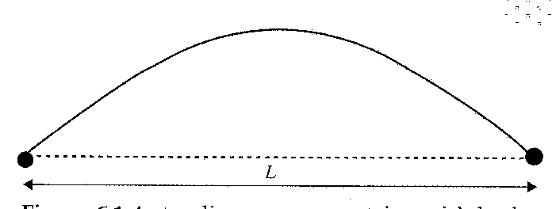
Standing Waves on Strings
Difference between standing and traveling waves
No energy or momentum is transferred in a standing wave
Standing wave has points where the displacement is always zero (nodes)
Points of maximum displacement are called antinodes

Slide 41
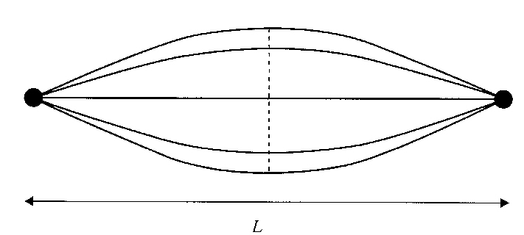
Standing Waves on Strings
A standing wave with a single antinode is known as a fundamental standing wave
When the string is in the stretched position, all of its energy is potential energy
When the string is in its unstretched position, all the energy is kinetic energy

Slide 42
Standing Waves on Strings
In this picture, there is one-half of one wavelength depicted
Therefore, the wavelength is:

Slide 43
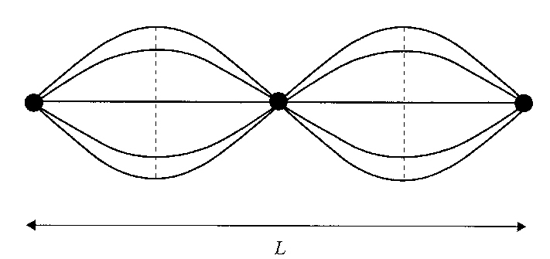
Standing Waves on Strings
This picture also depicts a standing wave, with one entire wavelength between the ends
The string has three nodes and two antinodes
The wavelength is:

Slide 44
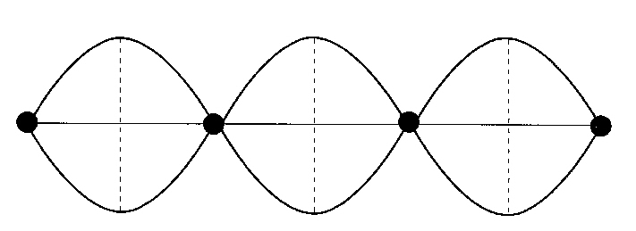
Standing Waves on Strings
This standing wave has four nodes and three antinodes
The wavelength is:

Slide 45
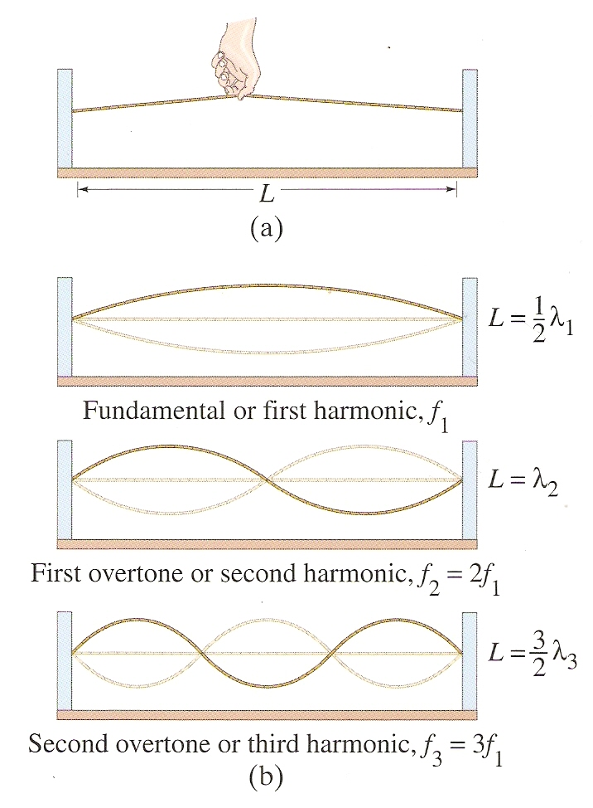
Standing Waves on Strings

Slide 46
Standing Waves on Strings
A general formula for finding the wavelength of a string with both ends fixed is:
n is called the mode and n = 1 is call the fundamental mode or first harmonic of the string

Slide 47
Standing Waves on Strings
There is a frequency associated with the fundamental mode called, coincidentally, the fundamental or natural frequency (f_{n})
All other harmonics will have frequencies that are integral multiples of f_{n}

Slide 48
Standing Waves on Strings
Note that the smallest frequency is associated with the fundamental mode (largest wavelength)

Slide 49
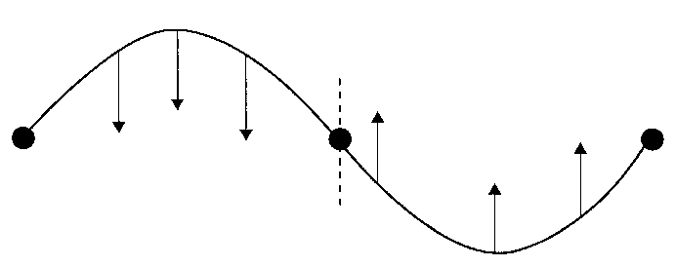
Standing Waves on Strings
All points between two consecutive nodes move in the same direction
Particles between adjacent nodes move in the opposite direction

Slide 50
Fun With PhET

Slide 51
Standing Waves in Tubes
Same as waves on a string
Open end – string free - antinode
Closed end – string fixed - node

Slide 52
Standing Waves in Tubes
General Principle:
As the length of the tube gets smaller the wavelength for each harmonic gets smaller
Assuming constant wave speed (like sound), the smaller the wavelength, the higher the frequency
Think of the sound made when filling up a bottle of water

Slide 53
Learning Objective(s):
The student is able to make claims and predictions about the net disturbance that occurs when two waves overlap. Examples should include standing waves.
The student is able to construct representations to graphically analyze situations in which two waves overlap over time using the principle of superposition.

Slide 54
Learning Objective(s):
The student is able to use representations of individual pulses and construct representations to model the interaction of two wave pulses to analyze the superposition of two pulses.
The student is able to design a suitable experiment and analyze data illustrating the superposition of mechanical waves (only for wave pulses or standing waves).

Slide 55
Learning Objective(s):
The student is able to design a plan for collecting data to quantify the amplitude variations when two or more traveling waves or wave pulses interact in a given medium.
The student is able to analyze data or observations or evaluate evidence of the interaction of two or more traveling waves in one or two dimensions (i.e., circular wave fronts) to evaluate the variations in resultant amplitudes.

Slide 56
Learning Objective(s):
The student is able to refine a scientific question related to standing waves and design a detailed plan for the experiment that can be conducted to examine the phenomenon qualitatively or quantitatively.
The student is able to predict properties of standing waves that result from the addition of incident and reflected waves that are confined to a region and have nodes and antinodes.

Slide 57
Learning Objective(s):
The student is able to plan data collection strategies, predict the outcome based on the relationship under test, perform data analysis, evaluate evidence compared to the prediction, explain any discrepancy and, if necessary, revise the relationship among variables responsible for establishing standing waves on a string or in a column of air.
The student is able to describe representations and models of situations in which standing waves result from the addition of incident and reflected waves confined to a region.

Slide 58
Learning Objective(s):
The student is able to challenge with evidence the claim that the wavelengths of standing waves are determined by the frequency of the source regardless of the size of the region.
The student is able to use a visual representation to explain how waves of slightly different frequency give rise to the phenomenon of beats.

Slide 59
Learning Objective(s):
The student is able to calculate wavelengths and frequencies (if given wave speed) of standing waves based on boundary conditions and length of region within which the wave is confined, and calculate numerical values of wavelengths and frequencies. Examples should include musical instruments.

Slide 60
Essential Knowledge(s):
When two waves cross, they travel through each other; they do not bounce off each other. Where the waves overlap, the resulting displacement can be determined by adding the displacements of the two waves. This is called superposition.
Two or more wave pulses can interact in such a way as to produce amplitude variations in the resultant wave. When two pulses cross, they travel through each other; they do not bounce off each other. Where the pulses overlap, the resulting displacement can be determined by adding the displacements of the two pulses. This is called superposition.

Slide 61
Essential Knowledge(s):
Two or more traveling waves can interact in such a way as to produce amplitude variations in the resultant wave.
Standing waves are the result of the addition of incident and reflected waves that are confined to a region and have nodes and antinodes. Examples should include waves on a fixed length of string, and sound waves in both closed and open tubes.

Slide 62
Essential Knowledge(s):
The possible wavelengths of a standing wave are determined by the size of the region to which it is confined.
A standing wave with zero amplitude at both ends can only have certain wavelengths. Examples should include fundamental frequencies and harmonics.
Other boundary conditions or other region sizes will result in different sets of possible wavelengths.

Slide 63
Essential Knowledge(s):
Essential Knowledge 6.D.5: Beats arise from the addition of waves of slightly different frequency.
Because of the different frequencies, the two waves are sometimes in phase and sometimes out of phase. The resulting regularly spaced amplitude changes are called beats. Examples should include the tuning of an instrument.
The beat frequency is the difference in frequency between the two waves.

Slide 64
Enduring Understanding(s):
Only waves exhibit interference and diffraction.
Interference and superposition lead to standing waves and beats.

Slide 65
Big Idea(s):
Waves can transfer energy and momentum from one location to another without the permanent transfer of mass and serve as a mathematical model for the description of other phenomena.

Slide 66
Questions?

Slide 67
Homework
#51-61

